Slide 1
Sensitivity and Specificty
Will Doyle

Slide 2
Evaluating Classifiers
A good classifier will accurately predict group membership
There are well known tradeoffs in creating classifiers
Some classifiers are very good at predicting group membership– this is called having high sensitivity
Some classifiers are very good predicting when someone is NOT in a group– this is called having high specificty

Slide 3
Example: Purchasing a Product
 | Actual Outcome: Purchased | Actual Outcome: Did not purchase
 | 25 | 75

Slide 4
Example: Purchasing a Product Classifier is Sensitive, but not Specific
 | Actual Outcome: Purchased | Actual Outcome: Did not purchase
Predicted Outcome: Purchased | 25 | 75
Predicted Outcome: Did not Purchase | 0 | 0

Slide 5
Example: Purchasing a Product Classifier is Specific but not Sensitive
 | Actual Outcome: Purchased | Actual Outcome: Did not purchase
Predicted Outcome: Purchased | 0 | 0
Predicted Outcome: Did not Purchase | 25 | 75

Slide 6
Sensitivity and Specificity
A good classifier will be both sensitive AND specific
But it’s not easy
We can vary the model, of course
We can also vary the classification threshold from 0 to 1

Slide 7
Receiver Operator Characteristic Curve
Calculates sensitivity AND 1-specificity over a range of classification thresholds
Thresholds go from 0-1
The measure of AUC (Area Under Curve) measures how well the model classifies at every threshold
A perfect classifier will have an AUC of 1 (never actually happens)
A random classifier will have an AUC of .5

Slide 8
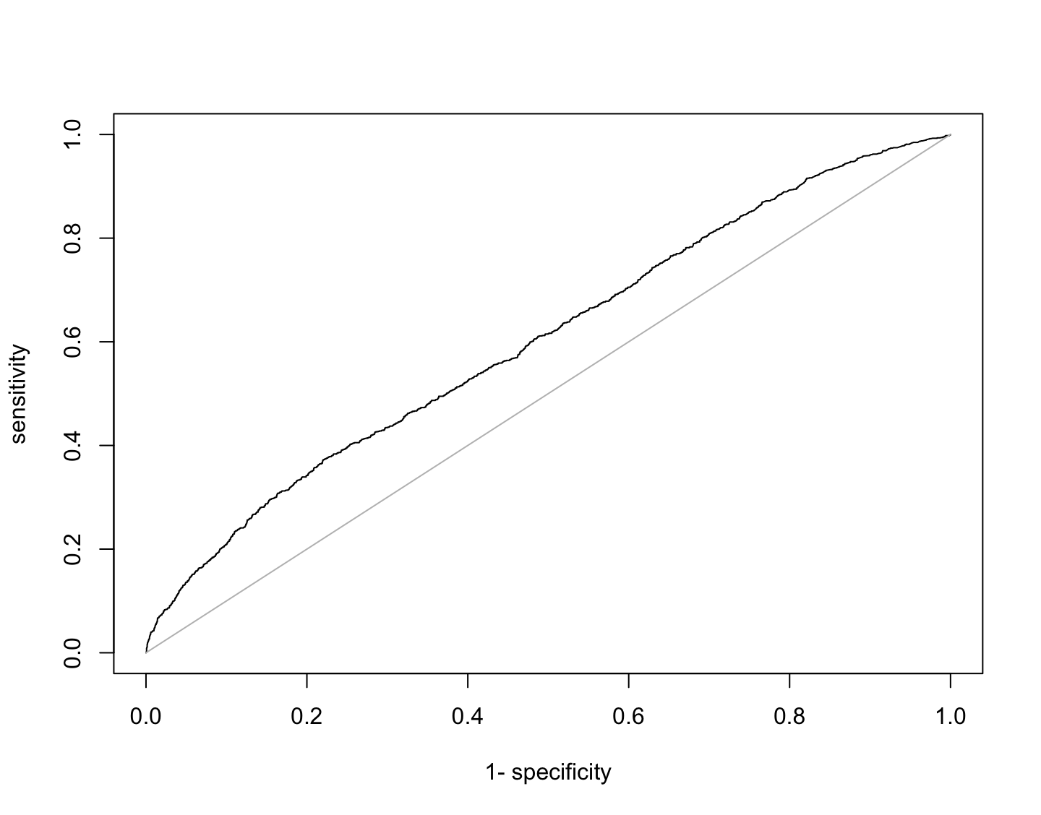
ROC and AUC

