Slide 1
Perceptions of Income Share Agreements: Evidence from a Public Opinion Survey
Jennifer A. Delaney, University of Illinois at Urbana-Champaign
Elizabeth A. Bell, University of Oklahoma
Maria Claudia Soler Salazar, University of Illinois at Urbana-Champaign
Notes:
Acknowledge co-authors
Back a boiler at purdue -2 million
24 states considering, 9 states with repeated introduction
3 states NJ OR IL seriously considering

Slide 2
Question Wording
Question Wording | Measurement
Like a student loan, income share agreements (ISAs) provide money for college to students. Unlike loans, though, ISAs charge no interest. Instead, students agree to pay a certain percentage of their incomes for a set number of years (typically 10 years) following graduation. Under these plans, it is possible for students who earn high incomes after graduation to end up paying more than the price of their education. However, students who earn lower incomes after graduation may end up paying less than the cost of their education. Do you support or oppose ISAs? | 5 – Strongly Support 4 – Somewhat Support 3 – Neither Support nor Oppose 2 – Somewhat Oppose 1 – Strongly Oppose
Notes:
Six questions: This one, wish I had, then support, then who (govt, private, unis) then is it right?

Slide 3
Question 1: What is the level of public support/opposition to ISAs?
Support or oppose ISAs?
Wish you had an ISA?
44% of individuals agree or somewhat agree with wishing that they had an ISA
46% of individuals support ISAs.
31% indicated that they neither support or oppose ISAs.
22% of individuals oppose ISAs.

Slide 4
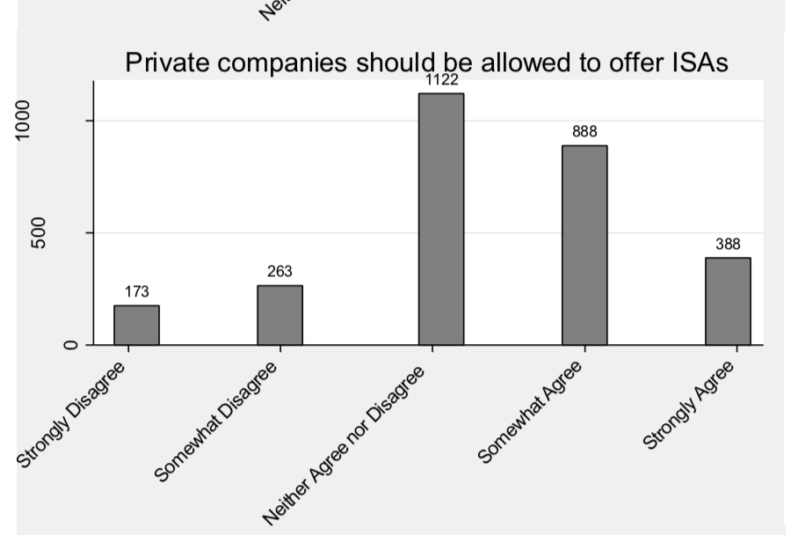
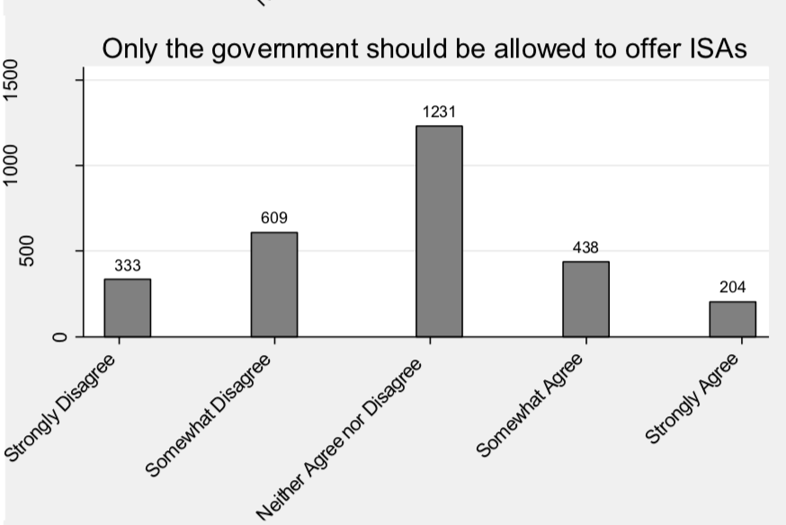
Results: Who should offer ISAs?

Slide 5
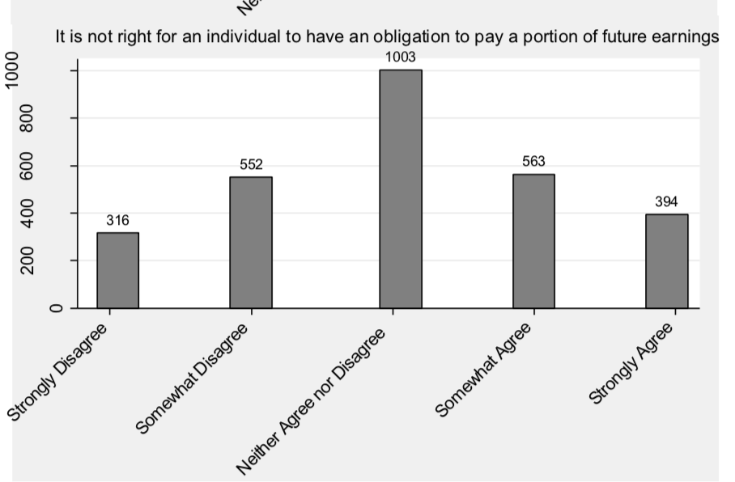
Results: Does the Public Think ISAs are Fair?

Slide 6
Research Question
What is the level of public support/opposition to ISAs?
What are the factors driving public support/opposition to ISAs?

Slide 7
Method: Public Opinion Polling on ISAs
Survey
2,850 respondents over the age of 18 in November 2017.
Online, cross-sectional public opinion data matching demographic proportions to the U.S. Census.
Qualtrics
Standard post-stratification weighting.
Notes:
The survey underlying this analysis was completed by 2,850 respondents over the age of 18 in November 2017.
Set quota for over 50% of respondents to be parents of school age children (age 5-25) in order to ensure that the vast majority of respondents had experience with educational issues.
The respondents were recruited by Qualtrics based on Internet-based pools of respondents who were selected according to matching demographic proportions to the U.S. Census.
Online, cross-sectional public opinion data for a large sample of U.S. residents
Each sample from the panel base is randomized to avoid source bias and proportional to the general population in order to ensure the sample reflect the demographics of the national population.
Used standard post-stratification weighting.

Slide 8

Question 2: What are the factors driving public support/opposition to ISAs?
Table 3: ISA Support - Logistic Regression Results
 | (1)
 | ISA Support
Education-Bachelor's Degree or Higher | 0.414**
 | (0.123)
Private School Vouchers Support Dummy | 0.227*
 | (0.113)
Child in College | -0.481*
 | (0.208)
Pell Grant Support Dummy | 0.919**
 | (0.155)
Tuition-Free College Support Dummy | 0.572**
 | (0.133)
Deferred Tuition Support Dummy | 0.601**
 | (0.125)
Too Much Emphasis on Affordability | 0.361*
 | (0.147)
Too Much Emphasis on Workforce Development | 0.294*
 | (0.143)
Constant | -2.204**
 | (0.321)
Observations | 2,801
Notes:
Table shows only significant responses.
Positive relationships with ISA support:
Educational Background:
Having a Bachelor’s degree or higher level of educational attainment is associated with a 0.41 increase in the log odds of a respondent supporting ISAs.
K-12 Policy Support:
The log odds of supporting ISAs increased by approximately 0.23 for respondents who support private school vouchers in K-12 schools.
Higher Education Policy Support:
The log odds of supporting ISAs increased by approximately 0.92 for respondents who supported Pell grants,
by 0.57 for respondents who support tuition-free college,
and by 0.60 for respondents who support deferred tuition.
For respondents who believed there was too much emphasis on affordability, the log odds of ISA support increased by approximately 0.36.
For respondents who believed there was too much emphasis on workforce development, the log odds of ISA support increased by 0.29.
Negative relationships with ISA support:
Being the parent of a college student:
Having a child currently attending college decreased the log odds of supporting ISAs by approximately 0.48.
Insignificant factors:
Many of the demographic variables such as race, gender, age, income, employment, and region are not significantly related to ISA support.
Respondents who have student loans are not more or less likely to support ISAs.
The political variables capturing voter engagement and ideology are insignificant in predicting ISA support.
Respondents who indicated support for charter schools were not more or less likely to support ISAs.
In contrast, respondents who have had children attend college in the past were no more or less likely to support ISAs.
Additionally, when we break down the type of college respondents’ children have attended in the past or are currently attending, no significant relationships emerge.
Respondents who thought that universities place too much emphasis on teaching, research, athletics, tolerance, affirmative action, or free speech were not more or less likely to support ISAs.

Slide 9
Summary
46% of individuals support ISAs, with many neither supporting or opposing
Factors associated with ISA support/opposition:
Respondents’ experiences with financing their own higher education are more likely to support ISAs
However, experiences with sending children to college are less likely to support ISAs.
Respondents who support K-12 private school vouchers, Pell Grants, tuition-free college, and deferred tuition are more likely to support ISAs.
Respondents who believed there was too much emphasis on affordability and workforce development by colleges were more likely to support ISAs.

Slide 10
Future Research
Examine the mechanisms through which individuals learn about ISAs.
Consider the effect that the existing ISAs programs have on college access and attainment.
Explore how ISAs might lead to issues related to the selection of specific fields of study or types of degrees.
Explore how ISA policies might interact with other financial aid and higher education policies.

Slide 11
References
Delaney, Jennifer A. & Dharmapala, Dhammika (2017). 'Pay it Forward' and Higher Education Subsidies: A Median Voter Model. Contemporary Economic Policy, 35(4), 615-629.
Fain, Paul. 2017. “More Colleges Try Income-Share Agreements.” 2017. Washington, DC> Inside Higher Ed. https://www.insidehighered.com/quicktakes/2017/12/15/more-colleges-try-income-share-agreements.
Illinois Student Assistance Commission. 2014. “An Analysis of the Feasibility of an Illinois Pay It Forward Program. As Directed by Public Act 98-920. Report to the Illinois General Assembly.” Deerfield, IL: Illinois Student Assistance Commission. https://www.isac.org/dotAsset/1b1c678e-6a2e-463c-bfaa-f3265d9c87ec.pdf.
Krantowitz, Mark 2013. “Comments on Oregon plan would shift tuition payment after graduation” Inside Higher Ed. http://www.insidehighered.com/news/2013/07/09/oregon-plan-would-shift-tuition-payment-after-graduation
Lackawanna College. 2017. “Lackawanna College Launches Innovative Student Financing Solution.” 2017. Scranton, PA. http://www.lackawanna.edu/campus-news/lackawanna-college-launches-innovative-student-financing-solution/.
Long, Bridget, and Erin Riley. 2007. “Financial Aid: A Broken Bridge to College Access?” Harvard Educational Review 77, no 1. (October): 39–63.
Palacios, Miguel, Tonio DeSorrento, and Andrew P. Kelly. 2014. “Investing in Value, Sharing Risk. Financing Higher Education through Income Share Agreements.” Reinventing Financial Aid. Center on Higher Education Reform. American Enterprise Institute. February 2014. Washington, DC: American Institutes for Research. http://www.aei.org/files/2014/02/26/-investing-in-value-sharing-in-risk-financing-higher-education-through-inome-share-agreements_083548906610.pdf.
Roose, K. (November 19, 2013) “The IPO of you and me: How normal people are becoming corporations” New York Magazine http://nymag.com/daily/intelligencer/2013/11/ipo-of-you-and-me.html
Scott-Clayton, Judith. 2018. “The Looming Student Loan Default Crisis Is Worse than We Thought.” January 2018. Washington, DC: Brookings Institution. https://www.brookings.edu/research/the-looming-student-loan-default-crisis-is-worse-than-we-thought/.

Slide 12
Jennifer A. Delaney University of Illinois at Urbana-Champaign
delaneyj@Illinois.edu

Slide 13
Logistic Regression Results – ISA support
Positive relationships with ISA support:
Educational Background:
Having a Bachelor’s degree or higher level of educational attainment is associated with a 0.41 increase in the log odds of a respondent supporting ISAs.
K-12 Policy Support:
The log odds of supporting ISAs increased by approximately 0.23 for respondents who support private school vouchers in K-12 schools.
Higher Education Policy Support:
The log odds of supporting ISAs increased by approximately 0.92 for respondents who supported Pell grants,
by 0.57 for respondents who support tuition-free college,
and by 0.60 for respondents who support deferred tuition.
For respondents who believed there was too much emphasis on affordability, the log odds of ISA support increased by approximately 0.36.
For respondents who believed there was too much emphasis on workforce development, the log odds of ISA support increased by 0.29.

Slide 14
Logistic Regression Results – ISA support
Negative relationships with ISA support:
Being the parent of a college student:
Having a child currently attending college decreased the log odds of supporting ISAs by approximately 0.48.

Slide 15
Logistic Regression Results – ISA support
Insignificant factors:
Many of the demographic variables such as race, gender, age, income, employment, and region are not significantly related to ISA support.
Respondents who have student loans are not more or less likely to support ISAs.
The political variables capturing voter engagement and ideology are insignificant in predicting ISA support.
Respondents who indicated support for charter schools were not more or less likely to support ISAs.
In contrast, respondents who have had children attend college in the past were no more or less likely to support ISAs.
Additionally, when we break down the type of college respondents’ children have attended in the past or are currently attending, no significant relationships emerge.
Respondents who thought that universities place too much emphasis on teaching, research, athletics, tolerance, affirmative action, or free speech were not more or less likely to support ISAs.

Slide 16
Significant Difference of Means Tests
Race and education were significantly associated with ISA support. Specifically, the mean for ISA support among respondents who identified as White was approximately 0.25 lower than Non-White respondents.
The average level of ISA support for Black respondents was approximately 0.27 higher than Non-Black respondents.
Hispanic respondents were no more or less likely to support ISAs when compared with non-Hispanic respondents.
ISA support mean for respondents with a Bachelor’s degree or higher was significantly 0.14 higher than respondents with lower levels of educational attainment.
Respondents who currently have or have had student loan debt in the past had a significantly higher average level of ISA support (approximately 0.17) when compared with respondents that never had student loans.
The average response for ISA support for respondents currently paying off student loan debt is almost half a point higher on the 5-point support scale than respondents that paid off their student loans (approximately 0.42).

Slide 17
Significant Difference of Means Tests
Respondents that are currently paying off student loans are also more likely to support ISAs than respondents that have never had student loans by a significant magnitude (approximately 0.38).
The mean level of ISA support for respondents who identified as somewhat, strongly, or slightly conservative was approximately 0.28 lower than those identifying as middle of the road or liberal.
The average level of ISA support is 0.22 lower for respondents with children currently in college when compared with all other respondents.
Respondents who support tuition-free college, Pell grants, and deferred tuition programs are significantly more likely to support ISAs.
The average level of ISA support for respondents who support tuition-free college and deferred tuition policies is 0.47 higher than respondents who did not support these policies.
Moreover, the average level of ISA support for respondents who supported the Pell grant is over half a point higher (0.56) than the average ISA support for respondents that did not support this policy.

Slide 18
Discussion
Educational Background:
Respondents who have earned a Bachelor’s degree may be more likely to appreciate the value of a college education and be more receptive to financing mechanisms that provide an alternative to traditional student loans.
A connection between facing challenges to finance higher education and dealing with debt may make individuals more likely to support alternative mechanisms to finance education.
Race:
Black respondents are more likely to support ISAs.
This may be due to the fact that minority groups face more barriers to financing higher education, compared to White students, and as a result may be more open to alternatives such as private loans and credit cards.
Blacks students tend to borrow more than White students (Long and Riley 2007),
default at five times the rate of White Bachelor’s graduates,
and are more likely to default than White dropouts (Scott-Clayton 2018).
Therefore, Black respondents may be more receptive to ISAs based on the negative experiences with student loans or other riskier forms of financing higher education.

Slide 19
Discussion
Parents of Children in College:
Respondents with children currently in college are less likely to support ISAs.
Most respondents with children tend to support free-tuition policies and they may be more likely to reject mechanisms such as ISAs.
Higher Education Finance Policies:
Support for Pell grants, tuition-free college, and deferred tuition are positively related to ISA support.
All of these programs aim to increase the affordability of higher education institutions, which likely elicits support from respondents who are worried that college has become too expensive.
Higher Education Institution Policies:
There is a positive association between ISAs support and beliefs that people have about other institutional policies on affordability and workforce development.

Slide 20
Discussion
Political Ideology:
Conservatives are more likely to oppose ISAs.
This is a surprising finding given that ISA-related bills have been supported by Republicans such as Senators Marco Rubio (R-FL) and Todd Young (R-IN).
It is possible that the explanation for this finding relies on the relatively new nature of ISAs and individuals not having in-depth knowledge of ISAs.
K-12 Policies:
Respondents who support private school vouchers in K-12 education were more likely to support ISAs.
This result likely captures respondents who support the disruptive innovation that the influx of private investment and institutions brings to the education market.

Slide 21
What Are Income Share Agreements?
Student Loan Context
More than 38% of all 2015-16 undergraduates took out student loans,
Total student loan debt of over $1.3 trillion,
A projected cumulative student loan default rate of nearly 40 percent by 2023.
“Loan alternatives”
Income Share Agreements (ISAs) are income contingent financing mechanisms that provide individuals with access to capital to pay for college after individuals commit to pay a specified percentage of their future income.
Notes:
ISAs are an emerging and controversial mechanism for financing college.

Slide 22
U.S. ISA Policy Landscape
ISAs have gained bipartisan attention at fed level & state level
Pay it Forward (PIF) legislation spread to 24 states before January 1, 2015 (Illinois Student Assistance Commission 2014; Delaney and Dharmapala 2017)
Debate
Downside protections: ISAs may make it easier for students of all backgrounds to obtain financing, especially among credit-constrained and debt-averse students (Palacios, DeSorrento, and Kelly 2014).
However, others criticize ISAs as modern day indentured servitude (Krantowitz, 2013; Roose, 2013).

