Slide 1

Application of
The Belmont Principles of
Respect for Persons, Beneficence and Justice
David M Asmuth, MD
Division of Infectious Diseases
IRB Committee A Chair
CTSC co-Director of PCIR & RKS

Slide 2
Origins of Human Subject Research Ethics
Hippocrates (~400 B.C.)
  medical practice and medical ethics.
  physicians should “abstain from whatever is deleterious and mischievous.”
  purely observational in nature, his writings did not deal with research or experimentation with human subjects and therefore did not mention the principle of informed consent.
William Beaumont (1833)
  Oldest American document dealing with research observing digestive phenomena through a hole in a gun-shot wound survivor’s stomach.
  Experimentation is needed; information cannot be otherwise obtained but the investigator must be conscientious and responsible; methodological approach; no random studies.
  voluntary consent is necessary.
  discontinuation of experiment when it causes distress to the subject.

Slide 3
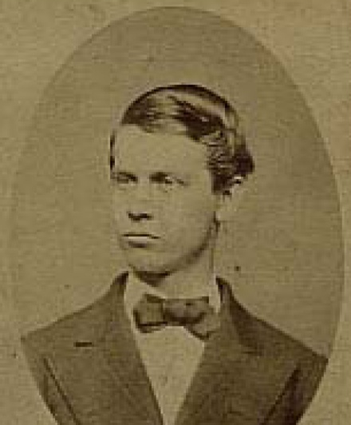
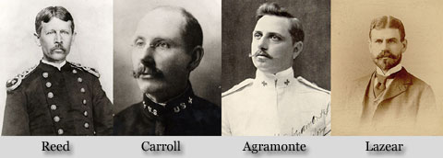
Walter Reed and the Yellow Fever Experiments – Camp Lazear, Cuba: 1901
Graduating from Medical School at the age of 18, he sought more clinical experience at Belview Hospital in NY and soon gained an interest in public health. When Major Walter Reed and Acting Assistant Surgeons James Carroll, Aristides Agramonte, and Jesse Lazear gathered on the porch of the Columbia Barracks Hospital in June of 1900 on the outskirts of Havana, they designed a series of controlled experiments to learn whether mosquitoes were the vector for the appalling plague that was yellow fever. At the time, yellow fever was responsible for thousands of deaths in the Caribbean and along the coast of the US.
After 4 unsuccessful attempts to transmit the disease by mosquitoes that had fed on infected individuals, Lazear and Carroll became infected when the mosquitoes had been allowed to ‘mature’ for 12 days prior to the feedings.
Reed was in Washington at the
time of these ‘successful’ exper-
iments and after the death of
Lazear, withdrew his plans to
be a subject.

Slide 4
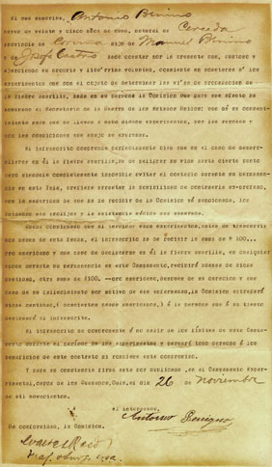
Antonio Benino
The undersigned, Antonio Benino being more than twenty-five years of age, native of Cerceda, in the province of Corima, the son of Manuel Benino and Josefa Castro here states by these presents, being in the enjoyment and exercise of his own very free will, that he consents to submit himself to experiments for the purpose of determining the methods of transmission of yellow fever, made upon his person by the Commission appointed for this purpose by the Secretary of War of the United States, and that he gives his consent to undergo the said experiments for the reasons and under the conditions below stated.
The undersigned understands perfectly well that in case of the development of yellow fever in him, that he endangers his life to a certain extent but it being entirely impossible for him to avoid the infection during his stay in this island, he prefers to take the chance of contracting it intentionally in the belief that he will receive from the said Commission the greatest care and the most skillful medical service.
It is understood that at the completion of these experiments, with-
in two months from this date, the undersigned will receive the sum of $100 in American gold and that in case of his contracting yellow fever at any time during his residence in this camp, he will receive in addition to that sum a further sum of $100 in American gold, upon his recovery and that in case of his death because of this disease, the Commission will transmit the said sum (two hundred American dollars) to the person whom the undersigned shall designate at his convenience.
The undersigned binds himself not to leave the bounds of this camp
during the period of the experiments and will forfeit all right to the
benefits named in this contract if he breaks this agreement.
And to bind himself he signs this paper in duplicate, in the Experimental Camp, near Quemados, Cuba, on the 26th day of November nineteen hundred.
The contracting party,
Antonio Benino
On the part of the Commission:
Walter Reed - Maj. & Surg., U.S.A.

Slide 5
Origins of Human Subject Research Ethics
The 1900 Prussian Directive
Response to public debate on human subject experimentation that included work by Amauer Hansen (1841-1912) who pricked the eye with a needle contaminated by nodules of a leprous patient in his work towards the bacillus strain that causes leprosy.
The directive prohibited experiments in minors and those not fully competent, required unequivocal consent after explanation of the experiment and possible adverse consequences, and only allowed certain people do the research requiring written records.
Did not apply to medical treatment for diagnosis, therapy, or immunization
Eugenics and Nazi Era Experiments
The Eugenics movements in the US and Europe lead to thousands of sterilizations in the US and later led to the Nazi Prison camps atrocities.

Slide 6
Nuremberg Code of Medical Ethics
“first authoritative, most stringent pronouncement on the rights of research subjects” (Annas, 1992)
adopted by the World Medical Association in 1948
True informed consent; freely given; prior to experimental procedures and allow discontinuation of participation at any time
Truly necessary, well thought out experiments in which the expected benefits justify the risks and there is no unnecessary physical or mental suffering or injury
Requires that the person performing the research tasks be qualified
No experiment shall be undertaken where death or disabling injury will likely occur and with proper preparation and adequate facilities to protect subjects and prevent further injury
Upon observing the likely risk of injury, disability or death, the research should terminate the experiment

Slide 7
Beecher, H.K. Ethics and clinical medicine. 1966 New Engl J Med v274(24):1354-60
22 examples of recent publications in major medical journals where questionable ethical research methodologies had been employed
well known Tuskegee Syphilis Study (1932-1972)
600 subjects of whom 399 with untreated syphilis and a ‘control group’ without syphilis were only told they had ‘bad blood’
Willowbrook Hepatitis Experiments (1956-1980)
700 subjects – Parents provided consent and approval from NY Depts. of Mental Health and Mental Hygiene and NYU School of Medicine
Jewish Chronic Disease Study in Brooklyn, NY in 1964
22 subjects injected with cancer cells to learn about rejection process not told in order to not ‘alarm them unnecessarily.’
Not in the Beecher exposé but noteworthy are the experiments of Stanley Milgram conducted in the 1960’s relating to obedience to authority.

Slide 8
US Federal Regulations
Congressional Mandate via The National Research Act (July 1974) included:
1. The establishment of the Code of Federal Regulations (CFR) Part 46 Protection of Human Subjects, and
2. The creation of the National Commission for the Protection of Human Subjects. Congress’ charges to the National Commission included the following:
“. . .the Commission [is] to identify the basic ethical principles that should underlie the conduct of biomedical and behavioral research involving human subjects and to develop guidelines which should be followed to assure that such research is conducted in accordance with those principles.”

Slide 9

The Belmont Report
Experts in the field of human research ethics were assembled at the Smithsonian Institute Belmont House in Elkridge, MD in July, 1974.
The Commission was directed to consider:
the boundaries between biomedical and behavioral research and the accepted and routine practice of medicine,
the role of assessment of risk-benefit criteria in the determination of the appropriateness of research involving human subjects,
appropriate guidelines for the selection of human subjects for participation in such research and
the nature and definition of informed consent in various research settings.

Slide 10
The Belmont Principles
Respect for Persons. – Respect for persons incorporates at least two ethical convictions: first, that individuals should be treated as autonomous agents, and second, that persons with diminished autonomy are entitled to protection.
Beneficence. – Persons are treated in an ethical manner not only by respecting their decisions and protecting them from harm, but also by making efforts to secure their well-being. In this document, beneficence is understood in a stronger sense, as an obligation. Two general rules have been formulated as complementary expressions of beneficent actions in this sense: (1) do not harm and (2) maximize possible benefits and minimize possible harms.
Justice. – Who ought to receive the benefits of research and bear its burdens? This is a question of justice, in the sense of "fairness in distribution" or "what is deserved. "

Slide 11
The Belmont Principles: Respect for Persons
1. Double coverage: (a) respect for the free autonomous choices of competent persons and (b) special protection for those who lack or have a “diminished” level of autonomy.
2. Applications: This principle directly pertains to informed consent (IC) and explains why IC must encompass 3 components: information, comprehension, and voluntariness.

Slide 12
Respect for Persons & Informed Consent
Respect for persons requires that subjects, to the degree that they are capable, be given the opportunity to choose what shall or shall not happen to them. While the importance of informed consent is unquestioned, controversy prevails over the nature and possibility of an informed consent. Nonetheless, there is widespread agreement that the consent process can be analyzed as containing three elements:
information,
comprehension and
voluntariness.

Slide 13
Informed Consent: Information
Information. Most codes of research establish specific items for disclosure intended to assure that subjects are given sufficient information.
These items generally include:
a) the research procedure,
b) their purposes,
c) risks and anticipated benefits,
d) alternative procedures (where therapy is involved),
e) a statement offering the subject the opportunity to ask questions and to withdraw at any time from the research.
Additional items have been proposed, including how subjects are selected, the person responsible for the research, etc. However, a simple listing of items does not answer the question of what the standard should be for judging how much and what sort of information should be provided.

Slide 14
Information: what is the standard that should be used?
Information as that provided for procedures in the hospital is not sufficient. This is inadequate since research takes place precisely when a common understanding does not exist.
Another standard, currently popular in malpractice law, requires the practitioner to reveal the information that reasonable persons would wish to know in order to make a decision regarding their care. This, too, seems insufficient since the research subject, being in essence a volunteer, may wish to know considerably more about risks gratuitously undertaken than do patients who deliver themselves into the hand of a clinician for needed care.
It may be that a standard of "the reasonable volunteer" should be proposed: the extent and nature of information should be such that persons, knowing that the procedure is neither necessary for their care nor perhaps fully understood, can decide whether they wish to participate in the furthering of knowledge. Even when some direct benefit to them is anticipated, the subjects should understand clearly the range of risk and the voluntary nature of participation.

Slide 15
The Need for Informed Consent and Deception
A special problem of consent arises where informing subjects of some pertinent aspect of the research is likely to impair the validity of the research. In many cases, it is sufficient to indicate to subjects that they are being invited to participate in research of which some features will not be revealed until the research is concluded. In all cases of research involving incomplete disclosure, such research is justified only if it is clear that:
Incomplete disclosure is truly necessary to accomplish the goals of the research,
there are no undisclosed risks to subjects that are more than minimal, and
there is an adequate plan for debriefing subjects, when appropriate, and for dissemination of research results to them.
Information about risks should never be withheld for the purpose of eliciting the cooperation of subjects, and truthful answers should always be given to direct questions about the research.
Care should be taken to distinguish cases in which disclosure would destroy or invalidate the research from cases in which disclosure would simply inconvenience the Investigator.

Slide 16
Informed Consent: Comprehension
The manner and context in which information is conveyed is as important as the information itself.
For example, presenting information in a disorganized and rapid fashion, allowing too little time for consideration or curtailing opportunities for questioning, all may adversely affect a subject's ability to make an informed choice. Because the subject's ability to understand is a function of intelligence, rationality, maturity and language, it is necessary to adapt the presentation of the information to the subject's capacities.
Investigators are responsible for ascertaining that the subject has comprehended the information. While there is always an obligation to ascertain that the information about risk to subjects is complete and adequately comprehended, when the risks are more serious, that obligation increases. On occasion, it may be suitable to give some oral or written tests of comprehension. Special provision may need to be made when comprehension is severely limited -- for example, by conditions of immaturity or mental disability. Capacity assessment should be applied here.
http://www.ucdmc.ucdavis.edu/clinicaltrials/tools.html

Slide 17
Informed Consent: Surrogate Consent
Whenever possible, investigators will attempt to obtain informed consent directly from the subject.
The application reviewed by the IRB must detail a protocol-specific plan for the assessment of the decision-making capacity of the subject that will be conducted by the investigator for any subject who may qualify for surrogate consent.
Surrogate consent can be obtained from:
The person's agent designated by an advance health care directive
The conservator or guardian of the person having the authority to make health care decisions for the person
The spouse of the person
An individual as defined in Section 297 of the Family Code (Domestic partners)
An adult son or daughter of the person
A custodial parent of the person
Any adult brother or sister of the person
Any adult grandchild of the person
An available adult relative with the closest degree of kinship to the person

Slide 18
Informed Consent: Voluntariness
An agreement to participate in research constitutes a valid consent only if voluntarily given.
This element of informed consent requires conditions free of coercion and undue influence.
Coercion occurs when an overt threat of harm is intentionally presented by one person to another in order to obtain compliance.
Undue influence, by contrast, occurs through an offer of an excessive, unwarranted, inappropriate or improper reward or other overture in order to induce the potential volunteer to put themselves at a risk that they would otherwise not do.
Unjustifiable pressures usually occur when persons in positions of authority or commanding influence -- especially where possible sanctions are involved -- urge a course of action for a subject.
A continuum of such influencing factors exists, however, and it is impossible to state precisely where justifiable persuasion ends and undue influence begins. But undue influence would include actions such as manipulating a person's choice through the controlling influence of a close relative and threatening to withdraw health services to which an individual would otherwise be entitle.

Slide 19
The Belmont Principles: Beneficence
Persons are treated in an ethical manner not only by respecting their decisions and protecting them from harm, but also by making efforts to secure their well-being. Such treatment falls under the principle of beneficence. The term "beneficence" is often understood to cover acts of kindness or charity. In this document, beneficence is understood in a stronger sense, as an obligation. Two general rules have been formulated as complementary expressions of beneficent actions in this sense: (1) do not harm and (2) maximize possible benefits and minimize possible harms.

Slide 20
The Belmont Principles: Beneficence
1. Double coverage: the moral obligations to:
(a) maximize benefits for research
subjects and
(b) protect them from harm
2. Applications: systematic, explicit, and
thorough assessment of the probable or possible harms and benefits.

Slide 21





Beneficence
What kinds of harms are there?
Physical
Economical
Legal
Psychological
Privacy
versus
Confidentiality
Social

Slide 22









Beneficence - How is Harm Minimized and Benefit Maximized?
100%
100%
Likelihood
of harm
Likelihood
of benefit
0%
0%
Magnitude of harm
Magnitude of benefit
Risk is a function of both the probability and the magnitude of the harm whereas benefit can be thought of in terms of the opportunity to produce benefit.

Slide 23
The Belmont Principles: Justice
Who ought to receive the benefits of research and bear its burdens? This is a question of justice, in the sense of "fairness in distribution" or "what is deserved."
1. Belmont relies on the principle of justice (equality of treatment) to focus on injustice in two senses:
(a) the injustice of keeping persons from receiving what they deserve and
(b) imposing undue burdens on emotionally, socially, and economically disadvantaged persons.
2. Application: the selection/recruitment of research subjects

Slide 24
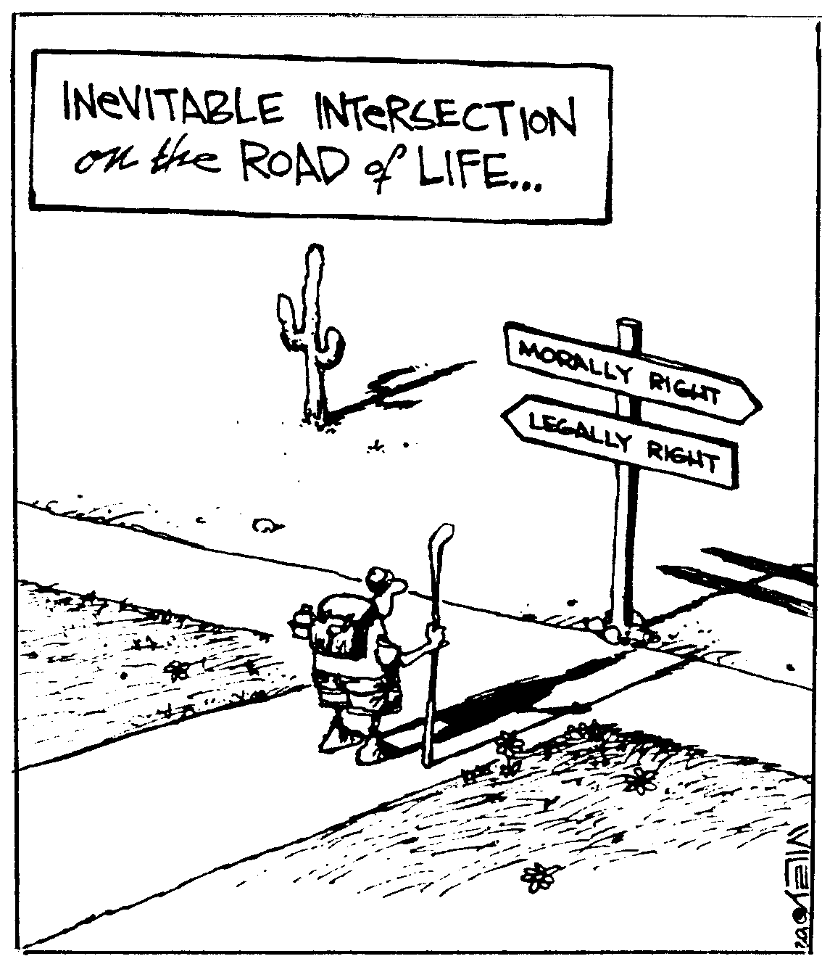
The Ethical Principles of The Belmont Report:
vs. the Federal Regulations in 45CFR Part 46

Slide 25
1. Risks to subjects are minimized
2. Risks to subjects are reasonable in relation to anticipated benefits, if any, to subjects, and the importance of the knowledge that may reasonably be expected to result.
3. Selection of subjects is equitable.
4. Informed consent will be sought from each prospective subject or the subject's legally authorized representative, in accordance with, and to the extent required by §46.116.
5. Informed consent will be appropriately documented, in accordance with, and to the extent required by §46.117.
6. When appropriate, the research plan makes adequate provision for monitoring the data collected to ensure the safety of subjects.
7. When appropriate, there are adequate provisions to protect the privacy of subjects and to maintain the confidentiality of data.
8. When some or all of the subjects are likely to be vulnerable to coercion or undue influence, such as children, prisoners, pregnant women, mentally disabled persons, or economically or educationally disadvantaged persons, additional safeguards have been included.
Respect
for Persons
2. Beneficence
3. Justice

Slide 26
Discussion Points
When does research not require IRB review?
Issues related to privacy and confidentiality.
Research into Standard of Care methodologies.

Slide 27
Is it Research?
Research is defined by federal regulations as a systematic investigation that contributes to generalizable knowledge (Common Rule 45CRF46:102d). If the goal of the intervention is entirely therapeutic, then it may not be research. Medicine includes many “experimental therapies” that are not treated as research. Students often conduct educational projects designed to teach research methods and techniques that may not be considered to be research.
Is it human subjects research? Research may involve human tissues but not human subjects. “A human subject is a living individual about whom an investigator… obtains data through interaction or intervention with the individual or identifiable private information.” Research on stored human tissue is not covered by current federal regulations and presents IRBs with some important ethical and policy dilemmas.

Slide 28
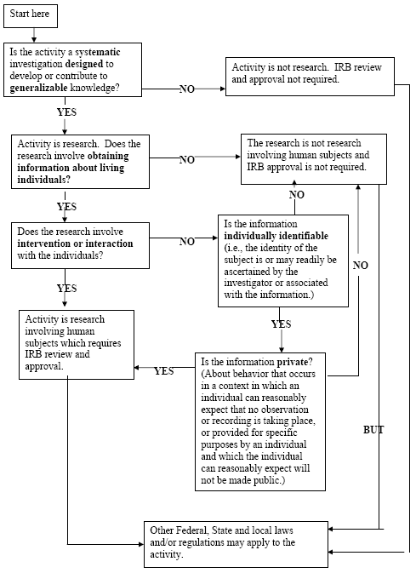
When are Scholarly Efforts not Research?
CQI
case reports
archived specimens
http://www.research.ucdavis.edu/home.cfm?id=OVC,1,1081,1433

Slide 29
Research versus Practice
a physician may alter the standard order of medications or a surgical technique to meet the needs of his/her patients.
what happens when the research is into minimal risk interventions or common steps in procedures that are not strictly defined or adhered to?
should different criteria exist for IRB review and the informed consent process?
do you think research ‘for the public good’ should be assessed with different or unique criteria?

Slide 30
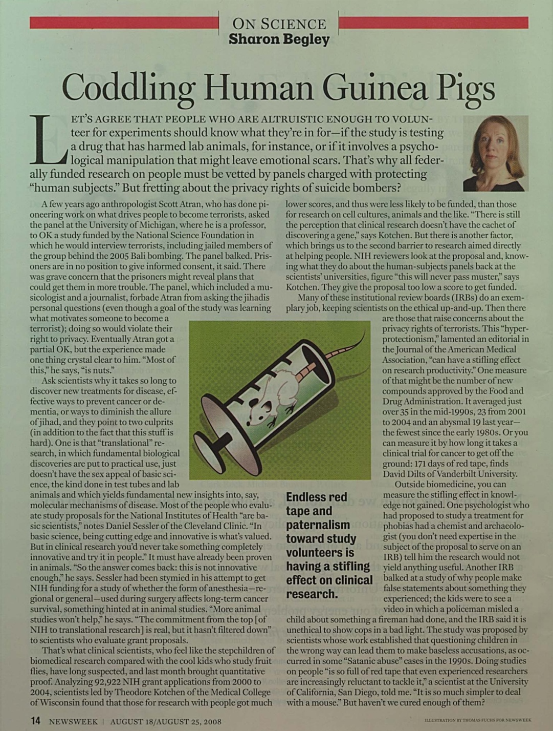
A few years ago, anthropologist Scott Atran, who has done pioneering work on what drives people to become terrorists, asked the panel at the University of Michigan, where he is a professor, to OK a study funded by the National Science Foundation (NSF) in which he would interview terrorists, including jailed members of the group behind the 2005 Bali bombing. The panel balked. Prisoners are in no position to give informed consent, it said. There was grave concern that the prisoners might reveal plans that could get them in more trouble. The panel, which included a musicologist and a journalist, forbade Atran from asking the jihadis personal questions (even though a goal of the study was learning what motivates someone to become a terrorist); doing so would violate their right to privacy.

Slide 31
Privacy versus Confidentiality
Privacy is about people and their freedom from unauthorized oversight or observation – ‘access to themselves.’ Privacy is in the eye of the subject; not the Investigator or the IRB – i.e., the subjects’ expectation.
Confidentiality is about data and the agreements with the participant about how data are to be handled. Main methods have to do with restricted access to data with passwords and perhaps Certificates of Confidentiality.

Slide 32
Additional Questions for Discussion:
Is the media paying too much, just enough or too little attention to questionable research with human subjects?
Do you think freedom of inquiry should surpass other values? Why?
What risks would you and members of your family take for public good? Why?
In your opinion, should there be a difference between informed consent for volunteering as a human subject and informed consent for medical treatment? What would those differences be, if any? Why?
Do you think IRBs are doing a good job of protecting human subjects? Can they? How would you improve the system, if you believe improvement is needed?
How would you design a system to ensure enrollment of mentally ill individuals into research studies while protecting them from harm? Why?

