Slide 1

Translation of Anti-CD22 Monoclonal Antibodies for the Treatment of Lymphoma
The Good, The Bad, and the Ugly
Joseph M. Tuscano, M.D.
Associate Professor of Medicine
Department of Internal Medicine
Division of Hematology and Oncology

Slide 2
Overview
The Good
  The data and the RAID program
The Bad
  UC Policy and Patents
The Ugly
  Licensing, industrial partners, and the ethics
  of it all

Slide 3
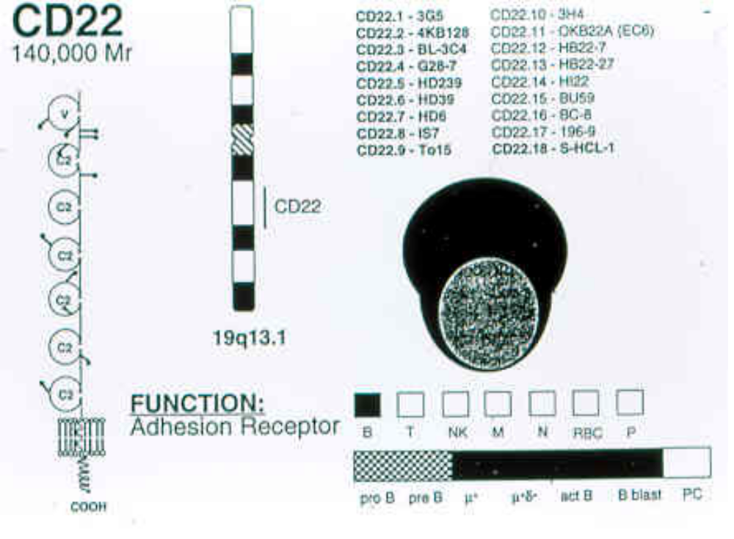

Slide 4
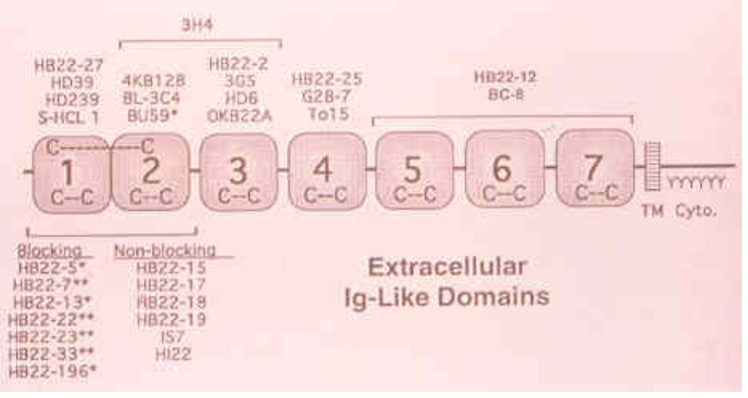

Slide 5
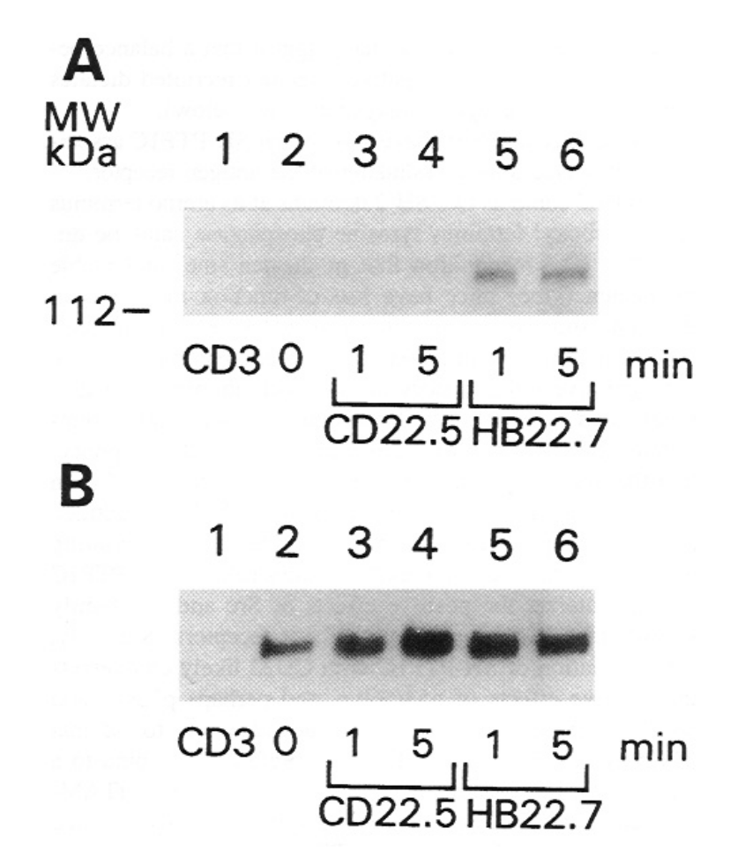

Slide 6
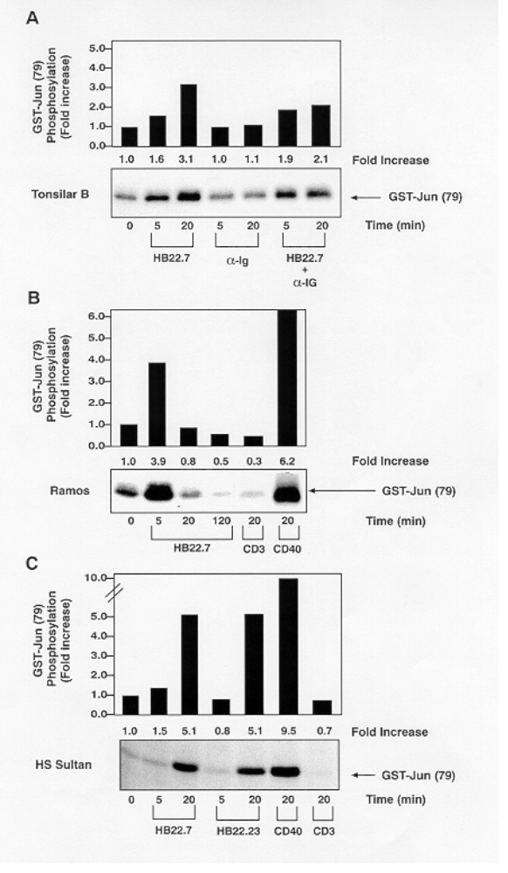

Slide 7
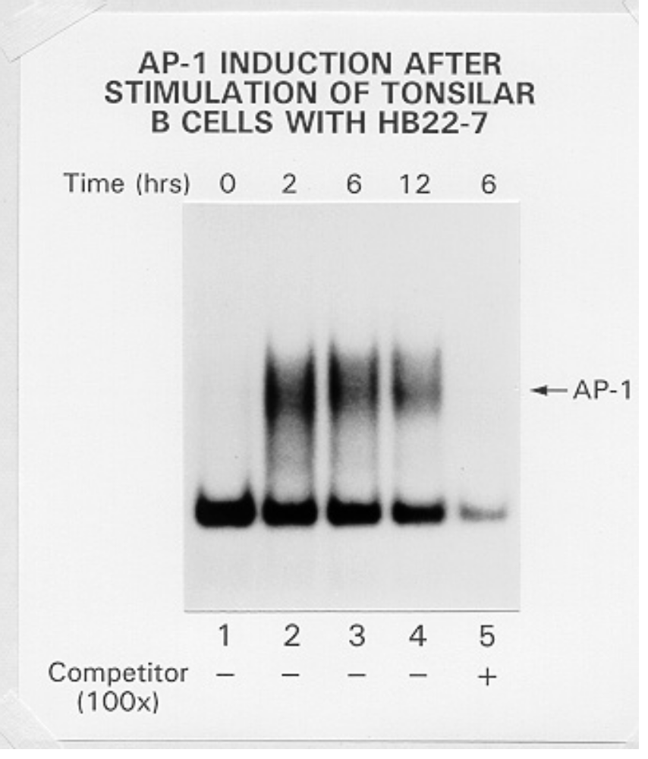

Slide 8
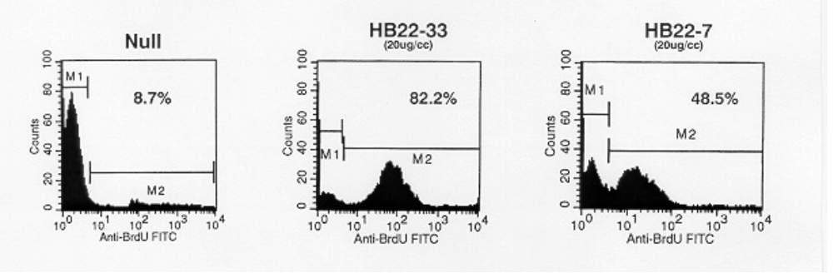

Slide 9
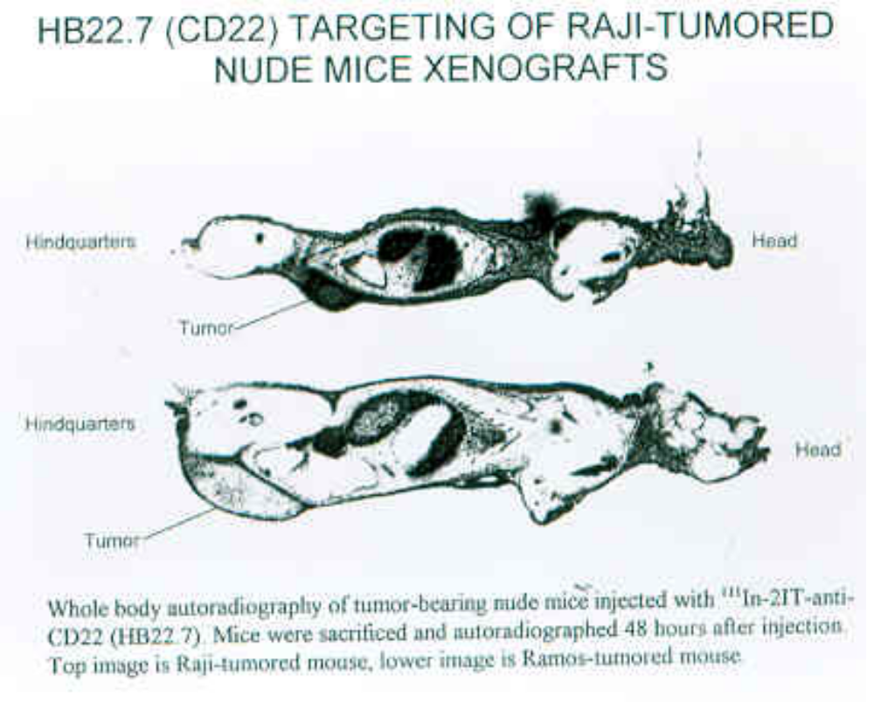

Slide 10
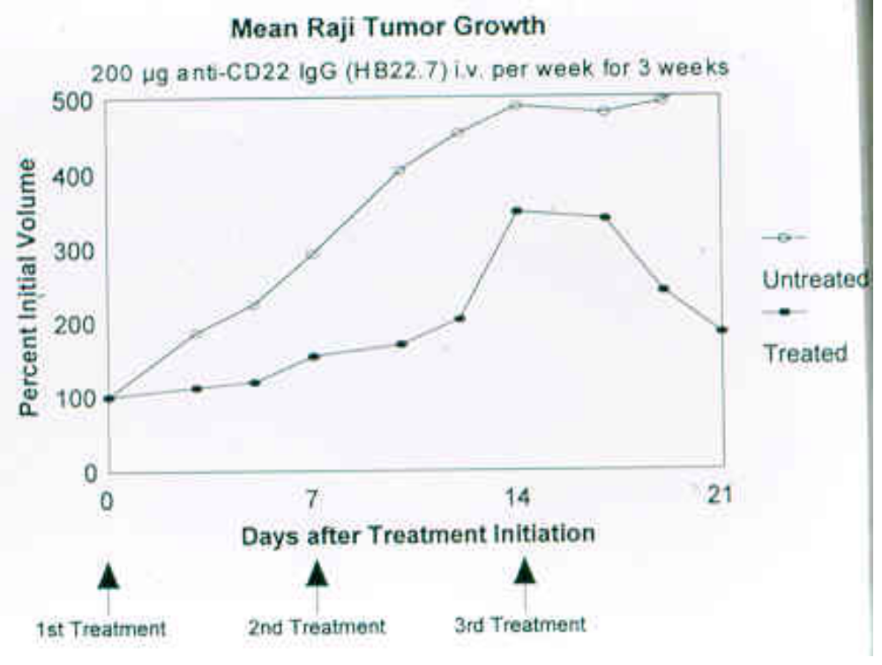

Slide 11
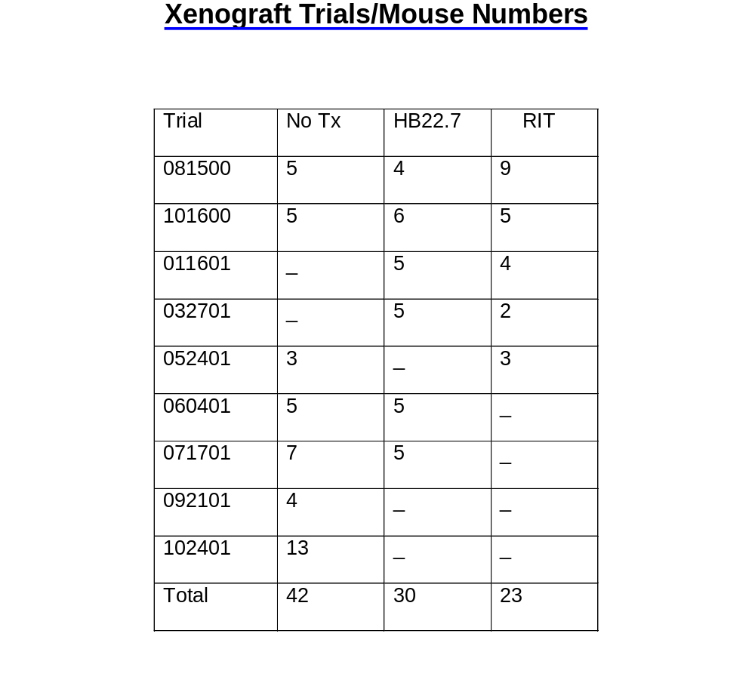

Slide 12
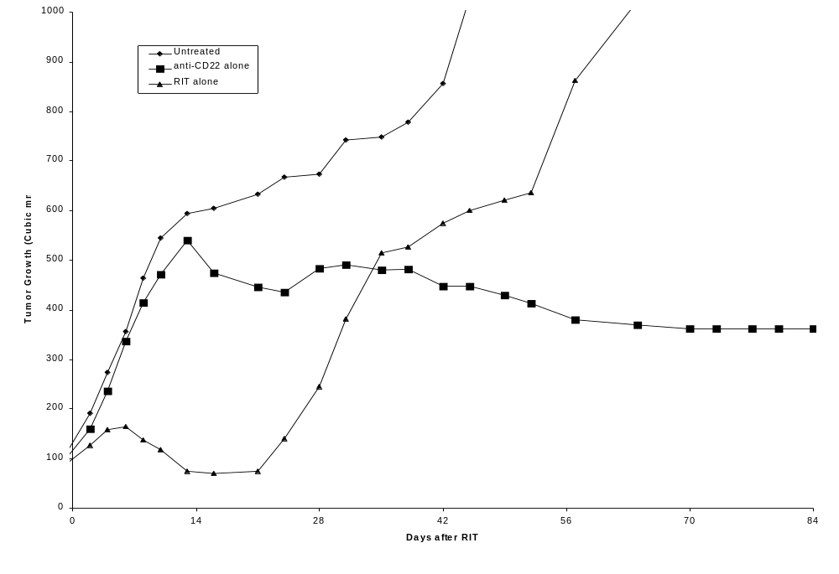

Slide 13
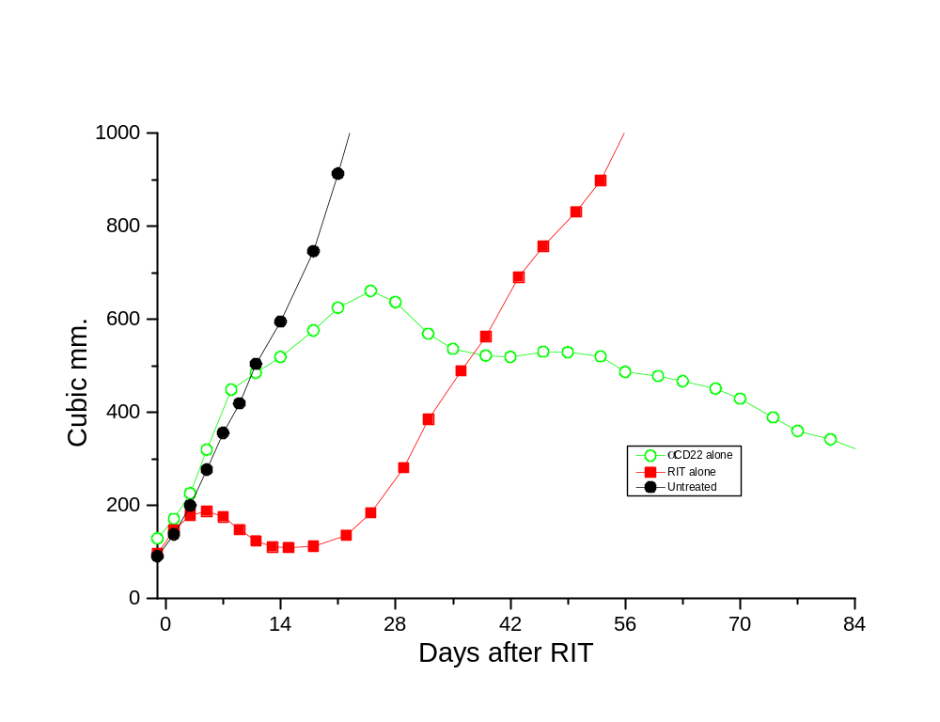

Slide 14
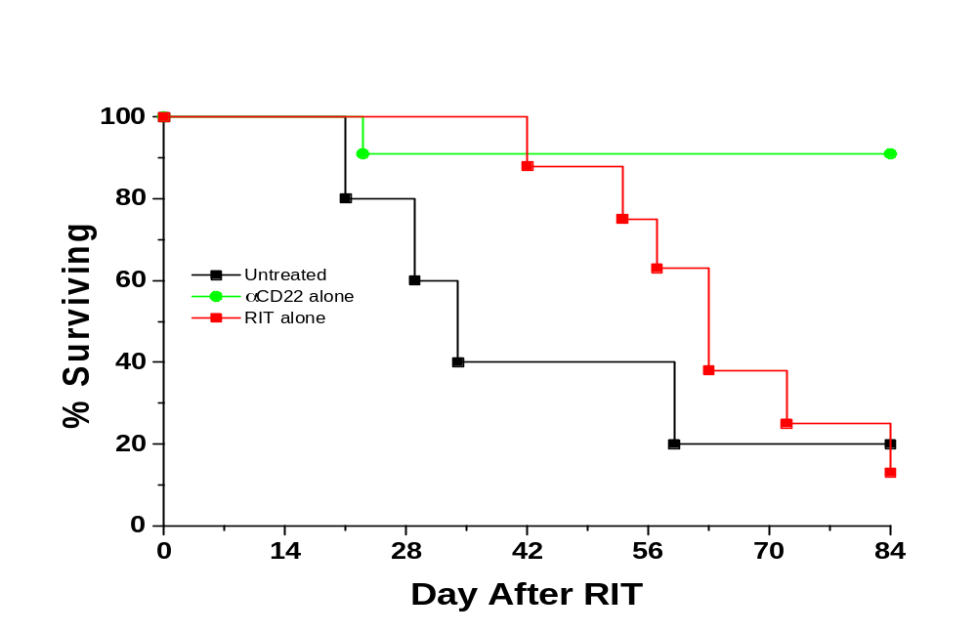

Slide 15
Conclusions/Significance
CD22 ligand blocking mAbs have unique physiologic properties
CD22 ligand blocking mAbs are pro-apoptotic
They target lymphoma xenografts
They have independent lymphomacidal properties
Augment the efficacy of RIT
Nontoxic alone and no additional toxicity with RIT
mAb with therapeutic potential identified based on
targeting AND physiology

Slide 16
Future Studies
Additional xenograft studies with mAb (HB22.7) alone (increased
dose and schedule)
Xenograft studies with HB22.33
Additional signaling studies
In vivo apoptotic studies
Humanization and human clinical trails with HB22.7
via the Rapid Access and Intervention Drug (RAID) program
Licensing and support from Cellective Therapeutics

Slide 17
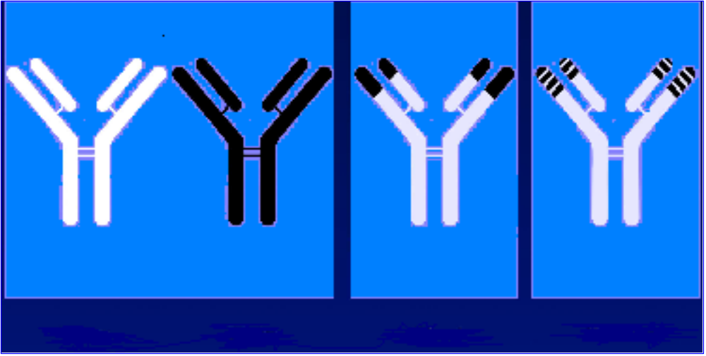
Types of Monoclonal Antibodies
Human Murine Chimeric Humanized
Adapted from LoBuglio. Crit Rev Oncol Hematol. 1992;13:273.
Notes:
The first clinical trials using first-generation murine antibodies saw a rapid formation of human antimurine antibody (HAMA). These responses from the hosts accelerated the clearance of the murine antibodies from the body of the patient and prevented repeat treatment.
To overcome the HAMA response, scientists redesigned antibodies to make them more human and less murine. Two types of “designer antibodies” are shown in the two panels on the right side of this slide.
Rituximab is a chimeric antibody created by splicing the framework of a human immunoglobulin—the constant portion—to the variable portion of a mouse antibody. The variable portion contains the specific receptors that determine the binding specificity of the antibody (ie, to which antigen it will bind).
Alemtuzumab, a monoclonal antibody indicated for chronic lymphocytic leukemia (CLL), is a humanized antibody created by another technique that further manipulates the antibody by retaining only key parts of the mouse amino acid sequences and replacing other sections with human immunoglobulin sequences.
The ⁹⁰Y ibritumomab tiuxetan (Zevalin™) regimen contains both chimeric (rituximab) and murine (ibritumomab) antibodies.
LoBuglio AF, Saleh MN. Monoclonal antibody therapy of cancer. Crit Rev Oncol Hematol. 1992;13:271-282.

Slide 18
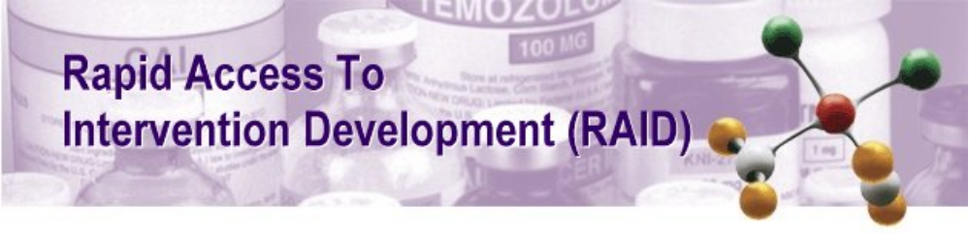

Slide 19
What is RAID ?
RAID is a program designed to facilitate translation to the clinic of novel, scientifically meritorious therapeutic interventions originating in the academic community. It will do this by making available to the academic research community, on a competitive basis, NCI resources for the pre-clinical development of drugs and biologics. RAID is intended to remove the most common barriers between laboratory discoveries and clinical trials of new molecular entities. The goal of RAID is clinical "proof of principle" that a new molecule or approach is a viable candidate for expanded clinical evaluation.

Slide 20
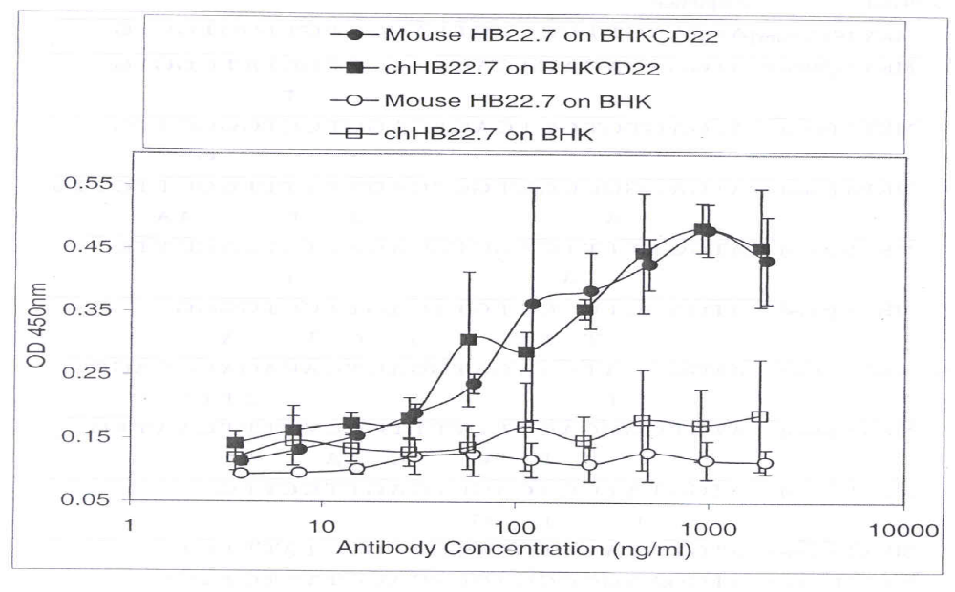
HB22.7 Chimerization

Slide 21
UC Policy
Tech Transfer Office
  Local vs. UCOP
Disclosure
  When and Why
Patents
  Different Types

Slide 22
The Bayh-Dole Act
What is the Bayh-Dole Act, what prompted it,
and why is it important to university technology transfer?
Enactment of the Bayh-Dole Act (P.L. 96-517), the "Patent and Trademark Act Amendments of 1980" on December 12, 1980 created a uniform patent policy among the many federal agencies that fund research. Bayh-Dole enables small businesses and nonprofit organizations, including universities, to retain title materials and products they invent under federal funding.

Slide 23
The Bayh-Dole Act
How has the Act influenced university technology transfer over the last decade and what are the results?
Bayh-Dole gave universities control of their inventions.
By placing few restrictions on the universities' licensing activities, Congress left the success or failure of patent licensing up to the institutions themselves.
Notes:
Bayh-Dole gave universities control of their inventions. By placing few restrictions on the universities' licensing activities, Congress left the success or failure of patent licensing up to the institutions themselves. That foresight has been rewarded by skillful and committed university professionals who have shown that licensing embryonic inventions can be successful. The keys are inventors motivated to engage in the process and a licensing relationship built on partnerships with industry. This model is now emulated by the federal laboratories. The success of Bayh-Dole in expediting the commercialization of federally funded university patents is reflected in the statistics. Prior to 1981, fewer than 250 patents were issued to universities per year. Slightly over a decade later, almost 1,600 were issued each year. Of those, nearly 80% stemmed from federally funded research. In addition, the number of universities participating in the patenting effort has increased to the point that in 1992, 200 universities had at least one patent issued annually.
Core technologies, likely to spark whole new industries, often result from university patents. This potential makes the contributions of the university sector to the national patent pool so significant. Examples range from the biotechnology to the laser industry. Stanford's Cohen-Boyer patent on basic gene splicing tools is at the heart of the entire biotechnology industry.

Slide 24
Tech Transfer Office
The mission
The mission of university technology transfer/licensing offices
is to transfer research results to commercial application for
public use and benefit.
Decides on patentability
Markets patents
Negotiates and administers licenses
Oversight of patent prosecution
Records income
Notes:
The mission of university technology transfer/licensing offices is to transfer research results to commercial application for public use and benefit. The office seeks and receives reports of inventions from investigators; reports the inventions to sponsors; decides whether to elect title for inventions developed with external funding; files patent applications; markets those patents to industry, negotiates and administers license agreements. The technology transfer office is also responsible for oversight of patent prosecution, recording of income and disbursements, and yearly reports to the government.
The major effort of the office is to find companies which have the capability, interest and resources to develop embryonic technologies into useful products. Once a match is found, a license agreement is negotiated to ensure that the company will be diligent in its efforts and will provide a fair financial return to the university's contribution to the return the company receives.
Technology transfer operations are generally also involved in negotiating material transfer agreements. Under such agreements, investigators share research materials (cells, cells lines, reagents, or other organisms) with colleagues in other universities or industry. Technology transfer experts also review the intellectual property terms in sponsored research agreements with industry (in some cases actually negotiating these agreements in conjunction with the university's Contract's and Grant's office.). Importantly, the professionals in the office are also a resource to the campus on a wide variety of intellectual property matters.

Slide 25
Tech Transfer Office
Cont.
Influences
  a) the faculty--inventors, who often have expectations of research opportunities, income, public utilization and fame;
  b) the private sector, expectations of securing commercially viable technology at a fair price;
  c) the university administration, which expects the office to be self-supporting and wants to prevent conflicts of interest;
  d) the governing board, which needs assurance that the university's name and reputation are protected in its industrial relationships;
  e) the taxpayers, with expectations that the office will manage state and federal resources in an effective and nondiscriminatory manner; and
  f) the sponsoring agency which insists on compliance with provisions of the Bayh-Dole Act.

Slide 26
Patents
Three types
  Utility
  Design
  Plant
Design
  Utility patents are granted for any new process, method, machine, manufacture, or compositions of matter, or any new and useful improvement thereof.

Slide 27
Licensing
Influences
What kind of licensing is most likely to lead to rapid commercialization; and
(2) What kind of licensing is in the public interest.
(3) $$$
Notes:
Patents which are broad in scope and can be used in multiple industries, or patents that they are so basic that they form the building blocks for new technologies are most likely to be licensed non-exclusively, or by fields of use. An exclusive, "field-of-use" license is a way to protect a market for a company while enabling the university to identify more than one license to assure public utilization of the technology in all markets.
Stanford University's Cohen-Boyer patent is an example of a basic patent that was licensed to all companies needing it. Non-exclusive licensing is preferred by universities when the technology can be used to foster product development in many fields of use. for example, if a technology will be of greatest benefit to the public if it becomes an industry standard, the university will make it readily accessible to all interested parties.
Universities most frequently will grant exclusive licenses to patents that require significant private investment to reach the marketplace or are so embryonic that exclusivity is necessary to induce the investment needed to determine utility. Frequently, these are new drugs requiring time-intensive and capital-intensive development or they are technologies that have only a tenuous link between the workbench and production. As such, they require a company willing to dedicate financial backing and the creativity of its own scientists on a long-range basis.
At the final call, the decision to license on an exclusive or non-exclusive basis is inevitably driven by market interest. Not only does the interest relate to the value of the invention, but also to the investment required to develop new products and the risk associated with that technology.

Slide 28
The Reality of Getting to Human Clinical Trials
After ~ 15 years of development, so close yet so far from
treating patients with cancer
Composition of Mater patent held by DFCI
Methods Patent held by UCD and Duke
RAID subcontracted to Aires Biochemical company
  Who owns the “right” to the humans antibody
Production issues have complicated translation
My role as a university researcher and royalty recipient, principle
investigator of human clinical trials, licensing company advisor
and shareholder.

Slide 29
LOST IN TRANSLATION
Duke
Licensing
UCOP
Patent/partner
Industry
Partner/advisor
$$ + control
Collaboration/academic
success
Licensing
Patent prosecution etc
$$$$$
**
$$$$$
JT
Grant support
Clinical Trials
$$
Academic success
Aeres/
Manufacturing

