Slide 1
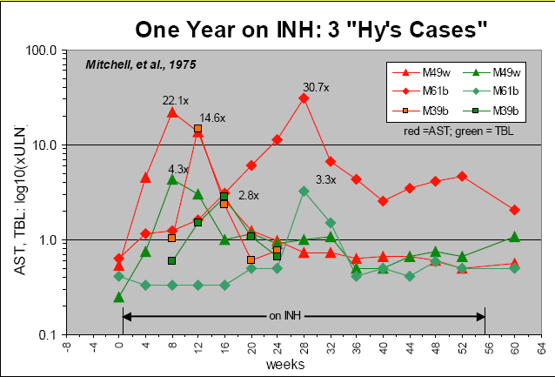
Questions 1
1: ‘ Time course of AST and TBIL in three subjects’ Notes: Lighten or remove gray background. Color choice and line styles work well. Limit this graphic to 1 subject with an option to have multiple panels for additional subjects. If multiple panels, use single legend as numerous will be illegible. [Mitchel et al, ‘Acetylation rates and monthly liver function tests during one year of isoniazid preventative therapy’ 1975]
Graphic display of the time course of serum aspartate aminotransferase AST (red) and total bilirubin (green) values (measured after treatment was over) in three subjects treated with isoniazid (Data plotted from table 4 in report from Mitchel et al.). All three fulfill present definition by Temple as “Hy’s Cases.” Despite this, all three adapted to the drug and became tolerant of it. Serum ALT was not measured in this study.

Slide 2
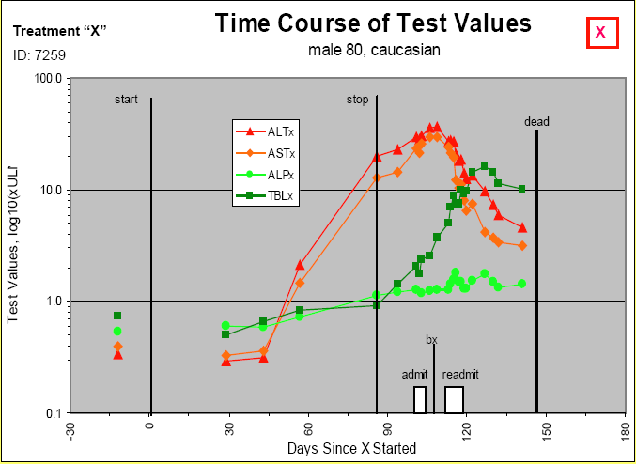
Questions 1
2: ‘Time course of test values’ Notes: Lighten or remove gray background. Color choice and line styles work well. Include horizontal dose bars (or lines as in figure 1) to show time on drug. Remove start and stop lines as well as the ‘dead’ line (or at least rename). Remove admit, bx, readmit boxes. Add reference lines for liver parameters. Add important med history on title or if lengthy, add below figure. [Mitchel et al, ‘Acetylation rates and monthly liver function tests during one year of isoniazid preventative therapy’ 1975]

Slide 3
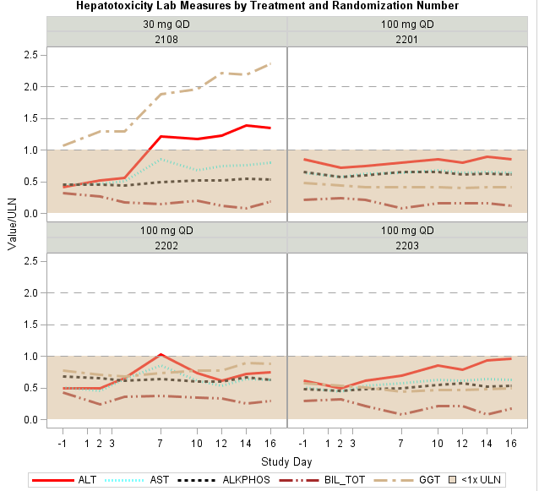
Questions 1
3: ‘Lab measures by treatment and randomization number’ Notes: Acceptable figure as it exists. Be sure that it is appropriate for more labs [Alain Smits – J&J]

Slide 4
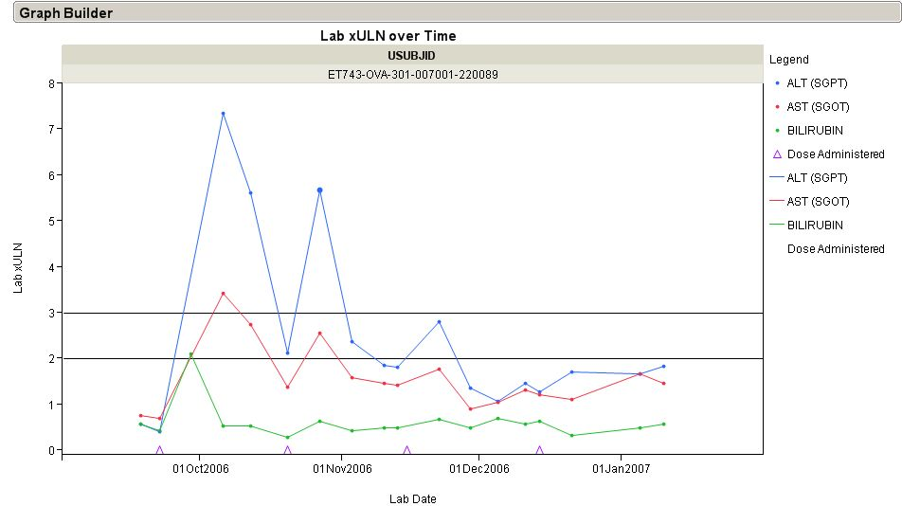
Questions 1
4. ‘Liver Function Tests over Time’ The x-axis should reflect study day or study month etc. and not date. The header should reflect the subject number. [Robert Gordon – J&J]

Slide 5
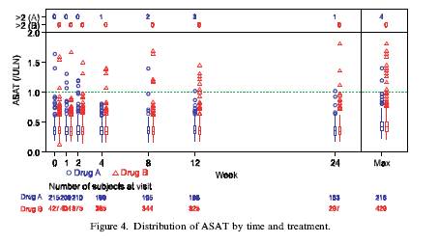
Questions 1,3
5: ‘Distribution of ASAT by time and treatment‘ Notes: Be sure that axis scale is representative of time (as is shown). Option of adding patient qualifiers on outliers would be beneficial. In graph description, would need to specify when to use and when not to use the Max (or other applicable) sections. [Amit, hieberger, Lane ‘Graphical approaches to the analysis of safety data from clinical trials’ 2007]

Slide 6
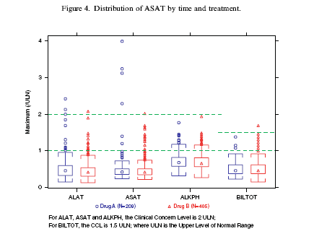
Questions 3
6: ‘Distribution of ASAT by treatment’ Notes: Title should not include time. Option of adding patient qualifiers on outliers would be beneficial. Option to mark outliers meeting Hy’s law criteria if possible. Would need to add Hy’s law criteria on footnote. Caveat – wouldn’t use this graph is there were different times on treatment for dose/drug groups. [Amit, hieberger, Lane ‘Graphical approaches to the analysis of safety data from clinical trials’ 2007]

Slide 7
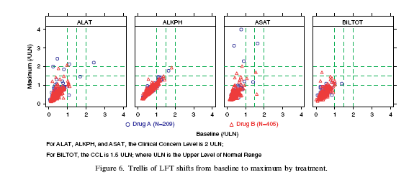
Questions 1,2,3
7: ‘Trellis of shifts of LFTs from baseline to maximum by treatment and timepoint’ Notes: Would be nice if there were additional rows for each time point. For instance a row of boxes for baseline, then one for week 1 etc. Maximum number of rows would depend on clarity. Definite focus on liver, would need additional relevant clinical groupings. [Amit, hieberger, Lane ‘Graphical approaches to the analysis of safety data from clinical trials’ 2007]

Slide 8
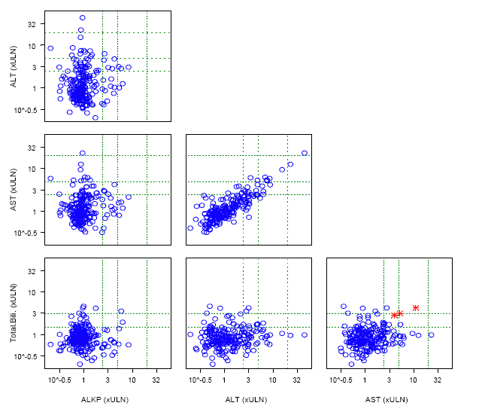
Questions 1,2,3
8: ‘Matrix display of maximum LFT levels’ Notes: Need legend to include treatment groups (if more than one group). Additionally, need label for red stars highlighted – perhaps Hys law cases. Possibly annotate red stars with subject ID. Remove the 10^-(0.5) and replace with 0. [Michael O’Connell, Insightful Presentation, 2007]

Slide 9
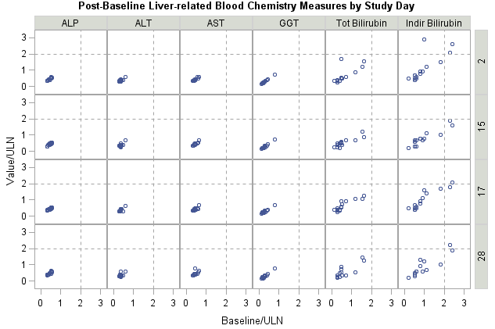
Questions 1,2,3
9: ‘Post-baseline liver-related blood chemistry measures by study day’ Notes: If using the same scale, this is a very nice graphic. But must use same scale. Color by treatment if possible with legend. [Alain Smits – J&J]

Slide 10
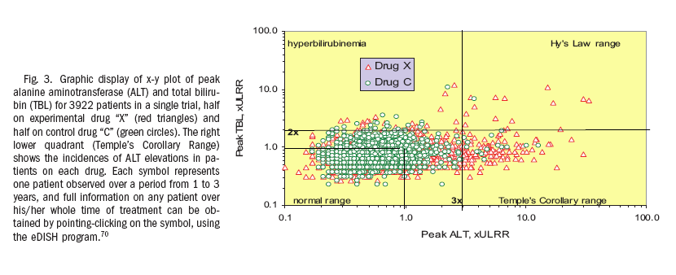
Questions 1,2,3
10: ‘Scatter Plot of peak ALT versus peak Total Bilirubin, by treatment’ Notes: The labels are a nice addition and are recommended on the final plot (which combines the three eDish type plots #9-#11) ULRR seems to represent upper limit of reference range. [Watkins et al, Hepatology 2008]

Slide 11
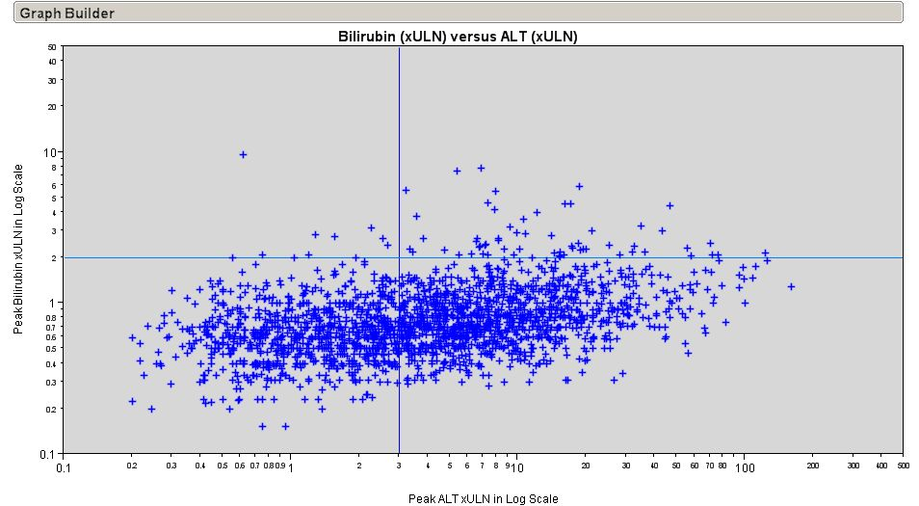
Questions 1,2,3
11: ‘Scatter Plot of peak ALT versus peak Total Bilirubin’ Notes: The x-axis scale (including the minor tick separation) is recommended on the final plot (which combines the three eDish type plots #9-#11) [Gordon – J&J]

Slide 12
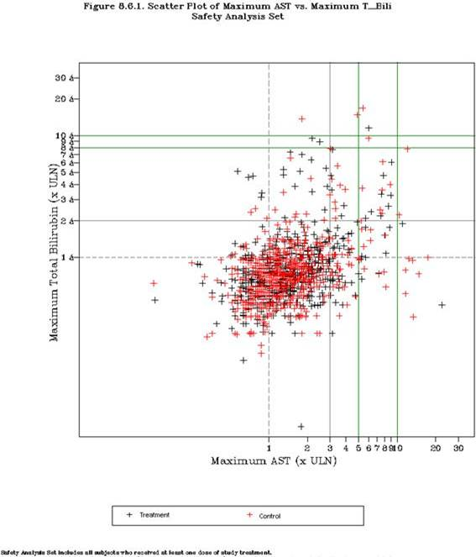
Questions 1,2,3
12: ‘Scatter Plot of maximum AST versus maximum Total Bilirubin’ Notes: This is the recommended eDish type plot, combining plots #9, 10 and 11. The x-axis scale (including the minor tick separation) from the previous plot is recommended here. Although the x-axis is AST, ALT could be substituted to arrive at a Hy’s Law plot and inclusion of the labels (as in plot #9) would be recommended. Green reference lines should be removed or explained if needed. [Qi Jiang – Amgen]

Slide 13
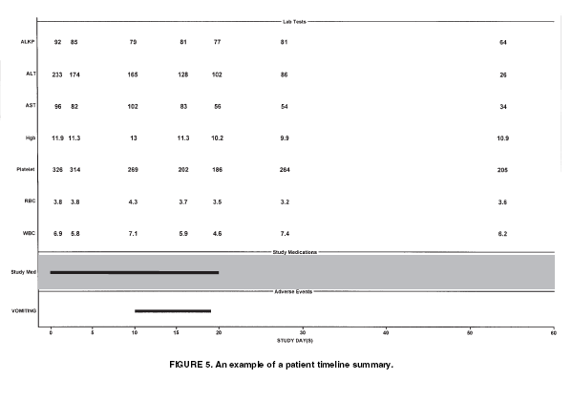
Questions 1
13: ‘Patient timeline summary’ Notes: Although this plot is not recommended, it is the basis for additional plots to be reviewed. Units would be needed (along y-axis). Addition of ULN values (perhaps in parentheses after the lab value) would be helpful. [CHRISTY CHUANG-STEIN et al, DIA Journal 2001]

Slide 14
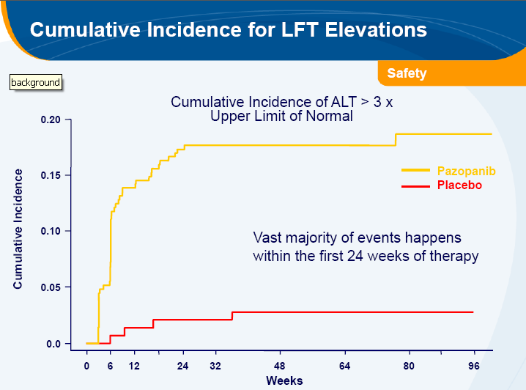
Questions 1,3
14. ‘Cumulative Incidence for LFT Elevations’ [GSK, Joint Statistical Meeting, 2010]

Slide 15
Questions 1,2,3,5
15: ‘Median and inter-quartile range plot for lab change from baseline’ Notes: Add subjects at risk across x-axis if possible, unless the population is already ‘completers’ then add to title. Very light grid in background in possible, if not then add either tick marks on both sides of y-axis on each plot or numbers. Remove brackets (< >). [Qi Jiang - Amgen]
≤
65 years
> 65 years
< Overall >
5
Control (N=x)
Control (N=x)
Control (N=x)
Drug (N=x)
Drug (N=x)
Drug (N=x)
4
3
Percent Change From Baseline
2
1
0
-1
1
6
12
24
1
6
12
24
1
6
12
24
<Study Month>
Placebo (at risk) | 160 | 157 | 152 | 150
Active (at risk) | 156 | 154 | 154 | 146
160 | 157 | 152 | 150
156 | 154 | 154 | 146
160 | 157 | 152 | 150
156 | 154 | 154 | 146
*

Slide 16
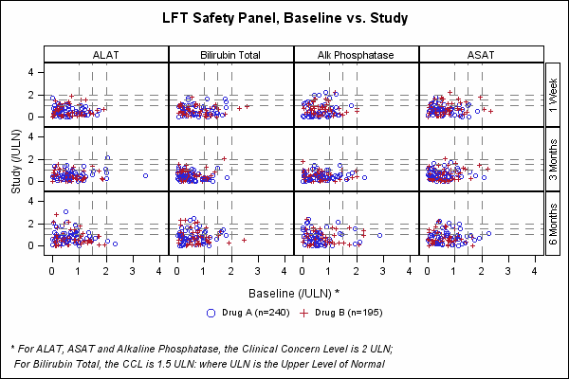
Questions 1,2,3,5
‘LFT Safety Panel, Baseline vs. Study’ Notes: Make y-axis same scale as x-axis, therefore making into squares, not rectangles. Clarity why outlier at 3 months in first panel but it isn’t in other visits. Better explain underlying data. Possibly put time on x-axis?
[SAS Institute - http://support.sas.com/sassamples/graphgallery/Health_and_Life_Sciences_Industry.html ]

Slide 17
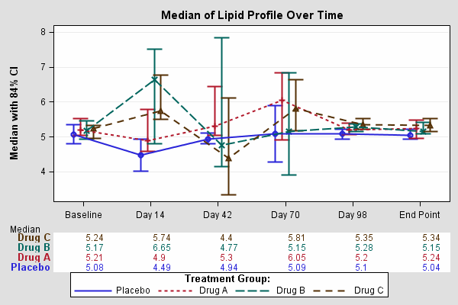
Questions 1,2,3,5
‘Median of Lipid Profile Over Time’ Notes: 90 or 95 % CI, not 84. Title needs to specify what lipids. Distance not uniform on x-axis. Lines should not connect endpoint, should be separate. Endpoint needs to be defined. Replace legend with sample sizes or add legend.
[SAS Institute - http://support.sas.com/sassamples/graphgallery/Health_and_Life_Sciences_Industry.html ]

Slide 18
BACK UP SLIDES
These slides were reviewed, however, they were removed because they were repetitive or not chosen as a standard graphic.

Slide 19
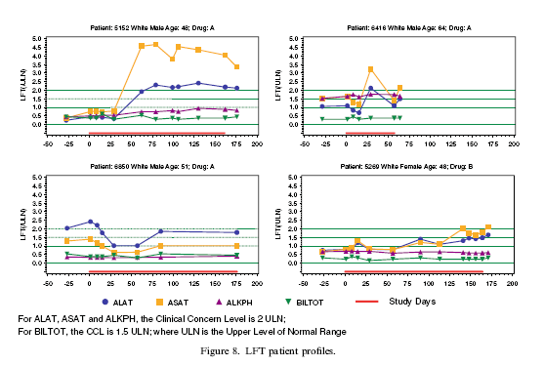
Questions 1

