Slide 1

Graphical Approaches for Safety Signal Detection
Efforts of the FDA-Industry-Academia Working Group
Mat Soukup, Ph.D.
Acting Team Lead
Biometrics 7, CDER
September 21, 2010

Slide 2
Disclaimer
The views expressed in this presentation are those of the presenter and must not be taken to represent policy or guidance on behalf of the U.S. Food and Drug Administration

Slide 3
Outline
Reason for Working Group Formation; proof by example
Barriers to Visualizations
Developing Standard Views of Safety Data
Public Dissemination of Information
Concluding Remarks

Slide 4
Example 1: Understanding the Trend
Tabular Summary of SBP Over Time:
 | Active Drug |  |  |  |  | Control Drug
Visit | N | Mean | SD | 95% CI |  | N | Mean | SD | 95% CI
1 | 112 | 118.1 | 1.3 | (115.9, 120.3) |  | 113 | 119.1 | 1.2 | (117.0, 121.2)
2 | 112 | 122.7 | 1.4 | (120.4, 125.0) |  | 112 | 119.1 | 1.1 | (117.0, 121.2)
3 | 111 | 125.6 | 1.0 | (123.6, 127.6) |  | 110 | 114.4 | 1.2 | (112.3, 116.5)
4 | 110 | 133.1 | 1.2 | (131.0, 135.2) |  | 108 | 124.2 | 1.4 | (121.9, 126.5)
5 | 110 | 136.7 | 1.2 | (134.6, 138.8) |  | 108 | 123.8 | 1.2 | (121.7, 125.9)
6 | 108 | 134.2 | 1.1 | (132.1, 136.3) |  | 108 | 114.9 | 1.1 | (112.8, 117.0)
7 | 106 | 131.0 | 1.2 | (128.9, 133.1) |  | 104 | 120.1 | 1.2 | (118.0, 122.2)
8 | 105 | 126.2 | 1.3 | (124.0, 128.4) |  | 103 | 121.6 | 1.2 | (119.5, 123.7)
9 | 104 | 124.3 | 1.2 | (122.2, 126.4) |  | 100 | 118.6 | 1.1 | (116.5, 120.7)
10 | 102 | 125.1 | 1.2 | (123.0, 127.2) |  | 100 | 117.7 | 1.3 | (115.5, 119.9)

Slide 5
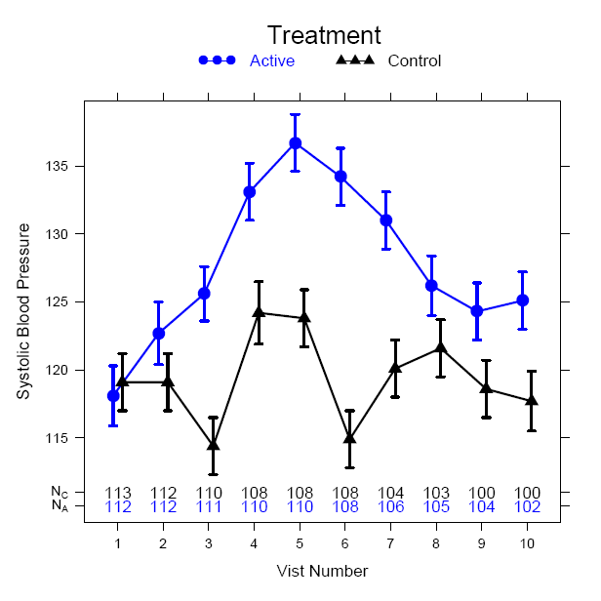
Example 1: Understanding the Trend
Graphical Summary:

Slide 6
Example 2: Beyond Dichotomy
Background:
Lab Parameter Assessed at baseline and end of exposure
Measured in 4 age cohorts
Dichotomized at a value ≤ 18
Tabular Summary of Dichotomized Laboratory Value:
Cohort | Low Dose | High Dose
6 mo. – 2 yrs | 1/20 (5%) | 2/20 (10%)
2 yrs – 6 yrs | 0/20 (0%) | 0/20 (0%)
6 yrs – 12 yrs | 0/20 (0%) | 0/20 (0%)
12 yrs – 18 yrs | 0/20 (0%) | 1/20 (5%)

Slide 7
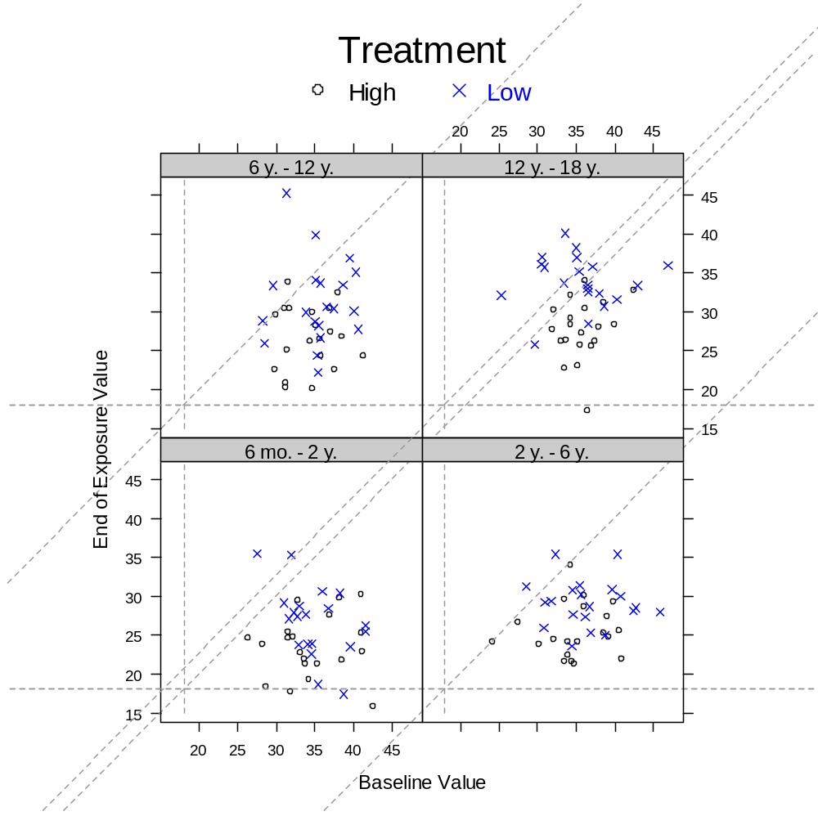
Example 2: Beyond Dichotomy
Graphical Summary:

Slide 8
Outline
Reason for Working Group Formation; proof by example
Barriers to Visualizations
Developing Standard Views of Safety Data
Public Dissemination of Information
Concluding Remarks

Slide 9
Barriers to Graph Creation
Lack of Training: Statistical coursework typically does not include classes/training on graphic construction
  Even more so, on good graphical principles
Limited Publications: Publications of graphical approaches for clinical trial data are few and far between
Time restraints
  May require creation after data base lock
Software dependency
  Software needed may be outside that allowed in closed computing environment

Slide 10

Remove the Barriers – Key for Future

Slide 11
Outline
Reason for Working Group Formation; proof by example
Barriers to Visualizations
Developing Standard Views of Safety Data
Public Dissemination of Information
Concluding Remarks

Slide 12
FDA/Industry/Academia Working Group
Background
  Formed: Fall 2009
  Membership
    Regulatory (21 members)
    Industry (13 members): Shering-Plough, Pfizer, GSK, Johnson and Johnson, Novartis, Eli Lilly, Merck, Sanofi-Aventis, Roche, Amgen
    Academia (2 members): Vanderbilt, UC-Davis
Goal: To develop a palette of graphics for visualizations of clinical trial safety data

Slide 13
Project Objectives
Identify areas particularly applicable or useful to regulatory review in which graphics can enhance understanding of safety information.
Develop a palette of statistical graphics for reporting on clinical trials safety data.
Recommend graphics for clinical data based on good scientific principles and best practices.
Create a publicly-available repository of sample graphics (ensuring appropriate credits are given for contributions), including data sets and code.
Educate and engage stakeholders through outreach activities.
Consider publishing with authorship/acknowledgments as is consistent with contributions and policy of the affiliated institution.

Slide 14
Project Scope
Includes
  Graphics to convey pre-approval clinical safety information typically submitted in support of an ISS
  Static graphics represented in: color, black and white, and grayscale
  Graphs for both descriptive and inferential purposes
  Static graphics should be printable
  Develop tools that will aid in the product of new graphics
Excludes
  Spontaneous reporting or epidemiological case control studies
  Dynamic graphics

Slide 15
Working Group Structure
Invited membership and time/resources are based on a volunteer basis
Four Subgroups
ECG/Vitals (10 members)
General Adverse Events (11 members)
General Principles (9 members)
Labs/Liver (7 members)

Slide 16
Addressing the Barriers
Lack of Training: Efforts are being developed to help untrained on how to select the right graph; outreach through presentations
Limited Publications: Materials will be presented in a public forum (more to follow)
Time Restraints: Standard set of views reduces time to develop graphical approaches, can be planned upfront
Software Dependency: Code to create graphics will be publicly available; ability to use multiple software packages

Slide 17
Outline
Reason for Working Group Formation; proof by example
Barriers to Visualizations
Developing Standard Views of Safety Data
Public Dissemination of Information
Concluding Remarks

Slide 18
Distribution of Content
Information will be publicly available at http://ctspedia.org
Currently, materials require administrative authorization as:
  Group is working on devising site structure
  Content for safety is just being populated
  Infrastructure for registration of graphics is being developed; desire for ease of entry
All content is intended to be publicly available in the near term

Slide 19
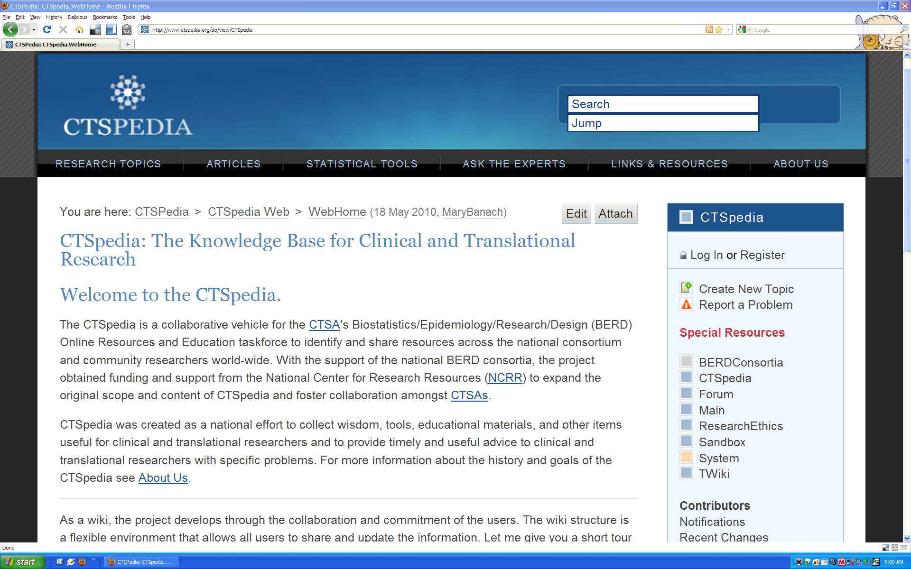
CTSpedia Screenshot
Draft

Slide 20
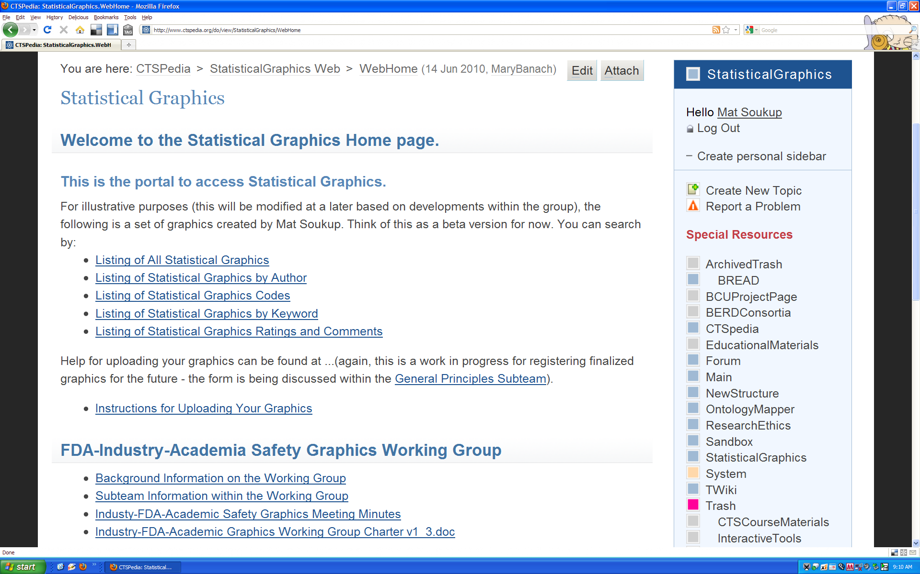
CTSpedia Graphics Homepage Screenshot
Draft

Slide 21
Describing Graphic Entries
Metadata included in the graphic library
  Required Fields: Title, Description, Background, Image, Author, Dates, Use/Suitability, Software, Code, Keywords
  Optional Fields: References, Data Description
  Categorizations: Evaluation (e.g. safety, efficacy), Graph Type (e.g. scatterplot, dotplot), Variable Relationship (e.g. categorical vs. categorical), Data Type (e.g. continuous)

Slide 22
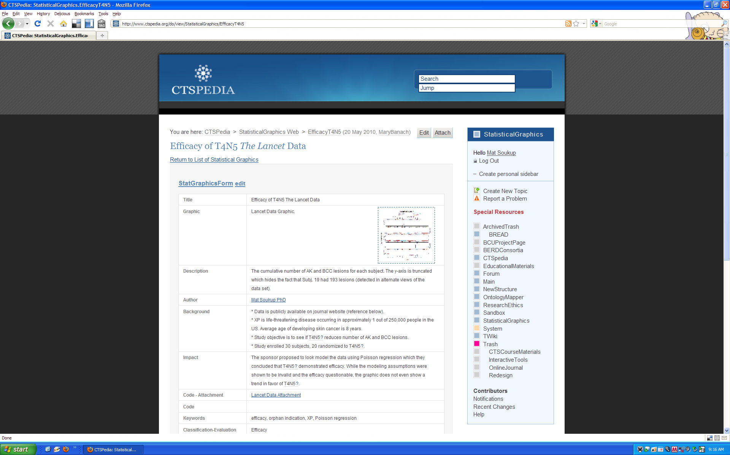
Graphic Example, 1
Draft

Slide 23
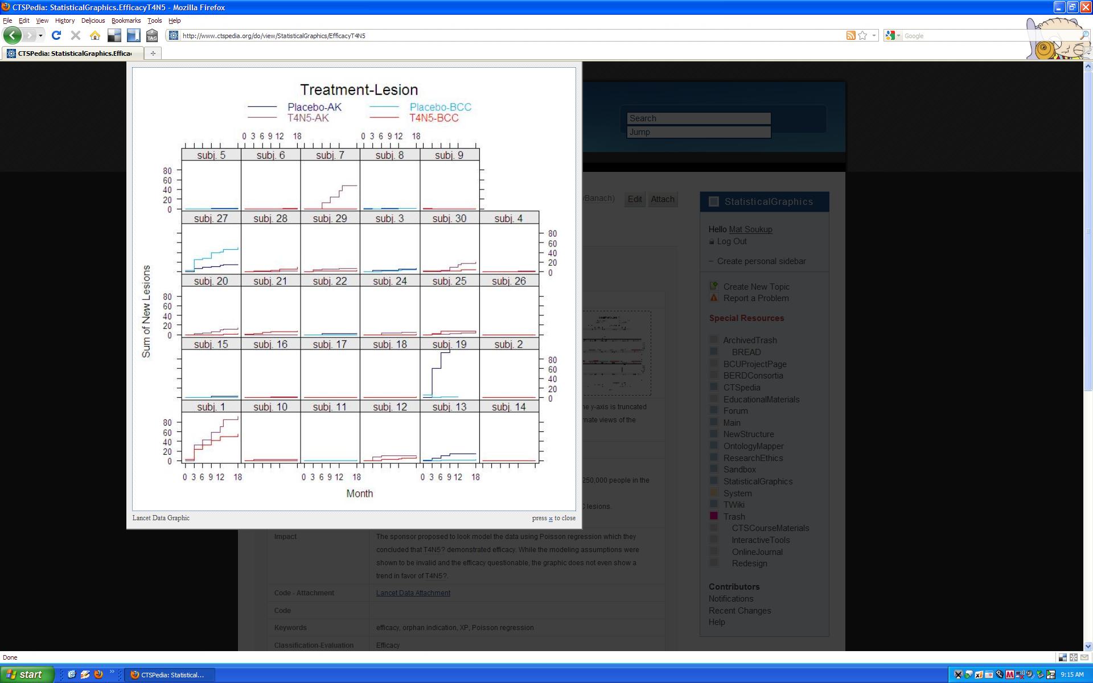
Graphic Example, 2
Draft

Slide 24
Outline
Reason for Working Group Formation; proof by example
Barriers to Visualizations
Developing Standard Views of Safety Data
Public Dissemination of Information
Concluding Remarks

Slide 25
Reasons to Include Graphic Summaries
Complex statistical concepts and data structures can be conveyed at a level which is within reach to those with little statistical training
Ability to highlight key safety signals from large data bases
Paradigm is to actively assess the data in a manner that is visual, intuitive, and geometric

Slide 26
Potential Results Using Effective Graphics
Clinical trial results are more transparent (hard to hide the data if it is all shown)
Increases the likelihood of detecting key safety signals
Improves the ability to make clinical decisions
Allows for more productive interactions with the FDA
Improves communication to the public

Slide 27
A Community for Graphics
Several advantages exist for using a public community
  Increases the talent pool for developing new approaches
  Provides access to the latest information
  Access to code lessens resources to implement the approach
  Evolution towards a best practice in reporting safety information

Slide 28
Special Thanks
The following members of the FDA/Industry/Academia Working Group
Regulatory: George Rochester, Bruce Weaver, Stephine Keeton, Janelle Charles, Chuck Cooper, Suzanne Demko, Robert Fiorentino, Richard Forshee, Eric Frimpong, Ted Guo,Pravin Jadjav, Leslie Kenna, Joyce Korvick, Antonio Paredes, Jeff Summers, Mark Walderhaug, Yaning Wang, Markus Yap, Hao Zhu
Industry: Ken Koury, Rich Anziano, Susan Duke, Mac Gordon, Fabrice Bancken, Navdeep Boparai, Andreas Bruckner, Brenda Crowe, Sylvia Engelen, Larry Gould, Matthew Gribbin, Liping Huang, Qi Jiang
Academia: Frank Harrell, Mary Banach

