Slide 1
Subgroup Update: General Principles
Industry/FDA/Academia
Safety Graphics Working Group
31 Aug 2010 Teleconference
Susan Duke, GSK
Fabrice Bancken, Novartis

Slide 2
Topics Covered Today
How graphics and glossary will fit with the flowcharts – Susan – 5 min
Populating flowcharts with clinical questions – Susan – 3 min thanks to Larry Gould for this great idea!
General graphics guidance – Susan – 2 min
Choosing the Right Graph flowcharts – Fabrice – 15 min
Discussion: Is the group comfortable with the direction General Principles subteam is headed? Any comments/suggestions? – 10 min

Slide 3
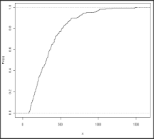
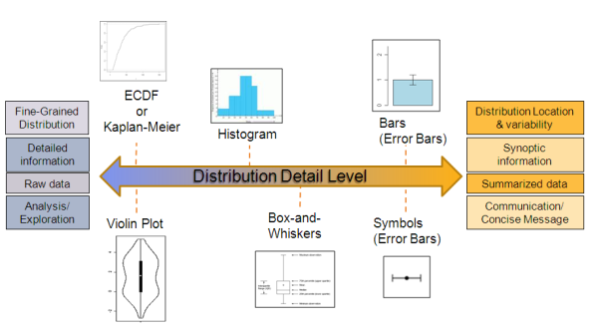
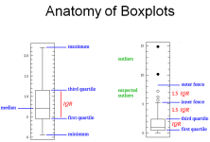
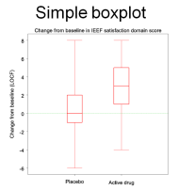
1. How graphics and glossary will fit with the flowcharts
Example A:
Quantitative Data Visualization
Cumulative distribution plots
CDF
Kaplan-Meier
Boxplots
Simple boxplot
Flowchart
Context Pages
Graphics Entries
Glossary
Wiki authors encouraged to hyperlink key words in flowchart, concept page and graphics entry to glossary entries.
Includes coded
example(s) (in R, SAS, etc)
Etc…
Includes coded
example(s) (in R, SAS, etc)
Etc…
Explanatory text,
hyperlink(s)
Includes coded
example(s) (in R, SAS, etc)
Explanatory text,
hyperlink(s)
Etc…
Etc…

Slide 4
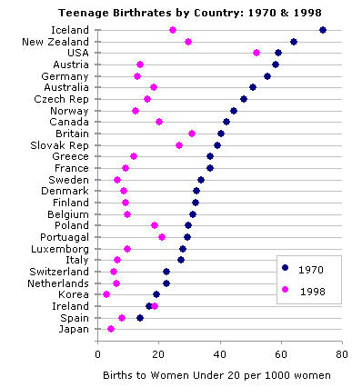
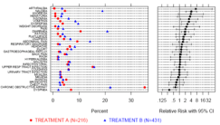
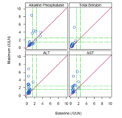
2. Populating flowcharts with clinical questions
Adverse events
Xxx xxxxxxxx xxxxx xxxxx xxxxx?
Grouped dotplot
Double dotplot
Xxx xxxxxxxx xxxxx xxxxx xxxxx?
Multi-panel scatterplot
Flowchart
Context Pages
Graphics Entries
Glossary
Wiki authors encouraged to hyperlink key words in flowchart, concept page and graphics entry to glossary entries.
Includes coded
example(s) (in R, SAS, etc)
Includes coded
example(s) (in R, SAS, etc)
Etc…
Etc…
Includes coded
example(s) (in R, SAS, etc)
Explanatory text,
hyperlink(s)
Etc…

Slide 5
3. General Graphics Guidance
“Top 10” to “Top 20” pointers/tips
Use of color
Vector and raster graphics
What is the thought task?
Etc
Could do a poll on favorites (means to encourage participation on wiki?)

Slide 6
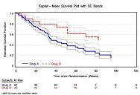


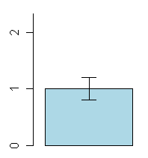
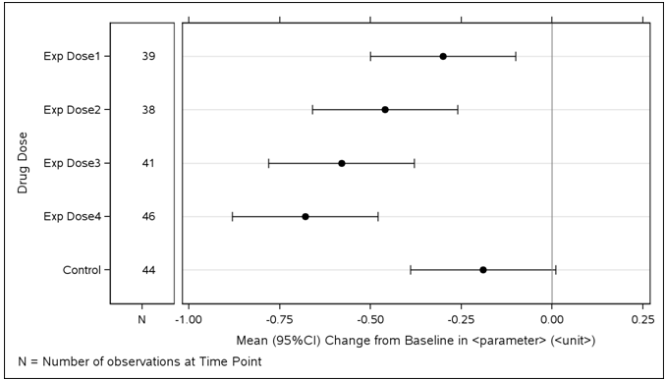
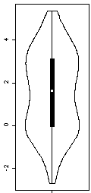
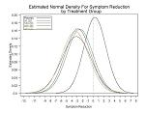
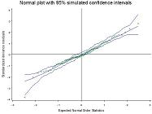

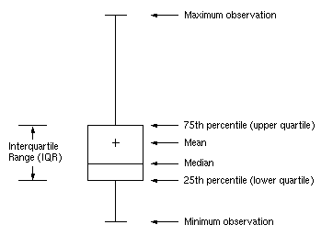
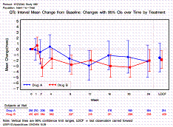
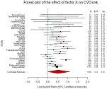
Quantitative data visualization Factors driving the choice of type of graph or its building blocks
Cumulative Distribution
Kaplan-Meier
Waterfall
Histogram
Bars & Error Bars
Fine-Grained
Distribution
Mean/Median & IQR/SE/95%CI
High Detail
Low Detail
Raw data
Distribution Detail Level
Summarized data
Analysis/
Exploration
Communication/
Concise Message
“Symbols & Error Bar”
PDF plot
QQ plot
[Extended] Box Plot
Violin Plot

Slide 7
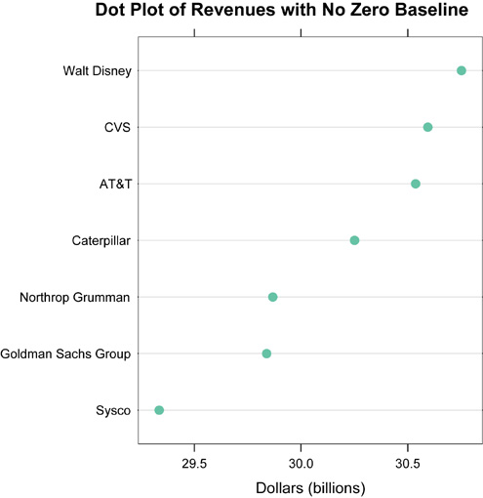
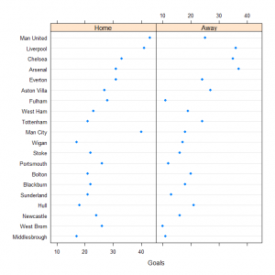
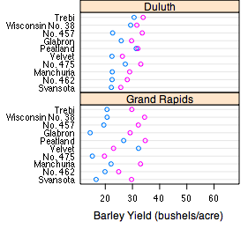

Data visualization Factor influencing the choice of Subtype/Flavor
Simple
Multipanel of simple
Graph Subtype/Flavor
Multiple grouping Variables (e.g., age category
x gender
x treatment group)
0 or 1 grouping Variable
Grouped
Multipanel of grouped

Slide 8
Data visualization Visual Perception
“When a graph is constructed, information is encoded. The visual decoding of this encoded information is graphical perception.
The decoding is the vital link …
No matter how ingenious the encoding … and no matter how technologically impressive the production, a graph is a failure if the visual decoding fails.”
William Cleveland, The Elements of Graphing Data
Hierarchy of human graphical perception abilities
Position along a common scale (most accurate)
Position along identical nonaligned scales
Length
Angle and slope
Area
Volume
Color
Hue (red, green, blue, etc) can give good discrimination but poor ordering
Saturation (pale/deep) can be useful if order is important
Source: F. Harrell http://biostat.mc.vanderbilt.edu/twiki/pub/Main/StatGraphCourse/graphscourse.pdf

