Slide 1
George Howard, DrPH
UAB School of Public Health
Keyword: Statistics as common sense

Slide 2
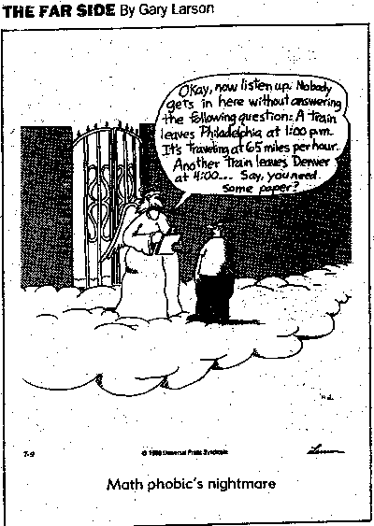
Overall Lecture Goals
It is surprising that as a society we accept bad math skills
Even if you are not an active researcher, you have to understand statistics to read the literature
Fortunately, statistics are mainly common sense
This lecture is to provide the foundation for common sense issues that underlie why and what is trying to be done with statistics
This is not a math lecture, so relax

