Slide 1
George Howard, DrPH
UAB School of Public Health
Keyword: Confounders – Example – BP and Age

Slide 2
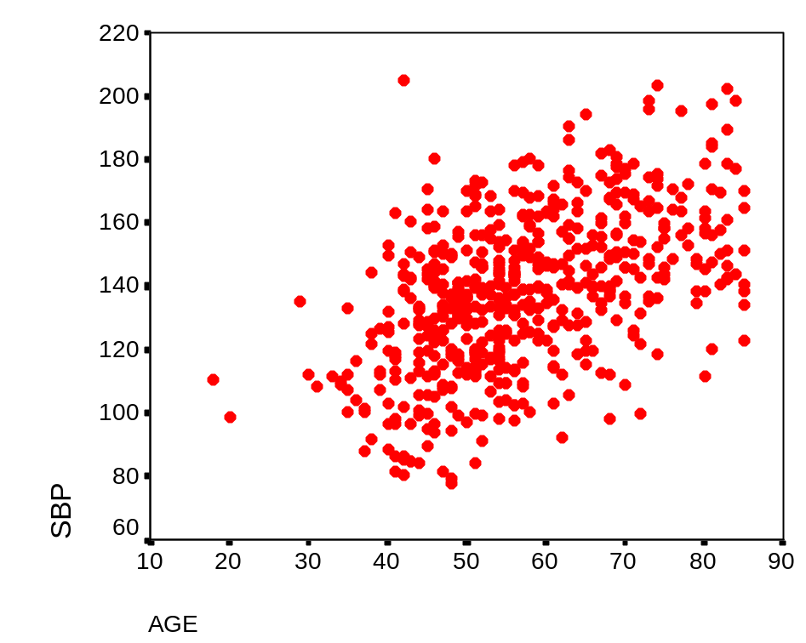
Age and Systolic Blood Pressure
Is there evidence that systolic blood pressure increases with age?
Collect SBP and age on 566 participants
Find the “average” value for SBP as a function of age
“Ask” if the average SBP changes with age?

Slide 3
Age and Systolic Blood Pressure
In this analysis:
  Age:
    Continuous (or interval) factor
    Predictor (independent variable)
    Single measures on each individual
  Systolic Blood pressure
    Continuous (or interval) factor
    Outcome (or dependent variable)
    Single measure on each individual

