Slide 1
George Howard, DrPH
UAB School of Public Health
Keyword: Estimation

Slide 2
What are the goals of “Estimation”
Again parameters (such as average BP) exist in the universe, but we are producing estimates in a sample
Parameters exist and do not change, but we cannot know them without measuring everyone
Our goal is to guess the parameters
  Natural question: How good is our guess?
  Some parameters describe the strength of an association
    Difference in one year survival among people treated with a standard versus a newly developed treatment

Slide 3
What is the role of statistics in estimation?
Dealing with uncertainty
Suppose we are interested estimating (guessing) the mean blood pressure of white men in the US
How much variation (uncertainty) can we reasonably expect to see?
The Universe
Parameter (true mean SBP)
The Sample
The other sample
Estimated Mean SBP
Another Estimated
Mean SBP

Slide 4
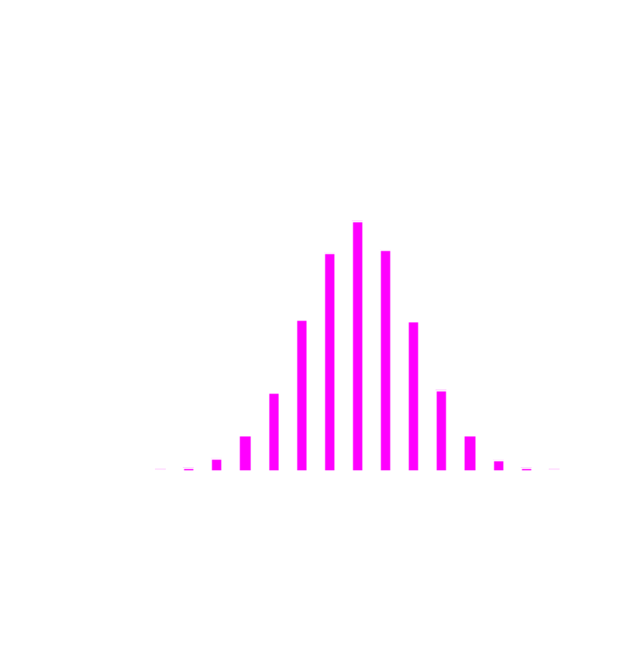
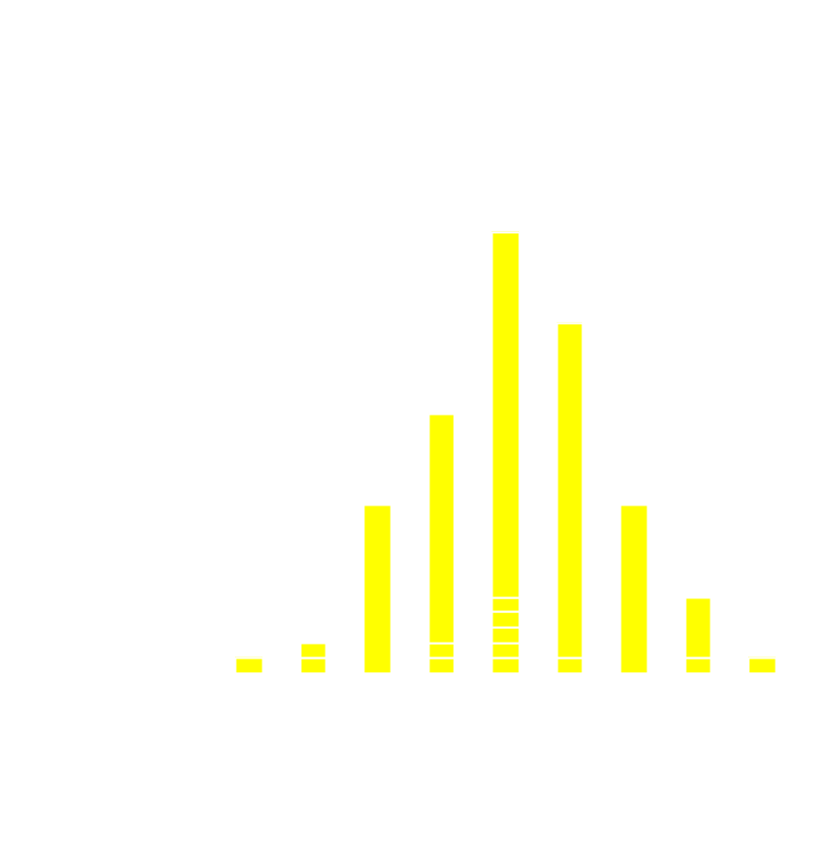
Example of Repeated Estimations of Means from a Universe
If you could repeat the experiment a large number of times, the estimates obtained would have a standard deviation
The standard deviation of the estimate is called the standard error
The standard error is the index of the reliability of an estimate
True mean = 120 mmHg
True SD = 10 mmHg
Mean of 100 means = 120.09 mmHg
SD of 100 means = 1.43 mmHg

Slide 5
Characterizing the Uncertainty in Estimation
The 95% Confidence Limits
Estimation is the guessing of parameters
Every estimate has a standard error
  95% confidence limits
    Show the range that we can “reasonably” expect the true parameter to be within
    Approximately (estimate + 2 SE)
    For example:
      If the mean SBP is estimated to be 117
      And the standard error is 1.4
      Then we are “pretty sure” the true mean SBP is between 114.2 and 119.8
  Slightly incorrect interpretation of the 95% confidence limit is “I am 95% sure that the real parameter is between these numbers”

Slide 6
Major take home points about estimation
Estimates from samples are only guesses (of the parameter)
Every estimate has a standard error, and it is a measure of the variation in the estimates
If you were to repeat the study, you would get a different answer
Now you have two answers
  It is almost certain that neither is correct
  However, in a well-designed experiment
    The guesses should be “close” to correct
    Statistics can help us understand how far our guesses are likely to be from the truth
Measures of association are estimates of special interest

