Slide 1
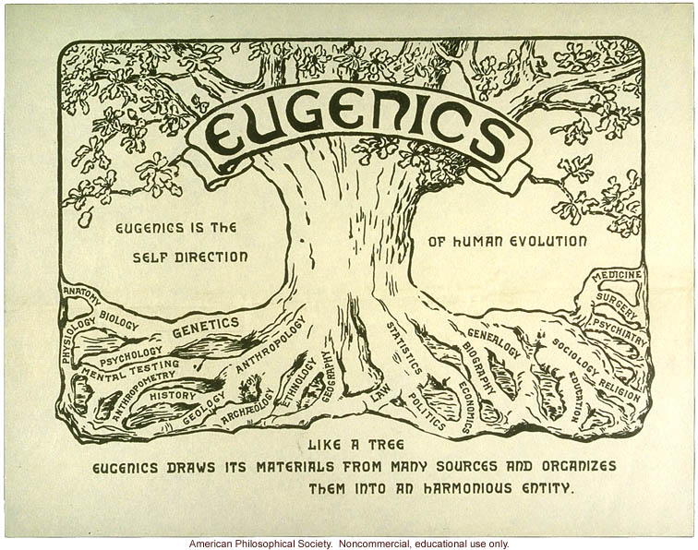
Eugenics and Medical Science

Slide 2


Resources
Image Archive of the American Eugenics Movement
Cold Spring Harbor Laboratory
URL - www.eugenicsarchive.org/eugenics/
Ethical, Legal, and Social Implications
Research Program
National Human Genome Research Institute

Slide 3
Learning Objectives
Describe the origins of the eugenics movement in 19th century Europe and America
Differentiate between ‘positive’ and ‘negative’ eugenics
Delineate the linkages between eugenic thought and public policy in the United States in the first half of the 20th Century
Discuss the potential for eugenic practices in the post-genomic era of medical science

Slide 4
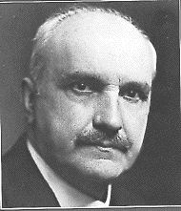
George Santayana
(1863 –1952)
"Those who cannot remember the past are condemned to repeat it."
Life of Reason, Reason in Common Sense, Scribner's, 1905, page 284

Slide 5
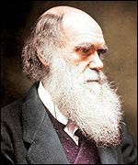
Charles Darwin
(1809-1882)
"On the Origin of Species by Means of Natural Selection, or the Preservation of Favoured Races in the Struggle for Life" (1859)
Develops the theory of Evolution

Slide 6
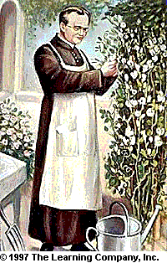
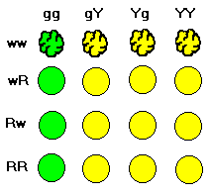
Gregor Mendel
(1822-1884)
Experiments in Plant Hybridization (1865)
g = green (Recessive)
Y = yellow (Dominant)
w = wrinkled (Recessive)
R = round (Dominant)

Slide 7
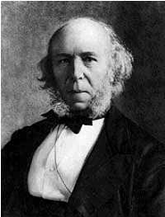
Herbert Spencer
(1820-1903)
A Sociologist who applied evolutionary theory to philosophy and the study of society
‘Social Darwinism’ – writes the phrase “survival of the fittest”

Slide 8
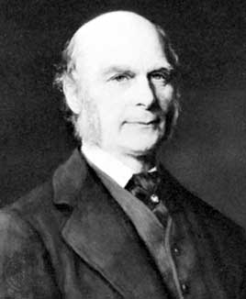
Francis Galton
(1822-1911)
In 1883 coins the word ‘Eugenics’ from the Greek for good (‘eu’) and born (‘genics’).
Defined as “the science of improvement of the human race germ plasm through better breeding.”
Charles Darwin’s cousin

Slide 9
Coins Phrase “Nature vs. Nurture”
“[It] is a convenient jingle of words for it separates under two distinct heads the innumerable elements under which personality is composed.”
“NATURE is all that a man brings with him into the world.”
“NURTURE is every influence from without that affects him after birth.”

Slide 10
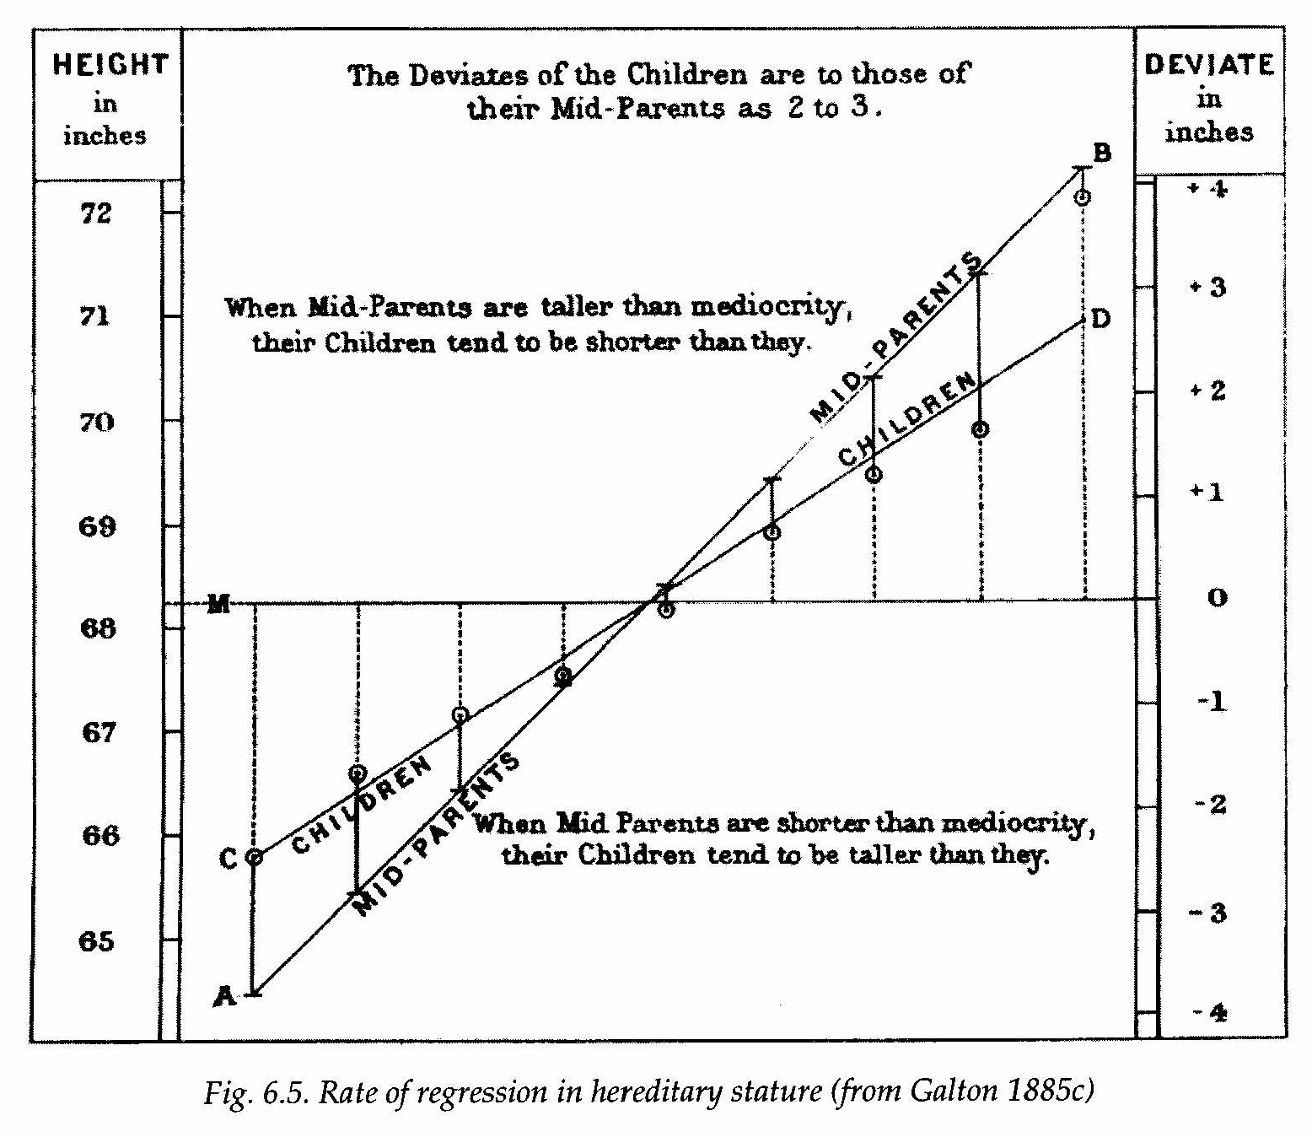
Galton Describes Correlation and Regression to the Mean

Slide 11
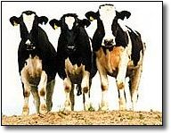
Positive and Negative Eugenics
Positive – encourage breeding and selection for favorable characteristics (e.g., animal husbandry)
Negative – prevention of
breeding and reproduction for
‘undesirable’ characteristics:
  Prevention of inter-racial marriage
  Sterilization

Slide 12
Concept of Negative Eugenics
H.G. Wells (1866-1946)
“I believe that now and always the conscious selection of the best for reproduction will be impossible; that to propose it is to display a fundamental misunderstanding of what individuality implies ….”
“It is the sterilization of failures, and not in the selection of successes for breeding, that the possibility of the improvement of the human stock lies.”
Discussion following Galton’s speech to the Sociological Society - 1903

Slide 13
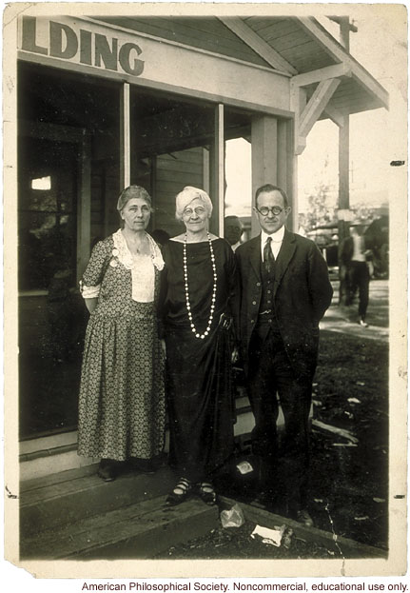
Positive Eugenics:
Fitter Families for Future Firesides
Contests founded by Mary T. Watts (middle) and Florence Brown Sherborn (to the left)
First contest at Kansas State Fair in 1920
Outgrowth of the Baby Health Examination Movement and “Better Baby” Contests

Slide 14
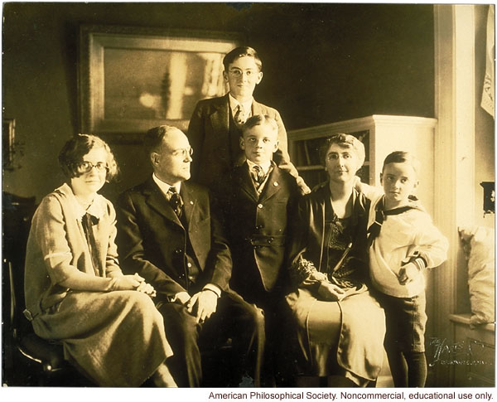
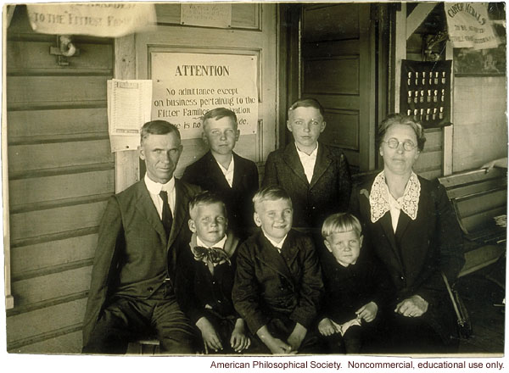
Positive Eugenics:
Fitter Families for Future Firesides
Competitors submit an “Abridged Record of Family Traits”
Doctors examine and grade each family member
Grades averaged across the family – ‘B+’ gets an award
Medals inscribed “Yea, I have a goodly heritage.”

Slide 15
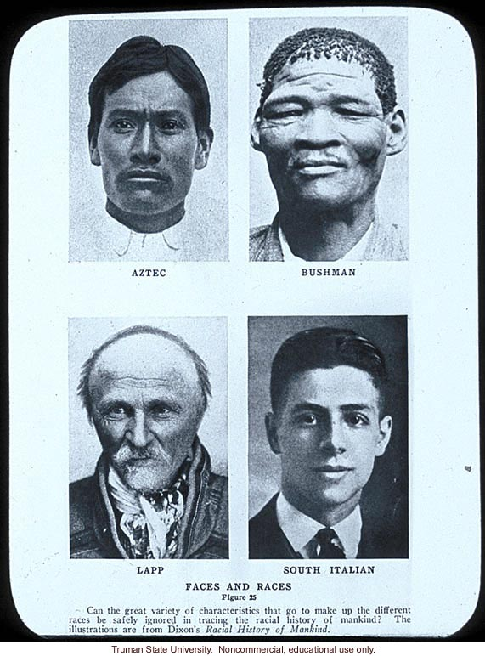
Negative Eugenics
Sterilization Laws
Immigration Restriction
Prohibition Against Racial Inter-marriage

Slide 16
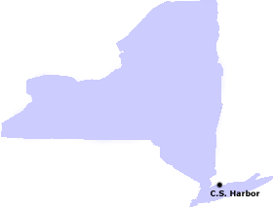
Eugenics Record Office (ERO)
New York State
North Shore of Long Island
Cold Spring Harbor Laboratories

Slide 17
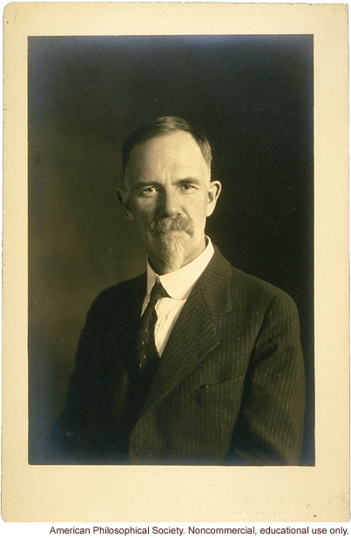
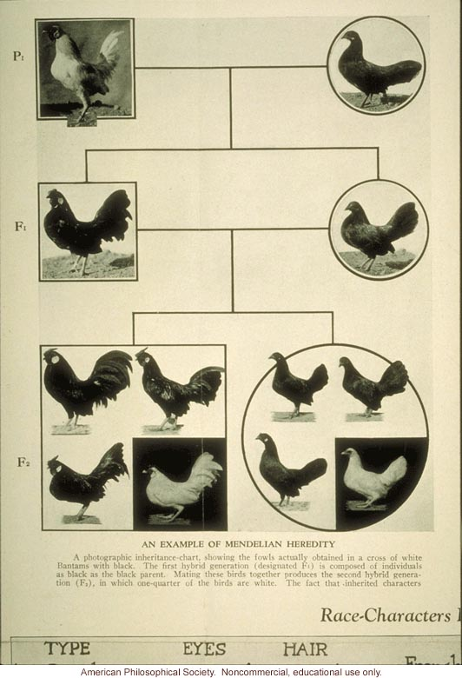
Charles Davenport, Ph.D.
(1866-1944)
Director of research station at Cold Spring Harbor
Interested in Quantification of Genetics
Chicken Breeding

Slide 18
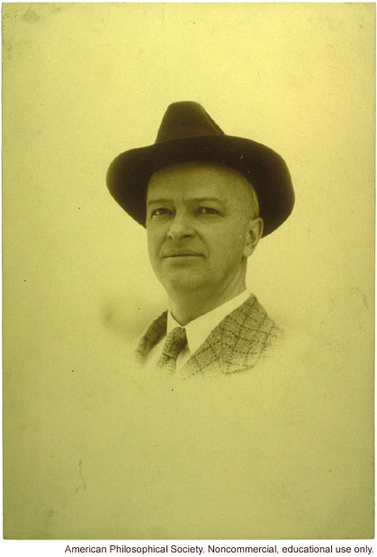
Harry H. Laughlin, D.Sc.
(1880-1943)
Director of Eugenics Record Office (1910-1940)
Wrote model sterilization law (1914)
  Used by > 30 states that passed such laws
  Model for Germany’s 1933 sterilization laws

Slide 19
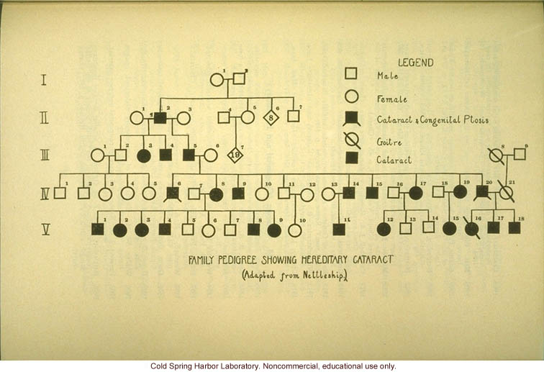
Eugenics Research Methods
Collect Pedigrees

Slide 20
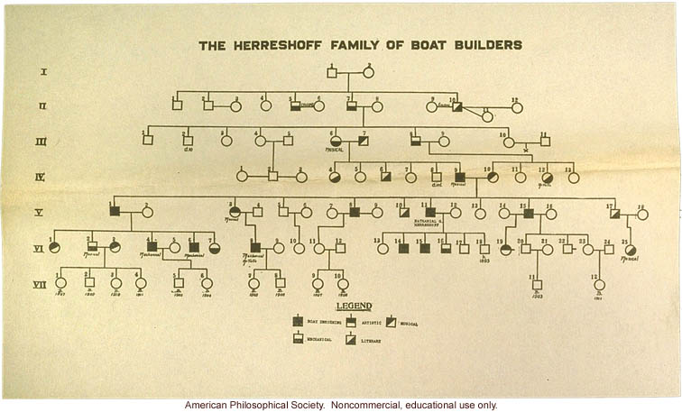
Eugenics Research Methods
Assess Phenotypes

Slide 21
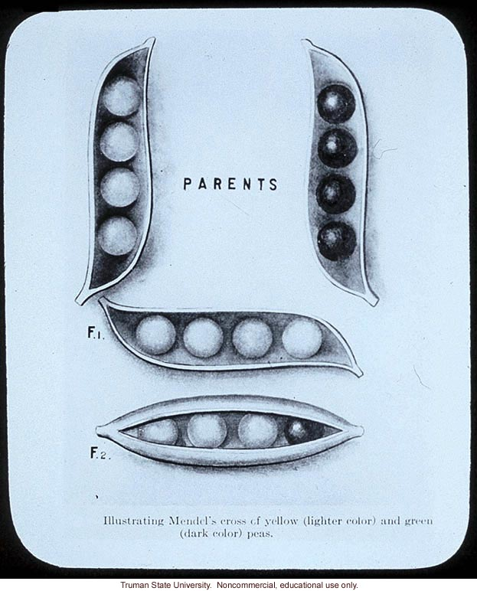
Eugenics Research:
Flaws in Methodology
Difficulty in defining traits
Tendency to treat complex traits as if they stemmed from a single cause (Reification)
Poor Survey and Statistical Methods

Slide 22
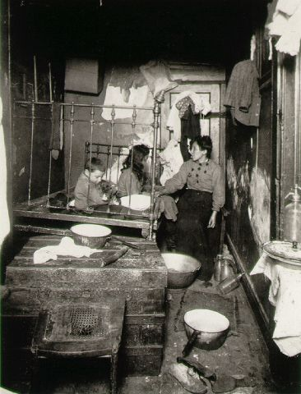
Eugenics Research:
Flaws in Methodology
False quantification – assume that if a trait has a numeric value, it must be valid
Discounted social and environmental influences on behavior
Lewis Hine - Tenement

Slide 23
Sterilization in the United States
Degeneracy Theory – concerns about environmental influences that might damage heredity – dates back to 1700s
Harry Clay Sharp, M.D.
  Prison physician – Jefferson, Indiana
  Fear of degeneracy through masturbation
  Performs vasectomies on prisoners – 1899
Indiana – first U.S. sterilization law - 1907

Slide 24
Laughlin’s Model Sterilization Law
Authorized sterilization of the “socially inadequate”
  People supported in institutions
  Maintained wholly or in part by public expense
Encompasses the “feebleminded, insane, criminalistic, epileptic, inebriate, diseased, blind, deaf, deformed and dependent – including orphans, ne’er do wells, tramps, the homeless and paupers.”

Slide 25
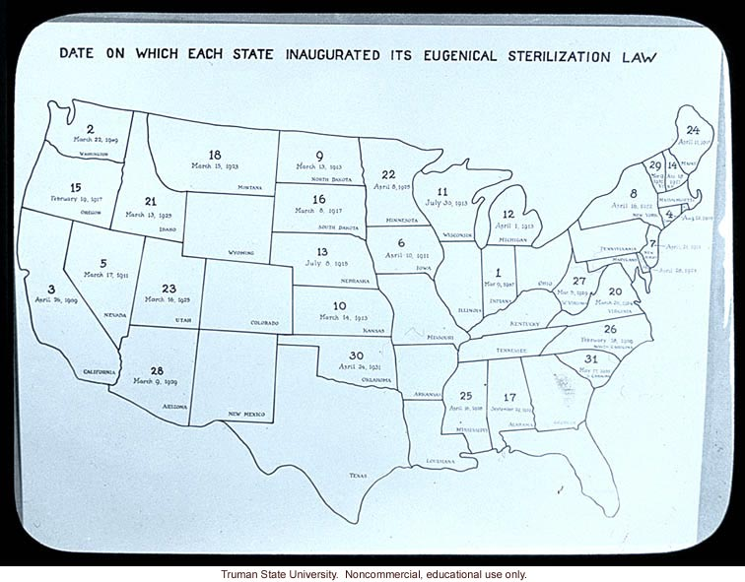
Sterilization in the United States
12 States enact Sterilization Laws by 1914
At one time or another 33 States had statutes for sterilization

Slide 26
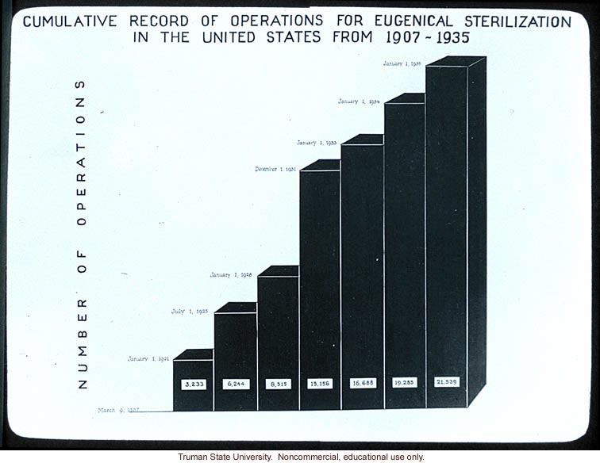
Sterilization in the United States
Over the years, more than 60,000 Americans underwent involuntary sterilization
Practice continued through 1970’s

Slide 27
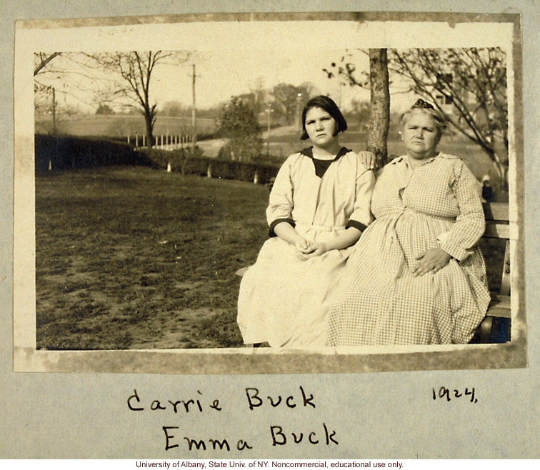
Buck vs. Bell:
Challenges Virginia’s Sterilization Law
Mother – Emma Buck
  Resident at Virginia Colony for the Epileptic and Feeble Minded
Daughter – Carrie Buck
  17 years old
  Unmarried
  Had a child
Granddaughter - Vivian

Slide 28
Buck vs. Bell:
Challenges Virginia Sterilization Law
Albert Priddy, M.D. - Superintendent of Colony
Testifies:
  Emma Buck had a “record of immorality, prostitution, untruthfulness, and syphilis”
  The Buck Family “belongs to the shiftless, ignorant, and worthless class of anti-social whites of the South.”
Carrie and Emma Buck shared the hereditary traits of “feeblemindedness” and promiscuity.
Therefore, Carrie Buck a “probable potential parent of socially inadequate offspring.”

Slide 29
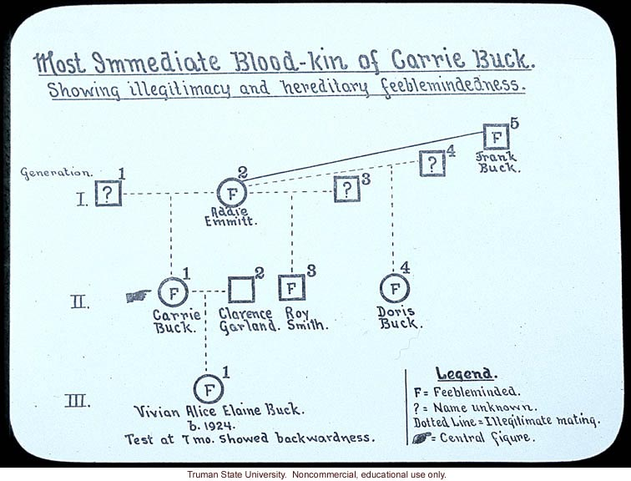
Buck vs. Bell:
Challenges Virginia Sterilization Law

Slide 30
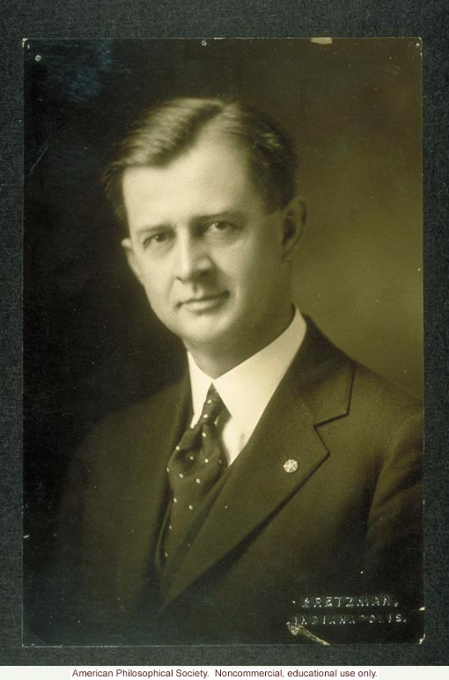
Buck vs. Bell:
Challenges Virginia Sterilization Law
Support from the Eugenics Record Office
Harry Laughlin:
  Never met Carrie Buck, but
  Sends a written deposition supporting Priddy’s conclusions about Carrie Buck’s “feeblemindedness and moral delinquency.”
Arthur Estabrook – Sociologist:
  Examines Vivian Buck
  Concludes that she was “Below average” and “Not quite normal”
Arthur Estabrook

Slide 31
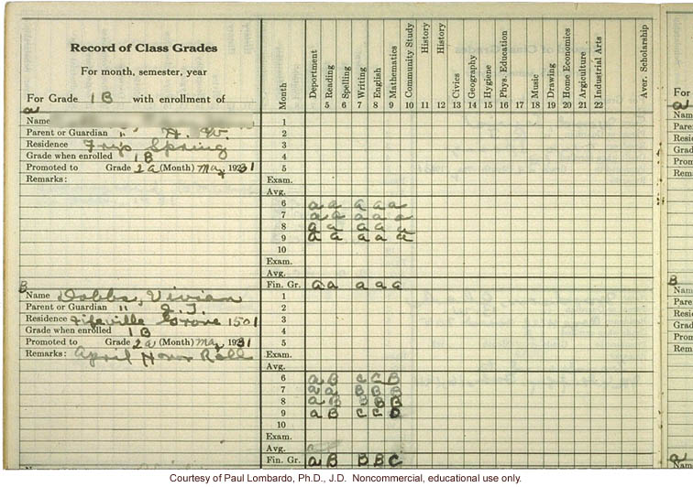
Buck vs. Bell:
Challenges Virginia Sterilization Law
Vivian Buck (Dobbs)
  The product of a rape, not promiscuity
  1st grade report card shows a “B student”
  Receives an “A” in deportment
  Had been on the honor roll
Dies of enterocolitis at age 8

Slide 32
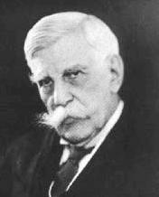
Oliver Wendell Holmes, Jr.
(1841-1935)
“It is better for all the world, if instead of waiting to execute degenerate offspring for crime or to let them starve for their imbecility, society can prevent those who are manifestly unfit from continuing their kind …
Three generations of imbeciles are enough.”
Supreme Court Opinion - 1927

Slide 33
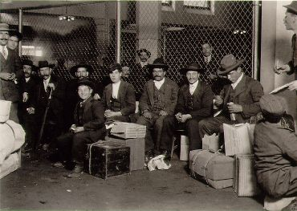
Negative Eugenics:
Immigration Restriction
Rates of immigration
into the United States
1870: 150,000/year
1900: 800,000/year
1907: 1,250,000/year
Italians at Ellis Island
Lewis Hine - 1905
1882 – Act to Regulate Immigration prohibits entry to “any person unable to take care of himself or herself without becoming a public charge.”

Slide 34
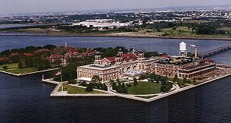
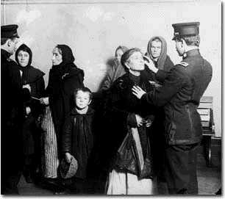
Negative Eugenics:
Immigration Restriction
1890’s – Federal Government assumes sole jurisdiction to monitor immigration
Establishes Ellis Island in New York Harbor to process immigrants
Public Health Service performs medical exams of immigrants

Slide 35
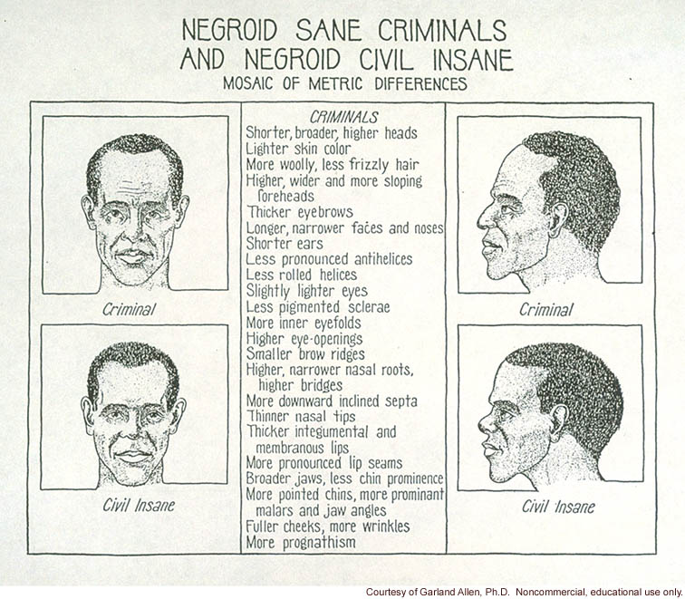
Negative Eugenics:
Immigration Restriction
1917 – Congress expands definition of those “likely to become a public charge.”
“all idiots, imbeciles, feebleminded persons, epileptics, insane persons,” and “mentally or physically defective.”

Slide 36
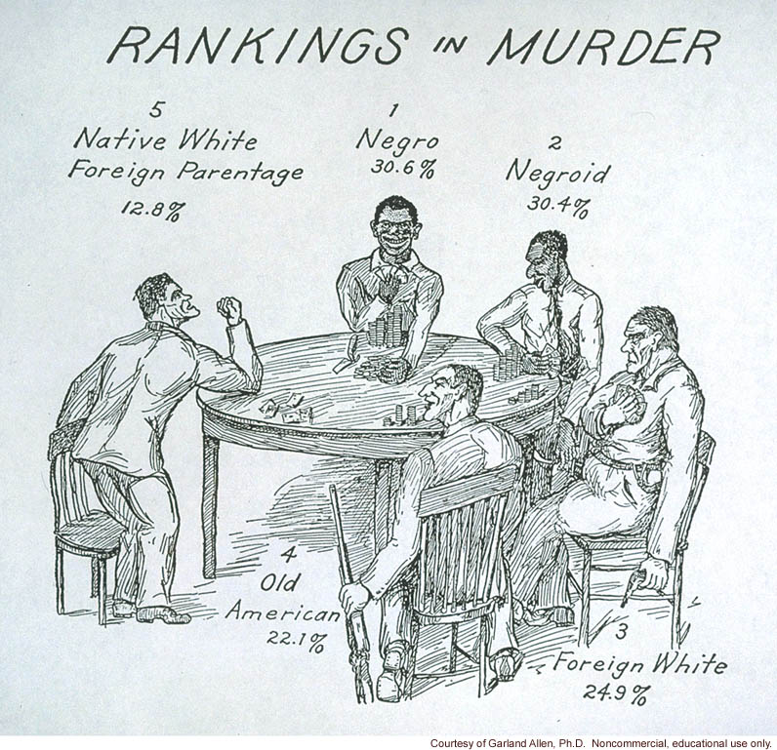
Negative Eugenics:
Immigration Restriction
Support from the Eugenics Record Office
Harry Laughlin
  “expert eugenics agent” for Congress
  Conducts large scale surveys of charitable institutions and mental hospitals
  Compares proportions of persons in institutions relative to their proportions in the 1890 census.

Slide 37
Negative Eugenics:
Immigration Restriction
 | 1920 | 1890 Census |  | 1920 | 1920 Census
 | Number in Institution | Base Population | % | Number in Institution | Base Population | %
Eastern Europeans | 40 | 1,000 | 4.0% | 40 | 4,000 | 1.0%
Nordics | 60 | 9,000 | 0.7% | 60 | 6,000 | 1.0%
TOTAL | 100 | 10,000 | 1.0% | 100 | 10,000 | 1.0%
1890 Census Base → 4.0/0.7 = 5.7
1920 Census Base → 1.0/1.0 = 1.0
Numbers are chosen to demonstrate effects of improper standardization.

Slide 38
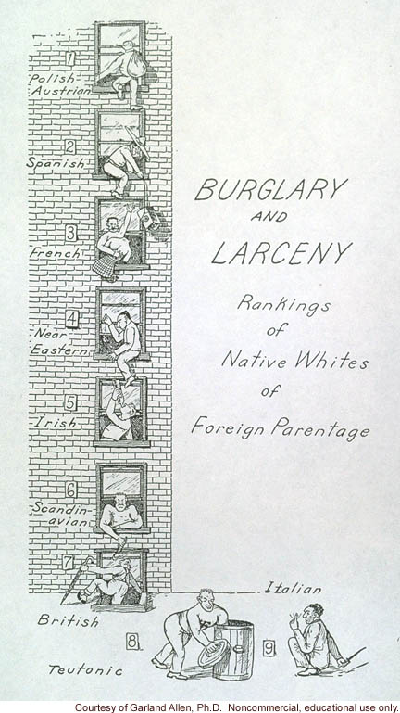
Negative Eugenics:
Immigration Restriction
Harry Laughlin
  CongressionalTestimony 1924
Immigration Restriction Act of 1924
  Halt immigration of “dysgenic” Italians and Eastern European Jews.
  Quota for these groups reduced from 45% to 15%

Slide 39
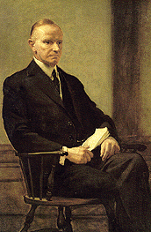
Negative Eugenics:
Immigration Restriction
Calvin Coolidge
  “America must remain American.”
Quota system put in place by the 1924 law:
  Halted largest immigration era in U.S. History
  Repealed by Immigration and Nationality Act of 1965
President Calvin Coolidge

Slide 40
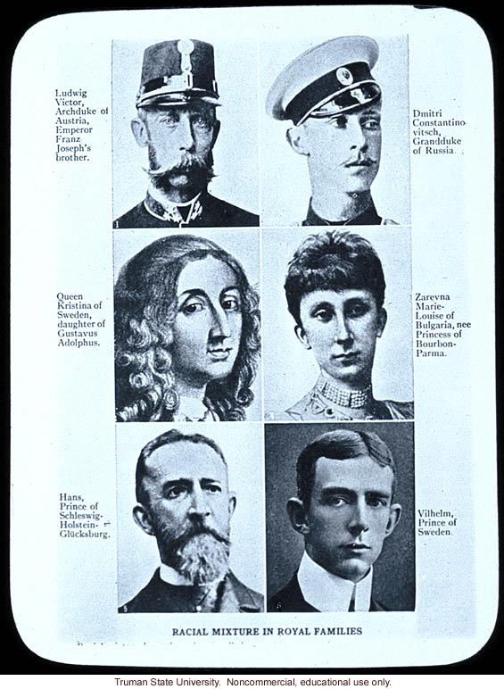
Negative Eugenics:
Laws Against Race Mixing
Miscegenation – marriage or interbreeding between members of different races
By 1915, 28 states made marriages between whites and negroes invalid.

Slide 41
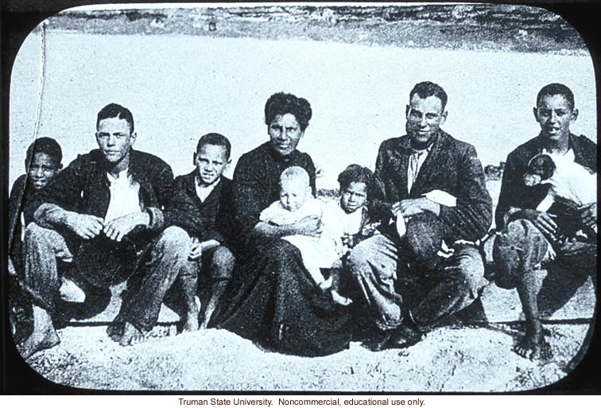
Negative Eugenics:
Laws Against Race Mixing
Madison Grant - The Passing of the Great Race (1916)
Mixture of higher racial types with lower races inevitably results in the decline of the higher race.

Slide 42
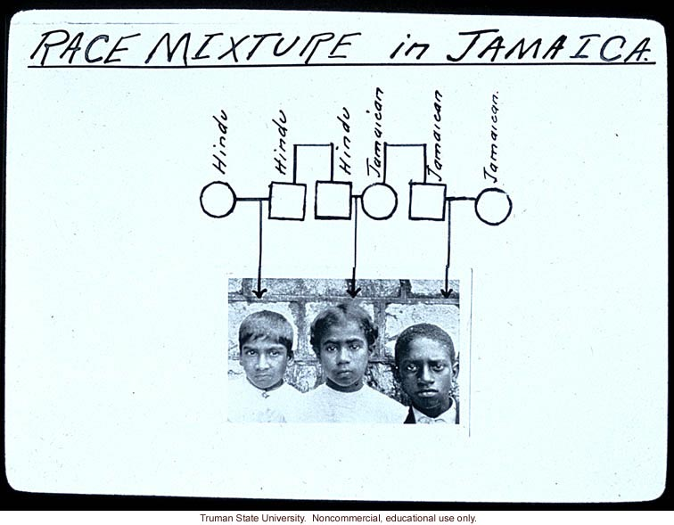
Negative Eugenics:
Laws Against Race Mixing
Eugenicists support anti-miscegenation laws
Efforts focus on legal definitions of who could qualify for a marriage license as a “white person.”
Provide a ‘scientific’ basis for race assessment.

Slide 43
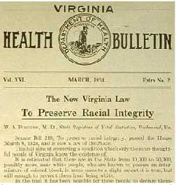
Negative Eugenics:
Laws Against Race Mixing
“It shall hereafter be unlawful for any white person in this State to marry any save a white person”
“The term ‘white person’ shall apply only to such person as has no trace whatsoever of any blood other than Caucasian.”
May include ≤ 1/16 American Indian
Viginia Racial Integrity Act - 1924

Slide 44
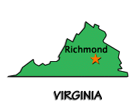
Challenging Laws Against Race Mixing:
Loving vs. Commonwealth of Virginia
In June 1958, two Virginia residents, Mildred Jeter, a Negro woman, and Richard Loving, a white man, were married in the District of Columbia.
The Lovings returned to Virginia and established their home in Caroline County.
A grand jury issued an indictment charging the Lovings with violating Virginia's ban on interracial marriages.

Slide 45
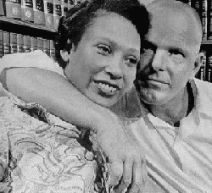
Challenging Laws Against Race Mixing:
Loving vs. Commonwealth of Virginia
In 1959, the Lovings pleaded guilty to the charge and were sentenced to one year in jail
Judge Harry Carrico suspended the sentence for a period of 25 years on the condition that the Lovings leave the State and not return to Virginia together.
Mildred Jeter and Richard Loving

Slide 46
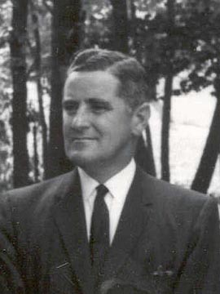
Challenging Laws Against Race Mixing:
Loving vs. Commonwealth of Virginia
Judge Carrico stated:
"Almighty God created the races white, black, yellow, malay and red, and he placed them on separate continents. And but for the interference with his arrangement there would be no cause for such marriages. The fact that he separated the races shows that he did not intend for the races to mix."
Justice Harry L. Carrico

Slide 47
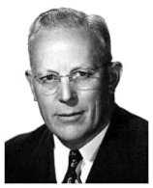
Challenging Laws Against Race Mixing:
Loving vs. Commonwealth of Virginia
1967 – US Supreme Court unanimously overturns the ruling.
“There can be no doubt that restricting the freedom to marry solely because of racial classifications violates the central meaning of the Equal Protection Clause … Under our Constitution, the freedom to marry, or not marry, a person of another race resides with the individual and cannot be infringed by the state.”
Chief Justice Earl Warren

Slide 48
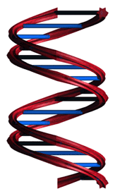
21st Century
DNA recognized as the molecular basis for genetics since the mid-20th century
The human genome is mapped by the end of the 20th century
Burgeoning amounts of information link molecular patterns to disease and health
Efforts underway to investigate the interactions of multiple genes in the expression of complex traits

Slide 49
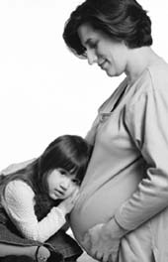
Is a new eugenics afoot?
Garland E. Allen, Ph.D. (Science 2001; 294:59-61)
Case 1:
  An HMO requires in utero screening
  The HMO Refuses to cover the birth or care of a purportedly “defective” child
Questions:
  Is this eugenics?
  What evidence would you need to support this policy?
  Who should be making these decisions?

Slide 50
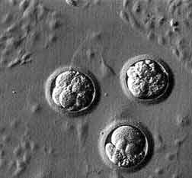
Is a new eugenics afoot?
Garland E. Allen, Ph.D. (Science 2001; 294:59-61)
Case 2:
A couple has several embryos stored at an in vitro fertilization clinic
They want the embryos screened for a panel of genetic traits before selecting one for implantation
Questions:
Is this eugenics?
What evidence would you need to support this policy?
Who should be making these decisions?

Slide 51
