Slide 1
Integrity in Research
Avoiding and Investigating Research Misconduct
Lynne Chronister
Associate Vice Chancellor for Research
Wendi Delmendo
Director – Research Compliance
University of California, Davis
Mentored Clinical Research Training Program
K30 Summer RCR Course – August 13, 2008

Slide 2
_{I. Research Integrity Programs}

Slide 3
What Does it Mean?
Integrity: Code of values/incorruptible.
Ethical: relating to accepted and especially professional standards.
Moral: relating to principles of right and wrong.
        Webster’s Unabridged Dictionary

Slide 4
Conduct of Research
Protections/Safeguards
Ensure validity of results/
Maximize return on public investment
Provide safety/welfare of subjects & environment
Research Integrity
Conflict of Interests
Conflict of Commitment
Data, Resource Sharing, Cyber Security (new)
Public Access to Publications (new)
Human Subjects
Animal Welfare
HIPAA (new)
Environmental Health & Safety
Select Agents (new)
Ensuring Research Protection:
Principles & Responsibilities
Cost Policy/Financial Management
Public Policy Requirements
Ensure fair & reasonable costs to Government
Meet national social, economic, security interests
Reasonable Allocation of Costs
Salary Charges/Effort Reporting
Indirect Costs
Cost Sharing
SEVIS/Visas (new)
Export controls (new)
Title IX
Lobbying
Debarment
Drug Use
Geoff Grant, May, 2005

Slide 5
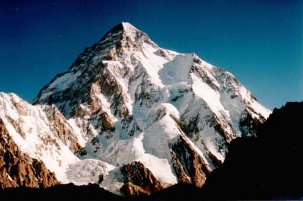
Scientific Integrity
Research Compliance
Misconduct & Non-Compliance

Slide 6
Research Compliance and
Scientific Integrity
Scientific integrity is the highest form of compliance
Compliance is rules driven, there are laws and regulations that must be followed
Integrity is more than following the rules: it includes setting standards and expectations of excellence in research & scholarship

Slide 7
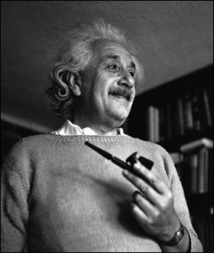
The right to search for truth implies also a duty; one must not conceal any part of what one has recognized to be true.
Albert Einstein

Slide 8
Compliance Mission
“The University’s research compliance program is committed to the achievement of high ethical and legal standards of conduct through a culture of compliance and conscience that reflects our belief in the integrity and truth in science and scholarship.”

Slide 9
How to Promote Integrity
Institutional Responsibility
    Culture of compliance
    Training and reward systems
    Firm policy and procedures
Responsibility of senior researcher
Understanding by younger investigators

Slide 10
Compliance Program Elements
Leadership and management
Written standards, policies and procedures
Education, training and communication
Monitoring/audits
Appointment of an official who promotes scientific integrity
Mechanism to report violations (e.g., hotline)

Slide 11
Research Compliance Elements
Animal and Human Subjects Treatment
Conflict of Interest
Intellectual Property (IP)
Environmental Regulations (chemical, radiation, biosafety)
Clinical Trials, Data Safety
Financial oversight
(spending and billing)

Slide 12
Program Elements (cont.)
  Record retention policy
  Oversight Committee
  Defined roles and responsibilities
  Financial commitment
  Mechanism to handle violations

Slide 13
Benefits of a Compliance Program
Highest reputation for research
Affirm a culture of compliance
Establish mechanisms for early, self- detection and self-correction of instances of non-compliance
Provide employees an avenue for notifying the University of instance of non- compliance
Reduce risk of fines

Slide 14
Challenges in Promoting
Compliance & Integrity
  Tenure and promotion system
  Different interpretation of laws & regulations
  Different definitions and understanding
  Cultural variances
  Differences in practice among disciplines (Life Sciences & Math)

Slide 15
Research Integrity – Challenges
  The academic culture is at risk for compliance failures due to:
      Decentralized organizations
      Potential for conflicts of interest
      Undefined roles and responsibilities
      Lack of comprehensive training
      Expanded requirements
  Recent, significant compliance failures at large, research institutions

Slide 16
Research Integrity – Challenges
  Increased funding for research resulting in greater scrutiny, increased inspections
  Findings of liability on the part of universities have become more frequent in recent years
  Successful law suits
  Personal credibility and career growth

Slide 17
Research Integrity – Why?
Build and maintain an exceptional reputation
We have an obligation to maintain the public’s trust by:
Conducting research ethically and responsibly
  Ensuring proper stewardship of research funds
  Protecting animal and human subjects
  Assuring compliance with federal regulations

Slide 18
Reputation is Built on Trust
“The scientific research enterprise, like other human activities, is built on a foundation of trust. Scientists trust that the results reported by others are valid. Society trusts that the results of research reflect an honest attempt by scientists to describe the world accurately and without bias. The level of trust that has characterized science and its relationship with society has contributed to a period of unparalleled scientific productivity. But this trust will endure only if the scientific community devotes itself to exemplifying and transmitting the values associated with ethical scientific conduct. ” [1]
[1] On Being a Scientist: Responsible Conduct in Research, Second Edition (1995),
National Academy of Sciences

Slide 19
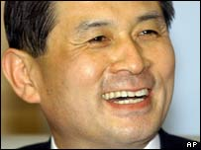
Dr. Hwang Woo-Suk

Slide 20
Dr. Hwang Woo-Suk
Dr. Hwang Woo-Suk was the first person to report that his lab extracted stem cells from cloned human embryos.

Slide 21
Public Trust is an Issue
2004 Science Articles
2004 Time “People Who Mattered”
2005 Allegations of fabrication
2006 Apologized and admitted that he fabricated part of the data; he and 5 members of his research team were indicted for embezzlement, faces jail term if convicted

Slide 22
Results
Personal: loss of position and honor
South Korea: loss of prestige and honor
Loss of public trust

Slide 23
“Scientists Behaving Badly”*
  Survey of 3,247 early and mid-career scientists
  • One-third of respondents reported engaging in ethically questionable practices in past three years.
  • Conduct ranged from ignoring contradictory facts to falsification.
  • Authors estimate substantial under-reporting.
  * B. Martinson, M. Anderson, R. De Vries, Nature 435, 737-738 (June 9, 2005)

Slide 24
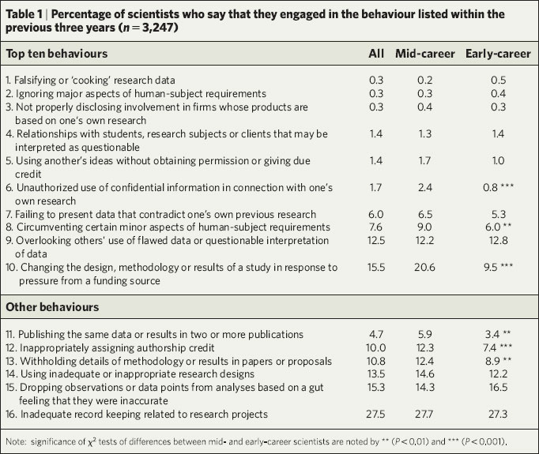
Survey Results

Slide 25
_{II. Conduct of Science}

Slide 26
“Rather fall with honor than succeed with fraud”
_{Sophocles}

Slide 27
The Conduct of Science
Scientific Integrity
Good Science
Error or Carelessness
Bad Science
Misconduct or Non-Compliance

Slide 28
Scientific Misconduct
Fabrication, falsification or plagiarism in proposing, performing or reviewing research or in reporting results
It does not include honest error or differences in interpretations or judgments or differences of opinion

Slide 29
Good Science
Good methodology or experimental design
Mentoring of students/technicians
Meticulous recording of data
Appropriate statistical analysis
Reporting of results
Reviewed and replicated by peers

Slide 30
Error or Carelessness
Misinterpretation of data
Poor recording of data
Calculation errors
Not checking chemical labels
Miscalculations of amounts of solutions
Carelessness can rise to recklessness

Slide 31
Correcting Error
Johns Hopkins retraction (Sept, 2003)
    Severe Dopaminergic Neurotoxicity in Primates After a Common Recreational Dose of MDMA (Science, 2002)
    Mix-up in labeling drugs -- all but one animal given methamphetamine
    Could not replicate

Slide 32
What If ?
A professor of Agronomy, Dr. Oplinger, diverted funds ($450,000) from grants over a 7-year period for research into soybean production.
Dr. Oplinger was very well regarded as a community leader and as a scientist.
The funds might be diverted to a private account or to a non-profit association where the professor was treasurer.

Slide 33
Dr. Oplinger
Ok, this is probably not good. What should be done about it?
  Internal investigation, followed by retirement

Slide 34
Bad Science
Poor design, inappropriate experimental methodology
Use of bad materials, tainted biologicals
Poor scientific assumptions
Use of wrong statistical methodology
Keeping poor research records

Slide 35
Outcomes of Bad Science
Inability to publish
No collaborators
Difficulty in receiving funding
Hard to recruit students
Tenure and Promotion at risk
Bad Science is generally self-correcting
Risk to human and animal subjects

Slide 36
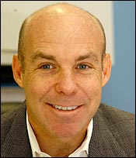
Dr. Eric Poehlman

Slide 37
Dr. Eric Poehlman
– Well-known obesity researcher.
– Received $3 million in federal grants from NIH and USDA.
– Reported by lab technician who performed initial analysis of data regarding effects of menopause. Analysis showed some improvements in health after menopause. Poehlman took data home to look for errors. Data later showed significant negative effects from menopause.
– Lab technician claimed he reversed the data points.

Slide 38
ORI Investigation
In menopause study, Dr. Poehlman falsified/fabricated results for all but 3 subjects at T1 and never saw any of the women a second time. This data was cited in grant applications and published articles.
In aging study, Dr. Poehlman exaggerated the number of subjects and altered the physical values and test results for subjects to create trends not reflected by the research.
In double-blind hormone replacement study, Dr. Poehlman cited data from study in grant applications even though he had no access to the study data.

Slide 39
ORI Investigation (cont.)
During investigation, Dr. Poehlman:
  Destroyed evidence
  Falsified testimony
  Falsified documents
  Pressured witnesses to give false testimony

Slide 40
Summary of ORI’s findings
Committed misconduct over 10 years with $3 million in funding.
Submitted false and fabricated data in 17 grant applications.
More than 50 findings of research misconduct, involving thousands of data points.
10 scientific papers with falsified and fabricated data.

Slide 41
Poehlman’s Sanctions
Poehlman ultimately agreed to comprehensive criminal, civil, and administrative settlement of charges of scientific misconduct
Plead guilty to making material false statements in federal grant application
Lifetime debarment from Federal research funding.
Civil penalty of $180,000.
Whistleblower to receive additional $21,000 plus attorneys fees.

Slide 42
Why He Did It
Research was important so it was okay to misrepresent minor facts to increase chance of grant approval.
Pressures of being in medical school environment – saw his job and lab as expendable if he couldn’t produce.
Motivated by a desire to advance as a respected scientist.

Slide 43
What else Happened ?
July 5, 2006, 6 years after the allegation was made, Poehlman was sentenced to one year in federal prison. He was given 60 days to turn himself in.
Judge Sessions told him that “he had betrayed the public trust in scientific research”
Poehlman: “I was on a treadmill and couldn’t get off…I panicked…I was desperate.”

Slide 44
Understanding the Difference!
  Eliminating raw data points
  Assuming data points
  Ideas generated from reviewing proposals
  Including authors who did not participate
  Crediting graduate student work
  Publication of minor experiments or results
  Spending for items not in budget
  Starting a business

Slide 45
Other Issues
Confidentiality
Security
Health Insurance Portability and Accessibility Act (HIPAA)
Trade Secrets
Intellectual Property (IP)

Slide 46
Responsible Science
Data Handling
Communication
Correction of Errors
Research Training and Mentorship
        Responsible Science: Ensuring the Integrity of the Research Process, National Academy of Science, National Academy of Engineering, National Academy of Medicine, 1992

Slide 47
Data Handling
Acquisition and Management
Sharing Data -- Material Transfer Agreement (MTA)
Access (who and when)
Storage

Slide 48
What If?
Dr. Singh has received funds from the NIH to look at a change in DNA structures due to solar energy devices.
He works in a large laboratory and has had a falling out with the Director. He moves to another laboratory and takes the funding with him.
He realizes that he does not have access to considerable data that he needs to complete his work. While he directed the study he did none of the collection.

Slide 49
Now What?
Does he have a right to the data?
What if he claims misconduct because the lab is withholding data from him.
What if the lab said that if he published, it would be plagiarism because he didn’t collect the data?

Slide 50
Communication and Publication
Journal publication: a record of achievement and advancement of science.
Authorship: guided in part by tradition and discipline.
  Honorary authorship (fraught with problems)
  Specialized authorship
  Order of credits
  (physics-alphabetical; biology-senior author last)

Slide 51
What If?
In 2003, Dr. Lyons published the results of an exciting study dealing with a new class of molecules in a small new journal just getting readership.
It didn’t get much attention. Then in 2005 he was able to publish the same article in Nature, a well known journal.
He had done additional work but because of his workload and the fact that the first article was well received, he simply used most of the text. Is this a problem?

Slide 52
Communication (cont.)
Peer Review
Plagiarism
  Self plagiarism

Slide 53
Correction of Error
Self Correcting
Replication

Slide 54
Training and Mentorship
Good Mentorship is Good Training

Slide 55
What If?
Sarah is a new graduate student and she is asked to work with Tanya, a Post-doc in Dr. Blair’s lab.
During the first year, Tanya has been diligent in training Sarah but during the second year she feels Sarah can work on her own more, and Tanya has a new project taking more time.
When Sarah submits a paper to Dr. Blair, some of the results are questioned.

Slide 56
What if I see or experience lack of integrity?
Whistleblower policy
Scientific Misconduct policy
Conflict of Interest / Conflict of Commitment
Faculty Code of Conduct
Principles of Community

Slide 57
But What do I Do?
Talk to your mentor, your Dean, Graduate Studies, Vice Provost, Office of Research Compliance Officer.
Policies are to protect but must be used judiciously not capriciously.

Slide 58
What If?
Your friend is working on a clinical trial sponsored by a drug company.
The PI is well known in the field. He tells your friend to modify the consent form that was approved by the IRB because it is too confusing for the patients. And in fact, it IS too difficult to understand.
The consent form is simplified. Is this OK?

Slide 59

It is not permitted to the most equitable of men to be a judge in his own cause.
Blaise Pascal (1670)

Slide 60
III. Research Misconduct Law and Policy

Slide 61
Federal Regulations
§50.105 – Institutional Compliance
“Institutions shall foster a research environment that discourages misconduct in all research & that deals forthrightly with possible misconduct associated with research for which PHS funds have been provided or requested. An institution’s failure to comply with its assurance & the requirements of this subpart may result in enforcement action against the institution, including loss of funding and may lead to the OSI’s [Office of Scientific Integrity] conducting its own investigation.”
42 CFR Part 50, Subpart A

Slide 62
Federal Regulations Require Misconduct Policy
DHHS requires all research institutions to have P & P for handling allegations of:
  Misconduct
  Protecting whistleblowers
  Providing education in RCR
  (Responsible Conduct in Research)

Slide 63
Assurance
Assurance on application form PHS 398, #15
Principal Investigator/Program Director Assurance:
I certify that the statements herein are true, complete and accurate to the best of my knowledge. I am aware that any false, fictitious, or fraudulent statements or claims may subject me to criminal, civil or administrative penalties. I agree to accept responsibility for the scientific conduct of the project and to provide the required progress reports if a grant is awarded as a result of this application.

Slide 64
What is Research?
Research includes all basic, applied and demonstration research in all fields of science, engineering and mathematics. This includes, but is not limited to, research in economics, education, linguistics, medicine, psychology, social sciences, statistics and research involving human subjects and animals.
Fed. Reg. Vol. 65 No. 235, December 6, 2000
Office of Science and Technology Policy – Executive Office of the President: Federal Policy on Research Misconduct

Slide 65
Research Misconduct - Definition
“…fabrication, falsification or plagiarism in proposing, performing or reviewing research or in reporting research results.”
“Research misconduct does not include honest error or differences of opinion.”
Fed Reg. Vol. 65 No. 235, December 6, 2000.
Office of Science and Technology Policy – Executive Office of the President: Federal Policy on Research Misconduct.
Implemented by NSF, 45 CFR Part 689

Slide 66
Fabrication, Falsification, Plagiarism
Fabrication:
“…is making up data or results and recording or reporting them.”
Falsification:
“…is manipulating research materials, equipment, or processes, or changing or omitting data or results such that the research is not accurately represented in the research record.”
Plagiarism:
“…is the appropriation of another person’s ideas, processes, results, or words without giving appropriate credit.”

Slide 67
A Finding of Research
Misconduct Requires:
A significant departure from accepted practices of the relevant community; AND
The misconduct be committed:
intentionally
knowingly
recklessly; AND
The allegation be proven by a preponderance of the evidence.
Fed. Reg. 12/6/2000

Slide 68
Office of Research Integrity
Model Policy & Procedures for Responding to Allegations of Scientific Misconduct
_{Adopted in UCD P&P 240-01}
All actions to be undertaken shall proceed promptly
Responsibility to report misconduct
Protecting whistleblower/complainant
Protecting the accused
  To ensure fair treatment and confidentiality to the greatest extent possible

Slide 69
UC Davis P&P Manual §240-01
Preliminary Assessment
Inquiry
  Initial fact-finding to determine if allegation of research misconduct warrants an investigation
  60 days from 1st inquiry meeting to submitting report
3. Investigation
  Formal examination/evaluation of all relevant facts to determine if misconduct has occurred
  Should begin within 30 days of completion of inquiry and be completed within 120 days

Slide 70
UC Davis P&P Manual § 240-01
4. Reporting to ORI
  Outcome of investigation
  Notify at any stage if:
    immediate hazard or public health issue involved
    immediate need to protect Federal funds or equipment
    possible criminal violation

Slide 71
UC Davis P&P Manual § 240-01
5. Sanctions & Administrative Actions
  Withdrawal or correction of all pending or published papers
  Removal of person from project, letter of reprimand, special monitoring of future work, probation, suspension, salary reduction, termination of employment
  If no misconduct found, institution to undertake reasonable efforts to restore accused’s reputation

Slide 72
UC Davis Policy & Procedures Manual
§ 240-01 Integrity in Research
Applies To:
Scientists
Technicians & other staff members
Fellows
Collaborators at UC Davis
Trainees
Students
Guest researchers

Slide 73
Responsibilities of Researchers
To avoid misconduct
To assure integrity in conducting of research, including proper assignment of credit in publication
To report instances of misconduct
To report instances of retaliation against those who bring good faith charges of misconduct

Slide 74
Whistleblower Protection
5 U.S.C. 1201; 42 CFR Part 94
“Public Health Service Standards for the Protection of Research Misconduct Whistleblowers”
California Whistleblower Protection Act, Cal. Gov’t Code Section 8547-8547.12

Slide 75
What If?
You are working on a project funded by Dr. Amir’s NIH grant and are making last minute calculations before she is presenting a paper at a major meeting that will determine future funding.
The research is the basis of your dissertation.
You have just found an error that you think will impact the outcome. What do you do?

Slide 76
UC Policy
“Reporting and Investigating Allegations of Suspected Improper Governmental Activities” (Whistleblower Policy) October 4, 2002
“Protection of Whistleblower from Retaliation and Guidelines for Reviewing Complaints” (Whistleblower Protection Policy) October 4, 2002

Slide 77
UC Davis Implementation
Locally Designated Official (LDO)
Robert Loessberg-Zahl, whistleblower coordinator and chairs UC Davis Investigation Workgroup
Hotline (1-877-ETHICS-2)

Slide 78
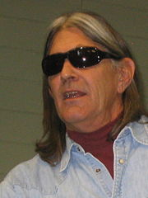
Ward Churchill

Slide 79
Ward Churchill
– Wrote essay “Some People Push Back: On the Justice of Roosting Chickens” in which he called some of the victims of 9/11 “technocrats” and “little Eichmans.”
– State legislators called for his removal.
– Accused of 7 instances of academic misconduct -- plagiarism, falsification and fabrication – none related to 9/11 essay

Slide 80
Ward Churchill (cont’d.)
Investigation by CU Research Misconduct Committee comprised of 3 CU faculty and 2 from other public universities (included 2 law professors)
Committee’s detailed report of May, 2006 ( >100 pages excluding multiple appendices) unanimously concluded he engaged in “repeated, intentional misconduct”
  Committee members don’t agree on appropriate punishment
    3 believed misconduct warranted revocation of tenure and dismissal from university
    2 recommended suspension without pay for 2 years

Slide 81
Ward Churchill
Fired from University of Colorado June, 2006; approved by Regents July 2007
Many questioned the circumstances leading to the inquiry but not the outcome
Mr. Churchill has sued the University for retaliation, denial of due process, defamation and breach of contract

Slide 82
“Most people say that it is the intellect which makes a great scientist. They are wrong: it is character.”
Albert Einstein

