Slide 1


Study Coordinator Education Series
Sponsored by OHSU Cancer Institute and
Oregon Clinical & Translational Research Institute
NIH CA P30 069533 NIH NCRR UL1 024120

Slide 2
Study Coordinator Class Objectives
Increase working knowledge of regulatory, operational, and practical requirements for coordinating research trials at OHSU
Classes include:
Analyzing & Implementing Research Protocols (4 hours)
Writing and Obtaining Informed Consent (4 hours)
Regulatory Documents and Submissions (4 hours)
Regulatory Binder and Source Documents (4 hours)
Continuing Education Credits are available through the School of Nursing
Notes:
These classes provide in-depth information for coordinating clinical research at OHSU. The classes involve more than an overview of the requirements, they provide detailed instruction for getting a study up and running at OHSU and maintaining compliance with OHSU policy and Federal Regulations. Each class includes a practical exercise that will give students and opportunity to practice their skills.
The 4 classes will be taught on a rotating basis 2X per year. Classes are limited to 20 individuals so sign up early. Interested OHSU employees can take the whole series or one class – whatever meets their needs. Continuing Education Credits through the school of nursing will be available for each completed class. Continuing Ed credits are only available if you complete the evaluation.

Slide 3
Contacts:
If you are interested in taking one or more of the classes visit the OCTRI Education Website (http://www.octri.org/octri/public/index.aspx?pageid=128&siteid=1&menuid=39&siteid=1&MenuSelectedIndex=-1) or contact Jennifer Kepler (503) 494-3812 keplerj@ohsu.edu

Slide 4
Analyzing and Implementing a Research Protocol
Objective – Increase skills for analyzing and implementing research protocols at OHSU
At the end of the class students should know:
How it identify key information in a protocol
Differences in industry and investigator initiated research
OHSU policies related to research (beyond IRB)
EPIC research documentation

Slide 5
Writing and Obtaining Informed Consent
Objective – increase working knowledge writing and obtaining informed consent
At the end of the class students should be able to:
Identify which informed consent documents are required for a protocol (e.g. genetic consent, media, assents)
Obtain informed consent from an adult
Be aware of OHSU Policies on informed consent (medical records, subjects with limited English Proficiency, Assent)
Document informed consent appropriately

Slide 6
Regulatory Documents and Submissions
Objective – increase working knowledge of IRB submission and approval process and ancillary oversight committee approvals
At the end of the class students should be able to:
Complete an Initial IRB application including IRQ, lay summary, DSMP
Know when a modification is required
Complete a modification and continuing review
Complete Regulatory Documents (PPQ, WOA, Billing Schedule, Nursing Summary)

Slide 7
Regulatory Binder and Source Documents
Objective – Increase working knowledge of essential regulatory and source documentation for conducting a clinical research study
At the end of the class students should be able to:
How to document study data/ complete “adequate case histories”
Make corrections to study records and document corrective actions
Know the essential regulatory documents
Retention requirements

Slide 8
Essential Regulatory and Source Documents
Phyllis Carello, BS, CCRC, CTRC Research Study Coordinator Manager
Bridget Adams, MSHS, CCRA, Manager Clinical Trials Office
& Investigator Support and Integration Services
Kristin Pattee, CCRP, Senior Research Assistant

Slide 9
Topics To Be Covered
Subject Research Records
Source Documents
Case Report Forms
Regulatory Files
Essential Documents
Financial Files
Knight Institute Audits

Slide 10
Subject Research Records

Slide 11
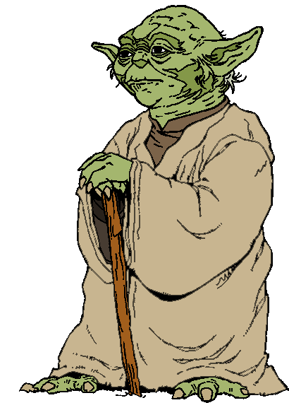
Stan Woollen, Former Deputy Director FDA
“May the Source be with you”

Slide 12
Why do we need Source Documents?
Federal Requirement to maintain “Adequate Case Histories” for FDA studies
21 CFR 312.62 Investigator recordkeeping and record retention (Drug studies)
21 CFR 812.140 (G) Records (a ) Investigator Records (Device Studies)
FDA cites ICH guidance as their current thinking on Good Clinical Practices (http://www.fda.gov/cder/guidance/959fnl.pdf)
Notes:
Alternative methods may be used but only if the approach satisfies the requirements of the applicable statute, regulations, or both. So why recreate the wheel.

Slide 13
Source Documents
Adequate Case Histories must include records of clinical findings, observations, and other activities that occurred during a clinical trial necessary for the reconstruction and evaluation of the data
Source documents
Case Report Forms (CRFs)
Consent forms
Records must be present for all individuals who participate in a research study (including screen failures and control subjects)

Slide 14
Source Documents
Source Documents
First place subject data is recorded
Certified Copies of original records are also acceptable
International Conference on Harmonization (ICH) Good Clinical Practice (GCP) Guidance
any data recorded that will not have a source must be outlined in the protocol (e.g. direct data entry)
case report forms and the source docs must match, data point to data point
where the terms “source data” and “source documents” are defined for clinical trials
Notes:
The CRF and Source date points must match one another
You should also check to see that your source docs match each other (MD note matches OR nurses notes)
Give example of drug dose inconsistency from AIM dysplasia study

Slide 15
Source Documents
Examples
Patient history documents
Medical charts with progress notes
Laboratory/Pathology reports
Investigator interpretation of results
Other Ancillary reports (ECG, Scans, chest x-ray)
Informed Consent Form (ICF) and HIPAA authorization signed and dated by subject

Slide 16
Source Documentation
Why is it so hard to have good source documentation?
Not always clear what records need to be maintained
Not always clear how records are to be completed
Who is responsible for recording data?
No written standards for quality source data
Notes:
ICH and FDA guidance don’t have detailed description of adequate.
May vary from study to study.
Phyllis to give AM dysplasia study example

Slide 17
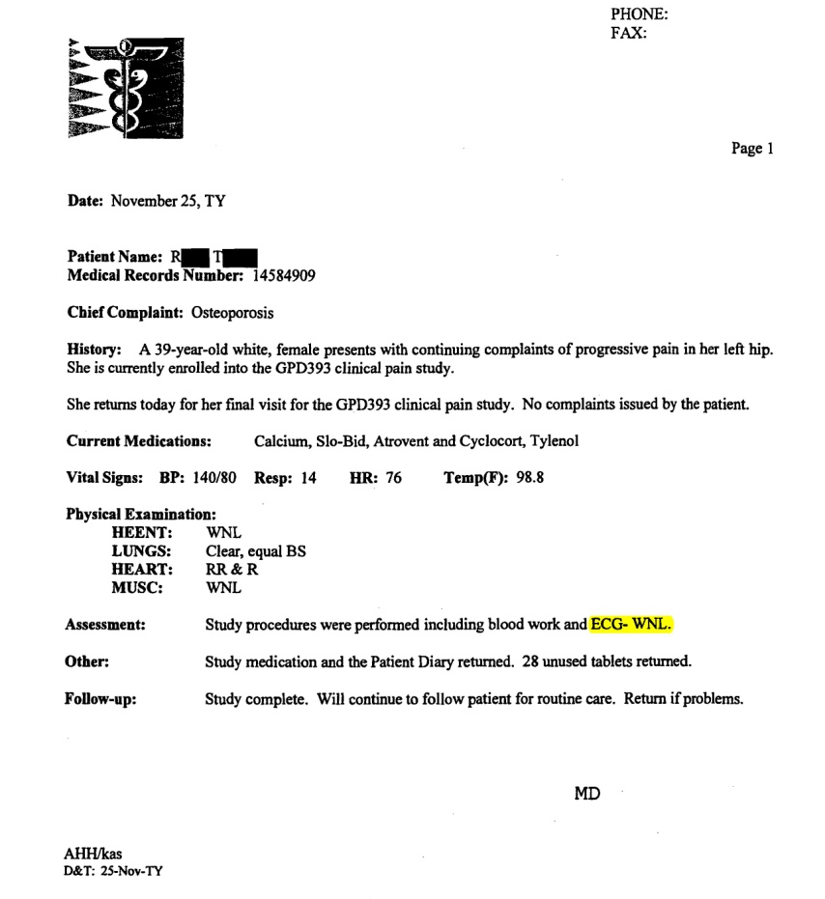

Example: Which is the Source?
ECG
MD Interpretation
Notes:
Trick question:
Both are…
ECG shows that the test was completed, allows it to be read at a later date incase to replicate the study results
MD interpretation required

Slide 18
Source Documentation Cont’d
How to make it easier?
Make sure you know what information needs to be recorded (e.g. What does medical history mean?)
Investigator initiated trials – review standard with PI
Sponsor initiated trials – review with your monitor
Use indigenous record-keeping as much as possible
redundant systems lead to errors
minimize the need for transcription
Notes:
Medical History – how far back do you need to go? Ask your PI or sponsor before you start collecting data. At a minimum, record pre-existence of all current conditions.
Indigenous – use systems that are already in place at OHSU use EPIC
Don’t reinvent the wheel.

Slide 19
Source Documents
Quality Source Documentation must be:
A
L
C
O
A
Attributable
Legible
Contemporaneous
Original
Accurate
Notes:
Attributable – you can tell the data was collected for your study and belongs to an individual study subject and site
Legible – you can read it
Contemporaneous - data was collected during the course of the study
Original – the source
Accurate – take a minute to make sure it is accurate

Slide 20
Source Documents
L – Logical!!
Your source documents need to tell a story
Remember your audience
PI
Other MDs participating in the patient’s care
FDA!
IRB and other auditors
If it wasn’t documented (or doesn’t make sense)… it wasn’t done (or it might be misconstrued)
Notes:
This final L (logical) isn’t in the ALCOA definition but we added it because we feel it may be the most important one.
Study records will be around for a long time and you may have moved on to your next job before the data is analyzed or final FDA approval is granted from the drug/device. Make sure there is enough information and that it is logical that someone else can recreate what occurred.

Slide 21
Writing Progress Notes
Record what you observe
Vital signs
Compliance (with medication, diaries, etc)
Your observations of subject
Within your scope of practice
Don’t use unacceptable abbreviations (see OHSU unacceptable and dangerous abbreviations list: http://ozone.ohsu.edu/healthsystem/HealthSystems/pharmacy/unacceptable%20abbreviations1-06.htm)
Just the facts not your impression
Don’t editorialize
Notes:
We talked about source documents, now lets get to the details of documentation.
Research records including progress notes may be discoverable in litigation

Slide 22
Writing progress notes
When documenting AEs record what the subject says
Have you been sick/ill since your last visit?
Prompt the subject for information but don’t lead the subject in their response
Ask onset date
Duration/ongoing
Severity
Did they take any medication?
What meds
When (start and stop dates)
Dosage and frequency
Notes:
AE interview example:
Subject on an investigational diabetes drug trial that has know GI side affects complains of heartburn at their 3 month study visit. At this visit you are just supposed to get vital signs, review AEs, collect glucometer and diary information and distribute more study drug.

Slide 23
Writing progress notes
Report your findings/observations to PI/co-I
If you discuss in person, have PI write note
You can send via email and file their email response in the research records
If you discuss with the PI on the phone, best to follow-up in writing

Slide 24
Writing Progress Notes
Record the plan for the subject
When will the subject return
Changes to medications/ study regimen
Repeat testing/ procedures planned
Reason for withdrawal (if applicable)
Referrals (to PCP or other MD)

Slide 25
Creating your own Data Collection Forms
Data collection forms should only capture data specified in the protocol
Organize data collection forms to match your workflow
Be clear and concise with your questions
Collect Date Of Birth vs. Age
Notes:
If the sponsor doesn’t provide source docs or you are working on a PI initiated study you will need to create your own source document templates/ data collection forms.

Slide 26
If you have to create your own Data Collection Forms
Avoid duplication
Request minimal free text responses
Provide units to ensure comparable values
Lbs vs Kg
Check with the statistician to see if you are collecting the data in a way they can easily analyze

Slide 27
Data Collection Forms
Inclusion/Exclusion Criteria
You need to document the actual criteria/values not “yes/no”
For example, if inclusion criteria states Hgb > 10.0
Record the actual result
Why is this important?
Need proof that subjects met the inclusion/exclusion criteria
May need the actual values for data analysis later
Notes:
If the Hgb is included in the lab results, the lab report is the source document
However; if you are getting a Hgb as point of care (Hemacue) you need to record this on your data collection form/source doc.

Slide 28
Research Procedures in Medical Records
What research data need to be filed in the medical records?
The Signed consent if subjects are receiving clinical services at OHSU http://ozone.ohsu.edu/healthsystem/POLICYMANUALS/Clin02MedRec/Clin02-15.pdf
Documentation of all Clinical Services provided at OHSU and the results http://ozone.ohsu.edu/healthsystem/POLICYMANUALS/Clin02MedRec/Clin02-01.html
Anything that will be billed to insurance
Point of Care testing
Pregnancy tests
Hgb/Hct
Notes:
Medical Records/ Epic/ Integrated Health Record can all be used interchangeably.
Basically, any information potentially used to make a clinical decision has to be put in EPIC. If you aren’t sure whether something should go into the medical record or not , forget the data was collected for research and ask yourself why the information should go in the medical record. You will usually come to the right answer. If you have any specific questions relating to your study – ask Darlene Kitterman.
Why does point of care testing info have to be in the medical records? Joint commission requires it (formerly JCAHO). Point of care testing can be a gray area – for example a pregnancy test done by someone who has completed the OHSU competencies, and was purchased by OHSU should go in the medical record. If the pregancy test are provided by the sponsor then they aren’t under our CLIA cert so they should not be included in the medical record. If a pregnancy test was positive then the patient would need to have the test repeated before any clinical decisions are based on the results.
ITG is creating a training course on how to document research in EPIC – announcements should be coming in the next few months.

Slide 29
Research Procedures in Medical Records
What data should not be filed in medical records
Lab results that are not from a CLIA approved lab
Genetic test results that aren’t validated
Results collected by an individual that has not completed the appropriate training/competencies (see OHSU Study Coordinator Required Training Checklist http://www.octri.org/octri/public/common/getdocpublic.aspx?docid=83EE5310-6DA9-44B4-B996-8A5D94B814D4)

Slide 30

Case Report Form Completion
Looks easy…
But it is very easy to make mistakes!!!!
Notes:
How many of you get sticky notes during monitoring visits?

Slide 31
Completing Paper Case Report Forms
Make sure you are listed as study personnel in the eIRB
Make sure your name is on the delegation log stating you can complete CRFs (if applicable)
Use only black ballpoint pen
Note: if using carbonless copies ensure that the entry has gone through to the other pages
Print!
Only write in the data fields – don’t make extraneous marks on the CRF pages

Slide 32
Completing Paper Case Report Forms Cont.
Be sure to use the correct date and time format
Record the data in the correct measurement
(Kg vs. Lbs)
Ensure you use the CRF completion guidelines provided by the sponsor (if applicable)
Only have the PI sign off on a CRF when it is complete (never before)
Don’t backdate signatures
Notes:
Data entry may vary from company to company.
If you are working on an investigator initiated trial and you don’t have guidelines, work with your PI and use these helpful hints.

Slide 33
Completing Paper Case Report Forms Cont.
Don’t use abbreviations unless they are agreed upon by the sponsor
BA can mean Barium, Backache, Blood Alcohol, Bone Age, or Boric Acid to name just a few
Don’t use nursing/medical shorthand
NEVER leave blank fields
Use leading zeros, dashes, or not done (ND) per the sponsor instructions
Never write in data that doesn’t have a source or that was not collected.
Notes:
Don’t make up data. A missing data point is better than falsified data.

Slide 34
Completing Electronic Case Report Forms
Only complete electronic CRFs under your own log in
Never share your log-in
Be brief in your responses to free text fields
Save work frequently
PI sign off is the same as a paper signature
Notes:
Don’t use your PI’s log in!!!!! No matter what!

Slide 35
Examples of CRFs Questions
What would you record on the CRF?
Lab report lists estradiol <20.0 pg/mL
Estradiol
PI progress note lists NYHC as 3-4
Class I Class II Class III Class IV
 |  | .
Notes:
It isn’t always easy to tell what values should be recorded on the CRF.
How would you complete these questions?
NYHC = New York Heart Class
The correct answers – whatever the sponsor, PI, or both want you to list. Then you need to be consistent for all subjects.
In the second example you can see that you may need to train your PI to write appropriate progress notes.

Slide 36
Correcting Source Docs and CRFs
Four elements that must be visible each time data is changed
Old value
New value
Date of change
Identification (e.g. initials) of person making change
Only authorized study staff can make changes
Don’t use whiteout
Notes:
No one is perfect – in fact – perfect CRFs would be a cause for concern in an audit.

Slide 37
Corrections to Source Documents and CRFs

Slide 38
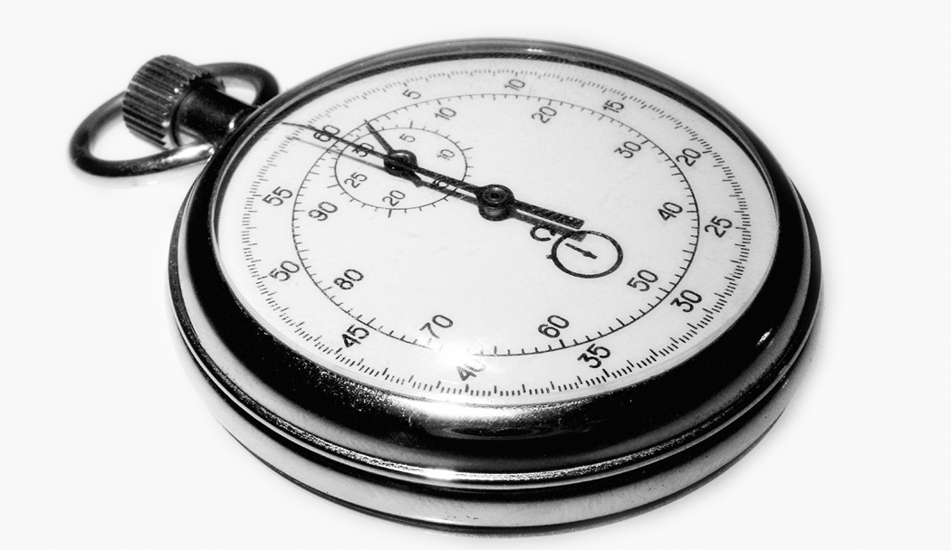
BACK in 10 minutes

Slide 39
Practicum

Slide 40
Regulatory Files

Slide 41
Regulatory Files
“Regulatory Documents” must be completed and filed at the clinical site, the sponsor, and/or IRB
Documents demonstrate compliance of site, sponsor, IRB with Good Clinical Practice Guidance and regulatory requirements
Notes:
I put Reg docs in quotes because it could be called by many names…
Admin binder
Regulator binder
Study file
This information is important because it allows you to recreate what occurred during the study if necessary.

Slide 42
Investigator Regulatory Files
Essential Documentation
Protocol Personnel
IRB Documents
Correspondence
Protocol and Amendments
Informed Consent/HIPAA
FDA Forms
Screening/Enrollment
Investigational Product
Laboratory
Monitoring
Notes:
Darlene Kitterman’s two day coordinator workshop goes over this information two times so we are going to breeze through this quickly. However, if you have questions don’t hesitate to ask.
We are mainly going to provide tips and point out areas that commonly have deficiencies.

Slide 43
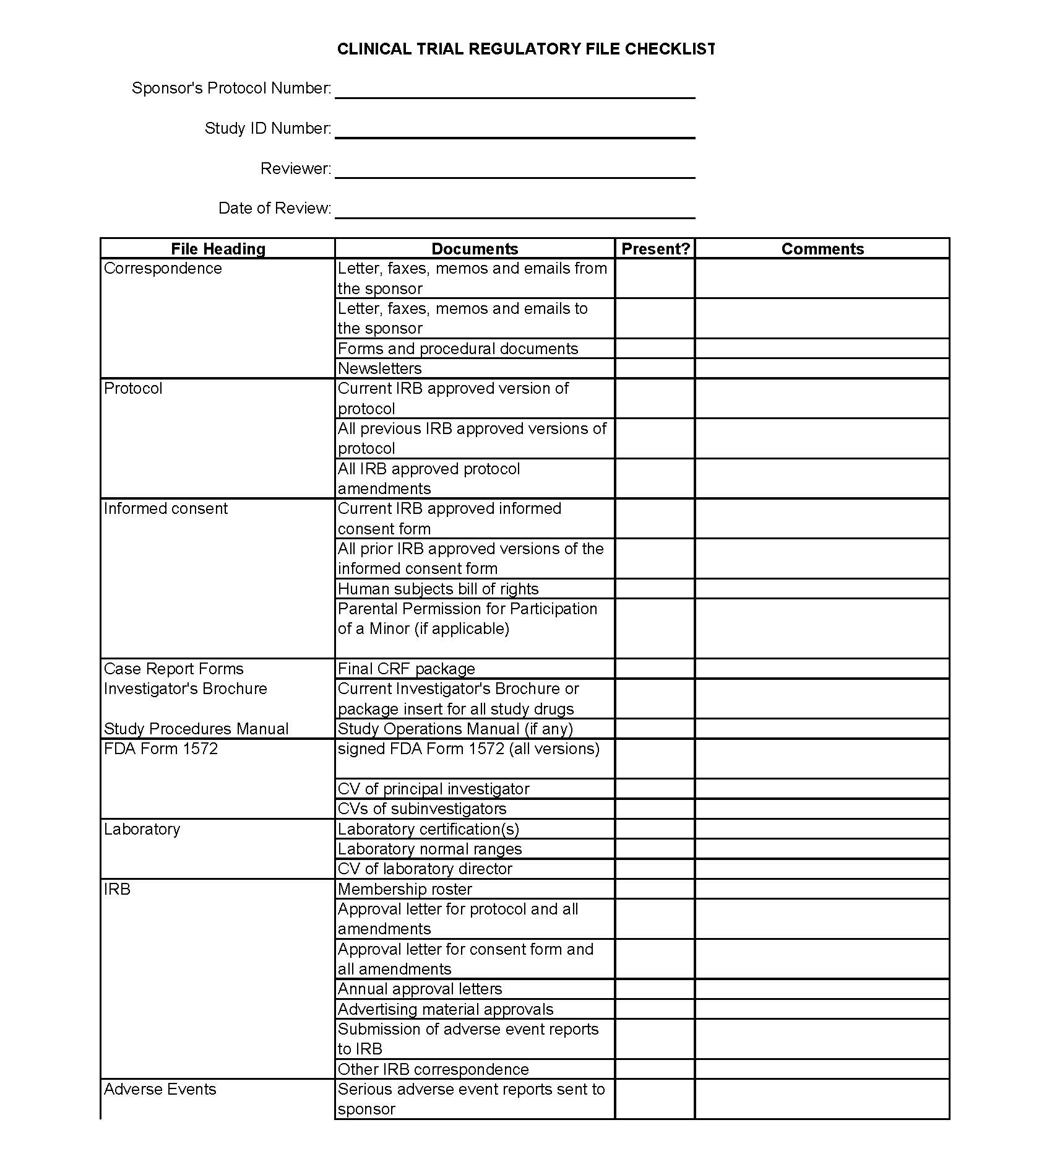
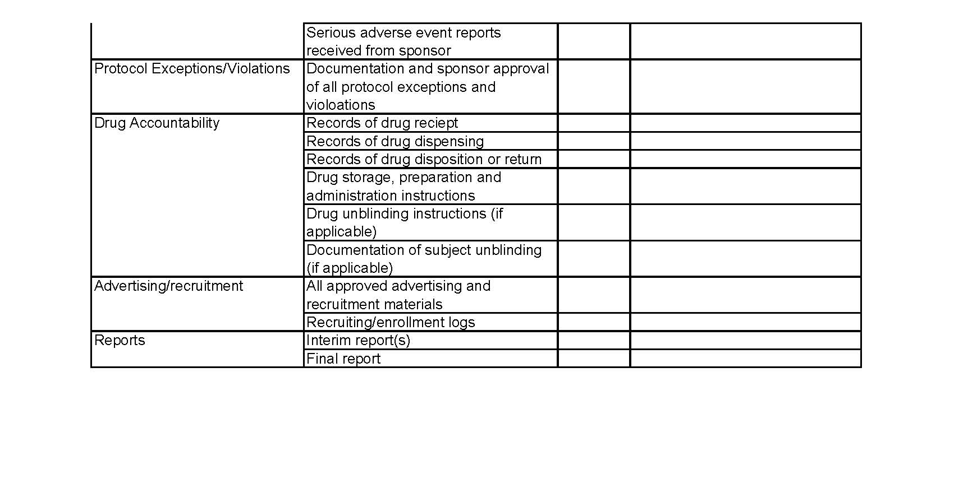
Investigator Regulatory Files
Regulatory Binder Checklist on OCTRI website http://www.octri.org/octri/public/index.aspx?pageid=126&siteid=1&siteid=1&MenuSelectedIndex=5

Slide 44
Investigator Regulatory Files Protocol Personnel
Delegation of authority documentation
Documentation (e.g. training logs) of training on the following:
Study Protocol and amendments
Investigator Drug Brochure/Device Manual
Study procedures outside of the investigators/study staff’s practice (e.g. new surgical procedure)
Equipment
Case Report Form Completion
Database entry and audit procedure
Notes:
Co-Is may not get automatic notifications from the eIRB or they may ignore them. You should decide at the beginning of the study how you are going to disseminate and acknowledge receipt of new information.

Slide 45
Investigator Regulatory Files IRB Documents
IRB membership list
IRB Initial Review Questionnaire (IRQ)
IRB initial review/approval memo(s)
Continuing Review Questionnaires (CRQs) and approval memos
Modification forms/PRAFs and approval memos
Cover memos and correspondence with IRB including Analyst and PI comments in eIRB
Unanticipated Problem and Protocol Deviation Reports
Notes:
If you are using the OHSU eIRB print copies of all essential documents.
Frequent errors I see is just printing the approval memos and not the IRQ,CRQ, Modification etc.
Also need to print and file cover memos and comments related to the submission in the eIRB. This may clarify why you didn’t make all changes requested in an IRB review memo.

Slide 46
Investigator Regulatory Files Correspondence/Communications
Relevant study communications/ telephone calls/ emails
Including correspondence between:
the PI and co-investigators, study coordinators
the PI/study staff and the manufacturer
the PI/study staff and monitor
the PI/study staff and the research pharmacy
the PI/study staff and laboratory
other study related correspondence
Follow-up on telephone calls with an email or write it up in a log
Notes:
When should there be correspondence with co-Investigators?
When new versions of the protocol/consent are available
When protocol deviations and adverse events occur
Need to set a plan before the study starts to work out how these issues will be communicated with the team.
This shows that the PI is overseeing the conduct of the study
If you have lab meetings to discuss issues, you should file the agendas and minutes

Slide 47
Investigator Regulatory Files Monitoring
Monitoring Log
Monitoring Reports
Audit Reports
Documentation of any activities completed to fulfill your data and safety monitoring plan.

Slide 48
Regulatory Files
Print everything you submit and receive in the eIRB for your Regulatory Binder
The IRQ is dynamic and changes over time (e.g. study personnel) so you will probably need to print it more than once
Documents in the eIRB may be inadvertently deleted or archived
Check after modifications/CRQs are approved to make sure all of your documents are in the approved documents bin
If you don’t print it you may loose it
Check the dates on your approval memo, IRB approval date in the eIRB and status, and the consent form dates

Slide 49
Financial Documents
Contract and Financial documents should be stored in a central but separate location from the study records
Contract
Budget
Invoices
Monthly reports from Oracle
Financial Correspondence
With Sponsor
With SPA

Slide 50
Financial Documents
Track when activities occur on a study that need to be invoiced
Additional study procedures
Start-up fees
Communicate tracking to Department Personnel invoicing if not doing it yourself
Notes:
Does anyone have a good system for tracking invoice able items that they want to share.
Start up fees – Spa will bill for IRB fees, Knight Institute Review Fees, OCTRI Review Fees and anything they identify in the contract is start up money. Coordinator/PI is responsible for invoicing after that. If you received money for other start-up activities (investigator meeting etc.) you may need to

Slide 51
Notes to File
Notes to file (NTF) can be used to explain a protocol deviation or data inconsistency
Notes to file are not required
They do not correct a problem
If used incorrectly they can provide a trail for an auditor to find all of your problems
Notes:
NTF can be a letter, memo, email whatever explaining something that occurred during a research study. Not defined anywhere in the code of federal regulations.

Slide 52
Notes to File
Essential elements of the note(s):
Date(s)
Document the problem
Document the root cause (if known)
Document how you will prevent the problem in the future
Procedural change
Staff re-education
Protocol/Consent form changes
Training occurred on the new procedure/corrective action
Date new procedure was implemented
If applicable, steps to monitor that the procedural change is working
PI Sign-off
Notes:
Speaker Notes: How many of you write notes to file? How many of you include all of these elements? If you don’t there isn’t much point in writing a note to describe the problem.
Recent Warning letter (2007) issued by FDA indicated that a Sponsor was aware of problems but did nothing to address the issues other than write memos to file after the monitoring visits. FDA found that it would have been better to spend the time training the study staff.
Documenting a corrective action is very important in case of an audit.
Once a NTF is generated it can’t be retracted so make sure they are adequate.
If you don’t take corrective action all a note to file does is provide a road map for an auditor to find problems at the site.
Does anyone know how to find the root cause of a problem? Just ask the question why 5 times and you usually find your answer.
Example: Missing data for a study endpoint for a subject at their 3 month visit. Why? Wrong tubes were drawn. Why? Lab set up wasn’t completed correctly. Why? Subject showed up 2 hours early for their scheduled visit.
Now you can see how this would branch in two possible directions 1) why did the subject show up early or 2) probing why the set up was done incorrectly. May find that there is more than one corrective action possible – maybe you find that you should do the visit set up the day before so you aren’t rushed or you create a checklist for lab set up. You may also find that reminder calls or appt cards would help subjects show up for their visits at the appropriate time.
You may come to the determination that something occurred just one time and it is unlikely to happen again. If that is the case you don’t need to document corrective action you could just document that the current procedures should be adequate and that no further action is planned at this time.

Slide 53
What is wrong with this NTF?
Date: 12/28/2008
PI: Dr. Jones
Protocol: ABC123
Re: Informed Consent Version 1 date 11/23/2008 approved by the OHSU IRB 12/02/2008
Dr. X is listed as a co-investigator on the ICF but he is not listed on the 1572 form therefore he will not be able to work on this study.
Subjects will be informed of the discrepancy during the consent process and this will be documented. The consent will be revised on the next updated consent that is submitted to the IRB.
Notes:
Missing some elements:
Cause
Steps to prevent this from occurring in the future
Education
What are the 5 whys?
Is the course of action proposed appropriate? No
What are the PI’s options?
Add co-I to 1572, have PI sign and send to the sponsor
Remove co-I from consent and study
Does this require a note to file?
Not really, since you found it before a deviation occurred. You will just fix it. Now if you found this error several months in to the study and the co-I has been participating in the study a note to file is appropriate.

Slide 54
Study Document Retention
Documents must be retained after study termination
(see OHSU Summary of Regulatory Retention Requirements for Records Associated with Research http://www.octri.org/octri/public/common/getdocpublic.aspx?docid=C71ADB9D-59F3-4DBB-AFE9-0450F30569E2)
Per FDA 2 years after investigational product has been approved or IND/IDE withdrawal (Sponsor may require you to keep longer)
Protected Health Information must be retained for 6 years
Do not keep PHI longer than outlined on the HIPAA authorization form
Keep Financial Records for 3 years from the date of submission of the final expenditure report
Notes:
Be sure to include storage in budget. Probably don’t want to send study documents to off site storage until you are sure all of the queries have been resolved.
Best to mark “indefinitely” on the HIPAA authorization form so you are covered.
If you move documents or transfer ownership – notify the sponsor

Slide 55
Quality Assurance
Whether you are monitored for an Industry sponsored study or you have an investigator- initiated trial it is good practice to review your study records periodically
Allows you to catch errors
Change study activities in a timely manner to ensure quality data
Ensure you are reporting appropriately to the IRB and or sponsor
Make sure you are billing appropriately

Slide 56
Quality Assurance
QA recommendations
Review records early in the trial to make sure things get off to a good start
Review consents/HIPAA authorizations for all subjects enrolled
At least 10% of records - more if errors are found
Share results of your review with the study team
Document corrective actions, if necessary
Take corrective actions, if necessary
Notes:
10% guideline – you can do more. If your study only has a few subjects and/or is a short duration we recommend that you review all of the study records – especially if you are conducting a study where the PI is the Sponsor-Investigator for an FDA regulated study.
OCTRI has monitoring services available. When we monitor we review the inclusion/exclusion criteria for all subjects.
OCTRI has a monitoring procedure and report template that we are happy to train people to use to conduct self monitoring visits. Call Bridget if you want more information on this.

Slide 57
Quality Assurance Auditing
For Cancer Protocols
Presented by: Kristin J. Pattee, CCRP
Date:

Slide 58
Quality Assurance Auditing for Cancer Protocols

Slide 59
Who audits?
Cancer studies are audited by the Knight Cancer Institute Data and Safety Monitoring Committee (DSMC)
DSMC is made up of: physician members of the Knight Cancer Institute, administrators of CRM, biostatisticians, research nurses, and study coordinators.
Audits are usually done by two auditors, one of which has to be a nurse or physician.

Slide 60
Why audit?
Insure safety of study participants
Maintain validity of research data
Terminate studies when appropriate
if significant risks uncovered
appears the trial cannot be concluded successfully
Notes:
The DSMC collaborates with the CRRC and the IRB if termination seems to be appropriate.

Slide 61
What gets audited?
High-risk cancer studies including:
Locally initiated studies
NIH sponsored studies
NCI sponsored studies
Notes:
The DSMC can audit any cancer study at any time for just cause. Typically, however, only high-risk studies that aren’t audited by another monitoring entity get audited by the DSMC. Studies that have outside monitoring entities include industry sponsored studies, cooperative group studies, and studies that have their own data safety & monitoring board.

Slide 62
How often are studies audited?
Ideally, studies are audited annually, but no less than every 3 years.
Can be audited at any time randomly or for just cause

Slide 63
What is the auditing process?
The DSMC Quality Assurance Coordinator will arrange an audit date with the PI and study coordinator
Audit notice given in the form of a letter 30 days prior to audit
Subject study records & regulatory documents audited by auditing team
Notes:
Audit letter will include which subject records (selected at random) will be reviewed; usually 2 subjects are reviewed. If necessary, any subject records can be reviewed and unannounced review can be done of all or part of the total cases for appropriate informed consent and eligibility.

Slide 64
Preparation for the audit
Relevant materials include:
original or copies of the patient source documents
signed consent forms
research notes
IRB documents
drug accountability forms
case report forms
any other protocol specific documents
Notes:
The study coordinator is responsible for making sure that all the relevant materials are available for the audit team. It is recommended that the staff member most familiar with the patient cases be present at the audit. To help with reviewing the records, it is recommended that the study coordinator label all documents beforehand.

Slide 65
Conducting the audit
Subject data reviewed by auditors includes:
consent form
inclusion/exclusion criteria
treatment regimen
documentation of disease outcome/response
toxicities addressed according to protocol
general data quality
Notes:
Consent form has to be present, signed & dated by the patient before study protocol procedures are started, signed & dated by person obtaining consent, and most recent IRB approved version must be used.
All documentation that confirms inclusion/exclusion criteria must be present.
Checking treatment regimen includes: correct agent/treatment used, dose modifications followed, treatment doses administered correctly, etc.
Checking general data quality includes: recurrent missing documentation, protocol-specified cabs or diagnostic studies not documented, errors in submitted data, etc.

Slide 66
Conducting the audit (cont.)
Regulatory items reviewed by auditors include:
IRB approvals for protocol, amendments, & consent forms
Possible lapse in IRB approval
Current enrollment log
Reportable adverse events/Unanticipated Problems and protocol deviations not reported to IRB/appropriate entity

Slide 67
Conducting the audit (cont.)
Enrollment information in the Surveyor database
Drug accountability records kept
For Coordinating Center:
Enrollment information in the Surveyor database
Central reporting of UPs
DSMP provided for all other sites
Audit result letters & Quarterly Summary Reports filed for other sites

Slide 68
Conducting the audit (cont.)
For IND/IDE Holders:
IND Safety reports submitted to the FDA
Protocol amendments submitted to the FDA
Information amendments submitted to the FDA
Annual reports submitted to the FDA
Notes:
Susan Aust is the Investigator Initiated Trials Development coordinator. If your PI holds an IND, they should let Susan know as she keeps track of all of the INDs for the entire Knight Cancer Institute.

Slide 69
Audit Findings
Exit interview
Follow-up letter sent within two weeks of audit. Audit rated:
Acceptable
Acceptable, needs follow-up
Unacceptable
Notes:
After the audit is complete, the audit team will have an exit interview with the research staff. Preliminary findings and any recommendations from the audit team will be discussed. This provides opportunity for education, immediate dialogue, feedback, and clarification.
Acceptable: few deficiencies and/or all major deficiencies addressed prior to the audit, including documentation that no further action is required
Acceptable, needs follow-up: multiple lesser deficiencies identified and/or major deficiencies
Follow-up can be documented correspondence and/or re-audit
Unacceptable: multiple major deficiencies identified, major flagrant deficiency identified,
Flagrant deficiencies include: willful disregard of safety and regulatory standards and data fabrication or falsification

Slide 70
Audit Findings (cont.)
If audit rated Acceptable, needs Follow-up or Unacceptable, the PI must submit a written response and/or corrective plan to the DSMC within 30 days of receiving the audit report.
If PI response is sufficient, the DSMC will send final letter to the PI.
Audit is complete after final letter is sent.
Notes:
Final letter to PI will include a statement requiring the PI to submit a copy of the letter to the IRB at the time of the CRQ. All audit records will be kept on file at the CRM.

Slide 71
Audit Follow-up Measures
Letter of warning
Probationary status
Enrollment put on hold
Immediate repeat audit
Removal of access to investigational drugs
Notification of the FDA if investigational drugs are involved
Notes:
If audit is rated unacceptable and PI does not address audit problems, the DSMC as a committee decides on what the follow-up measures will be.

Slide 72
Audit Follow-up Measures (cont.)
Notification of OHSU Scientific Integrity Committee if scientific misconduct is suspected
Notification of the IRB if issues of patient rights, informed consent, protocol violations or IRB review are involved

Slide 73
Audit Follow-up Measures (cont.)
Replacement of PI
Termination of study
Reanalysis or retraction of published results
Debarment of investigator from future participation in the Knight Cancer Institute research
Notes:
The following actions may be taken by the DSMC in instances of suspected data fabrication or falsification or other possible scientific misconduct.
It is the responsibility of the DSMC to see that any action resulting in a temporary or permanent suspension of an NCI-funded clinical trial is reported to the NCI grand program director responsible for the grant.

Slide 74
Evaluation Form
If you want to receive continuing education credits for the class today, you need to complete the evaluation form

