Slide 1

The Nuremberg Code:
Historical Context
Michael J. Lichtenstein, M.D., M.Sc.
Program Director, GCRC
University of Texas Health Science Center at San Antonio
South Texas Veterans
Health Care System
National Center for Research Resources
Notes:
December 17, 2002

Slide 2
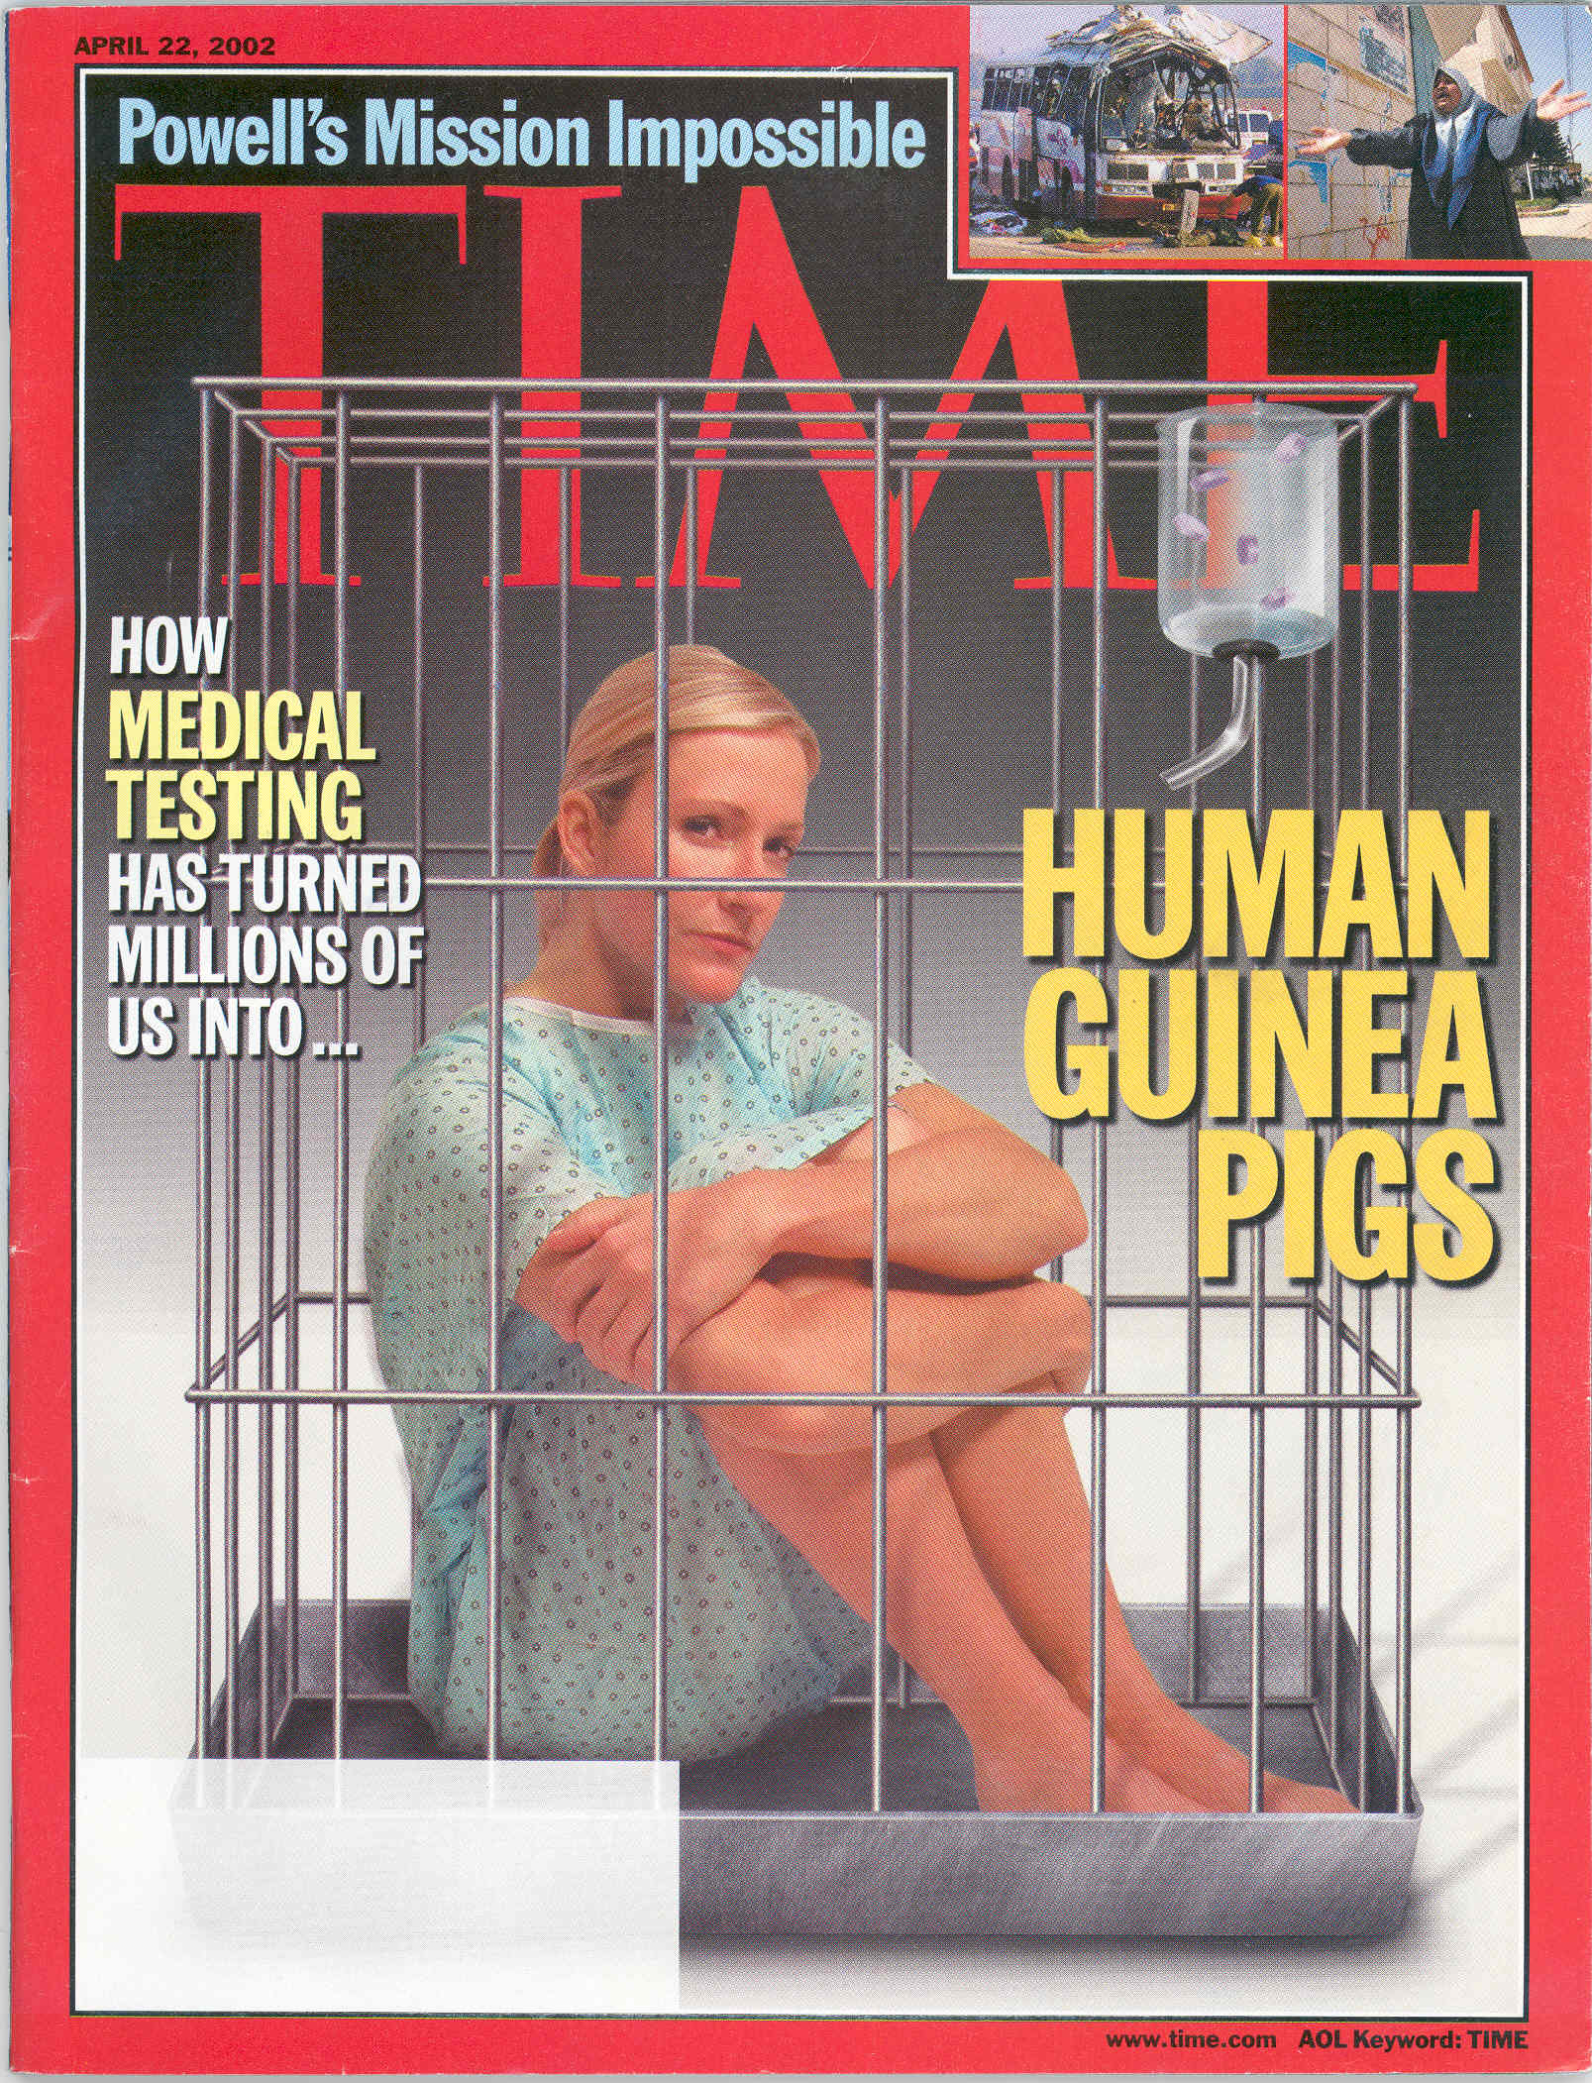
In the early 21st century, an erosion of public trust exists in physicians’ and clinical investigators’ capacity to safely conduct research with human volunteers.
April 22, 2002

Slide 3
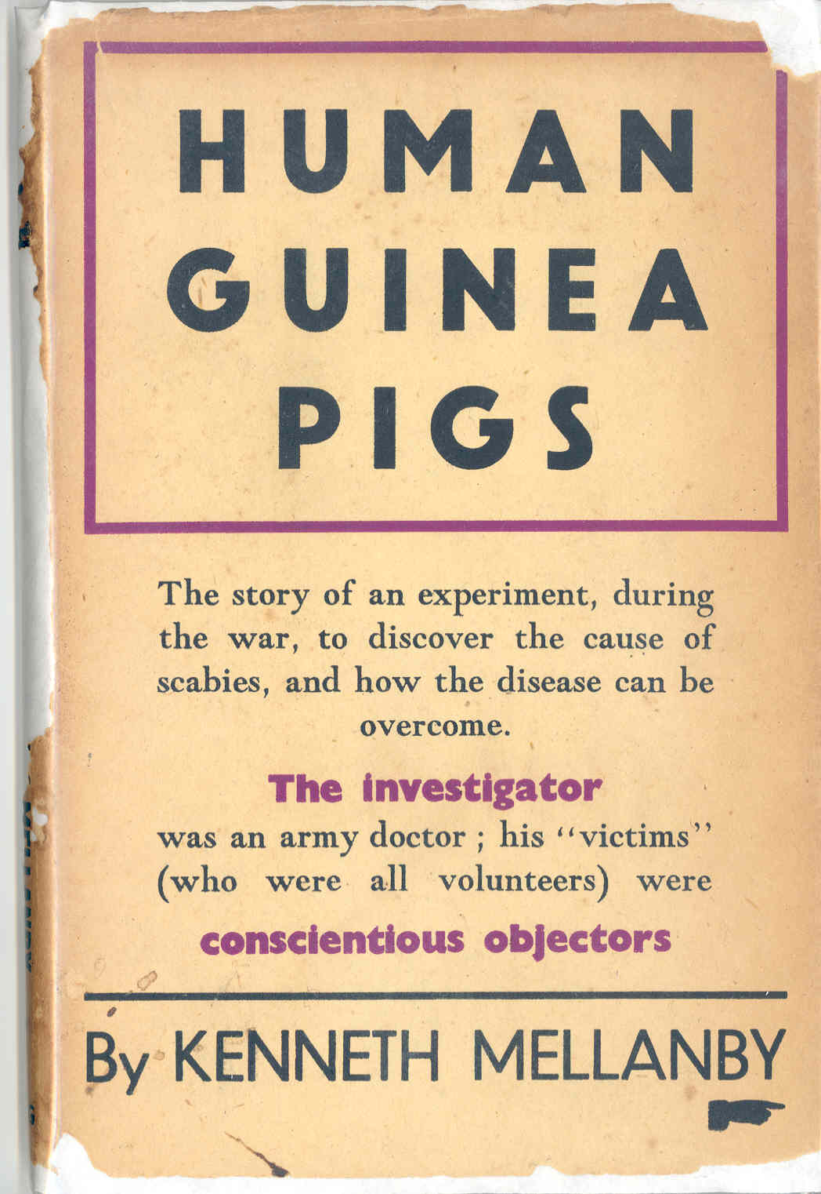
First published - 1945
Second edition – 1973
Kenneth Mellanby
  Entomologist
  Studied the transmission of scabies
  Observer for the BMJ at the Nazi Doctors Trial in Nuremberg

Slide 4
Class Assignment:
Annas, GJ, Grodin, MA, Editors, The Nazi Doctors and the Nuremberg Code: Human Rights and Human Experimentation. Oxford University Press, New York, 1992
  Mozes-Kor, E. The Mengele Twins and Human Experimentation: A Personal Account. Chapter 4 pages 53-59.
  Grodin, MA. Historical Origins of the Nuremberg Code. Chapter 7 pages 121-144.

Slide 5
Learning Objectives
Describe the difference between medical treatment vs. medical research
Compare and contrast the role of the physician in treating patients with that of an investigator
Describe how Nazi medical care arose out of the eugenics and race medicine theories of the time.
Describe one example, in detail, of Nazi medical experiments conducted in concentration camps.

Slide 6
Learning Objectives – Cont’d
Describe the formulation of the Nuremberg Code
Discuss the responsibility of individual investigators conducting research with human subjects
Delineate the influence the Nuremberg Code was to have on subsequent human subject regulations.

Slide 7
Time Line for Human Subject Research and Protection
Eugenics Movement
1900 | 10 | 20 | 30 | 40 | 50 | 60 | 70 | 80 | 90 | 2000

Slide 8
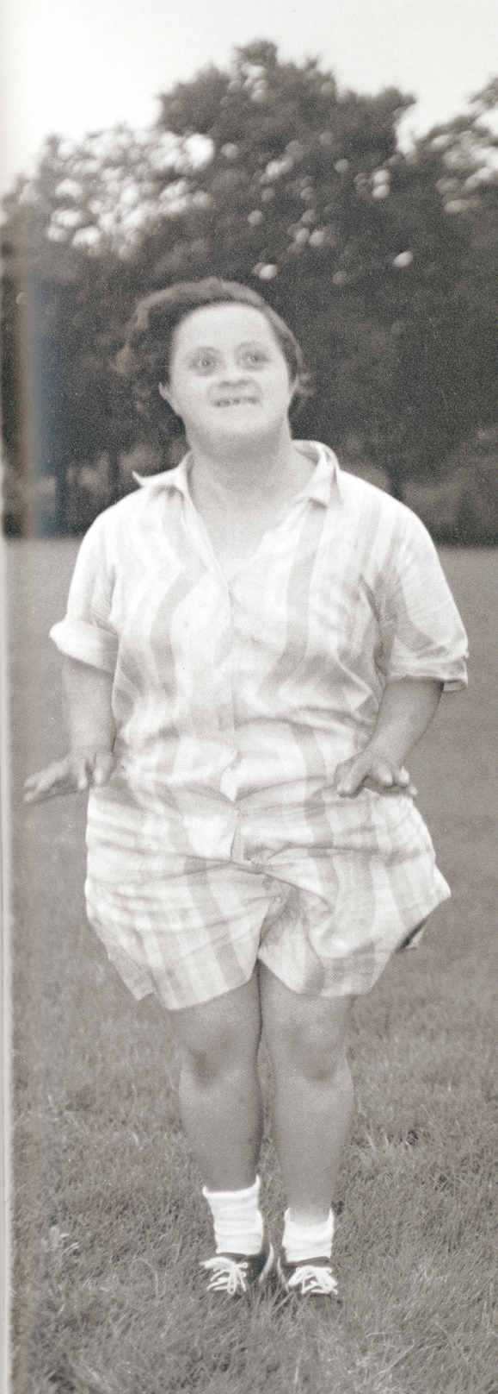
Eugenics
‘Science’ of racial improvement through control of hereditary factors
“Racial Hygiene” – U.S. and Europe
Sterilization Laws (1933) in Germany
Nuremberg Laws (1935) prevent intermarriage between Jews and non-Jews
Euthanasia (1939)
  “Incurably sick by medical examination”
  Gases residents of mental institutions
  Develop methods used in concentration camps
Diane Arbus – Untitled - 1970

Slide 9
Time Line for Human Subject Research and Protection
WWII – 1939-45
Eugenics Movement
1900 | 10 | 20 | 30 | 40 | 50 | 60 | 70 | 80 | 90 | 2000

Slide 10
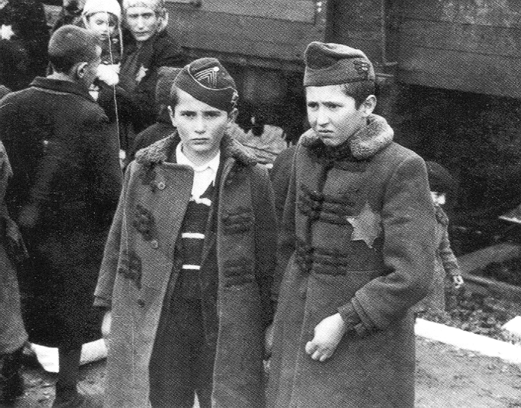
Josef Mengele’s Twin Studies
Twins selected for ‘controlled’ studies
One twin given an infectious disease, e.g., Typhoid
At time of death of diseased twin, ‘control’ twin put to death (e.g., Phenol injected into heart)
Both twins autopsied
Two Hungarian Jewish twin brothers at the camp in Birkenau, prior to selection, 1944 (Bernhard Walter)

Slide 11
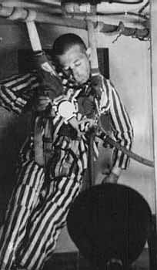
Dachau Studies – 1942-1943
Done for benefit of German Air Force
High altitude
  To investigate limits of human endurance at extremely high altitudes, studies were carried out in low-pressure chambers that duplicated atmospheric conditions
  Experiments often resulted in death
Low Pressure Chamber
National Archives

Slide 12
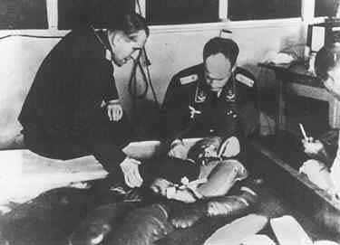
Dachau Studies – 1942-1943
Hypothermia
  Experiments conducted to
  investigate the most
  effective means of treating
  persons who had been
  severely chilled or frozen.
  Subjects were forced to
  remain in a tank of ice
  water.
  Experiments often resulted in death.
Cold water immersion study
Yad Vashem Archives

Slide 13
Time Line for Human Subject Research and Protection
Nuremberg Code - 1947
WWII – 1939-45
Eugenics Movement
1900 | 10 | 20 | 30 | 40 | 50 | 60 | 70 | 80 | 90 | 2000

Slide 14
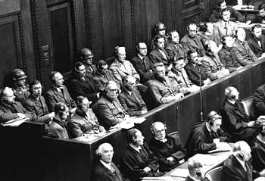
Nazi Doctors’ Trial – Nuremberg – 1946-47
23 Defendants
Military Tribunal
Four Counts:
  Conspiracy
  War Crimes
  Crimes Against Humanity
  Membership in a Criminal Organization (SS)
Defendants in the Doctors Trial, held in Nuremberg, Germany, from December 9, 1946, to August 20, 1947

Slide 15
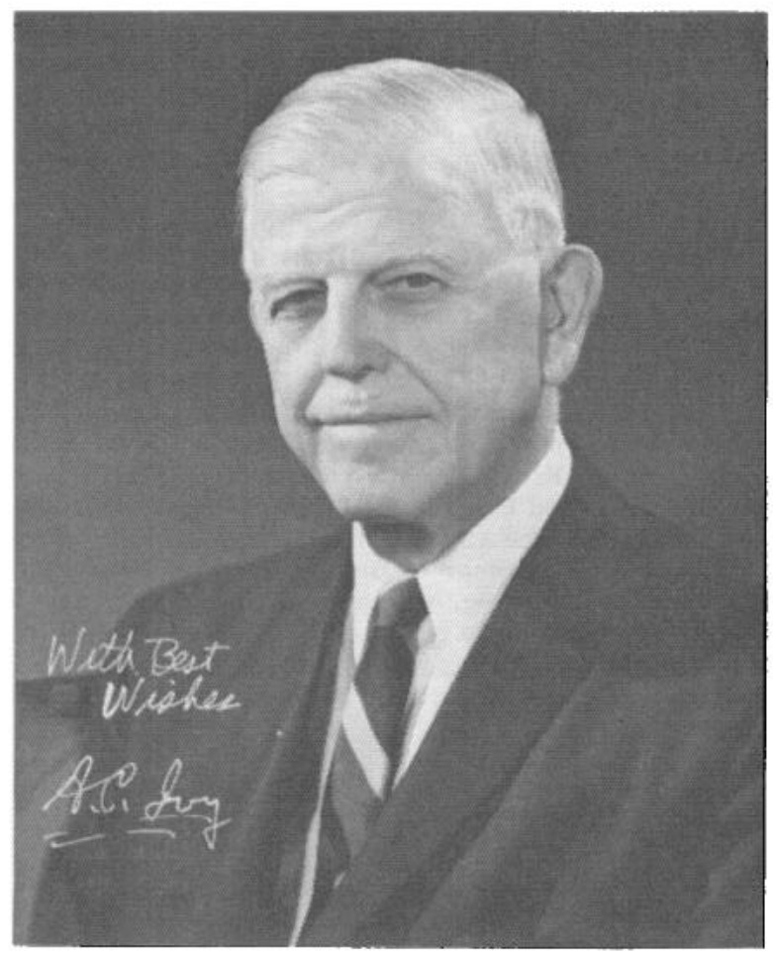
Andrew C. Ivy, M.D., Ph.D.
Professor of Physiology and Pharmacology at the University of Illinois, Chicago
‘Golden Rule of the medical profession’ – treat the patient or subject as though the physician were serving as a subject.

Slide 16
Medical Science Under Dictatorship
Leo Alexander, M.D., N Engl J Med 1949:39-47
Science under dictatorship becomes subordinated to the guiding philosophy of the dictatorship. … the guiding philosophic principle of … the Nazis, has been Hegelian in that what has been considered "rational utility" and corresponding doctrine and planning has replaced moral, ethical and religious values. .... In the medical profession this expressed itself in a rapid decline in standards of professional ethics. Medical science in Nazi Germany collaborated in the following enterprises:
the mass extermination of the chronically sick in the interest of saving "useless" expenses to the community as a whole;
the mass extermination of those considered socially disturbing or racially and ideologically unwanted;
the individual, inconspicuous extermination of those considered disloyal within the ruling group;
and the ruthless use of "human experimental material" for medico-military research.

Slide 17
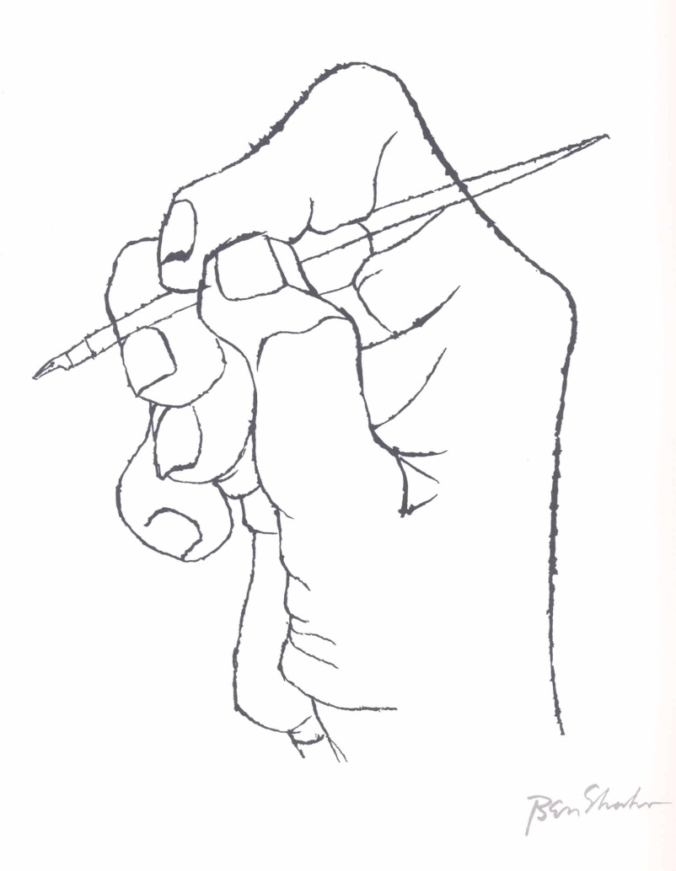
Nuremberg Code - 1947
The voluntary consent of the human subject is absolutely essential
2. The experiment should yield fruitful results for the good of society, unprocurable by other methods
Ben Shahn – A Verse Arises - 1968

Slide 18
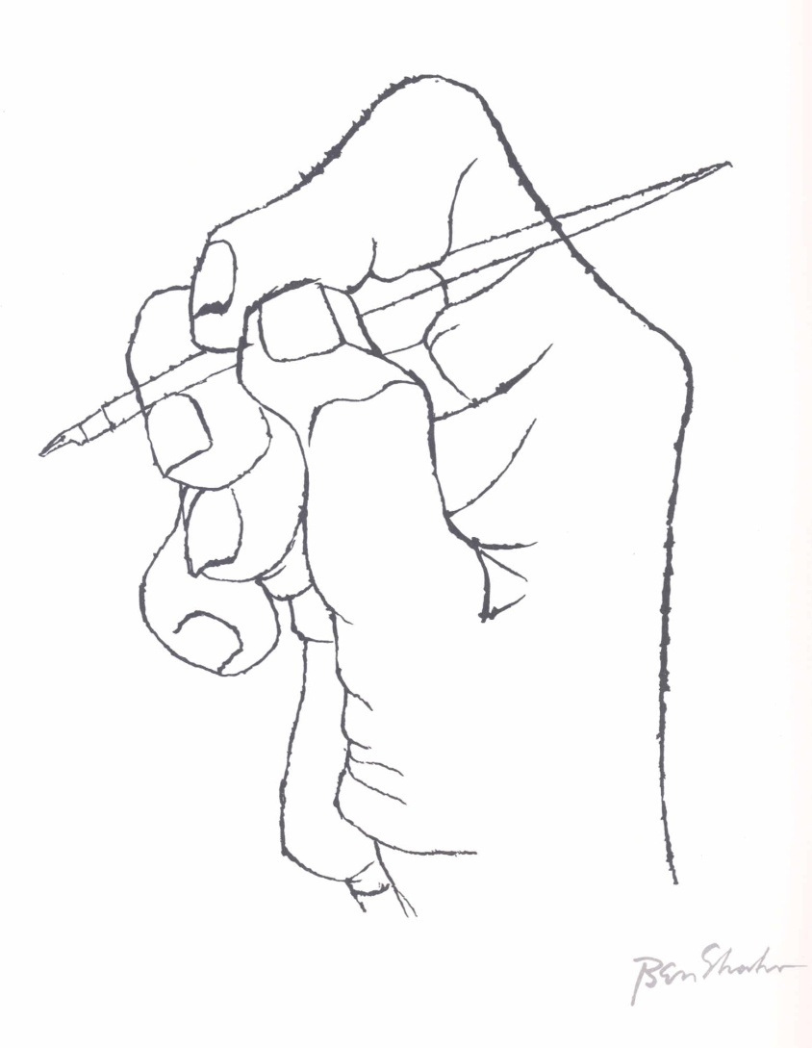
Nuremberg Code – 1947 – cont’d
The experiment should be designed and based on the results of animal experimentation and a knowledge of the natural history of the disease
Experiment conducted to avoid all unnecessary physical and mental suffering and injury
5. No experiment where there is an a priori reason to believe death or disabling injury will occur
Ben Shahn – A Verse Arises - 1968

Slide 19
Nuremberg Code – 1947 – cont’d
Degree of risk should never exceed humanitarian importance of problem
Proper preparation and facilities to protect the subject against even the remote possibility of injury, disability, or death
Ben Shahn – A Verse Arises - 1968

Slide 20
Nuremberg Code – 1947 – cont’d
Experiment conducted only by scientifically qualified persons
Subject has the right to bring the experiment to an end at any time
10. The scientist in charge must be prepared to end the experiment at any stage
Ben Shahn – A Verse Arises - 1968

Slide 21

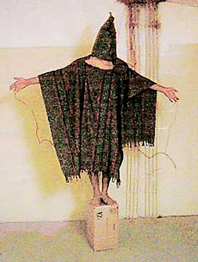
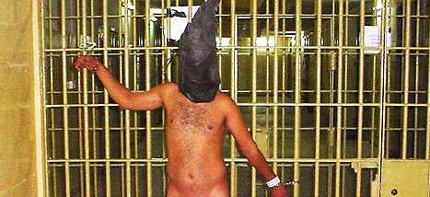
Echos from the Past
Europe
1942
Iraq
2004

Slide 22
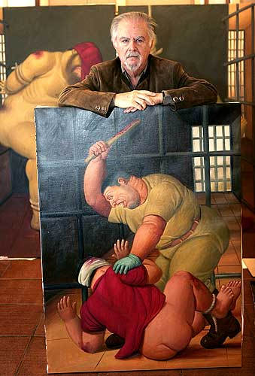

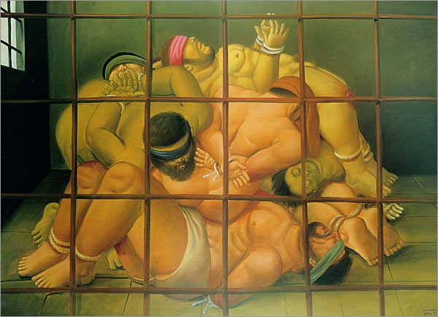

Slide 23
Roles of Medical Professionals Debated in Times of War
Lifton RJ. Doctors and Torture. N Engl J Med 2004; 351(5):415-416.
  Correspondence N Engl J Med 2004; 351(15):1571-1574.
Annas GJ. Unspeakably Cruel – Torture, Medical Ethics, and the Law. N Engl J Med 2005; 352(20):2127-2132.
Bloche MG, Marks JH. When Doctors Go to War. N Engl J Med 2005; 252(1):3-6.

Slide 24
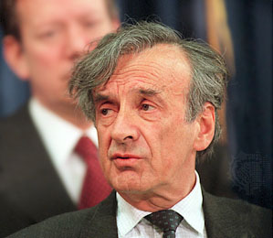
Elie Wiesel. Without Conscience.
N Engl J Med 2005; 351(15): 1511-1513
“Yet these horrors of medical perversion continued beyond Auschwitz … how can the recent, shameful torture to which Muslim prisoners were subjected by American soldiers be justified? Shouldn’t the prison conditions in Iraq have been condemned by legal professionals and military doctors alike?”
“Am I naive in believing that medicine is still a noble profession, upholding the highest ethical principles? For the ill, doctors still stand for life. And for us all, hope.”

