Slide 1

The Scientist and Society
Ted Wun, M.D., F.A.C.P.
Professor of Medicine, Pathology and Laboratory Medicine
Division of Hematology and Oncology

Slide 2
Why this topic?
This was a topic considered by many to be important in RCR but was left out of the final NIH recommendations
Tony Perez took my topic
An interesting personal conversation

Slide 3
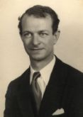
Chemistry
(1954)
Peace
(1962)

Slide 4
Linus Pauling (1901-1994)
Founding Father of molecular biology
Probably the most visible and accessible of American scientists
  Over 1,000 articles and books, 2/3 scientific
  Wrote many books for the public; notorious Vitamin C
  The Nature of the Chemical Bond is considered the most influential scientific book of the 20th century
Described sickle cell disease as a molecular abnormality of hemoglobin along with Harvey Itano

Slide 5
Linus Pauling: Social Activist
The day he had dinner with JFK in honor of Noble Prize winners, he picketed the White House to ban atmospheric nuclear testing
“Minimization of suffering” was his guiding ethical principle
Outspoken critic of nuclear weapons and “loyalty oaths” during the McCarthy era
  Asked other scientists to join him and presented a petition signed by 9,000 scientists to the U.N. in 1958; eventually signed by 11,000 (before the internet)
  Nuclear test ban treaty went into effect in 1963; on that same day Pauling was awarded the Nobel Peace Prize
Lifelong critic of war
Left his post at Caltech due to pressure from administrators

Slide 6
"It is sometimes said that science has nothing to do with morality. This is wrong. Science is the search for truth, the effort to understand the world; it involves the rejection of bias, of dogma, of revelation, but not the rejection of morality...."
Linus Pauling

Slide 7
What is the purpose of science?

Slide 8
Natural Philosophy
The term “science” was not coined until the 1800’s
  Newton’s “The Mathematical Principles of Natural Philosophy”
Many of histories great scientists wrote on “humanistic subjects”
  Aristotle, Boyle, Bacon, Descartes, Newton, Darwin, Einstein

Slide 9
“Hard” and “Soft” Science
Universities are split among the “humanities” and the “sciences”
  The commonly held conception that each “side” does not understand the other
    “How is an English Professor going to appropriately judge my work”
Economics, sociology, political “science” considered “pseudo-science” by many of us
Concept that the hard sciences are valueless, cold, complex, and inhumane

Slide 10
Science in Ancient Greece
Modern science began in Ancient Greece
  Natural explanations for natural phenomenon
  Socratic method
  Theories
  Observations and experiments
Did not have a split between science and other disciplines
  The basis for what we consider a liberal education is based on Greek intellectual life
  The highest type of knowledge was the form of the good

Slide 11
Science and the Renaissance
There was also not as dramatic a split between science and the arts
Leonardo da Vinci
  Detailed drawings of human anatomy, animals
  Inventor
  Mona Lisa

Slide 12
The Scientific Revolution
Copernicus, Galileo, Vesalius, Harvey, Newton
  Challenged Church dogma and thus the authority of the Church
Science was established as a social institution separate from Church and State
The Enlightenment
  Strong “faith” in science and technology
  “Belief” in the power of human reason
  Science should not concern itself with teleological explanations?

Slide 13
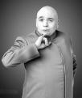
Science Grows in Influence
Science began to have broad influence on Western culture
  Scientific method applied to many areas of finance, government
Scientists became respected and influential
Backlash
  Luddites and Amish
  Thoreau’s Walden, Shelley’s Frankenstein
  Darwin
  “Mad Scientists”

Slide 14
Scientists and Social Responsibility
Many of the scientists that worked on the Manhattan project felt guilt and moral revulsion at their role in the bomb
  Robert Oppenheimer was especially haunted and opposed the development of the hydrogen bomb
    Also fell victim to McCarthyism
Rachel Carson’s Silent Spring
Union of Concerned Scientists, Environmental Defense, Council for Responsible Genetics, Science for the People, Center for Science in the Public Interest, AASS

Slide 15



Slide 16

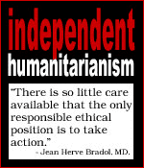
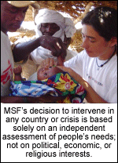

Slide 17
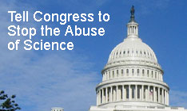

Slide 18
Obstacles of Social Responsibilty
Obligation not to disclose confidential information vs. the public interest
  Jeffery Wigand, Ph.D.
Personal interest and career ambitions
  Irving Weisman, M.D., testifying for stem cell research

Slide 19
Avenues of Influence on Policy: Objectivity vs. Advocacy
Provide expert testimony or opinions
Education of students
  Volunteer in the classroom
Conducting research that benefits society
  Refusing to do research that may be harmful to society
Assessing the impact of scientific research
Writing editorials with attached professional title
Lobbying Congress
Organizing/participating in rallies or protests
Voting

Slide 20
Recombinant DNA
In the early 1970’s, it became possible to do gene transfer
  Great excitement (EPO) and concern (the Andromeda Strain)
Asilomar Conference, February 1975
  140 scientists met to discuss ethical issues surrounding recombinant technology
  Recombinant DNA Advisory Committee

Slide 21
The Human Genome Project
Was it good to sequence the human genome?
Can you patent it?
Media spin on the race:
  Public versus private
  Societal benefit versus private profit
  Francis Collins versus Craig Venter
  Good versus Evil?
    One good thing: 4 years ahead, under budget

Slide 22
Issues Where UC Davis Faculty Have/Are Involved
Genetically Modified Crops
Laboratory Animals
Gun Control
MBTE as a carcinogen
Funding for Medical Research
Intelligent Design
Migrant worker health

Slide 23
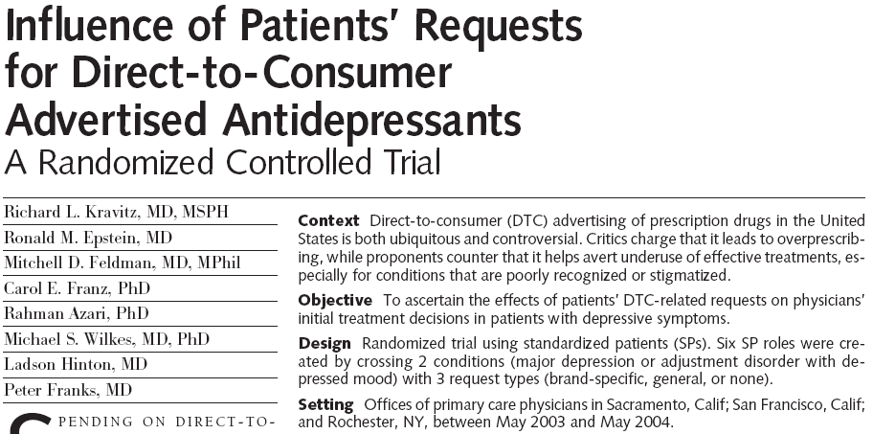

Slide 24
Case Discussion #1
You are an oncologists who repeatedly see patients who have received alternative treatments from a alternative medicine practitioner.
This patients pays $10,000 out of pocket for the treatments, which are based on the theory that enemas will purge the body of cancer causing toxins.
You advise your patient against this practice, but he tells you that this practitioner has hundreds of patients who are cured and has a thriving practice as evidenced by his Ferrari.
What, if any, action should you take?

Slide 25
Who Decides Funding Priorities?
Let science happen, the practical applications will come
“Disproportionate” funding for HIV? Breast Cancer? Women’s Health? Lung Cancer? Prostate Cancer?
Should you try to influence these priorities?

Slide 26
Case Discussion #2
You are a molecular biologists and live in Lawrence, Kansas and have a child entering the 7th grade.
The school board decides to affix a warning label to the science textbook that the theory of natural selection is only that, and alternative explanations such as “intelligent design” are legitimate, alternative explanations.
You want your child to attend public school but are very concerned about this policy. What are you going to do?

Slide 27
Case Discussion #3
Dr. O is working on an oral iron chelator for thalassemia patients with iron overload
  She notes a number of hepatic adverse events and wants to publish these results
She has signed a confidentiality agreement with the sponsoring pharmaceutical company, and the executives of the company and one of her collaborators oppose publication of the results to date
What does Dr. O do?

Slide 28
Case Discussion #4
You are a 2nd year neurobiology graduate student studying Alzheimer’s disease in the lab of a prominent researcher (PR).
In response to the California stem cell initiative, PR elects to change the focus of his research as proposes to use ESC in his research.
You are opposed to ESC research on religious grounds, but PR has no other projects for you.
Should you refuse to work on this research?

