Slide 1




Slide 2

Animals kept and used in many capacities in our society
Growing public awareness of animal issues and growing discussion about our obligations to animals
  Animal ethics
Evident in increasing legal protection for animals
  Anti-cruelty statutes date as far back as the 1600s, but comprehensive legal protections for animals are a product of the 20th century
  Animal law

Slide 3


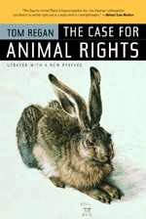


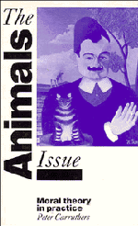


Slide 4

Many factors have affected this interest
  Urbanization
  Pet-keeping
  Television
  Technological developments
  Affluence
Role of animal experimentation
  In using animals as models, has emphasized commonalities between humans and animals and so blurred the moral boundaries

Slide 5

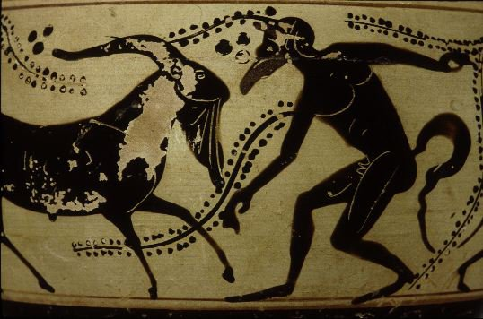
Greeks and Romans studied animals to understand how organisms functioned (and malfunctioned)
Played an important role in Arabic medicine until the 15th century
16th century – ban on human dissection by Catholic Church

Slide 6

Real beginnings in the 17th century with the development of the field of physiology
  Blood circulation – 1628
  Function of lungs – 1667
  Blood pressure – 1733
Experiments became increasingly complex and invasive
  Unanesthetized animals (ether not discovered until 1866)
  Also became more public

Slide 7
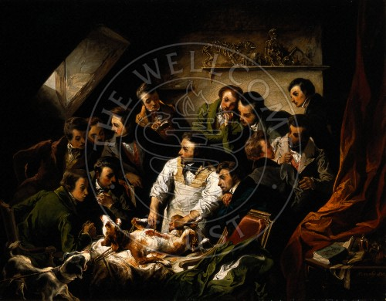

Slide 8
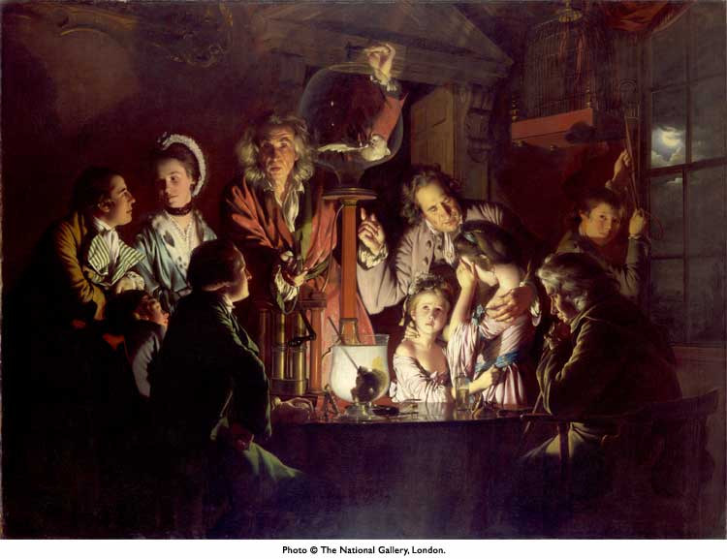

Slide 9

“Unhappily…the subjects of animal physiology are sentient, and every experiment is attended by pain and suffering” – Marshall Hall, early 19th century physiologist
  Lack of an alternative
  Clear objective
  The avoidance of repetition of work
  The need to minimize suffering
  Full and detailed publication of the results

Slide 10
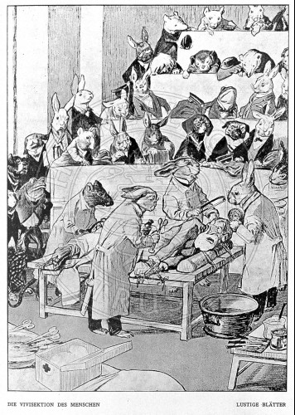

Slide 11

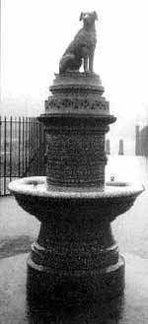
Old Brown Dog riots (UK) [Lansbury]
1876 Cruelty to Animals Act (UK)
Antivivisection movement in US (first peak 1880-1910)
Resurgence of concern in 1940s, Animal Welfare Act passed in 1964

Slide 12
Many philosophers throughout history have articulated philosophical views about the treatment of animals
  Aristotle, Kant, Descartes, Bentham
Many religions also contain ethical precepts about the treatment of animals
However, animal ethics as a formal field is relatively new

Slide 13
Legally, animals are classified as property
However, morally we treat animals as more than property (mostly), that is as beings that have interests
This does not imply that there is a societal consensus about the treatment of animals, because there is not!
Treatment and use of animals is very situation-dependent and varies culturally
Ideas about this topic are in a state of flux

Slide 14
?

Slide 15

Capacity to experience pain
Capacity to experience other positive or negative emotional states (pleasure, fear)
Intelligence (rational)
Intentionality (goals, purposes)
Consciousness
Self-awareness
Relationships with humans (which creates human obligations towards them)

Slide 16
Understanding the degrees to which animals have these capacities is a matter for scientific investigation
That investigation is integral to the scientific field of animal welfare
There is general (although not universal) agreement that all vertebrate animals experience pain and certain basic emotions (e.g. fear)
Possession of other characteristics that confer interests is less clear

Slide 17

“Anything goes”
Abolitionism
The troubled
middle

Slide 18

Humane beneficence
(Jerry Tannenbaum)
Animals do not have an inherent right to life
They may be used and killed for a variety of legitimate human purposes
However, when they are so used we should strive not to cause them pain (or suffering), or at least no more than is necessary
When animals do not experience any pain in the service of a legitimate human end, there is no moral issue
  But also often place value on the animal’s life

Slide 19

Advancing scientific knowledge
  Animal behavior, development, or biological function
  Understand basic physiological and genetic processes
Applied studies
  Pest management, improving animal welfare, conservation biology and ecology
Models for human (or animal) disease
  Understand disease processes, develop preventative and therapeutic measures; testing of medical devices
Toxicity testing
  Safety of potentially hazardous products (household products, cosmetics, etc)

Slide 20

Worldwide it is estimated that 50-100 million animals are used each year in research; in the U.S. about 20 million
  In the U.S. each year we raise about 14 billion animals for food, and keep more than 163 million dogs and cats as pets
Worldwide, use has decreased by 30-50% since peak in 1975-80
  Mainly due to decreased use of animals for testing
  But numbers of mice now increasing dramatically; fish also on the increase
About 80-90% of animals used in research are rodents (purpose-bred rats and mice)

Slide 21

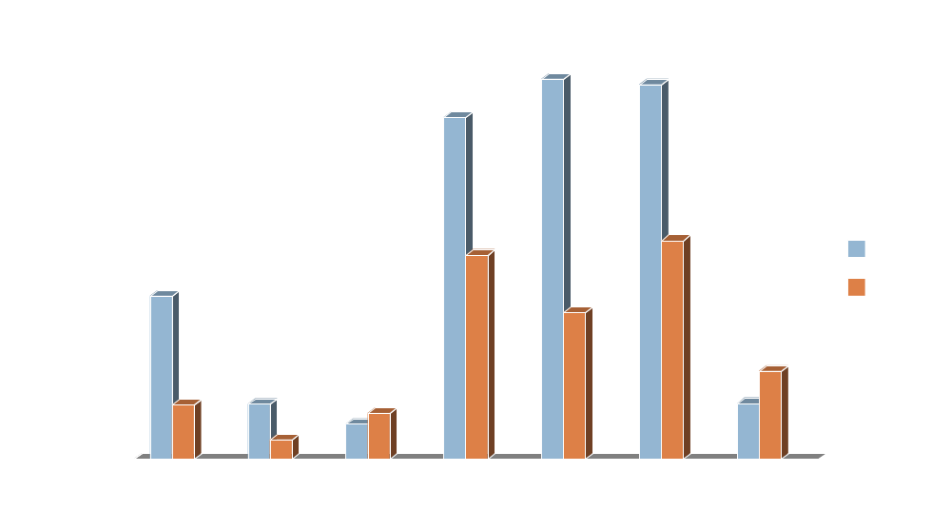

Slide 22

Fundamental biological studies 35%
Medical R&D ¹ 31%
Medical production and QC¹ 16%
Toxicology and safety 10%
Education and training 3%
Disease diagnosis 2%
Other 6%
^{I} Both human and veterinary

Slide 23

The majority of animals used in research are used in non-painful procedures, or their pain (or distress) is alleviated by anesthetics, analgesics, or other measures
Unalleviated pain
  US: 8% (but poor statistics)

Slide 24
Research is the most highly regulated activity involving animals in the US
  This is largely a historical accident having very little to do with research itself!

Slide 25
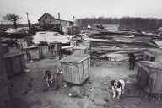

Slide 26
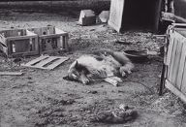

Slide 27
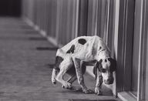

Slide 28
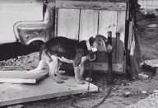

Slide 29

Federal laws and regulations
  Animal Welfare Act (AWA)
  Health Research Extension Act of 1985 (“PHS”; Public Health Service)
  Marine Mammal Protection Act
  Endangered Species Act
State laws and regulations

Slide 30

Covers animals used or bred for exhibit, and for biomedical research, teaching, or testing
Congress gave regulatory authority to USDA to develop standards for certain species (dogs, cats, primates, rabbits, guinea pigs, hamsters) and to determine which other animals should be covered
Coverage has been extended several times (e.g. to wild rodents, farm animals used in biomedical research)
However, by law (now) the following are excluded from coverage – purpose bred rats and mice, farm animals used in agricultural research and teaching

Slide 31

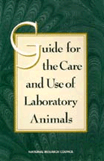
In parallel, the NIH was developing voluntary guidelines (1963)
These were made mandatory for all institutions receiving PHS funds under the Health Research Extension Act of 1985 – PHS Policy
Federal granting agencies require that these guidelines be followed
The guidelines cover all vertebrate animals used in biomedical research

Slide 32

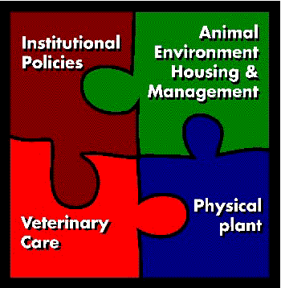

Slide 33

Administered by USDA
Lengthy, specific regulations in the Code of Federal Regulations
At least yearly inspections of facilities and paperwork
Potential for severe disciplinary action, including fines
Administered by the Office of Laboratory Animal Welfare (OLAW) of the NIH
Covers only research animals in federally-funded projects
Some standards, but mainly depends upon written “assurance” filed by covered institutions
Inspections possible, but occur only after a complaint or suspected problems
Potential for severe disciplinary action, including cutting off federal funding

Slide 34
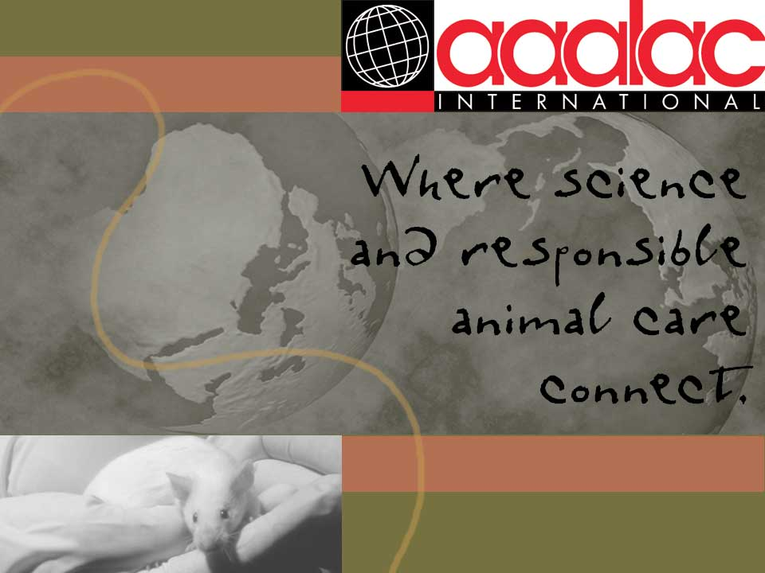
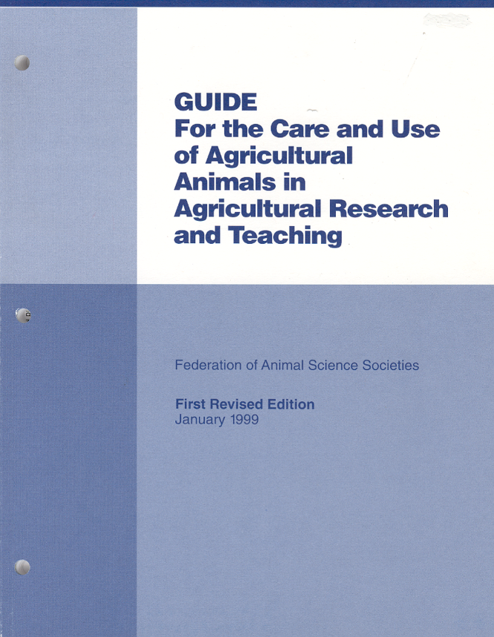
Voluntary standard.
Developed by animal
scientists
Voluntary certification organization
The Gold Standard
Over 700 accredited institutions worldwide
Visit every three years

Slide 35

“Procedures involving animals should be designed and performed with due consideration of their relevance to human or animal health, the advancement of knowledge, or the good of society.”
“The animals selected for a procedure should be of an appropriate species and quality and the minimum number required to obtain valid results. Methods such as mathematical models, computer simulation, and in vitro biological systems should be considered.”
US Government Principles for the Utilization and Care of
Vertebrate Animals Used in Teaching, Research & Training

Slide 36

Proper use of animals, including the avoidance of minimization of discomfort, distress, and pain when consistent with sound scientific practices, is imperative. Unless the contrary is established, investigators should consider that procedures that cause pain and distress in human beings may cause pain or distress in other animals.
“Procedures with animals that may cause more than momentary or slight pain or distress should be performed with appropriate sedation, anesthesia, or analgesia. Surgical or other painful procedures should not be performed on unanesthetized animals paralyzed by chemical agents

Slide 37

“The living conditions of animals should be appropriate for their species and contribute to their health and comfort.” ...
Investigators and other personnel shall be appropriately qualified and experienced for conducting procedures on living animals.
Where exceptions [to these principles] are required…..the decisions should not rest with the investigators directly concerned but should be made by….an appropriate review group such as the institutional animal care and use committee

Slide 38

There are specific regulations and expectations in the Animal Welfare Act
However, the focus otherwise is on responsible decision-making
  Professional judgment & performance-based outcomes
  Tailoring the process to arrive at best solutions for each institution
  IACUC

Slide 39

Scientist who uses animals in research
Veterinarian
Non-scientist
Non-affiliated member who does not use animals in research and who is intended to represent the general’s community’s interest in the treatment of animals

Slide 40
Works with the veterinarian and responsible official (Institutional Official) to establish policies and procedures for animal use
Oversees training of staff in responsible animal care and use
Oversees occupational health and safety program for animal users
Responds to “whistleblower” concerns about the treatment of animals

Slide 41
Inspects animal facilities and animal holding areas semi-annually
Exercises oversight over other areas where procedures are performed on animals (e.g. investigator laboratories)
Conducts a semi-annual program review
Must approve procedures involving animals before they can be performed (protocol review)

Slide 42

Three R’s (Russell and Burch)
  REDUCTION: Reduce numbers of animals used to smallest number possible to achieve goals of research
  REPLACEMENT: Replace animals with non-animal models, or with less sentient species
  REFINEMENT: Minimize pain and distress experienced by the animal

Slide 43

Pain relief
Appropriate euthanasia (AVMA Panel on Euthanasia, 2000)
Earliest possible endpoint
Best/least stressful techniques (e.g. blood sampling, restraint)
Training of researchers

Slide 44

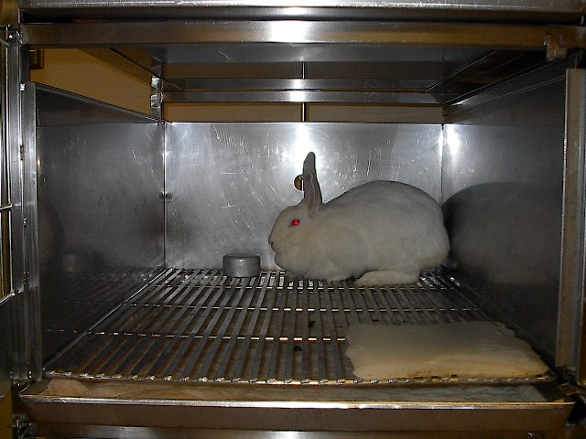
Notes:
In the US, laboratory rabbits are traditionally housed individually in small, barren cages. This type of housing is problematic for several reasons.
The amount of space provided does not allow rabbits to express certain normal behaviors such as taking a single full hop, stretching out fully, and rearing up.
In addition to not being able to express these normal behaviors, rabbits housed in cages often express abnormal behaviors such as bar-biting, biting the floor grid, drinker pressing.
Laboratory rabbits are also more susceptible to osteoporosis due to the inability to move around much.
These problems are exacerbated by the fact that rabbits are often housed in these cages for several years.
Previous attempts to provide enrichments have included the provision of parrot and cat toys.
In our own Small Animal Colony, rabbits receive boards to rest on (this white square seen in the front) and small metal cups to toss around (seen along the back wall)
However, due to space constraints, more biologically relevant objects have not really been tried.

Slide 45

Low
High
L
E
S
S
J
U
S
T
I
F
I
E
D
M
O
R
E
J
U
S
T
I
F
I
E
D
Importance of experimental/testing aim
High
Low
Severity/length of pain/distress
High
Low
Perceived value/moral status of animal
QUALITY OF RESEARCH?

Slide 46

Judging the importance of the science
  IACUCs do not necessarily have the expertise to evaluate particular experiments
  Rely on the peer review system (granting agencies)
  But not all experiments are peer reviewed

Slide 47

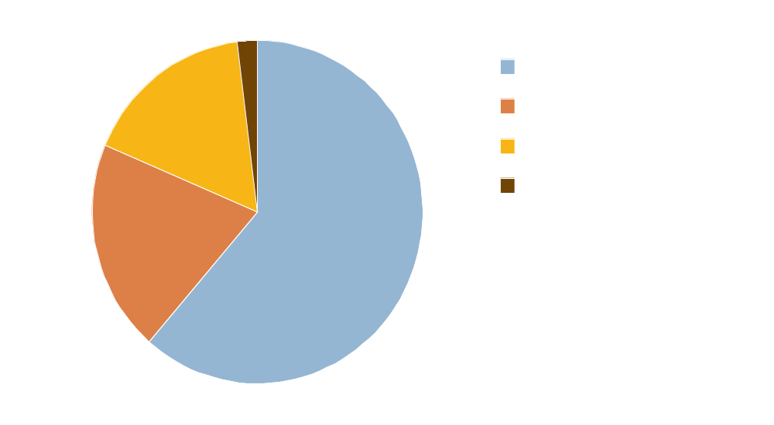
16.5%
20%
61.5%
41.6% of this research
unrelated to the later
clinical advance
Comroe and Dripps, 1977

Slide 48

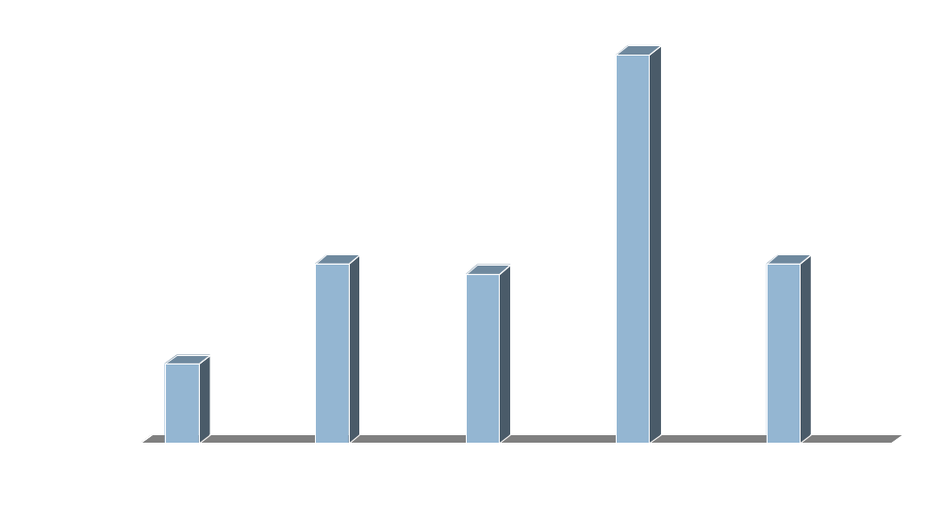
(Comroe and Dripps, 1977)

Slide 49
Judging the severity of pain or distress
  Our ability to measure and alleviate animal pain is far from perfect, although improving
  At present, we have comparatively little understanding of animals’ experience of distress, and hence methods to alleviate their distress
Assessing the moral value of the animal
  Imbued with cultural judgments, minimal scientific data

Slide 50

IACUCs receive little guidance from government authorities regarding what ethical issues they should consider or what ethical principles should be applied to important issues
There is some evidence that different IACUCs can come to different conclusions given the same or similar animal use protocols.
However, there is also no doubt that IACUC oversight has benefited animals and animal research

Slide 51

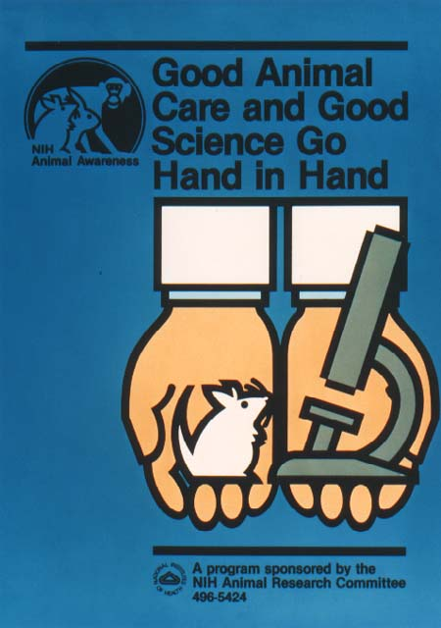
Institutional Commitment
Researchers
Veterinarians
Animal Caretakers
Animal Facility Managers

Slide 52

Second-largest animal research program in the US (behind NIH)
I.O. Vice Chancellor for Administration
19-member IACUC
1400 active animal care protocols
Animal facilities both on- and off-campus
Visited by USDA about every 2 weeks
AAALAC accredited
Extensive policies and standards

Slide 53
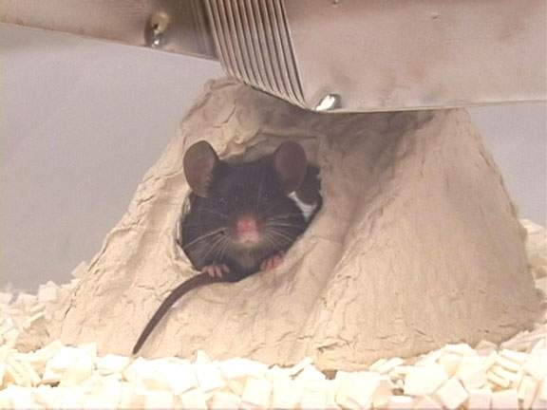
Check out
http://ehs.ucdavis.edu
The End

