Slide 1
Time Line for Human Subject Research and Protection
Declaration of Helsinki - 1964
Nuremberg Code - 1947
WWII – 1939-45
Eugenics Movement
1900 | 10 | 20 | 30 | 40 | 50 | 60 | 70 | 80 | 90 | 2000

Slide 2
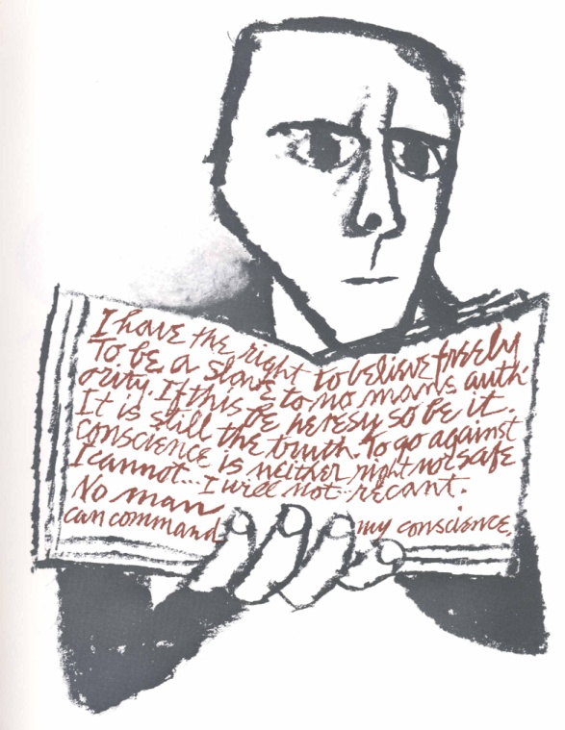
Declaration of Helsinki – 1964
Ethical Principles for Medical Research
Involving Human Subjects
“… a statement of ethical principles to provide guidance to physicians and other participants in medical research involving human subjects.”
“It is the duty of the physician to promote and safeguard the health of the people. The physician’s knowledge and conscience are dedicated to the fulfillment of this duty.”
“In medical research on human subjects, considerations related to the well being of the human subject should take precedence over the interests of science and society.”
World Medical Association
Updated 1975, 1983, 1989, 1996, and 2000
Ben Shahn – Credo - 1966

Slide 3
Time Line for Human Subject Research and Protection
Tuskegee Study – 1932-72
Declaration of Helsinki - 1964
Nuremberg Code - 1947
WWII – 1939-45
Eugenics Movement
1900 | 10 | 20 | 30 | 40 | 50 | 60 | 70 | 80 | 90 | 2000

Slide 4
Time Line for Human Subject Research and Protection
Belmont Report - 1979
Tuskegee Study – 1932-72
Declaration of Helsinki - 1964
Nuremberg Code - 1947
WWII – 1939-45
Eugenics Movement
1900 | 10 | 20 | 30 | 40 | 50 | 60 | 70 | 80 | 90 | 2000

Slide 5
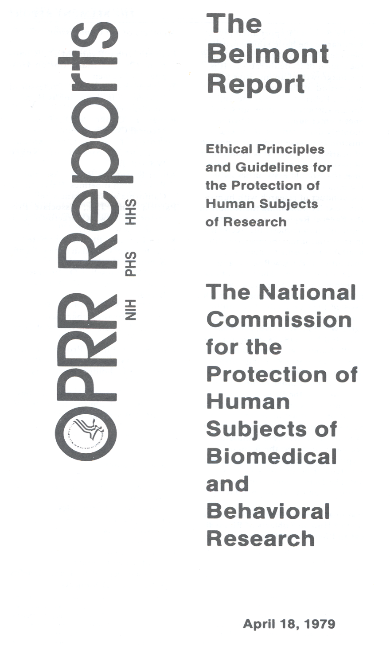
National Research Act - Public Law 93-348 – July 12, 1974 - Establishes the National Commission
Charge to Commission:
  Identify the basic ethical principles that should underlie the conduct of biomedical and behavioral research involving humans subjects
  Develop guidelines which should be followed to assure that such research is conducted in accordance with those principles
Smithsonian Institution’s Belmont Conference Center – February 1976

Slide 6
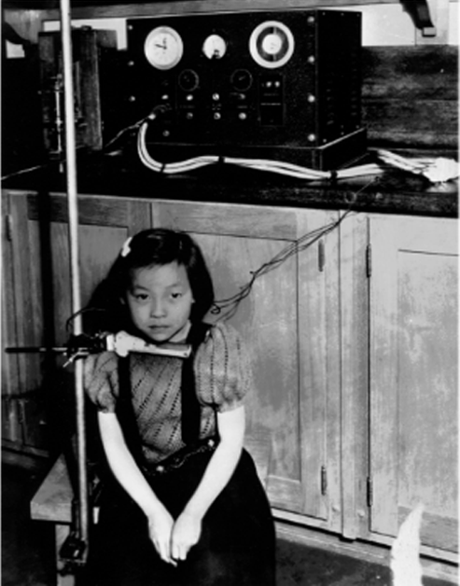
Belmont Report – Basic Ethical Principles Respect for Persons
“Respect for persons incorporates at least two ethical convictions; first that individuals should be treated as autonomous agents, and second, that persons with diminished autonomy are entitled to protection.”
“To respect autonomy is to give weight to the autonomous persons’ considered opinions and choices ….”
Department of Energy
Radiation Counting in Child – 1950s

Slide 7
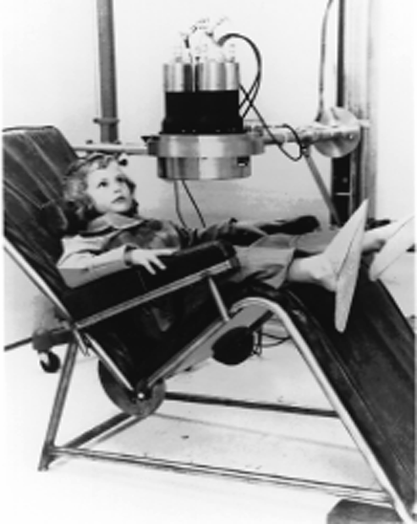
Belmont Report – Basic Ethical Principles Beneficence
“Persons are treated in an ethical manner … by making efforts to secure their well being … In this document, beneficence is understood … as an obligation.”
“Two general rules have been formulated as complementary expressions of beneficent actions in this sense: (1) do not harm and (2) maximize possible benefits and minimize possible harms.”
Department of Energy
Radiation Counting in Child – 1950s

Slide 8
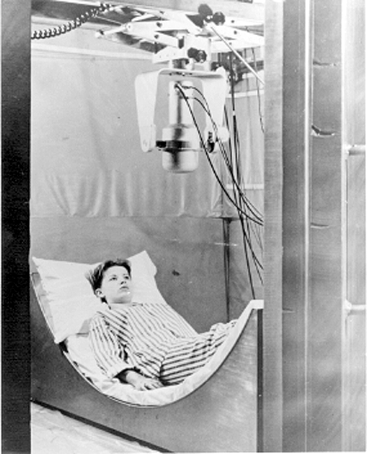
Belmont Report – Basic Ethical Principles Justice
“Who ought to receive the benefits of research and bear its burdens? This is a question of justice in the sense of ‘fairness in distribution’…”
“… the selection of research subjects needs to be scrutinized … to determine whether some classes (e.g., …persons confined to institutions) are being … selected simply because of their easy availability, their compromised position, or their manipulability, rather than for reasons directly related to the problem being studied.”
Department of Energy
Radiation Counting in Child – 1950s

Slide 9
Time Line for Human Subject Research and Protection
I.R.B.s
Belmont Report - 1979
Tuskegee Study – 1932-72
Declaration of Helsinki - 1964
Nuremberg Code - 1947
WWII – 1939-45
Eugenics Movement
1900 | 10 | 20 | 30 | 40 | 50 | 60 | 70 | 80 | 90 | 2000

Slide 10
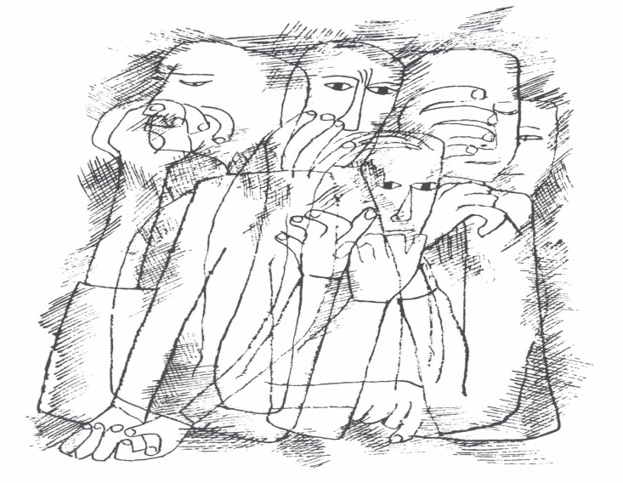
Institutional Review Boards (IRB)
Responsibilities
  Review informed consent document
  Assess risks and benefits of proposed research
  Review subject selection
Constitution
  At least five members
  Varied backgrounds
  Scientists
  Non-scientists
  Community members
Ben Shahn - 1965

Slide 11
Time Line for Human Subject Research and Protection
Common Rule - 1991
I.R.B.s
Belmont Report - 1979
Tuskegee Study – 1932-72
Declaration of Helsinki - 1964
Nuremberg Code - 1947
WWII – 1939-45
Eugenics Movement
1900 | 10 | 20 | 30 | 40 | 50 | 60 | 70 | 80 | 90 | 2000

Slide 12
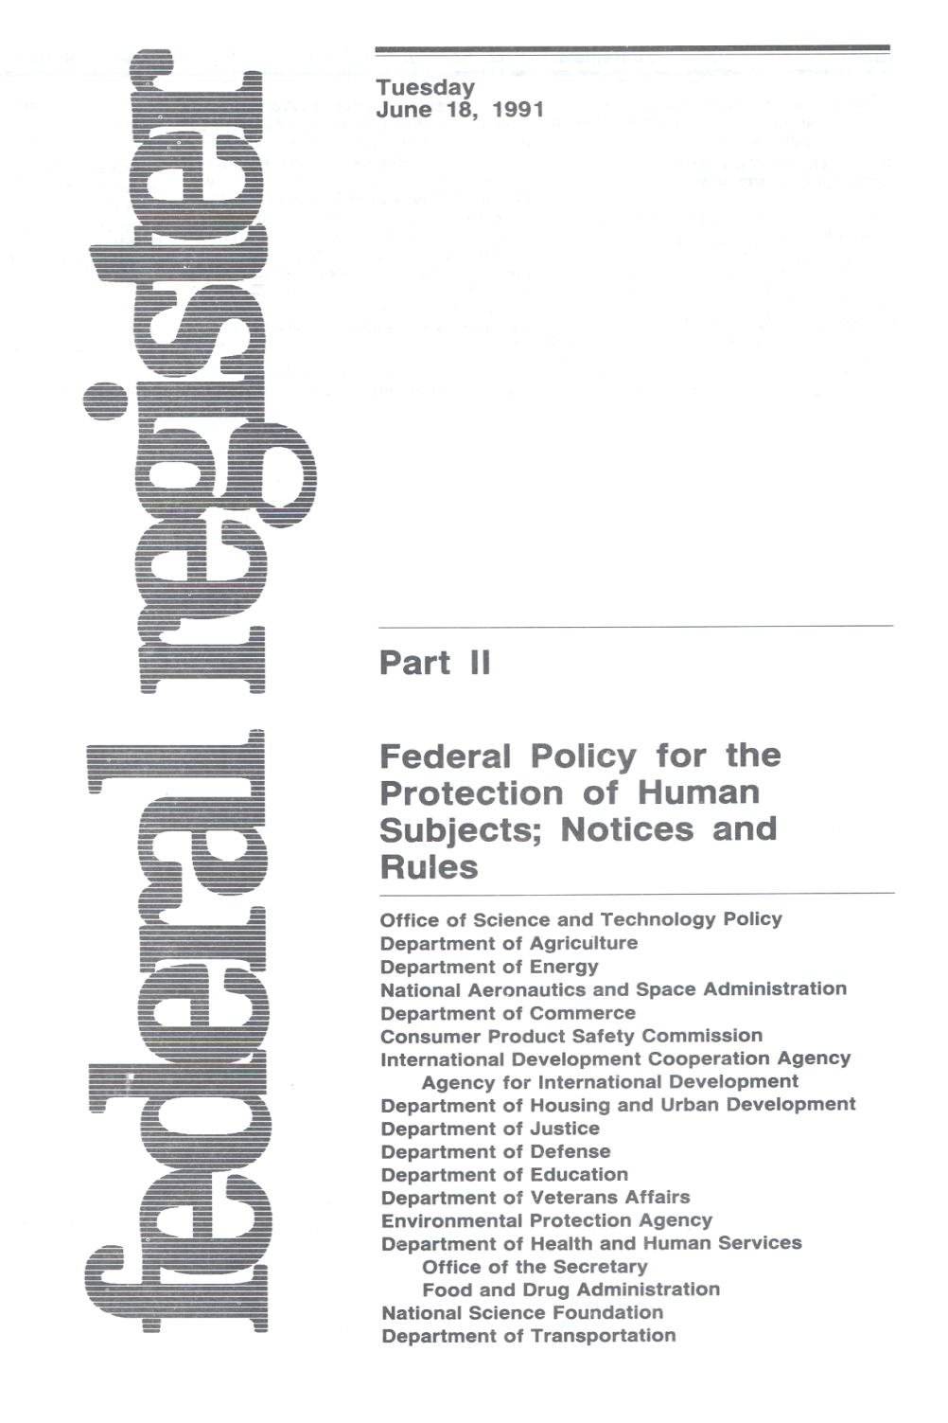
“Common Rule”
Subpart A45 CFR 46
Agreed to by 16 Federal Agencies
Effective August 19, 1991
Sets forth as a common rule requirements for the protection of human subjects involved in research conducted by Federal Departments and Agencies

Slide 13

Jesse Gelsinger (Age 18)
Facts
  University of Pennsylvania
  Institute for Human Gene Therapy
  Ornithine Transcarbamylase (OTC) Deficiency
  Adenovirus Vector
  Dies September 17, 1999
Issues
  Problems not reported to IRB
  Eligibility questions
  Conflicts of Interest

Slide 14

Ellen Roche (Age 24)
Facts
  Johns Hopkins Medical Institution
  Healthy Volunteer
  Study of Airway Reactions
  Inhales Hexamethonium
  Dies June 2, 2001
Issues
  Institutional Responsiveness
  Inadequate IRB Review
  Studies from 1950s
  describing Hexamethonium
  toxicities not identified

Slide 15
Time Line for Human Subject Research and Protection
R.S.A.
Common Rule - 1991
I.R.B.s
Belmont Report - 1979
Tuskegee Study – 1932-72
Declaration of Helsinki - 1964
Nuremberg Code - 1947
WWII – 1939-45
Eugenics Movement
1900 | 10 | 20 | 30 | 40 | 50 | 60 | 70 | 80 | 90 | 2000

Slide 16
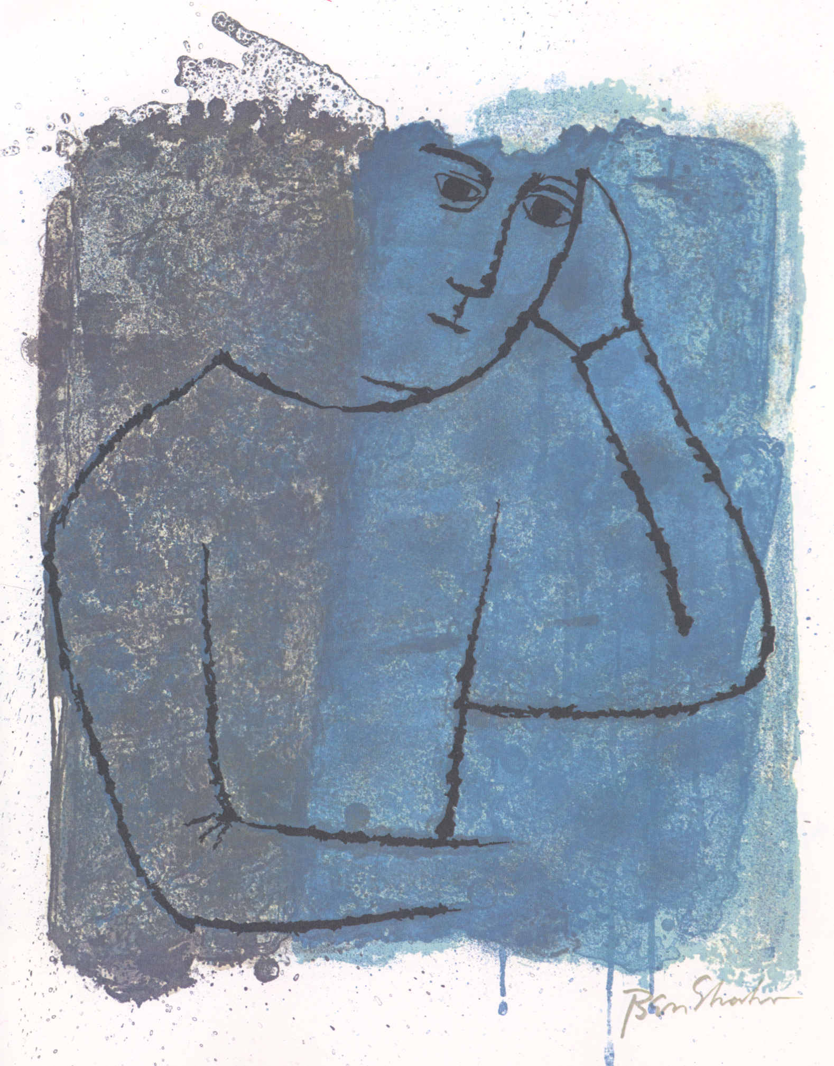
Research Subject Advocates (RSA)
New positions within the GCRCs (2001)
Educate investigators and facilitate the informed consent process
Assist in developing data safety monitoring plans for research protocols
Audit research records to assure compliance with federal regulations
Ben Shahn – In Quiet Rooms - 1969

Slide 17

Over the past century, the process of conducting research with human subjects has improved with substantial gains in human health.
Yet each day brings new challenges, and we must remain vigilant.
Ben Shahn – Birds Fly - 1968

