Slide 1
Industry/FDA/Academia Safety Graphics Working Group
Introduction and Overview
FDA/QSPI Biostatistics, Statistical Programming,
and Data Management Summit
March 8, 2012
FDA White Oak Campus
Notes:
ICSA 2011

Slide 2
Motivation
Tables: most presentations of safety data convey information in tables
often difficult to understand, especially when data are complex
volume and complexity of presentations complicate regulatory review
may obscure important relationships
Graphical displays: more effective and more efficient
communicate critical safety information
facilitate rapid integration and dissemination of new information
Notes:
Identify areas particularly applicable or useful to regulatory review in which we would like to answer some questions (What are the questions?)
Recommend graphics for clinical data based on good graphical principles developed by individuals like Cleveland and Tufte. (Draw up what would be effective to address (a).)
ICSA 2011

Slide 3

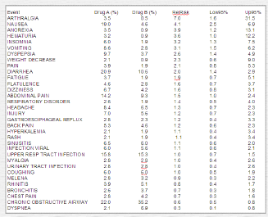
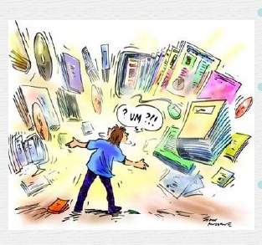
Where is the signal?
Notes:
ICSA 2011

Slide 4
Example: Understanding the Trend
Tabular Summary of Systolic Blood Pressure Over Time:
 | Active Drug |  |  |  |  | Control Drug
Visit | N | Mean | SD | 95% CI |  | N | Mean | SD | 95% CI
1 | 112 | 118.1 | 1.3 | (115.9, 120.3) |  | 113 | 119.1 | 1.2 | (117.0, 121.2)
2 | 112 | 122.7 | 1.4 | (120.4, 125.0) |  | 112 | 119.1 | 1.1 | (117.0, 121.2)
3 | 111 | 125.6 | 1.0 | (123.6, 127.6) |  | 110 | 114.4 | 1.2 | (112.3, 116.5)
4 | 110 | 133.1 | 1.2 | (131.0, 135.2) |  | 108 | 124.2 | 1.4 | (121.9, 126.5)
5 | 110 | 136.7 | 1.2 | (134.6, 138.8) |  | 108 | 123.8 | 1.2 | (121.7, 125.9)
6 | 108 | 134.2 | 1.1 | (132.1, 136.3) |  | 108 | 114.9 | 1.1 | (112.8, 117.0)
7 | 106 | 131.0 | 1.2 | (128.9, 133.1) |  | 104 | 120.1 | 1.2 | (118.0, 122.2)
8 | 105 | 126.2 | 1.3 | (124.0, 128.4) |  | 103 | 121.6 | 1.2 | (119.5, 123.7)
9 | 104 | 124.3 | 1.2 | (122.2, 126.4) |  | 100 | 118.6 | 1.1 | (116.5, 120.7)
10 | 102 | 125.1 | 1.2 | (123.0, 127.2) |  | 100 | 117.7 | 1.3 | (115.5, 119.9)

Slide 5
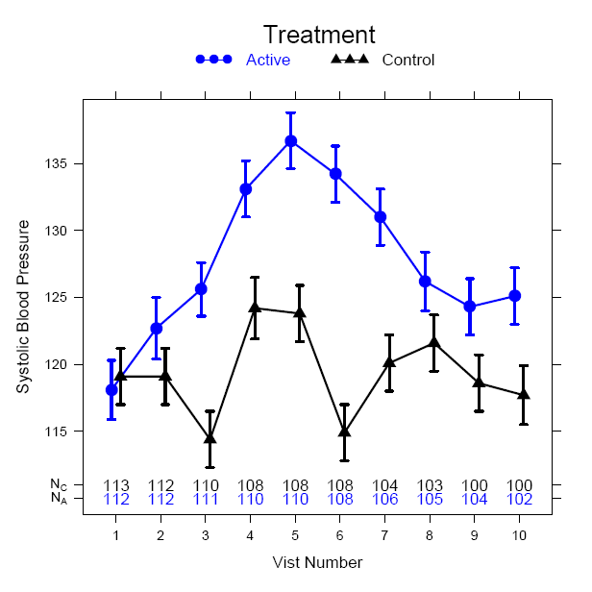
Example: Understanding the Trend
Systolic Blood Pressure
Visit Number
Notes:
Can see how much easier it is to see the trend with a graph.
Reasons to Include Graphic Summaries
Complex statistical concepts and data structures can be conveyed at a level which is within reach to those with little statistical training
Ability to highlight key safety signals from large data bases
Paradigm is to actively assess the data in a manner that is visual, intuitive, and geometric

Slide 6
Barriers to Graph Creation
Lack of Training: graph construction and good graphical principles not typically covered in coursework
Limited Publications of graphical approaches for clinical trial data
Time constraints
  May require creation after data base lock
Software dependency
  Software needed may not be allowed/available
  Can be a big learning curve for new software
Notes:
It is prohibitive from a resource perspective to bring in new software to a big company.

Slide 7
FDA/Industry/Academia Working Group
Formed: Fall 2009
Membership
    Regulatory (17 members): FDA
    Industry (14 members): Pfizer, GSK, Johnson and Johnson, Novartis, Eli Lilly, Merck, Sanofi-Aventis, Roche, Amgen, Actelion
    Academia (2 members): Vanderbilt, UC-Davis

Slide 8
Members of the FDA/Industry/Academia Safety Graphics Working Group
Regulatory: Mat Soukup, George Rochester, Antonio Paredes, Chuck Cooper, Eric Frimpong, Hao Zhu, Janelle Charles, Jeff Summers, Joyce Korvick, Leslie Kenna, Mark Walderhaug, Pravin Jadjav, Richard Forshee, Robert Fiorentino, Suzanne Demko, Ted Guo, Yaning Wang,
Industry: Brenda Crowe, Ken Koury, Andreas Brueckner, Andreas Krause, Fabrice Bancken, Larry Gould, Liping Huang, Mac Gordon, Matthew Gribbin, Navdeep Boparai, Qi Jiang, Rich Anziano, Susan Duke, Sylvia Engelen,
Academia: Frank Harrell, Mary Banach
Co-leads are in bold font
Notes:
Note: names will be updated before presentation.

Slide 9
Project Vision and Objectives
Enhance understanding of safety information obtained from clinical trials
Facilitate and promote development and use of effective graphical displays
Communicate critical safety information effectively and efficiently
  Create a scientific forum
    discussion, development, and recommendation of graphics
    based on good scientific principles and best practices
  Identify applications useful for regulatory review
  Provide a palette of statistical graphics
    publicly-available repository
    includes data sets and programming code
    encourages interactions among the user community
  Engage stakeholders through outreach activities
    promotion and dissemination of methods and best practices
    sharing experiences and effective examples

Slide 10
Working Group Structure
Focus:
Identify important clinical questions for safety reporting and signal detection
Develop appropriate graphical displays
Four Subgroups: Leaders:
ECG/Vitals Rich Anziano
General Adverse Events Liping Huang and Qi Jiang*
Labs/Liver Mac Gordon
General Principles Susan Duke**
* Previously led by Stephine Keeton and Janelle Charles
** Previously led by Rich Forshee and Fabrice Bancken

Slide 11
Addressing the Barriers
Lack of Training: Develop materials to help scientists select the right graph; outreach through presentations
Limited Publications: Materials presented in a public forum
Time Constraints: Standard set of views reduces time to develop graphics; can be planned upfront
Software Dependency: Code to create graphics will be publicly available; examples are included from multiple software packages

Slide 12
Distribution of Content
Information is becoming publicly available at CTSpedia (www.ctspedia.org)
CTSpedia is an online collection of best practices, tools, educational materials, and other items about biostatistics, ethics, and research design.
Site is constantly updated/changed to help users.
Notes:
Mary Banach wants me to tell people that she appreciates any comments or suggestions that users give her.

