Slide 1
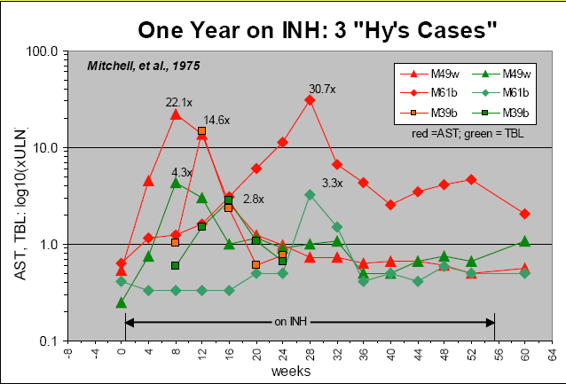
Questions 1,2,3,5
1: ‘ Time course of AST and TBIL in three subjects’ Notes: Lighten or remove gray background. Color choice and line styles work well. Limit this graphic to 1 subject with an option to have multiple panels for additional subjects. If multiple panels, use single legend as numerous will be illegible. [Mitchel et al, ‘Acetylation rates and monthly liver function tests during one year of isoniazid preventative therapy’ 1975]
Graphic display of the time course of serum aspartate aminotransferase AST (red) and total bilirubin (green) values (measured after treatment was over) in three subjects treated with isoniazid (Data plotted from table 4 in report from Mitchel et al 1975.). All three fulfill present definition by Temple as “Hy’s Cases.” Despite this, all three adapted to the drug and became tolerant of it. Serum ALT was not measured in this study.

Slide 2
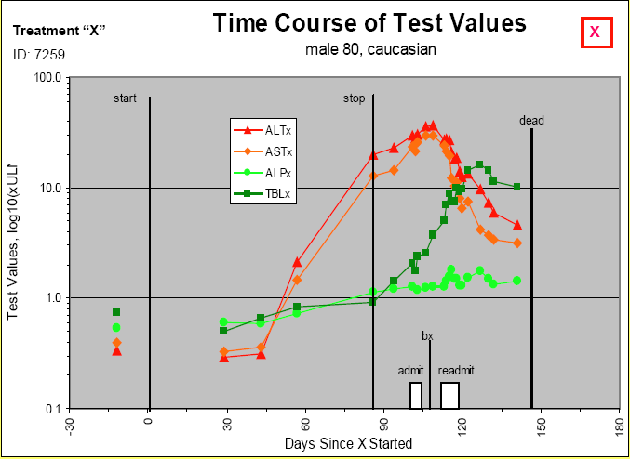
Questions 1,2,3,5
2: ‘Time course of test values’ Notes: Lighten or remove gray background. Color choice and line styles work well. Include horizontal dose bars (or lines as in figure 1) to show time on drug. Remove start and stop lines as well as the ‘dead’ line (or at least rename). Remove admit, bx, readmit boxes. Add reference lines for liver parameters. Add important med history on title or if lengthy, add below figure. [Mitchel et al, ‘Acetylation rates and monthly liver function tests during one year of isoniazid preventative therapy’ 1975]

Slide 3
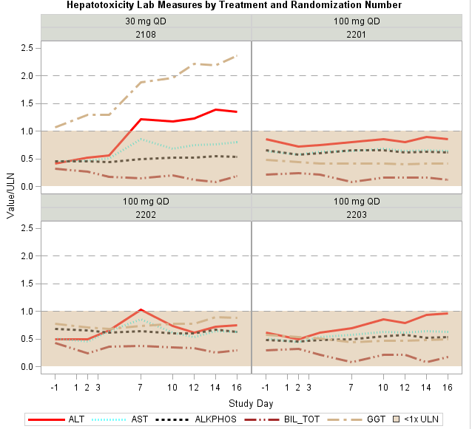
Questions 1,2,3,5
3: ‘Lab measures by treatment and randomization number’ Notes: Acceptable figure as it exists. Be sure that it is appropriate for more labs [Alain Smits – J&J]

Slide 4
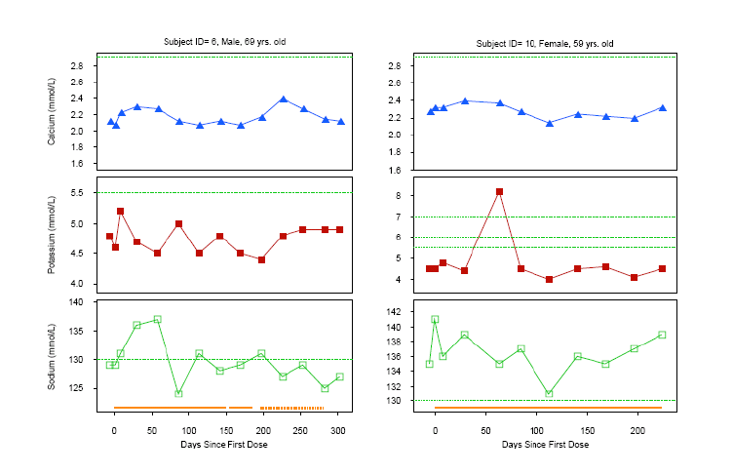
Questions 2,3,5
4: ‘Time Course of Test Values – Two Subjects’ Notes: Axis scales need to match. Legend needed for reference lines. [Michael O’Connell, Insightful Presentation, 2007]

Slide 5
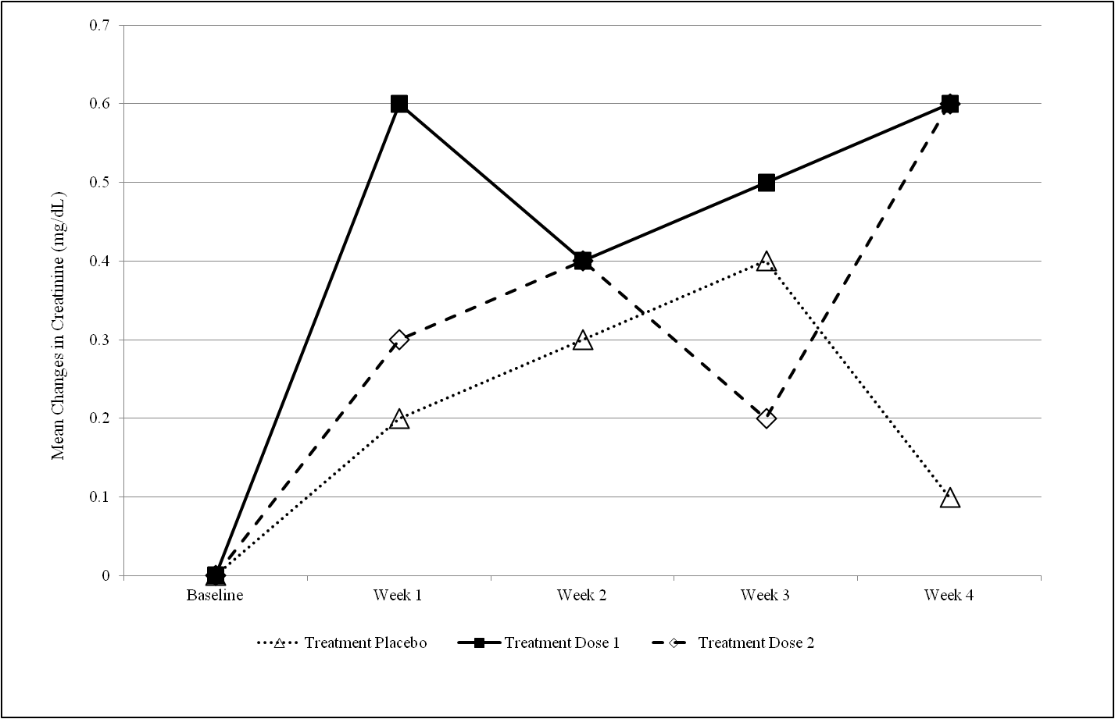
Questions 1,2,3,5
5: ‘Mean Change in Creatinine over Time’ Notes: Confidence intervals should be added to plot. Replace x-axis test with a numeric scale (i.e. Study Week similar to figure 6). [Robert Gordon – J&J]
Study Week
Placebo (at risk) | 160 | 157 | 152 | 150 | 147
Active (at risk) | 156 | 154 | 154 | 146 | 144

Slide 6
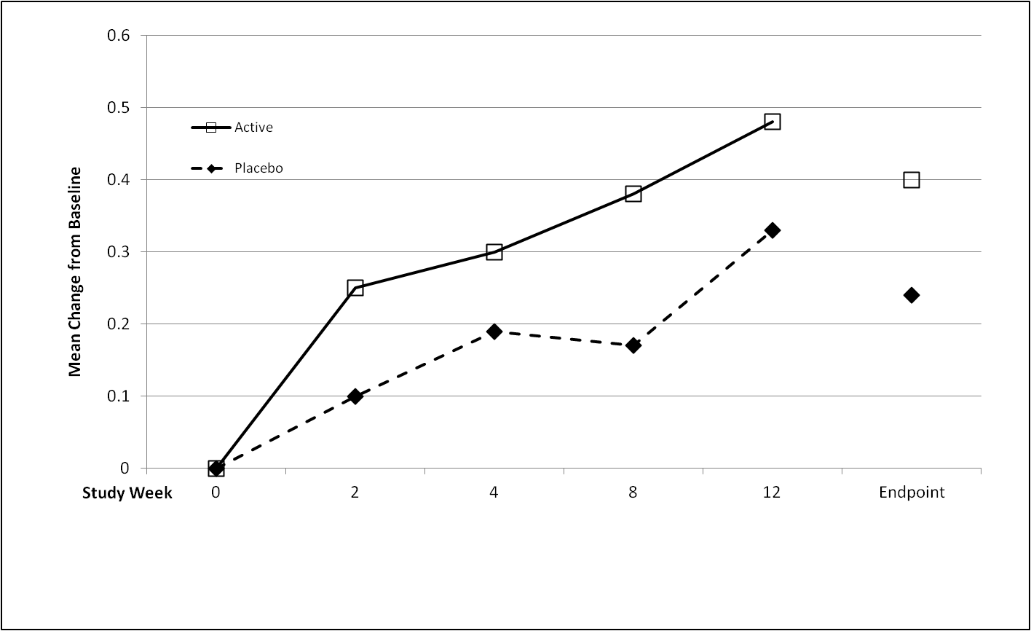
Questions 1,2,3,5
6: ‘Mean Change from Baseline over Time’ Notes: Confidence intervals should be added to the plot. [Robert Gordon – J&J]
Placebo (at risk) | 160 | 157 | 152 | 150 | 147 | 160
Active (at risk) | 156 | 154 | 154 | 146 | 144 | 156

Slide 7
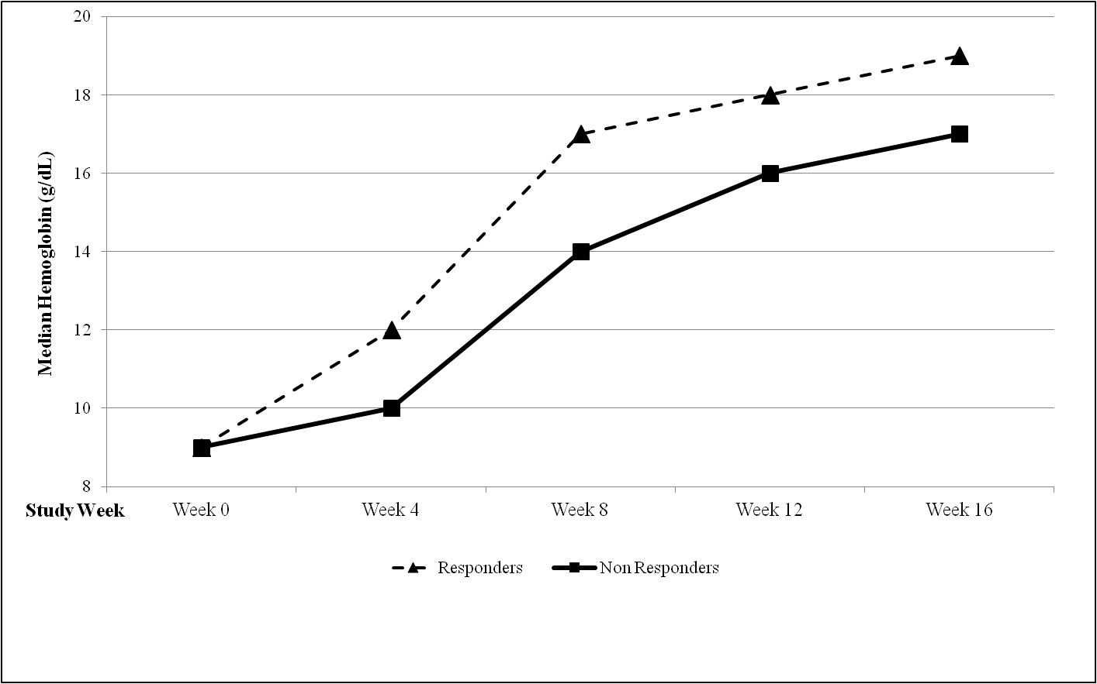
Questions 1,2,3,5
7: ‘Median/Mean hemoglobin (g/dL) over time by treatment’ Notes: If median, quantiles should be added. If mean, confidence intervals should be added. Include definition of population (responders, non responders in this case). X-axis should be numeric as in figure 6. Add counts as in figure 6 if possible. [Robert Gordon – J&J]
Placebo (at risk) | 160 | 157 | 152 | 150 | 147
Active (at risk) | 156 | 154 | 154 | 146 | 144

Slide 8
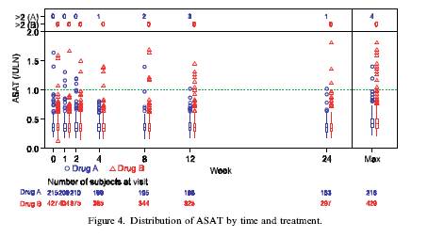
Questions 3
8: ‘Distribution of ASAT by time and treatment‘ Notes: Be sure that axis scale is representative of time (as is shown). Option of adding patient qualifiers on outliers would be beneficial. In graph description, would need to specify when to use and when not to use the Max (or other applicable) sections. [Amit, hieberger, Lane ‘Graphical approaches to the analysis of safety data from clinical trials’ 2007]

Slide 9
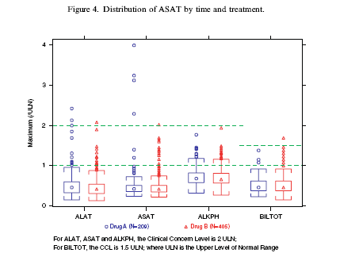
Questions 3
9: ‘Distribution of ASAT by treatment’ Notes: Title should not include time. Option of adding patient qualifiers on outliers would be beneficial. Option to mark outliers meeting Hy’s law criteria if possible. Would need to add Hy’s law criteria on footnote. Caveat – wouldn’t use this graph is there were different times on treatment for dose/drug groups. [Amit, hieberger, Lane ‘Graphical approaches to the analysis of safety data from clinical trials’ 2007]

Slide 10
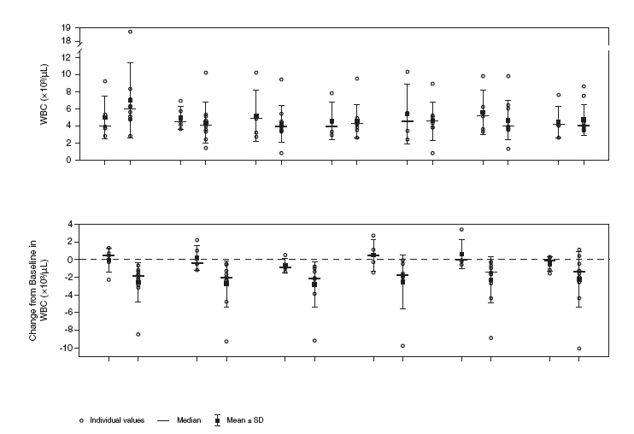
Questions 1,3
10: ‘Change from baseline in WBC over time by treatment’. Note that if the graphic was in color, a legend could be used for dose group and dose group could be removed from the x-axis. Be sure that axis scale is representative of time (as is shown). [Robert Gordon – J&J]
Dose 1
Dose2
Dose 1
Dose2
Dose 1
Dose2
Dose 1
Dose2
Dose 1
Dose2
Dose 1
Dose2
Dose 1
Dose2
Baseline Week 2 Week 3 Week 4 Week 5 Week 6 Week 7
Dose 1
Dose2
Dose 1
Dose2
Dose 1
Dose2
Dose 1
Dose2
Dose 1
Dose2
Dose 1
Dose2
Week 2 Week 3 Week 4 Week 5 Week 6 Week 7

Slide 11
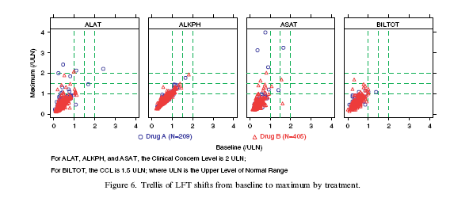
Questions 2
11: ‘Trellis of shifts of LFTs from baseline to maximum by treatment and timepoint’ Notes: Would be nice if there were additional rows for each time point. For instance a row of boxes for baseline, then one for week 1 etc. Maximum number of rows would depend on clarity. Definite focus on liver, would need additional relevant clinical groupings. [Amit, hieberger, Lane ‘Graphical approaches to the analysis of safety data from clinical trials’ 2007]

Slide 12
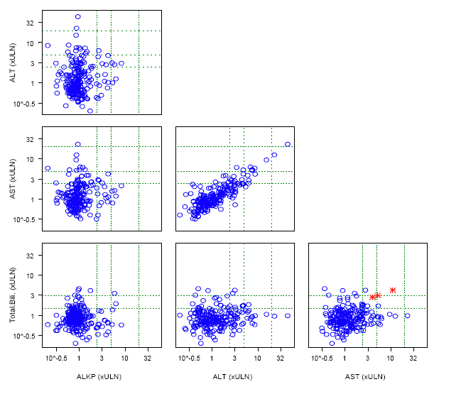
Questions 2
12: ‘Matrix display of maximum LFT levels’ Notes: Need legend to include treatment groups (if more than one group). Additionally, need label for red stars highlighted – perhaps Hys law cases. Possibly annotate red stars with subject ID. Remove the 10^-(0.5) and replace with 0. [Michael O’Connell, Insightful Presentation, 2007]

Slide 13
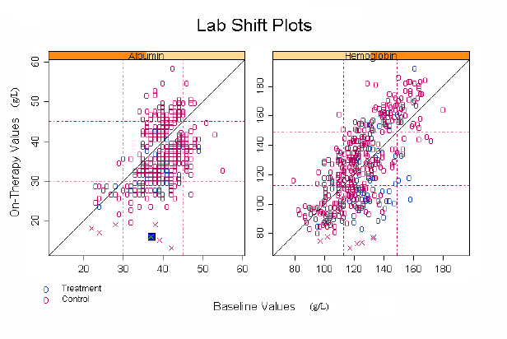
Questions 2
13: ‘Lab shift plots’ Notes: Light grid lines would be helpful in reading the values if adding doesn’t make the graph too busy. Scale the ranges to ULN if possible, but can use standard units if clinicians prefer. When programming, perhaps make it possible for program to input either ULN or standard units. Make sure boxes are square. Add legend concerning x values – outliers? [Michael O’Connell, Insightful Presentation, 2007]

Slide 14
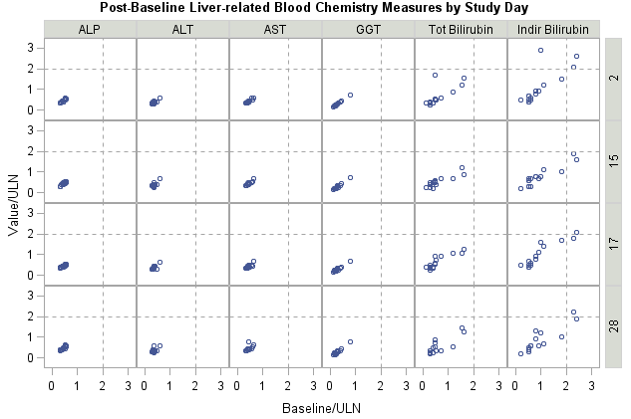
Questions 2
14: ‘Post-baseline liver-related blood chemistry measures by study day’ Notes: If using the same scale, this is a very nice graphic. But must use same scale. Color by treatment if possible with legend. [Alain Smits – J&J]

Slide 15
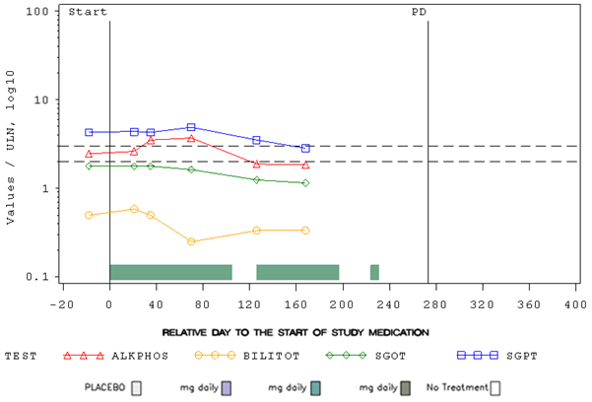
Questions 1,2,3,5
15: ‘Lab parameter measures by study day’ Notes: Representative of 1 patient. PD = progressive disease or could represent treatment period end etc. Need to add the following fields in a table or different section (patient ID, trial, gender, age) ‘TEST’ section can incorporate different parameters in the programming. Recommend using ‘Color Brewer’ for color choices, yellow and red may be difficult depending on background etc. [Andreas Brueckner – Bayer]

Slide 16
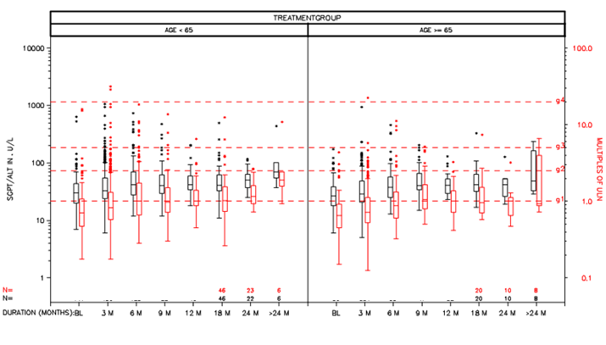
Questions 1,3
16: ‘ALT for treatment group over time by age group’ Notes: Some data currently hidden (e.g. N= values, treatment group) Adjustt x-axis scales to be realistic distances apart (12-18 should be larger than 9-12). Current ref lines are CTC grades, could change to ULN. Need title ‘ALT for treatment group over time by age group’ [Andreas Brueckner – Bayer]

Slide 17
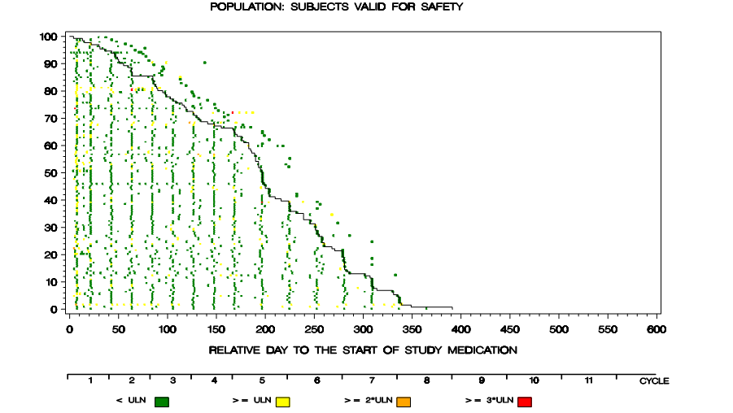
Questions 3,5
17: ‘LFT event history graph’ Notes: Patients represented on horizontal rows. Current y-axis is percent, perhaps change to absolute # of subjects. Describe the dark line as the treatment duration with subjects ordered from fewest to most days on treatment. Those points to the right of the line were events off treatment. Use ‘Color Brewer’ for colors. [Andreas Brueckner – Bayer]

Slide 18
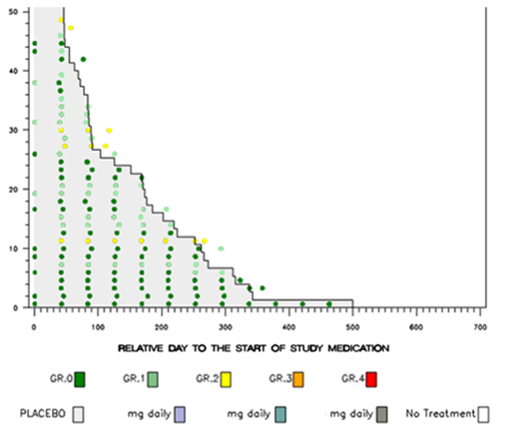
Questions 3,5
18: ‘LFT Event History Graph’ Notes: Some missing data (e.g. dose usually displayed) Points represent CTC grades with patients aligned on horizontal rows. May be better to have y-axis absolute number of subjects instead of percent. Describe black line as in previous graph. User ‘Color Brewer’ here as well. [Andreas Brueckner – Bayer]

Slide 19
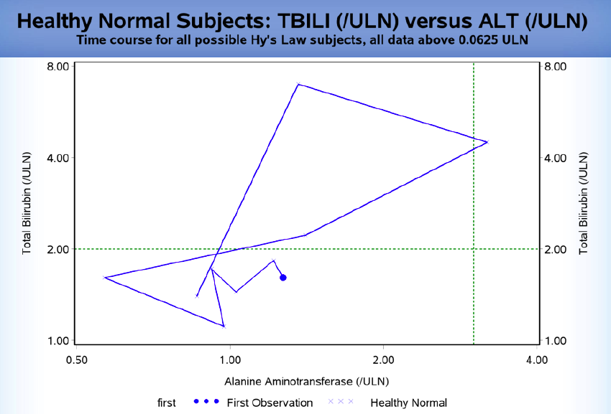
Questions 3,5
19: ‘Healthy Normal Subjects: TBILI (ULN) versus ALT (ULN)’ Notes: This graphic works well when there is a single or few subjects. Numerous subjects makes it difficult. The dot represents the first (baseline) measure and each slop change is an additional visit measurement (first of the visit). Capitalize ‘first’. [Ostroff – Pfizer, DILI workshop 2009]
First

Slide 20
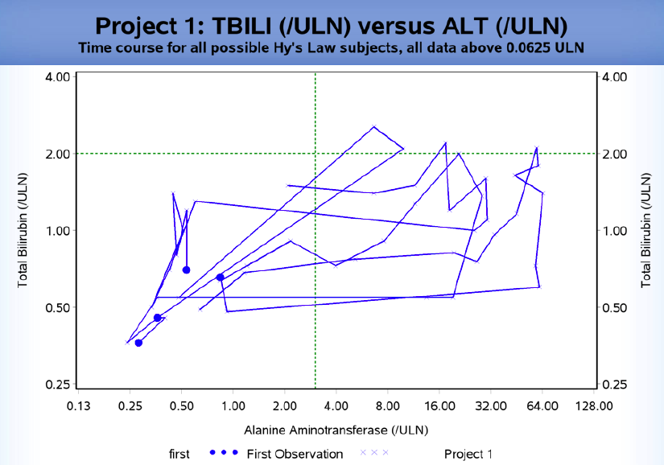
Questions 3,5
20: ‘Healthy Normal Subjects: TBILI (ULN) versus ALT (ULN)’ Notes: This graphic works well as it is focused on a small set – possible Hy’s Law cases. The dot represents the first (baseline) measure and each slop change is an additional visit measurement (first of the visit). Capitalize ‘first’. [Ostroff – Pfizer, DILI workshop 2009]
First

Slide 21
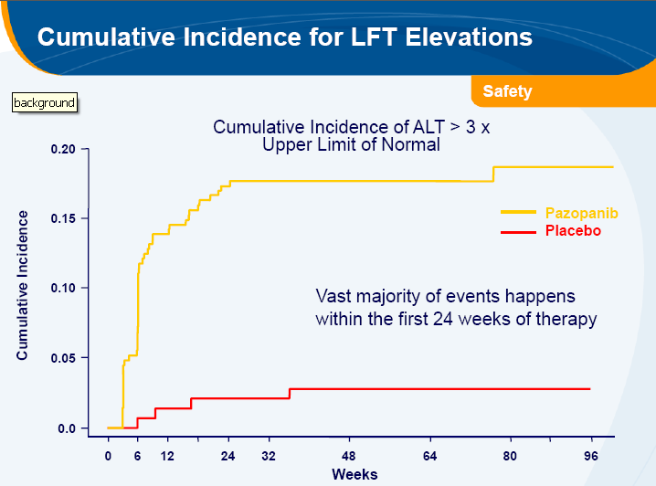
Questions 3,5
21. ‘Cumulative Incidence for LFT Elevations’ [GSK, Joint Statistical Meeting, 2010]
Placebo (at risk) | 160 | 157 | 152 | 150 | 147
Active (at risk) | 156 | 154 | 154 | 146 | 144
160 | 157 | 152 | 150
156 | 154 | 154 | 146

Slide 22
Questions 1,2,3,5
22: ‘Median and inter-quartile range plot for lab change from baseline’ Notes: Add subjects at risk across x-axis if possible, unless the population is already ‘completers’ then add to title. Very light grid in background in possible, if not then add either tick marks on both sides of y-axis on each plot or numbers. Remove brackets (< >). [Qi Jiang - Amgen]
≤
65 years
> 65 years
< Overall >
5
Control (N=x)
Control (N=x)
Control (N=x)
Drug (N=x)
Drug (N=x)
Drug (N=x)
4
3
Percent Change From Baseline
2
1
0
-1
1
6
12
24
1
6
12
24
1
6
12
24
<Study Month>
Placebo (at risk) | 160 | 157 | 152 | 150
Active (at risk) | 156 | 154 | 154 | 146
160 | 157 | 152 | 150
156 | 154 | 154 | 146
160 | 157 | 152 | 150
156 | 154 | 154 | 146
*

Slide 23
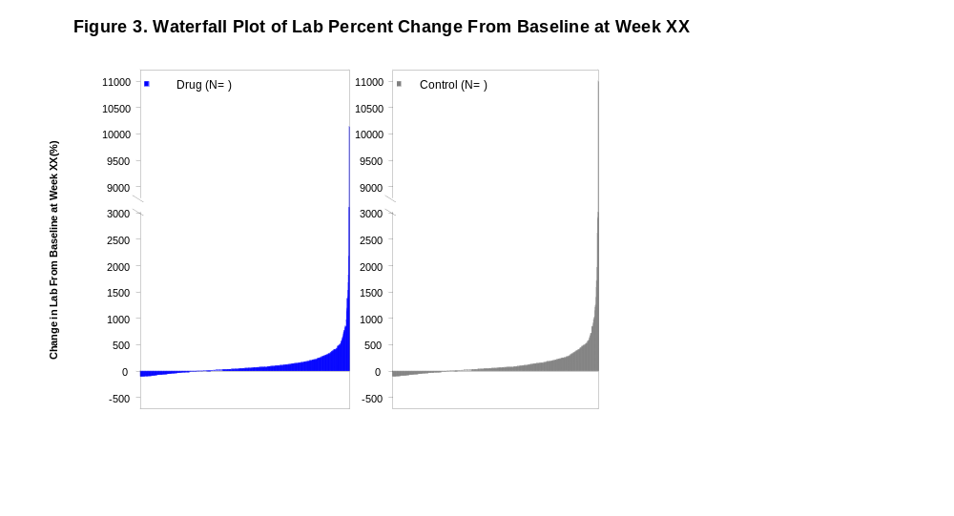
Questions 1,2,3,5
23: ‘Waterfall plot of lab percent change from baseline at Week XX’ Notes: If only one or few outliers, perhaps remove from plot and add footnote. Y-axis should say percent change. Can’t do more than 100% negative, so stop the axis at that point. Keep in mind gray scale printing, but graphic is meant to be colored. [Qi Jiang - Amgen]

Slide 24
Questions 2,3
24: ‘Cumulative distribution of lab changes from baseline’ by visit’ Notes: If only one or few outliers, perhaps remove from plot and add footnote. Normally used for information al purposes, not necessarily inclusion in study report. X-axis label should be change not % change. [Qi Jiang - Amgen]
Figure 2. Cumulative Distribution of Lab Change from Baseline by Visit
Control (N= )
Drug (N= )
100
Day 8
100
Week 5
100
Week 9
100
Week 13
80
80
80
80
60
60
60
60
40
40
40
40
Cumulative Percent of Subjects
20
20
20
20
0
-400
-200
0
200
400
1900
0
-400
-200
0
200
400
1900
0
-400
-200
0
200
400
1900
0
-400
-200
0
200
400
1900
100
Week 17
100
Week 21
100
Week 25
100
Week 29
80
80
80
80
60
60
60
60
40
40
40
40
20
20
20
20
0
-400
-200
0
200
400
1900
0
-400
-200
0
200
400
1900
0
-400
-200
0
200
400
1900
0
-400
-200
0
200
400
1900
Percent Change From Baseline

Slide 25
BACK UP SLIDES
These slides were reviewed, however, they were removed because they were repetitive or not chosen as a standard graphic.

Slide 26
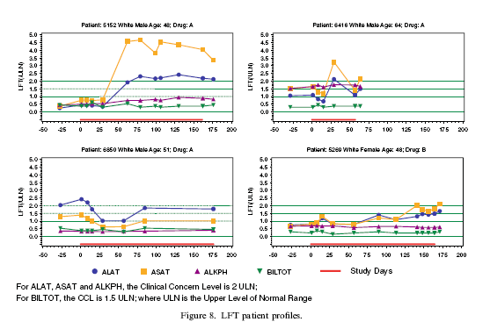
Questions 1,2,3,5
[Alain Smits – J&J]
[Amit, hieberger, Lane ‘Graphical approaches to the analysis of safety data from clinical trials’ 2007]

Slide 27
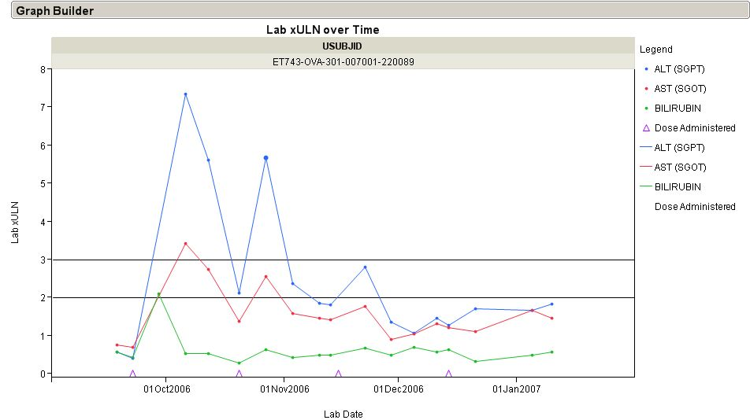
Questions 1,2,3,5
[Robert Gordon– J&J]

Slide 28
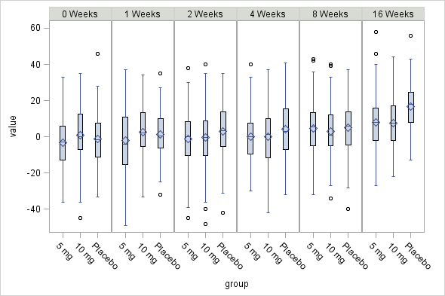
Questions 3
[Alain Smits – J&J]

Slide 29
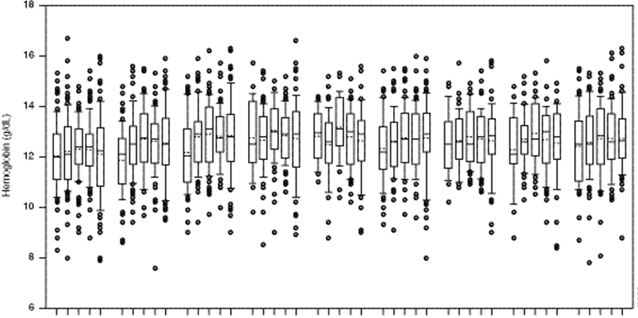
Questions 1,3
[Robert Gordon– J&J]
Dose 1
Dose2
Dose 3
Dose 4
Dose 5
Baseline
By dose group over time

Slide 30
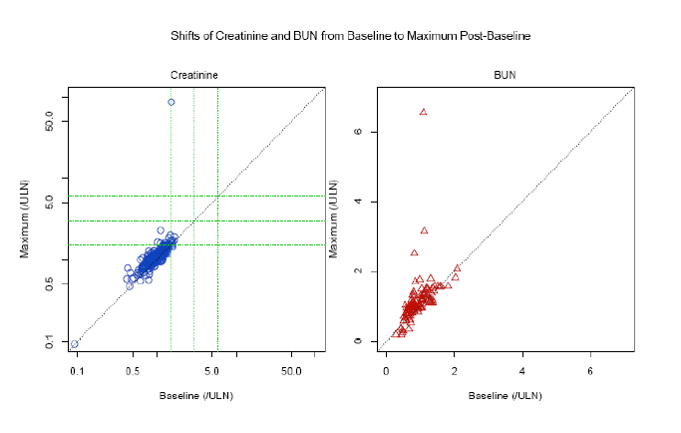
Questions 2
[Michael O’Connell, Insightful Presentation, 2007]

Slide 31
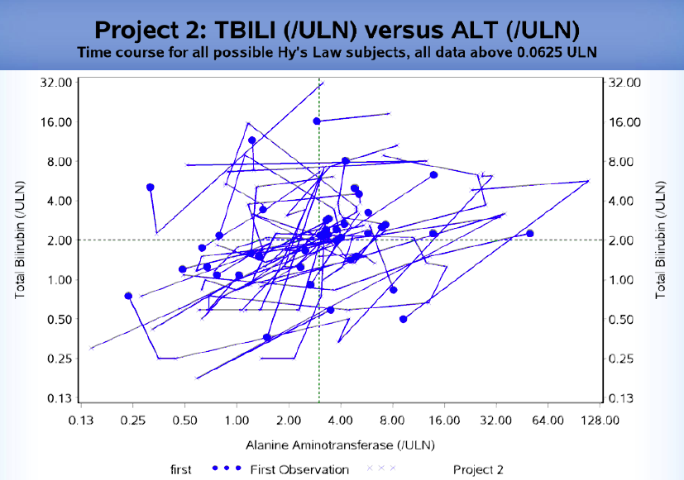
Questions 3,5
Ostroff – Pfizer, DILI workshop 2009]

