Slide 1
Graphical Presentation for Assessing Adverse Events
Introduction Examples Conclusions
FDA/Industry/Academia Safety Graphic Working Group
Adverse Event Subgroup

Slide 2
Disclaimer
Introduction Examples Conclusions
The views expressed in this presentation are those of the
presenter and must not be taken to represent policy or
guidance on behalf of the Food and Drug Administration.

Slide 3
Outline
Introduction Examples Conclusions
Introduction
Examples
Conclusions

Slide 4
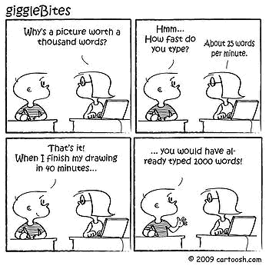
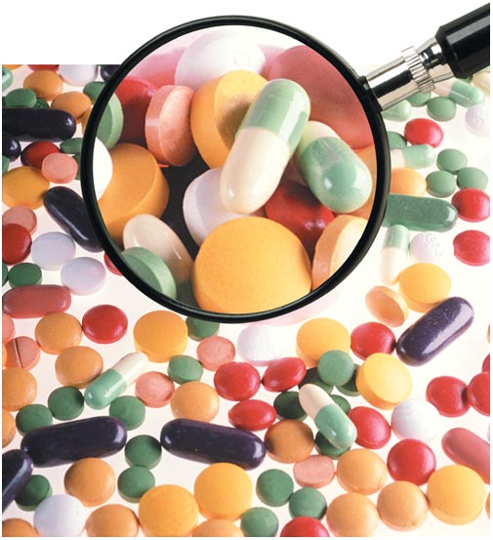
Background
Introduction Examples Conclusions

Slide 5
Motivation
Introduction Examples Conclusions
Drug development generates a lot of complex information about adverse events
Conventional tables and listings often do not communicate this information effectively and efficiently
Clear display of this information is crucial to understanding potential toxicity issues and to supporting appropriate decisions

Slide 6
Frequently Asked Questions Regarding Adverse Events
Introduction Examples Conclusions
Background
Rate?
Incidence
Rate?
Relationship
with Other AEs?
Adverse
Events
Withdraw/
Interruption?
Who are they?
Time to an
Event?
Relationship
with Dosage?
Risk Factors?

Slide 7
Objectives of Graphical Displays
Introduction Examples Conclusions
To characterize the frequency and patterns of adverse events, especially in key subpopulations
To explore possible temporal relationships in adverse event occurrence
To explore possible relationships to dosage
To relate possible toxicity to realized efficacy
Notes:
Suggest the group to come up objectives that will fit the uniqueness of the AE subgroup

Slide 8
Outline
Introduction Examples Conclusions
Introduction
Examples
Conclusions

Slide 9
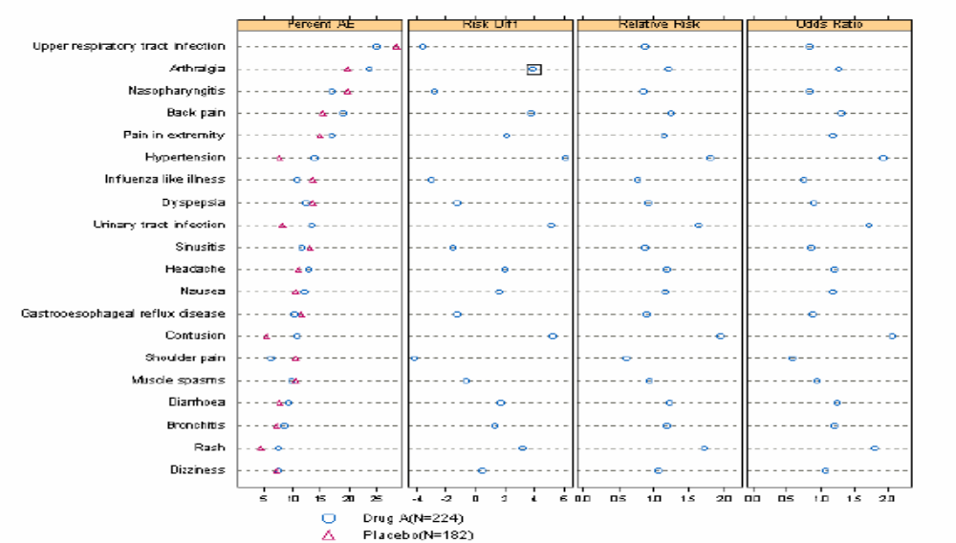
Introduction Examples Conclusions
Which AEs are elevated in treatment vs. placebo?
Notes:
Title: A brief title to describe the graphic
Description: A few sentences of what is plotted
Background: Reason for the graphic (this could list the clinical question). This field could also describe the motivation for the graphic.
Use/Suitability: Is the graphic intended for exploration, publication, presentation, or other uses? [May need some work in the description here]
Software: What software was used to create the graphic (include any relevant version numbers).

Slide 10
Introduction Examples Conclusions
More Examples
Notes:
Title: A brief title to describe the graphic
Description: A few sentences of what is plotted
Background: Reason for the graphic (this could list the clinical question). This field could also describe the motivation for the graphic.
Use/Suitability: Is the graphic intended for exploration, publication, presentation, or other uses? [May need some work in the description here]
Software: What software was used to create the graphic (include any relevant version numbers).

Slide 11
Introduction Examples Conclusions
More Examples
Notes:
Title: A brief title to describe the graphic
Description: A few sentences of what is plotted
Background: Reason for the graphic (this could list the clinical question). This field could also describe the motivation for the graphic.
Use/Suitability: Is the graphic intended for exploration, publication, presentation, or other uses? [May need some work in the description here]
Software: What software was used to create the graphic (include any relevant version numbers).

Slide 12
Outline
Introduction Examples Conclusions
Introduction
Examples
Conclusions

Slide 13
Introduction Examples Conclusions
Conclusions
Appropriate graphics can increase the likelihood of detecting potential safety issues
Appropriate graphics can enhance insight and understanding about the occurrence of potential safety issues
Effective graphical displays can make regulatory review more efficient and effective

