Slide 1
Clinical Questions and example graphs
Industry-FDA-Academia Safety Graphics Working Group
ECG/Vitals Subgroup
10August2010

Slide 2
Summary
The following slides present a list of clinical questions related to ECG/Vitals data and corresponding samples of graphs used to address the question.
Though the graphs are mostly done using the QTc interval, most graphs can easily and appropriately be extended to other intervals or to vitals data
The intent is to provide a graphic tool kit for the evaluation of ECG and Vital signs data.
We are looking for your feedback on whether we’ve captured the relevant questions and whether the proposed graph types are useful – or are there others that would aid in interpreting safety.

Slide 3
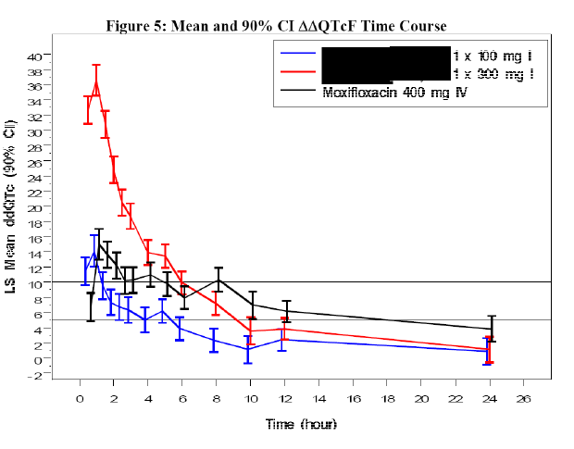
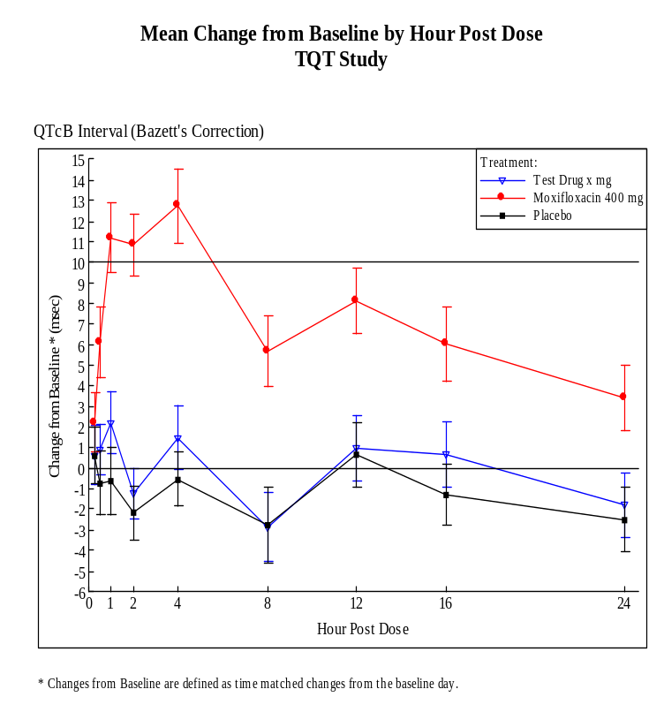
What are the longitudinal trends in the data?

Slide 4
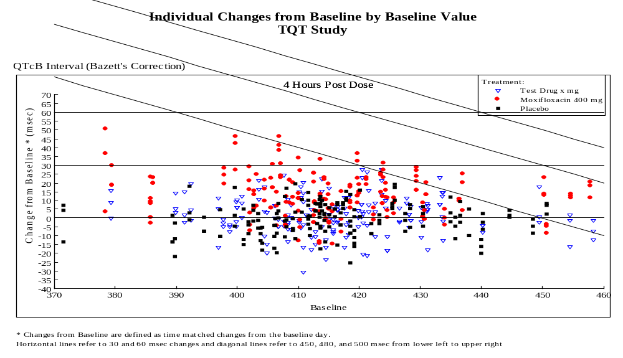
Are there outlier individuals that have large changes or raw values (categorical changes)?

Slide 5
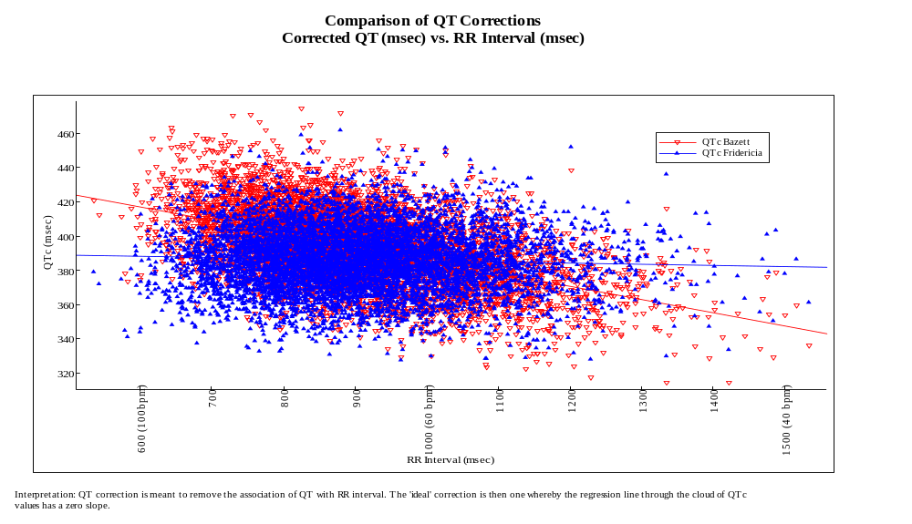
How do the different QT correction compare w.r.t. relationship with RR?

Slide 6
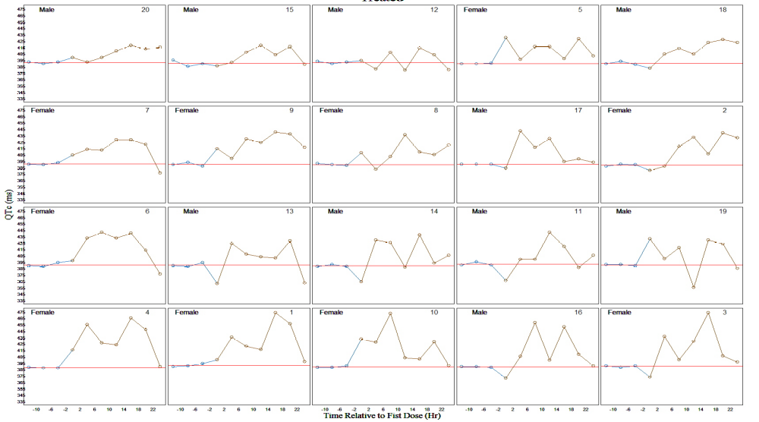
How do individuals’ values track over time? Individual profiles
To be added – profile plots

Slide 7
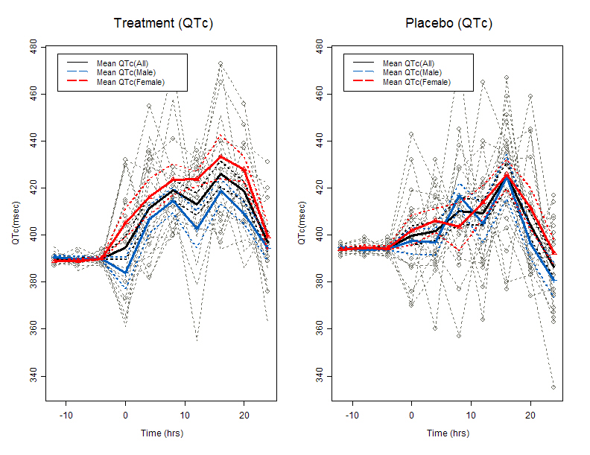
How do individuals’ values track over time? Aggregating individuals

Slide 8
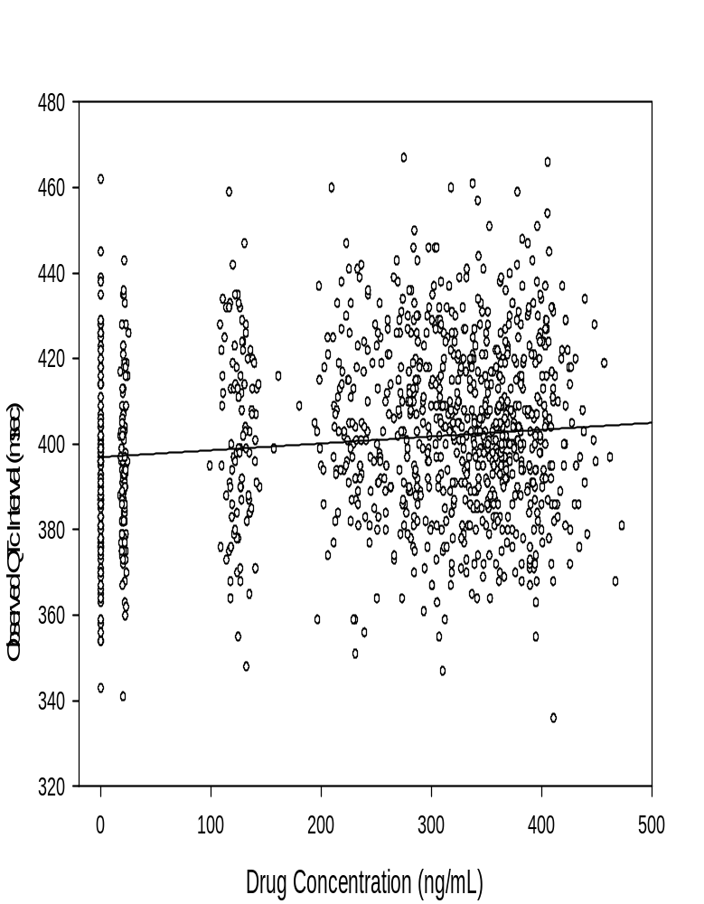
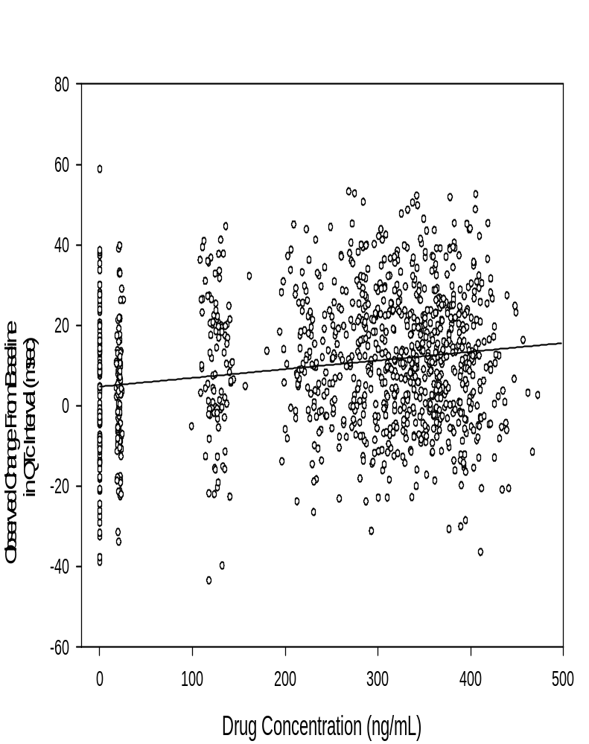
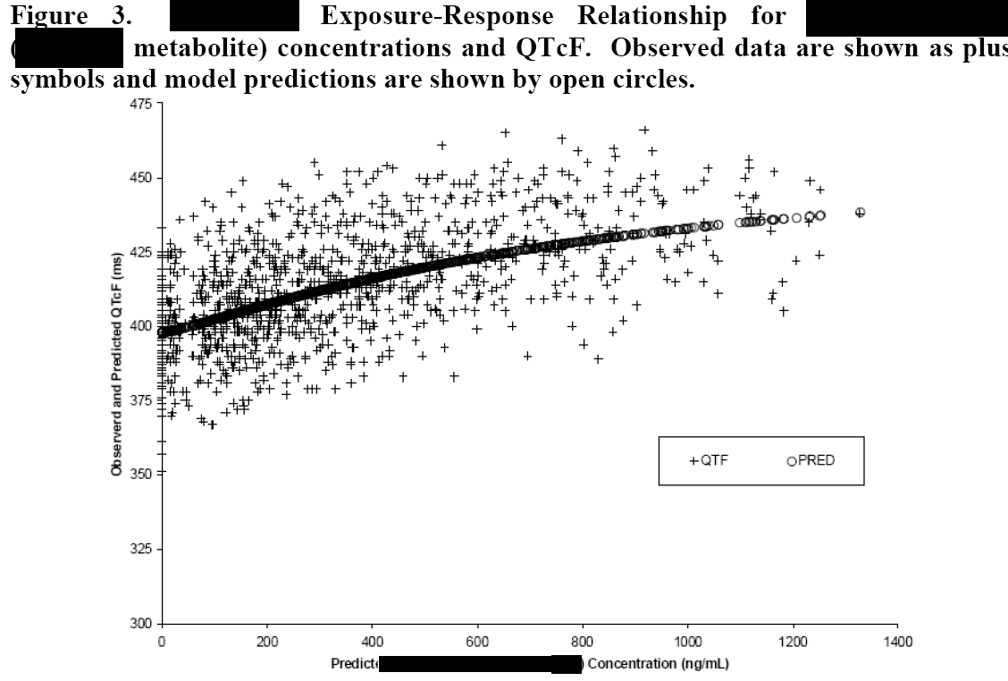
What is the relationship to drug concentration? (need to add form of model fit)

Slide 9
Other Clinical Questions?
Any specific to Vital signs (eg. orthostatic hypotension – comparing postural changes)

