Slide 1
QTc Clinical Questions and Example Graphs
R.J. Anziano on behalf of Industry-FDA-Academia Safety Graphics Working Group - ECG/Vitals Subgroup
1March2011
2nd International Symposium on Biopharmaceutical Statistics
Berlin, Germany

Slide 2
Outline
Highlight the Goal of the Safety Graphics Working Group
Describe the subgroups and the approach to graph selection
Brief orientation to the QT interval
Review five clinical questions and associated graphs related to QT

Slide 3
The goal of the Industry/FDA/Academia safety graphics working group is to provide a graphic tool kit for the evaluation of safety data

Slide 4
Outline
Highlight the Goal of the Safety Graphics Working Group
Describe the subgroups and the approach to graph selection
Brief orientation to the QT interval
Review five clinical questions and associated graphs related to QT

Slide 5
Safety Graphics Working Group Sub-teams
Four Sub-teams formed to focus on different types of safety data
  General Principles – develop broad recommendations across all safety data
  ECG/Vitals
  Labs/Liver
  AE

Slide 6
General Approach
Start with the Clinical Question
Collect/Develop Graphs that address the questions
Distill to a sufficient set
  Many ways of addressing the same question
  Select a most appropriate to recommend
  Other approaches still ok
Once there is agreement on this set of graphs, place Questions, Graphs, and Code in the public domain - CTSPedia
In the public domain let the figures and code develop organically

Slide 7
Outline
Highlight the Goal of the Safety Graphics Working Group
Describe the subgroups and the approach to graph selection
Brief orientation to the QT interval
Review five clinical questions and associated graphs related to QT

Slide 8
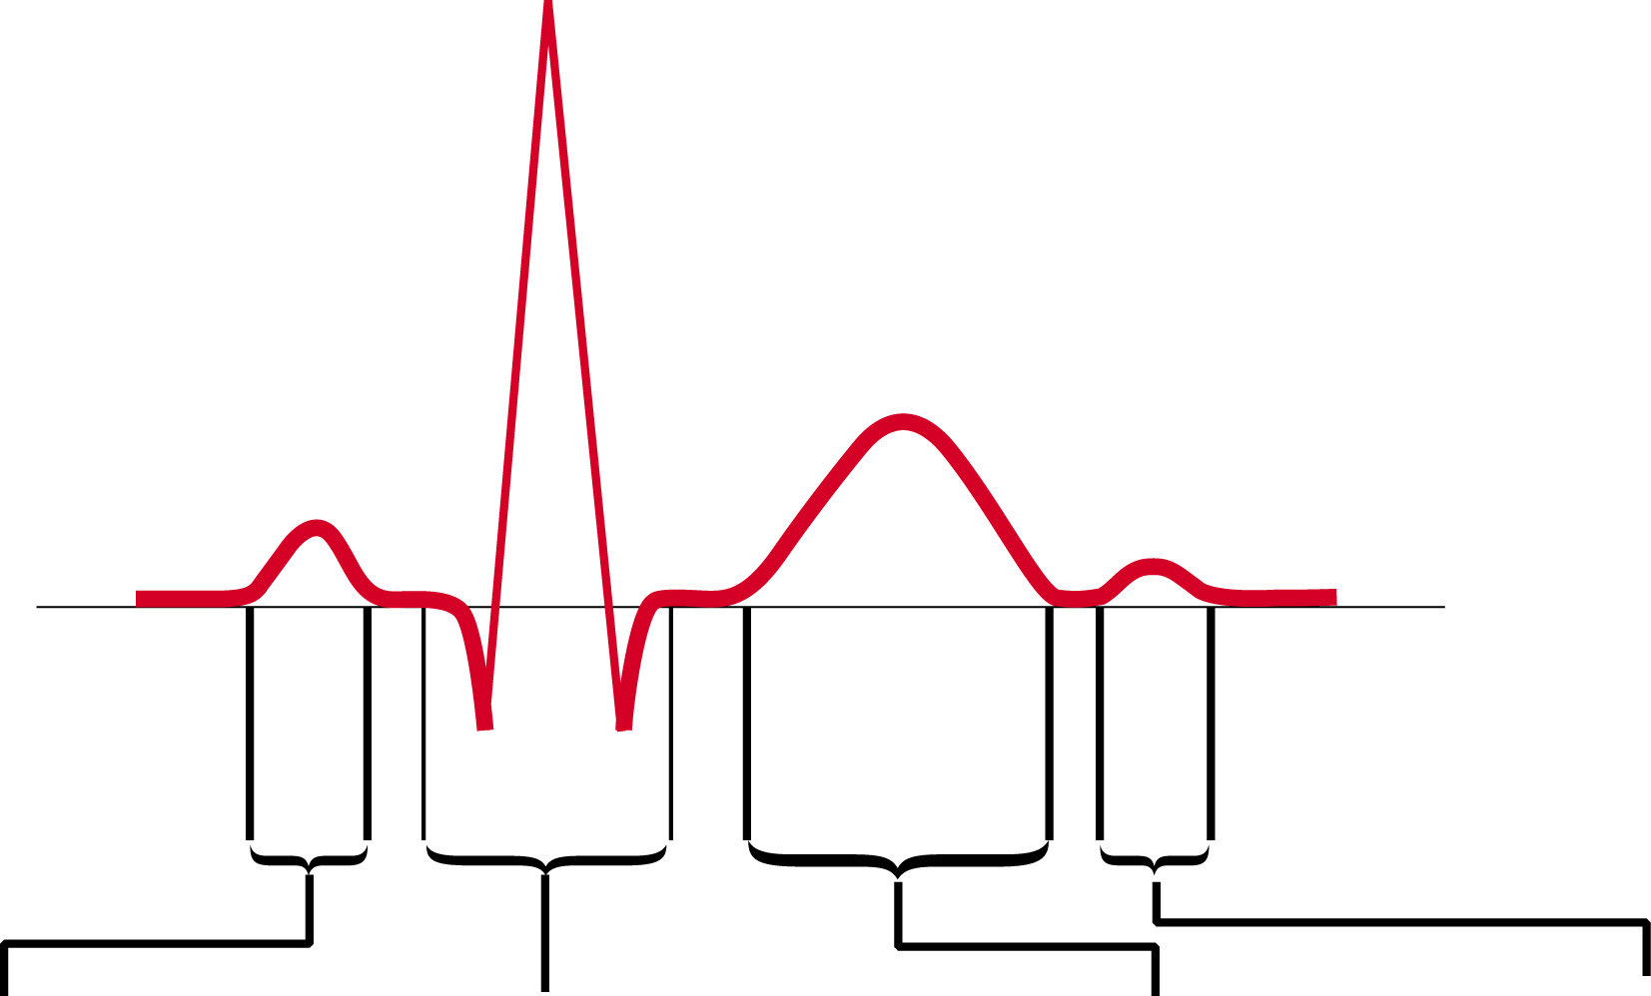
The ECG Waveform
R
T
P
U
Q
S
Atrial
depolarization
Ventricular
depolarization
Atrial
repolarization
Terminal phase
of ventricular
repolarization
(not always visible)

Slide 9
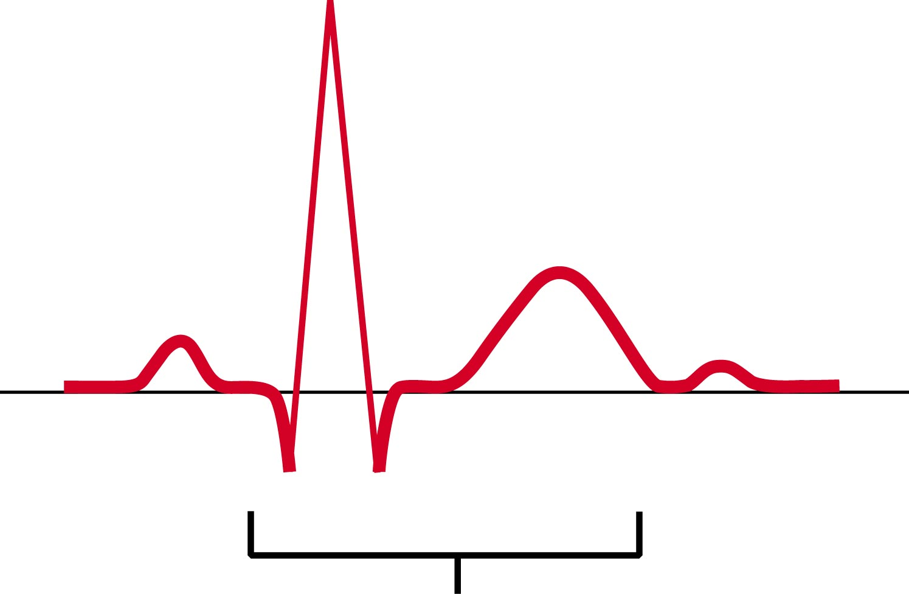
QT Interval
R
T
P
U
Q
S
QT interval

Slide 10
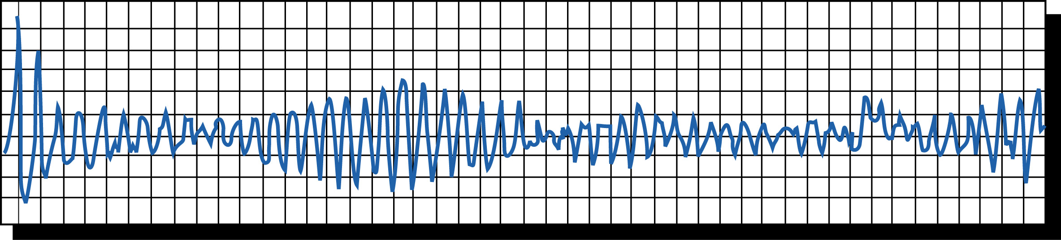
Torsade de Pointes

Slide 11
Outline
Highlight the Goal of the Safety Graphics Working Group
Describe the subgroups and the approach to graph selection
Brief orientation to the QT interval
Review five clinical questions and associated graphs related to QT

Slide 12
QT Data Sources
Thorough QT study – where the objective of the clinical trial is to quantify the effect of experimental treatment on the QT interval
  Often crossover, range of doses of experimental treatment, positive and pbo controlled, intensive pk collection timed to coincide with QT collection
QT data as collected as part of standard safety in studies where the primary objective is other than QT
  Less concentration of data, may be at baseline and follow up visits, without specific timing in relation to dose.

Slide 13
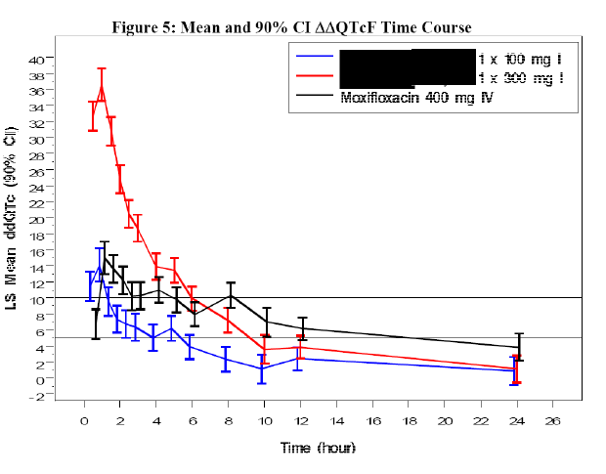
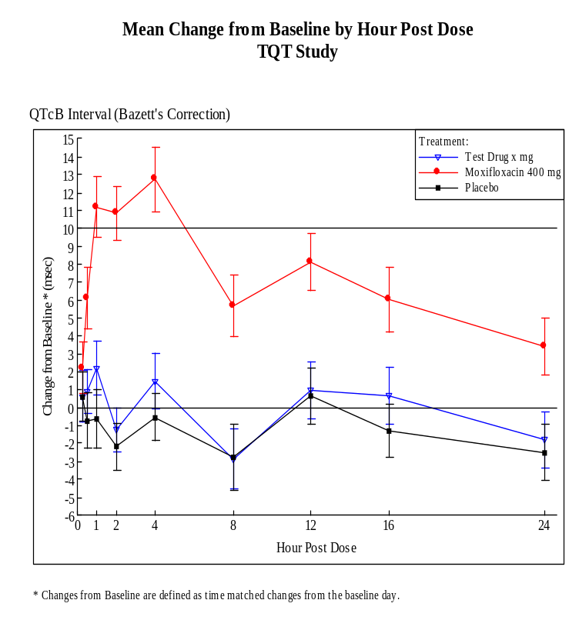
Q1: What are the longitudinal trends in the data?

Slide 14
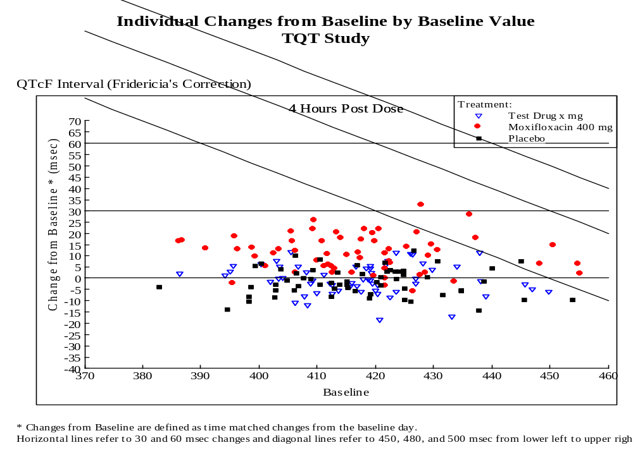

Q2: Are there outlier individuals that have large changes and/or raw values (categorical changes)?

Slide 15
Influence of Heart Rate on QT
HR , QT
HR , QT
RR (sec) = 60/HR (bpm)

Slide 16
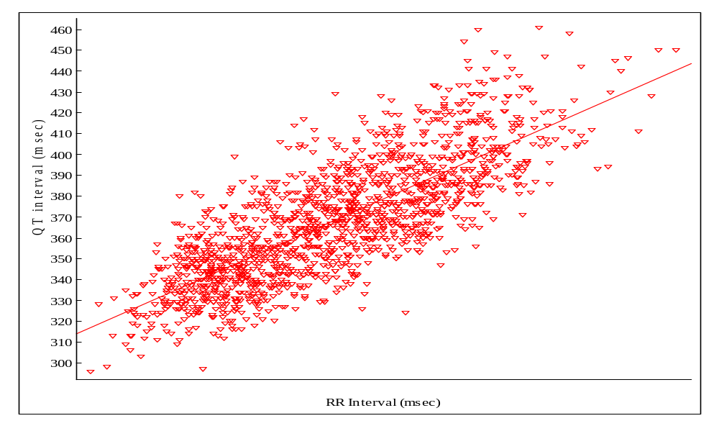
QT Relationship to RR interval

Slide 17
Graphical Depiction of QT Correction
Attempts to make QT ‘independent’ of Heart Rate
Can be viewed as a rotation of the datapoints around 60 bpm or the equivalent RR interval of 1000 msec
The further from RR=1000 the more impact the correction will have
QT_{c} = QT * RR ^{-β}
The larger β the more rotation
With Bazett correction β=0.5; while Fridericia β=0.33

Slide 18
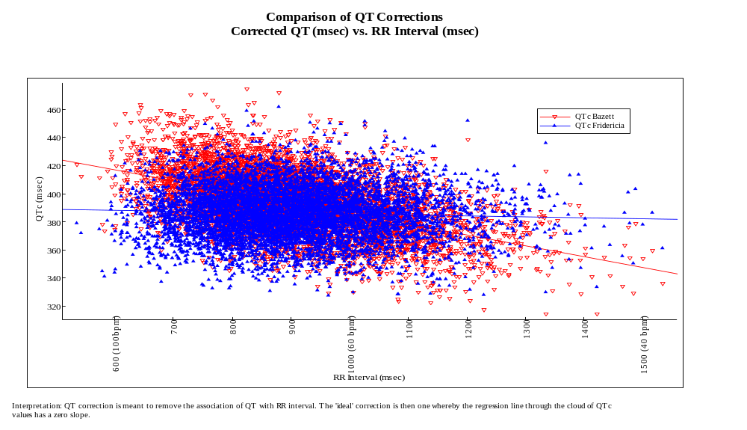
Q3: How do the different QT correction compare w.r.t. relationship with RR?

Slide 19
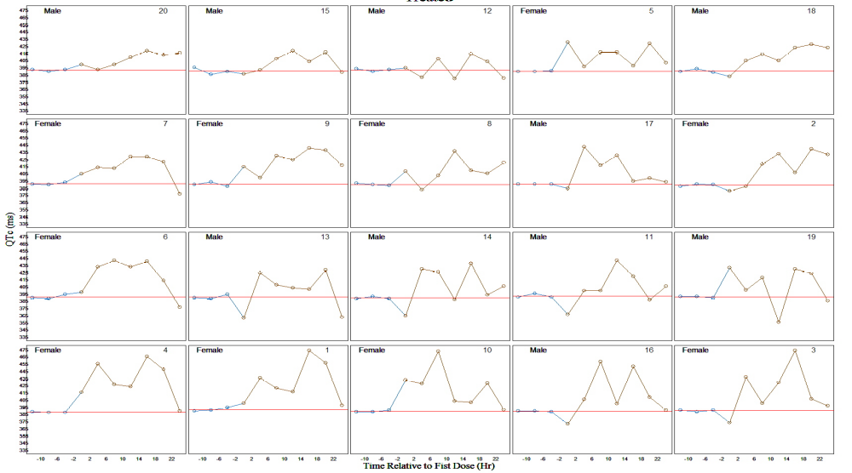
Q4: How do individuals’ values track over time? Individual profiles
To be added – profile plots

Slide 20
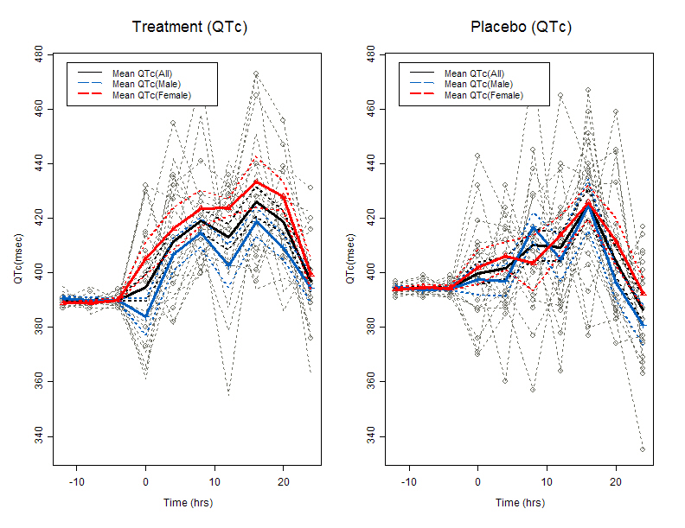
Q4: How do individuals’ values track over time? Aggregating individuals

Slide 21
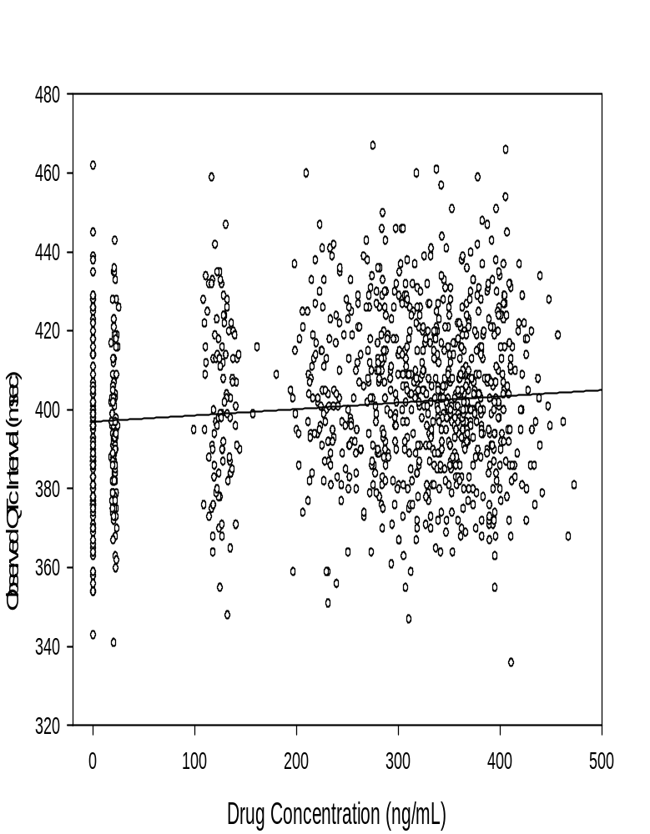
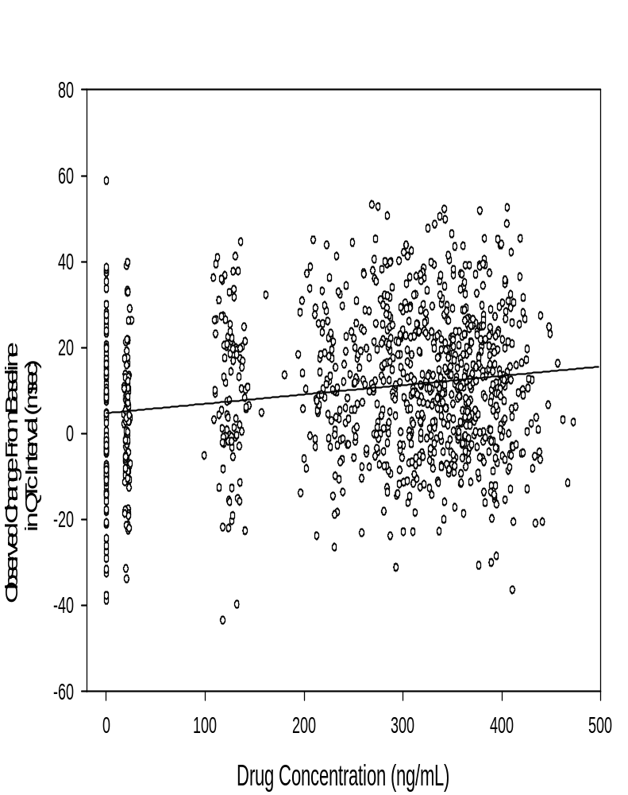
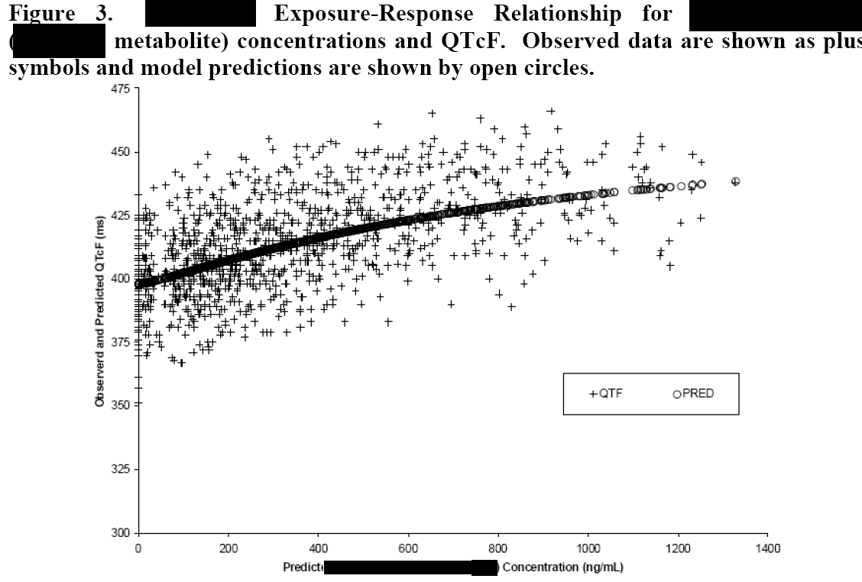
Q5: What is the relationship to drug concentration?
Notes:
Missing from this slide is the functional form of the model fit.

Slide 22
Concluding Remarks
We’ve reviewed some clinical questions and graphics associated with QT
Most graphs can easily and appropriately be extended to other intervals or to vitals data
We are looking for your feedback on whether we’ve captured the relevant questions and whether the proposed graph types are useful – and are there others that would aid in interpreting ECG or Vitals data.
Email: richard.j.anziano@pfizer.com

Slide 23
Acknowledgements
Members of the FDA/Industry/Academia safety graphics working group
Regulatory: George Rochester, Bruce Weaver, Stephine Keeton, Janelle Charles, Chuck Cooper, Suzanne Demko, Robert Fiorentino, Richard Forshee, Eric Frimpong, Ted Guo, Pravin Jadjav, Leslie Kenna, Joyce Korvick, Antonio Paredes, Matt Soukup, Jeff Summers, Mark Walderhaug, Yaning Wang, Markus Yap, Hao Zhu, Catherine Njue
Industry: Ken Koury, Rich Anziano, Susan Duke, Mac Gordon, Andreas Brueckner, Navdeep Boparai, Brenda Crowe, Sylvia Engelen, Larry Gould, Matthew Gribben, Liping Huang, Qi Jiang, Andreas Krause, Peter Bridge
Academia: Frank Harrell, Mary Banach

