Slide 1
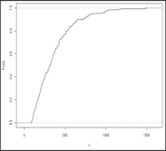
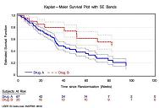


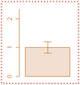
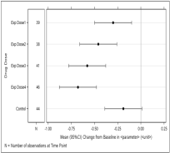
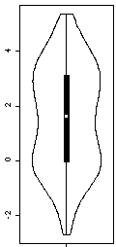
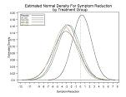
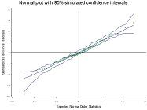

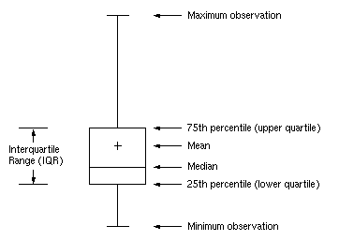
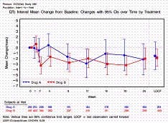
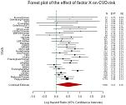
Quantitative data visualization
Factors driving the choice of type of graph or its building blocks
Cumulative
Distribution
Kaplan-Meier
Waterfall
Histogram
Bars & Error Bars
Fine-Grained
Distribution
Mean/Median & IQR/SE/95%CI
High Detail
Low Detail
Raw data
Distribution Detail Level
Summarized data
Analysis/
Exploration
Communication/
Concise Message
“Symbols & Error Bar”
PDF plot
QQ plot
[Extended] Box Plot
Violin Plot

Slide 2
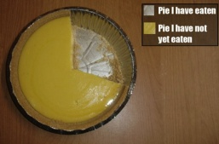
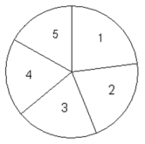
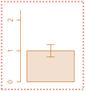
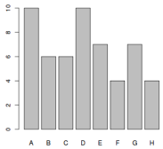
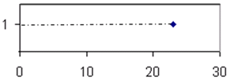
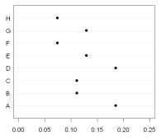
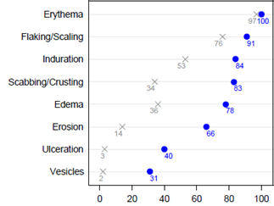
Qualitative data visualization
Factors driving the choice of type of graph or its building blocks
The graphical display of a categorical variable’s levels frequencies will depend on the number of levels of interest and the visual element chosen to represent this frequency
Visual Element | 1 Level of interest | >1 Level of interest
Portion of circle
Bar Height
Symbol along scale
: avoid use
: recommended
Most often assembled into bar/dot plots displaying results for several categorical binary variables (as in this example for 8 AEs)

Slide 3
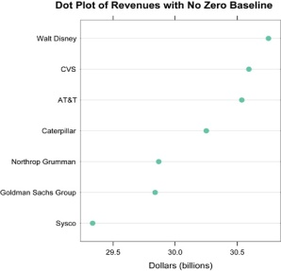
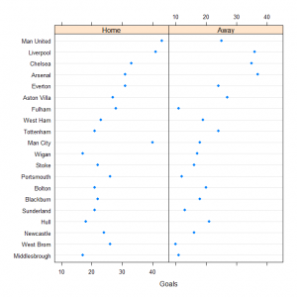
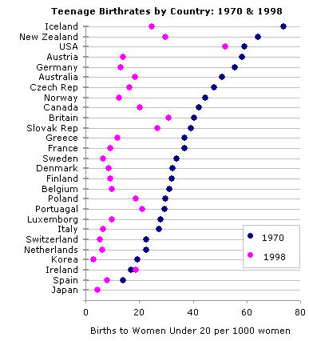
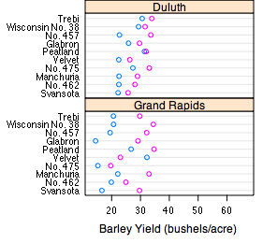

Data visualization
Factor influencing the choice of Subtype/Flavor
Simple
Multipanel of simple
Graph Subtype/Flavor
Multiple grouping Variables
(e.g., age category
x gender
x treatment group)
0 or 1
grouping Variable
Grouped
Multipanel of grouped

Slide 4
Data visualization
Visual Perception
“When a graph is constructed, information is encoded. The visual decoding of this encoded information is graphical perception.
The decoding is the vital link …
No matter how ingenious the encoding … and no matter how technologically impressive the production, a graph is a failure if the visual decoding fails.”
William Cleveland, The Elements of Graphing Data
Hierarchy of human graphical perception abilities
Position along a common scale (most accurate)
Position along identical nonaligned scales
Length
Angle and slope
Area
Volume
Color
  Hue (red, green, blue, etc) can give good discrimination but poor ordering
  Saturation (pale/deep) can be useful if order is important
Source: W.S. Cleveland - Elements of Graphing Data

