Slide 1

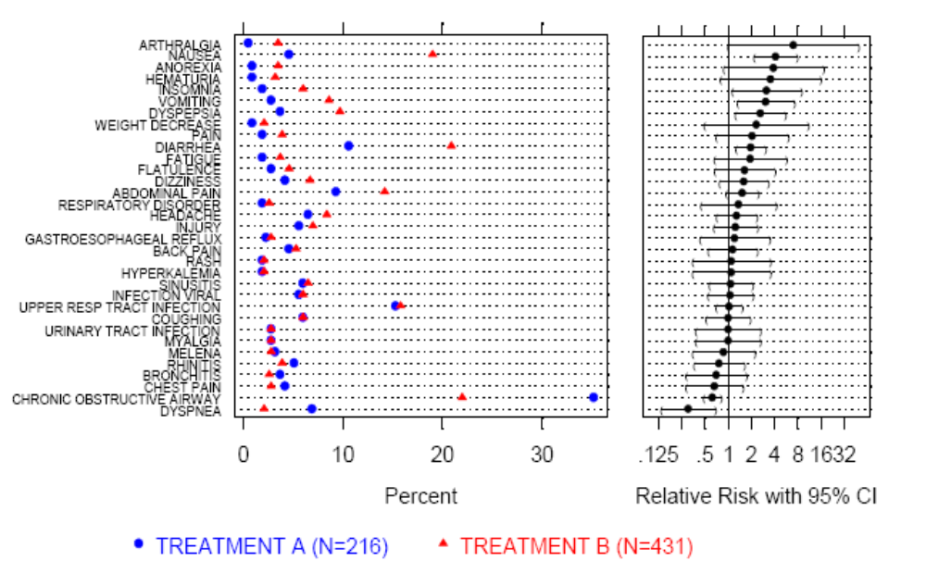
Adverse Event Information
Which AEs are elevated in treatment vs. placebo?
Figure 1. Dot Plot to compare incidence rate and relative risk

Slide 2
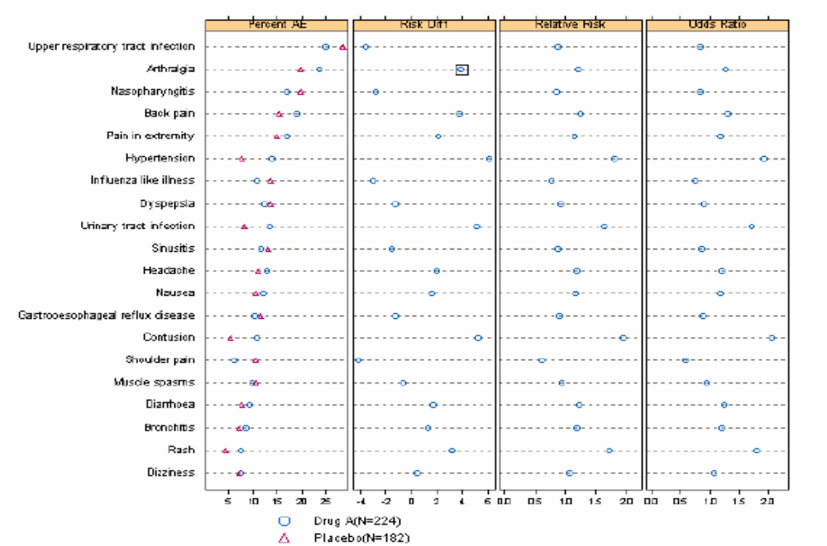
Adverse Event Information
Which AEs are elevated in treatment vs. placebo?
Figure 2. Adverse Event >=5% by Preferred Term in Descending Order of Frequency

Slide 3
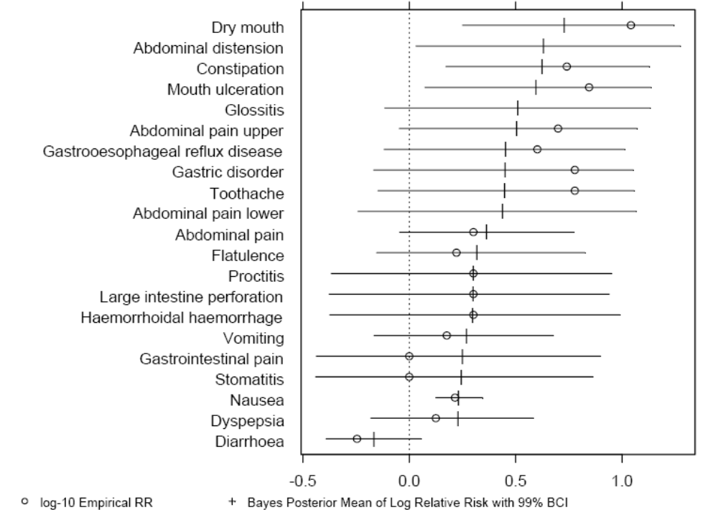
Adverse Event Information
Which AEs are elevated in treatment vs. placebo?
Figure 3. AE Dot Plot with Interval Pattern

Slide 4
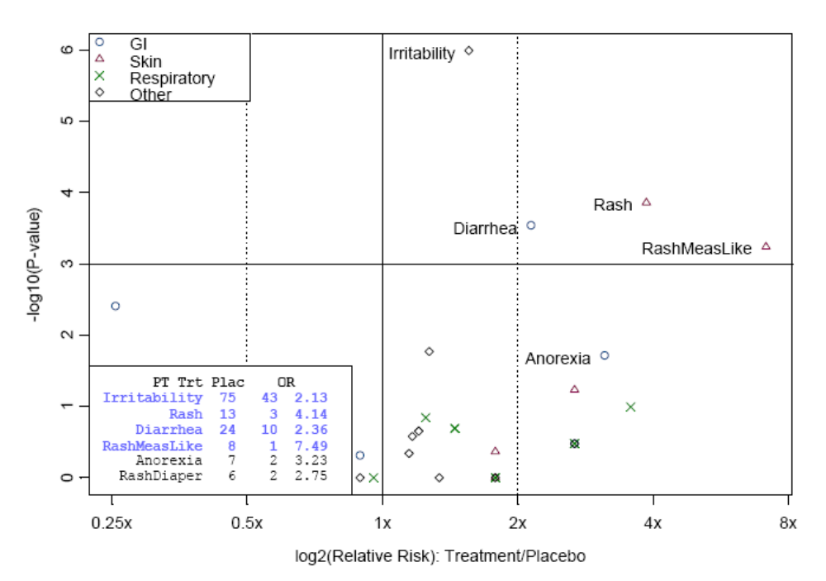
Adverse Event Information
Which AEs are elevated in treatment vs. placebo?
Figure 4. Trellis Plot: Risk plot of adverse event rates in a vaccine trial (Mehortra and Hayes, 2001)
*It shows the relative risk or ratio of the adverse event rates on the x-axis and the p-value comparing treatment and control on the y-axis. The additional information on the p-value of the treatment effect is important since it incorporates the number of observed events and confidence in the treatment effect.
Notes:
-log10(0.1)=1
Log(1)=0

Slide 5
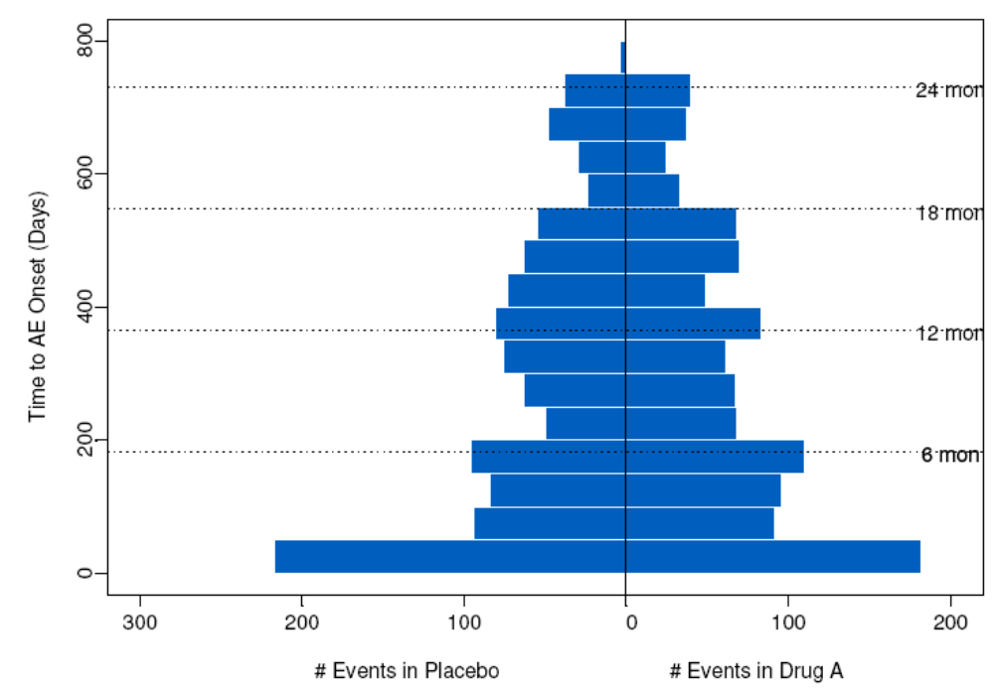
Adverse Event Information
Adverse Events Onset In Relation to Time
Figure 1. Time to AE Onset (Days)
Numbers at left are upper quartile : lower quartile or current group : reference group. The shaded bars represent 0:7; 0:8; 0:9; 0:95; 0:99 confidence limits. The intervals are drawn on the log odds ratio scale and labeled on the odds ratio scale. Ranges are on the original scale, even for transformed variables.

Slide 6
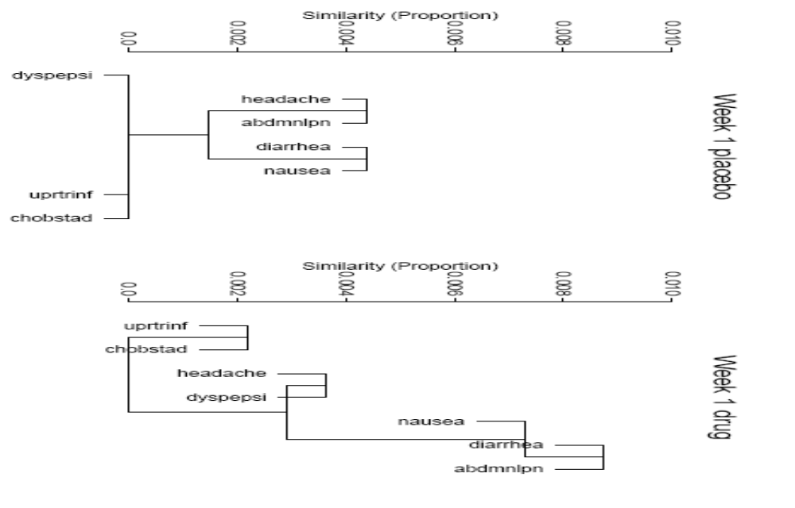
Adverse Event Information
Relationship of one AE with other Concurred AEs
Figure 2. Variable Clustering of AEs at Week 1, Using Proportion of Patients Had AEs as Similarity

Slide 7
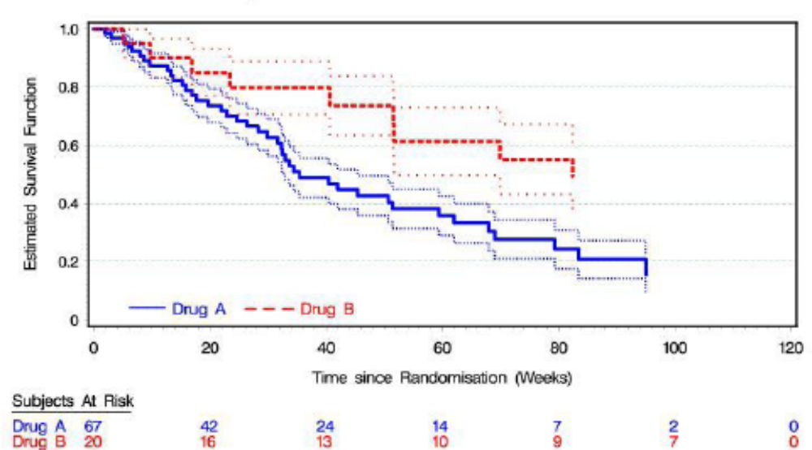
Adverse Event Information
Adverse Events Onset In Relation to Time
Figure 2. Kaplan-Meier Survival Plot with SE Band

Slide 8
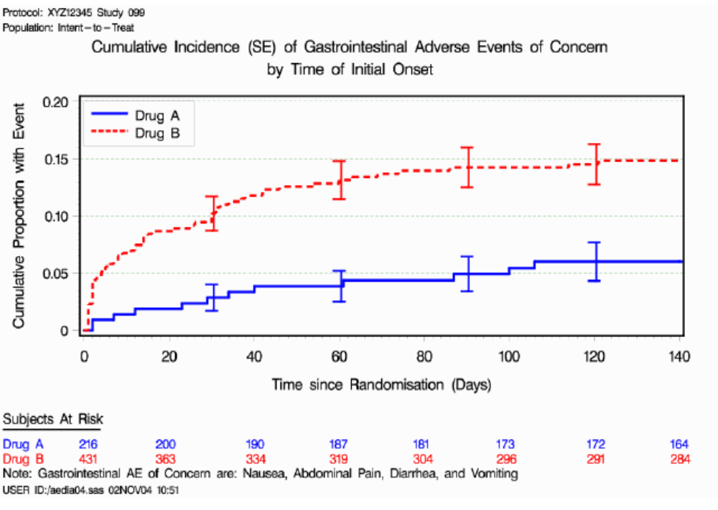
Adverse Event Information
Adverse Events Onset In Relation to Time
Figure 3. Cumulative Incidence (SE) by Time of Initial Onset

Slide 9
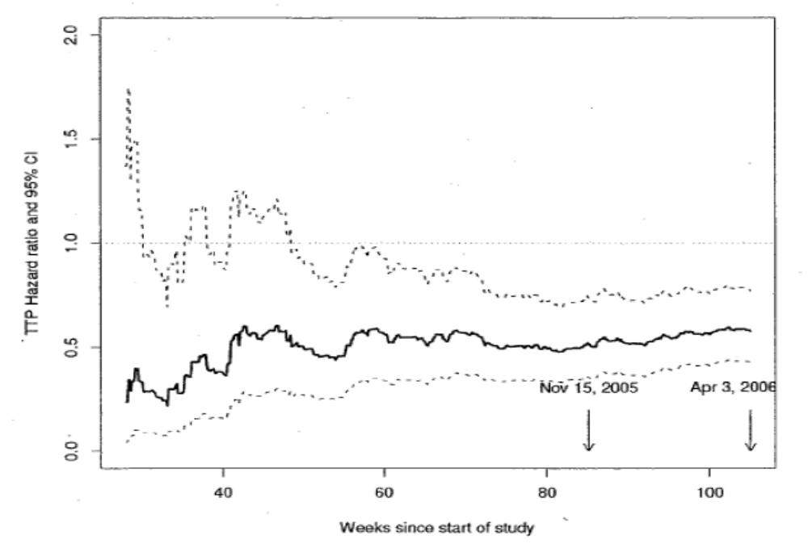
Adverse Event Information
Adverse Events Onset In Relation to Time
Figure 4. Hazard Ratio and 95% CI for IRC Time Progression Over Time

Slide 10
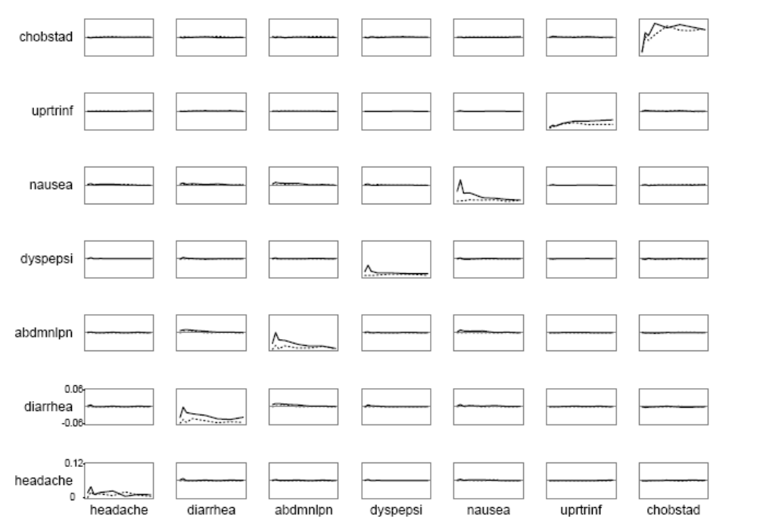
Adverse Event Information
Relationship of one AE with other Concurred AEs
Figure 1. Time Trends in Incidence of AEs (diagonal) and chance-corrected joint incidence (off-diagonal)
*Solid lines represent drug and dotted lines placebo. Horizontal reference lines are at zero (chance level of joint incidence). Week is on x-axes

Slide 11
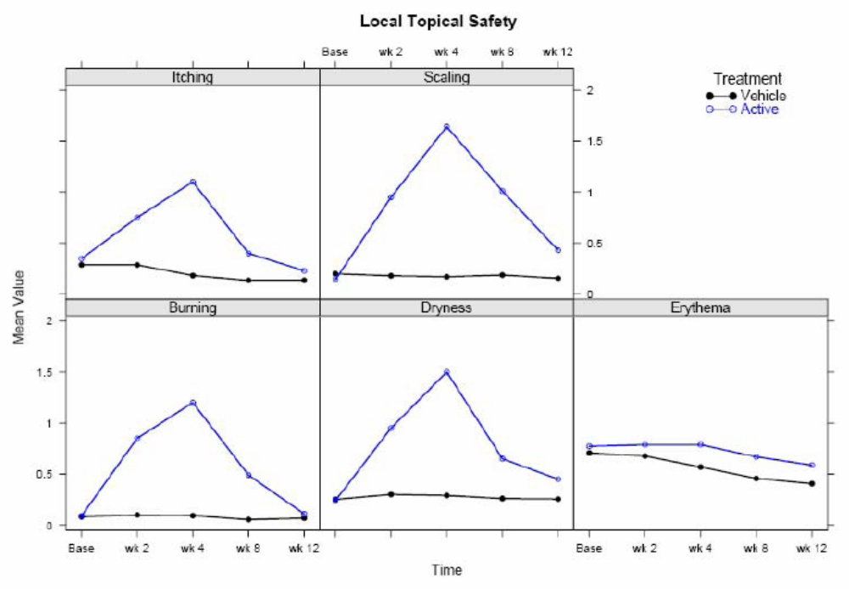
Adverse Event Information
Relationship of one AE with other Concurred AEs
Figure 3. Local Topical safety
Predicted values have been centered so that predictions at predictor reference values are zero. Pointwise 0:95 confidence bands are also shown. As all Y -axes have the same scale, it is easy to see which predictors are strongest

Slide 12
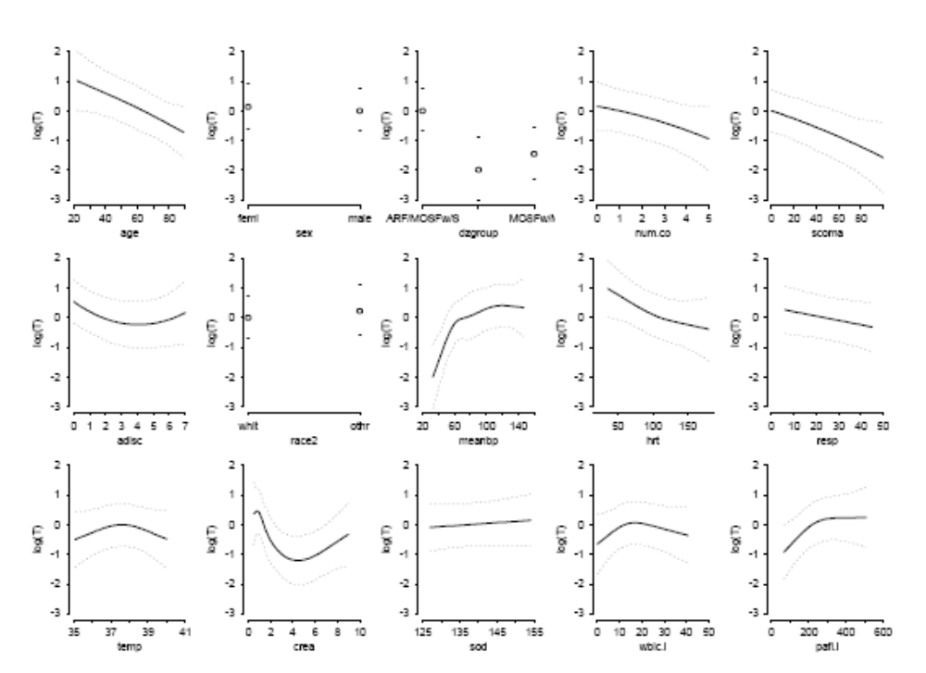
Adverse Event Information
Risk Factors in Relation to AEs
Figure 1. Effect of each predictor on log survival time
Predicted values have been centered so that predictions at predictor reference values are zero. Pointwise 0:95 confidence bands are also shown. As all Y -axes have the same scale, it is easy to see which predictors are strongest

Slide 13
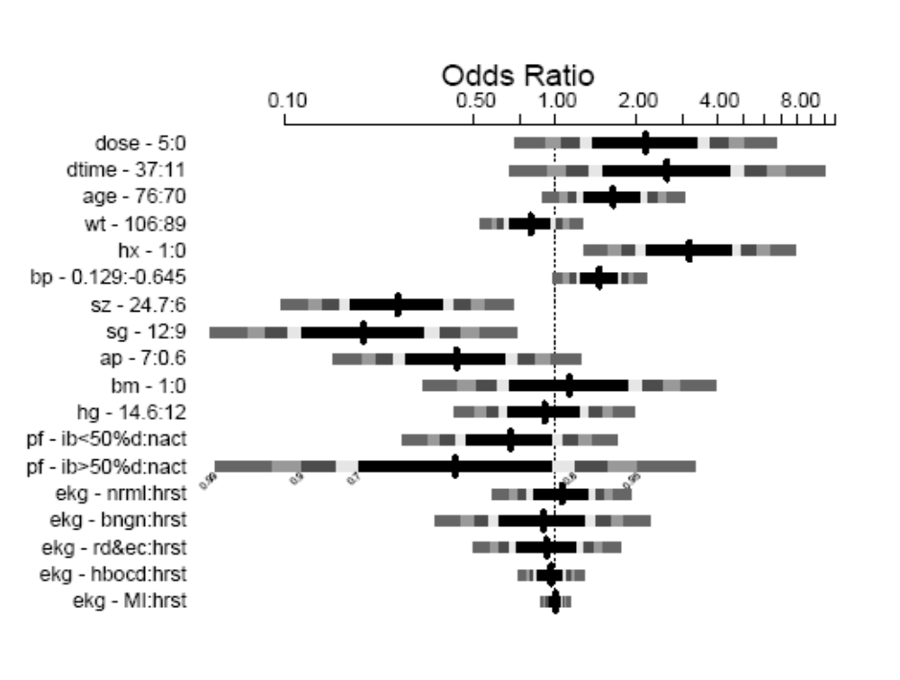
Adverse Event Information
Risk Factors in Relation to AEs
Figure 2. Inter-quartile-range odds ratios for continuous predictors and simple odds ratios for categorical predictors
Numbers at left are upper quartile : lower quartile or current group : reference group. The shaded bars represent 0:7; 0:8; 0:9; 0:95; 0:99 confidence limits. The intervals are drawn on the log odds ratio scale and labeled on the odds ratio scale. Ranges are on the original scale, even for transformed variables.

