Slide 1
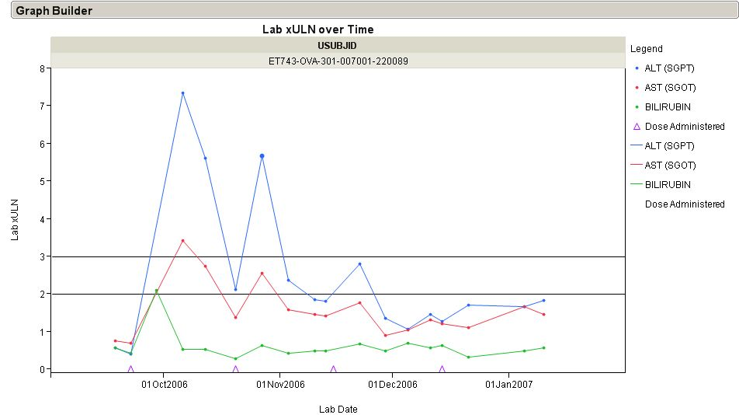
Questions 1
1. ‘Liver Function Tests over Time’ The x-axis should reflect study day or study month etc. and not date. The header should reflect the subject number. [Robert Gordon – J&J]

Slide 2
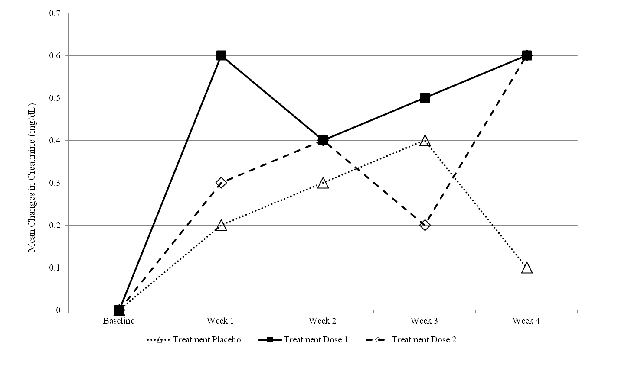
Questions 3
2: ‘Mean Change in Creatinine over Time’ Notes: Confidence intervals should be added to plot. Replace x-axis test with a numeric scale (i.e. Study Week similar to figure 6). [Robert Gordon – J&J]
Study Week
Placebo (at risk) | 160 | 157 | 152 | 150 | 147
Active (at risk) | 156 | 154 | 154 | 146 | 144

Slide 3
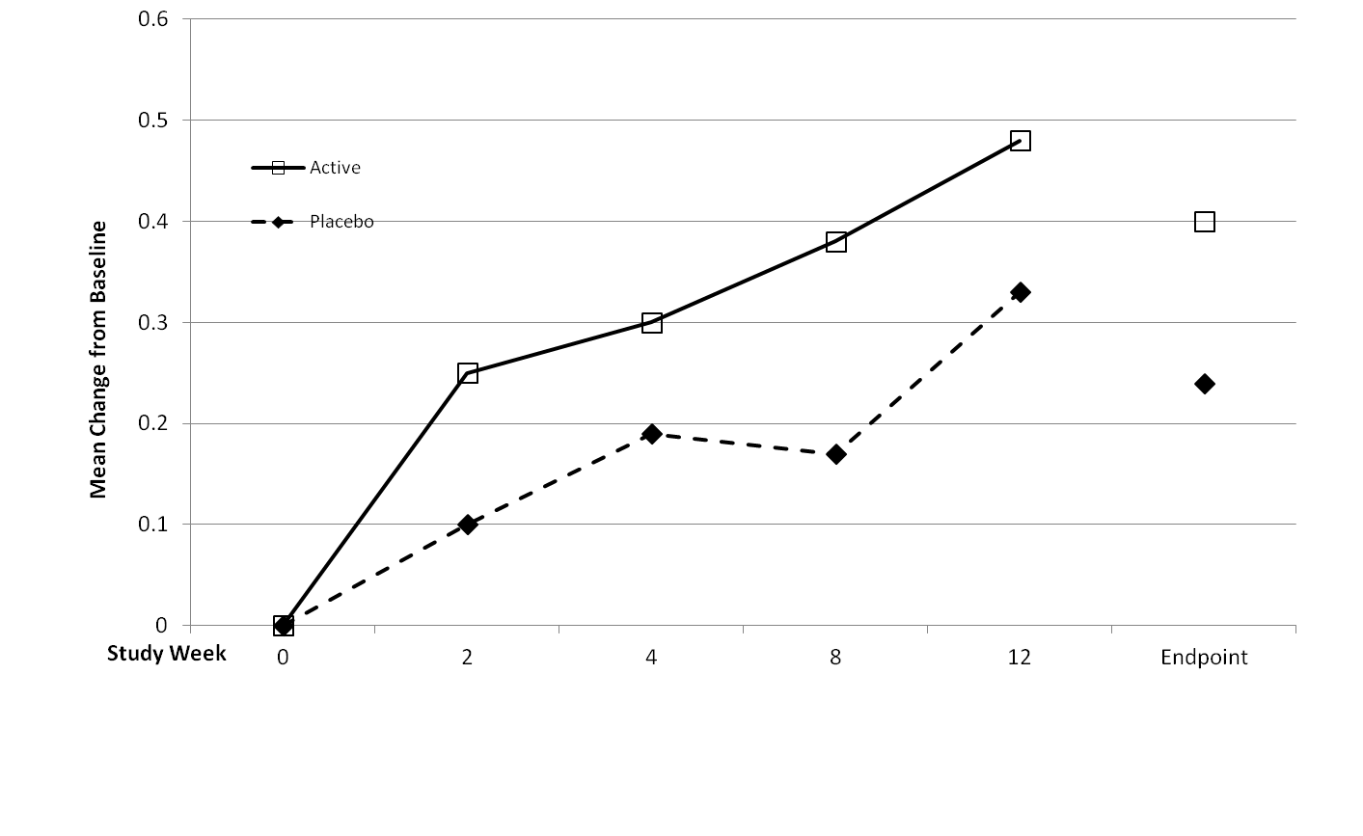
Questions 3
3: ‘Mean Change from Baseline over Time’ Notes: Confidence intervals should be added to the plot. [Robert Gordon – J&J]
Placebo (at risk) | 160 | 157 | 152 | 150 | 147 | 160
Active (at risk) | 156 | 154 | 154 | 146 | 144 | 156

Slide 4
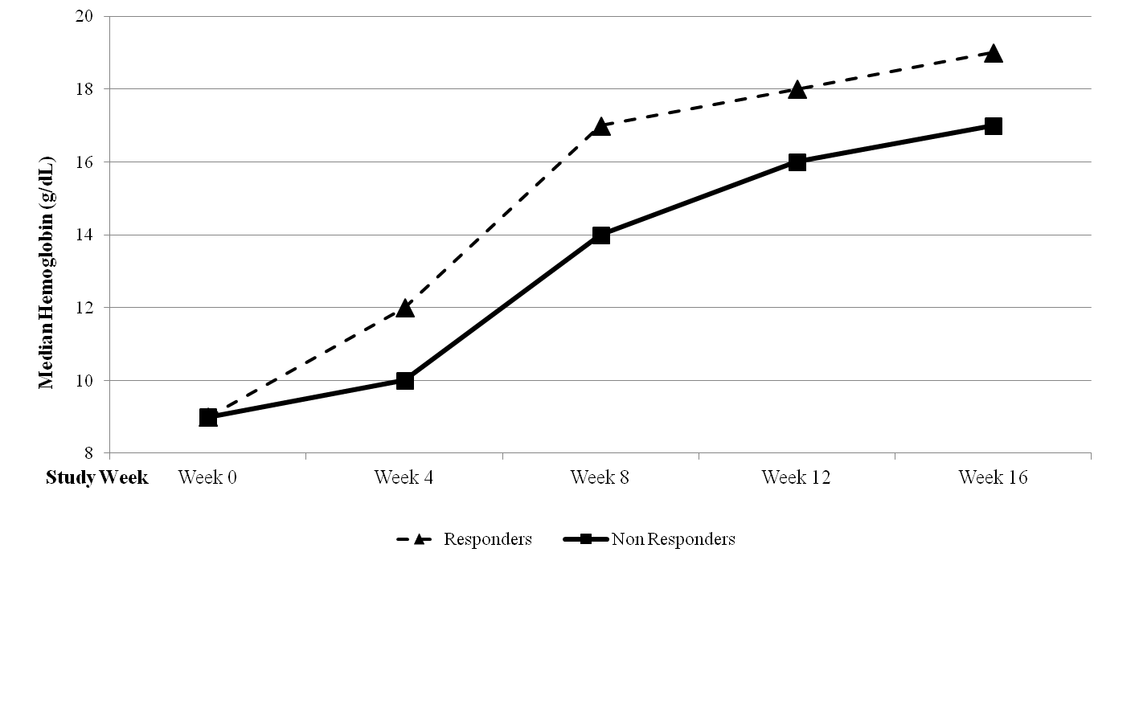
Questions 3
4: ‘Median/Mean hemoglobin (g/dL) over time by treatment’ Notes: If median, quantiles should be added. If mean, confidence intervals should be added. Include definition of population (responders, non responders in this case). X-axis should be numeric as in figure 6. Add counts as in figure 6 if possible. [Robert Gordon – J&J]
Placebo (at risk) | 160 | 157 | 152 | 150 | 147
Active (at risk) | 156 | 154 | 154 | 146 | 144

Slide 5
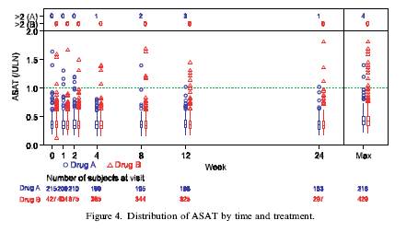
Questions 3,5
5: ‘Distribution of ASAT by time and treatment‘ Notes: Be sure that axis scale is representative of time (as is shown). Option of adding patient qualifiers on outliers would be beneficial. In graph description, would need to specify when to use and when not to use the Max (or other applicable) sections. [Amit, hieberger, Lane ‘Graphical approaches to the analysis of safety data from clinical trials’ 2007]

Slide 6
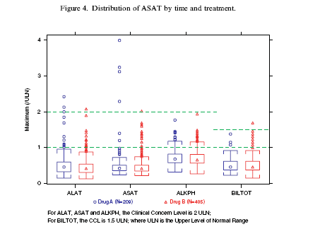
Questions 3,5
6: ‘Distribution of ASAT by treatment’ Notes: Title should not include time. Option of adding patient qualifiers on outliers would be beneficial. Option to mark outliers meeting Hy’s law criteria if possible. Would need to add Hy’s law criteria on footnote. Caveat – wouldn’t use this graph is there were different times on treatment for dose/drug groups. [Amit, hieberger, Lane ‘Graphical approaches to the analysis of safety data from clinical trials’ 2007]

Slide 7
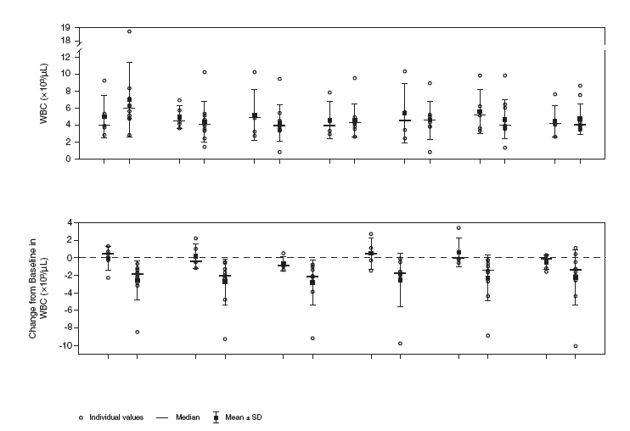
Questions 3,5
7: ‘Change from baseline in WBC over time by treatment’. Note that if the graphic was in color, a legend could be used for dose group and dose group could be removed from the x-axis. Be sure that axis scale is representative of time (as is shown). [Robert Gordon – J&J]
Dose 1
Dose2
Dose 1
Dose2
Dose 1
Dose2
Dose 1
Dose2
Dose 1
Dose2
Dose 1
Dose2
Dose 1
Dose2
Baseline Week 2 Week 3 Week 4 Week 5 Week 6 Week 7
Dose 1
Dose2
Dose 1
Dose2
Dose 1
Dose2
Dose 1
Dose2
Dose 1
Dose2
Dose 1
Dose2
Week 2 Week 3 Week 4 Week 5 Week 6 Week 7

Slide 8
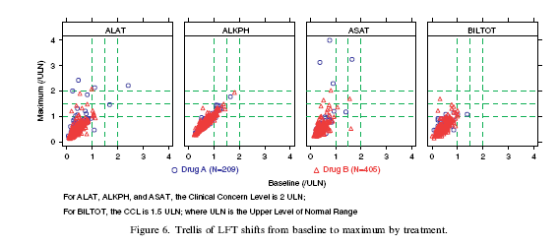
Questions 2,3,5
8: ‘Trellis of shifts of LFTs from baseline to maximum by treatment and timepoint’ Notes: Would be nice if there were additional rows for each time point. For instance a row of boxes for baseline, then one for week 1 etc. Maximum number of rows would depend on clarity. Definite focus on liver, would need additional relevant clinical groupings. [Amit, hieberger, Lane ‘Graphical approaches to the analysis of safety data from clinical trials’ 2007]

Slide 9
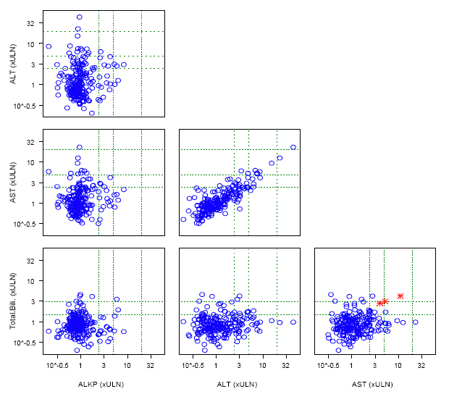
Questions 2,3,5
9: ‘Matrix display of maximum LFT levels’ Notes: Need legend to include treatment groups (if more than one group). Additionally, need label for red stars highlighted – perhaps Hys law cases. Possibly annotate red stars with subject ID. Remove the 10^-(0.5) and replace with 0. [Michael O’Connell, Insightful Presentation, 2007]

Slide 10
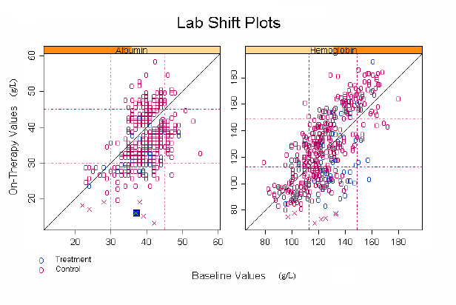
Questions 2,3,5
10: ‘Lab shift plots’ Notes: Light grid lines would be helpful in reading the values if adding doesn’t make the graph too busy. Scale the ranges to ULN if possible, but can use standard units if clinicians prefer. When programming, perhaps make it possible for program to input either ULN or standard units. Make sure boxes are square. Add legend concerning x values – outliers? [Michael O’Connell, Insightful Presentation, 2007]

Slide 11
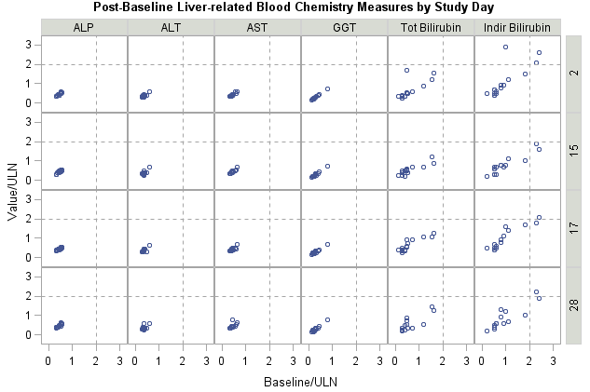
Questions 2,3
11: ‘Post-baseline liver-related blood chemistry measures by study day’ Notes: If using the same scale, this is a very nice graphic. But must use same scale. Color by treatment if possible with legend. [Alain Smits – J&J]

Slide 12
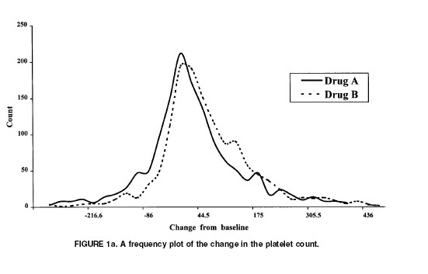
Questions 3,5
12: ‘Frequency plot of the change in the platelet count ’ Notes: Percent on the y-axis instead of count. Add units in title. Make the x-axis distances to be consistent between tick marks. Color if possible, keeping dashed line for gray scale printing. Add veritcal reference at zero, if applicable for clinical test. [CHRISTY CHUANG-STEIN et al, DIA Journal 2001]

Slide 13
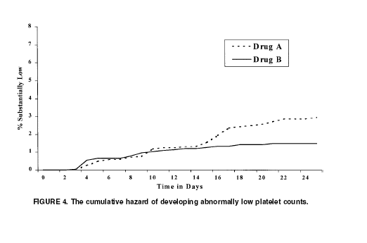
Questions 3,5,7
13: ‘The cumulative hazard of developing abnormally low platelet counts’ Notes: Add subjects at risk at each time point. Time in days should be explained, i.e. ‘Time in days from study start’. Definition of what substantially low represents. % should be written in words – ‘Percent’. Why does the graph go past Day 24? Numbers on x-axis need to align with tick marks. Maybe start at 100% on left if very high event rates. For low rates, this is good. CHRISTY CHUANG-STEIN et al, DIA Journal 2001]
Placebo (at risk) | 160 | 157 | 152 | 150 | Fill in remaining days as appropriate
Active (at risk) | 156 | 154 | 154 | 146 | Fill in remaining days as appropriate

Slide 14
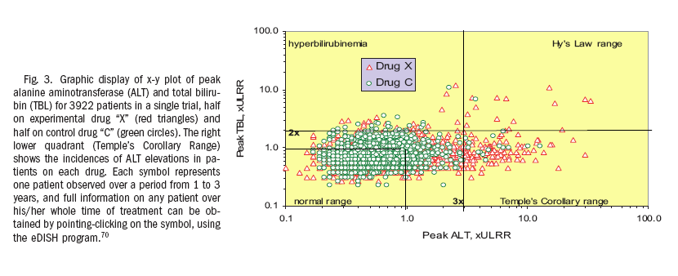
Questions 2,3,4
14: ‘Scatter Plot of peak ALT versus peak Total Bilirubin, by treatment’ Notes: The labels are a nice addition and are recommended on the final plot (which combines the three eDish type plots #9-#11) ULRR seems to represent upper limit of reference range. [Watkins et al, Hepatology 2008]

Slide 15
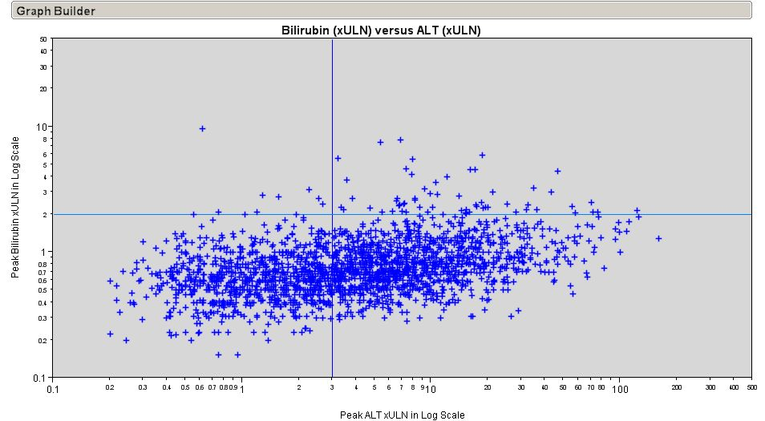
Questions 2,3,4
15: ‘Scatter Plot of peak ALT versus peak Total Bilirubin’ Notes: The x-axis scale (including the minor tick separation) is recommended on the final plot (which combines the three eDish type plots #9-#11) [Gordon – J&J]

Slide 16
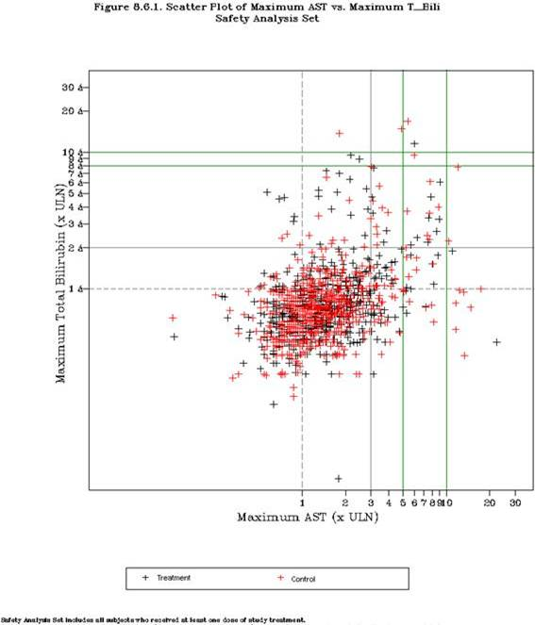
Questions 1,2
16: ‘Scatter Plot of maximum AST versus maximum Total Bilirubin’ Notes: This is the recommended eDish type plot, combining plots #9, 10 and 11. The x-axis scale (including the minor tick separation) from the previous plot is recommended here. Although the x-axis is AST, ALT could be substituted to arrive at a Hy’s Law plot and inclusion of the labels (as in plot #9) would be recommended. Green reference lines should be removed or explained if needed. [Qi Jiang – Amgen]

Slide 17
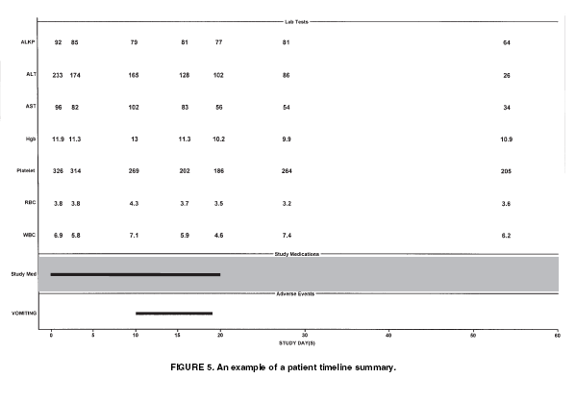
Questions 1,5
17: ‘Patient timeline summary’ Notes: Although this plot is not recommended, it is the basis for additional plots to be reviewed. Units would be needed (along y-axis). Addition of ULN values (perhaps in parentheses after the lab value) would be helpful. [CHRISTY CHUANG-STEIN et al, DIA Journal 2001]

Slide 18
Questions 1,2,3,5
18: ‘Median and inter-quartile range plot for lab change from baseline’ Notes: Add subjects at risk across x-axis if possible, unless the population is already ‘completers’ then add to title. Very light grid in background in possible, if not then add either tick marks on both sides of y-axis on each plot or numbers. Remove brackets (< >). [Qi Jiang - Amgen]
≤
65 years
> 65 years
< Overall >
5
Control (N=x)
Control (N=x)
Control (N=x)
Drug (N=x)
Drug (N=x)
Drug (N=x)
4
3
Percent Change From Baseline
2
1
0
-1
1
6
12
24
1
6
12
24
1
6
12
24
<Study Month>
Placebo (at risk) | 160 | 157 | 152 | 150
Active (at risk) | 156 | 154 | 154 | 146
160 | 157 | 152 | 150
156 | 154 | 154 | 146
160 | 157 | 152 | 150
156 | 154 | 154 | 146
*

Slide 19
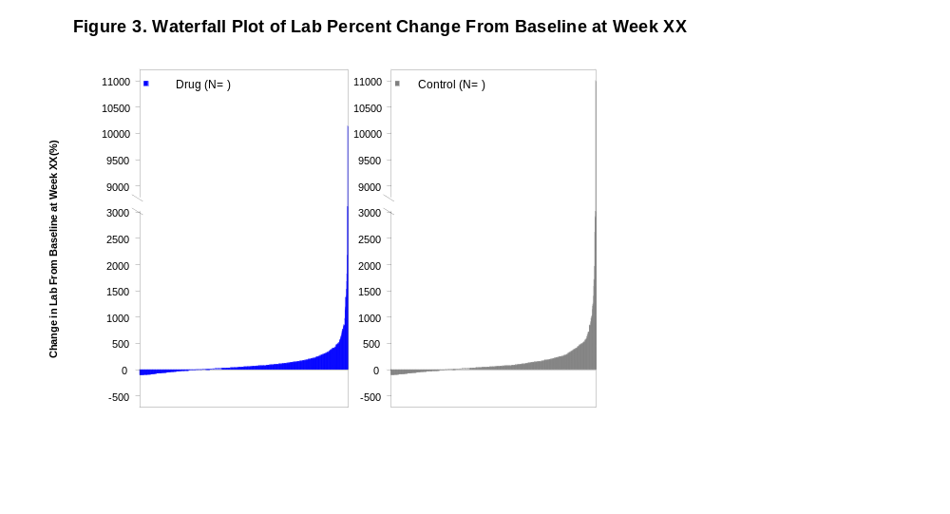
Questions 1,2,3,5
19: ‘Waterfall plot of lab percent change from baseline at Week XX’ Notes: If only one or few outliers, perhaps remove from plot and add footnote. Y-axis should say percent change. Can’t do more than 100% negative, so stop the axis at that point. Keep in mind gray scale printing, but graphic is meant to be colored. [Qi Jiang - Amgen]

Slide 20
Questions 3,4,5
20: ‘Cumulative distribution of lab changes from baseline’ by visit’ Notes: If only one or few outliers, perhaps remove from plot and add footnote. Normally used for information al purposes, not necessarily inclusion in study report. X-axis label should be change. [Qi Jiang - Amgen]
Figure 2. Cumulative Distribution of Lab Change from Baseline by Visit
Control (N= )
Drug (N= )
100
Day 8
100
Week 5
100
Week 9
100
Week 13
80
80
80
80
60
60
60
60
40
40
40
40
Cumulative Percent of Subjects
20
20
20
20
0
-400
-200
0
200
400
1900
0
-400
-200
0
200
400
1900
0
-400
-200
0
200
400
1900
0
-400
-200
0
200
400
1900
100
Week 17
100
Week 21
100
Week 25
100
Week 29
80
80
80
80
60
60
60
60
40
40
40
40
20
20
20
20
0
-400
-200
0
200
400
1900
0
-400
-200
0
200
400
1900
0
-400
-200
0
200
400
1900
0
-400
-200
0
200
400
1900
Percent Change From Baseline

Slide 21
BACK UP SLIDES
These slides were reviewed, however, they were removed because they were repetitive or not chosen as a standard graphic.

Slide 22
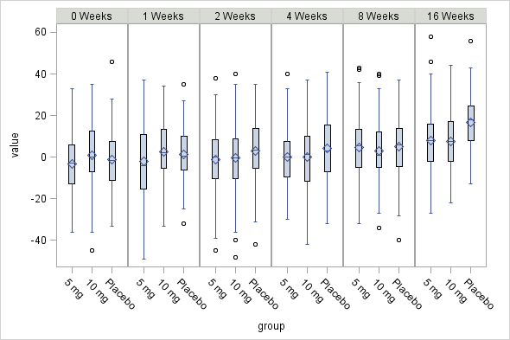
Questions 3,5
[Alain Smits – J&J]

Slide 23
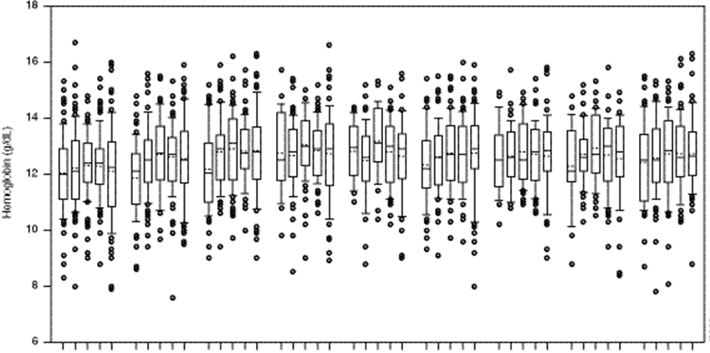
Questions 3,5
[Robert Gordon– J&J]
Dose 1
Dose2
Dose 3
Dose 4
Dose 5
Baseline
By dose group over time

Slide 24
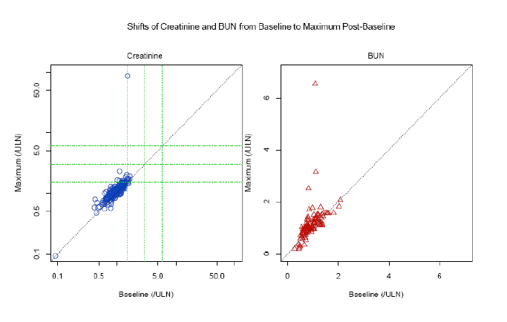
Questions 2,3
[Michael O’Connell, Insightful Presentation, 2007]

