Slide 1
General Principles, Illustrations and Wiki Resources for Improving Your Statistical Graphs: Advice from the FDA/Industry/Academia Safety Graphics Working Group
Brenda Crowe, PhD
Research Advisor
Eli Lilly and Company
Acknowledgements: Rich Forshee, Ken Koury, Mat Soukup, Fabrice Bancken

Slide 2
Disclaimer
The views and opinions expressed in the following PowerPoint slides are those of the individual presenter and should not be attributed to Drug Information Association, Inc. (“DIA”), its directors, officers, employees, volunteers, members, chapters, councils, Special Interest Area Communities or affiliates, or any organization with which the presenter is employed or affiliated.
These PowerPoint slides are the intellectual property of the individual presenter and are protected under the copyright laws of the United States of America and other countries. Used by permission. All rights reserved. Drug Information Association, Drug Information Association Inc., DIA and DIA logo are registered trademarks. All other trademarks are the property of their respective owners.

Slide 3
Members of the FDA/Industry/Academia Safety Graphics Working Group
Regulatory: Mat Soukup, George Rochester, Antonio Paredes, Chuck Cooper, Eric Frimpong, Hao Zhu, Janelle Charles, Jeff Summers, Joyce Korvick, Leslie Kenna, Mark Walderhaug, Pravin Jadjav, Richard Forshee, Robert Fiorentino, Suzanne Demko, Ted Guo, Yaning Wang,
Industry: Ken Koury, Brenda Crowe, Andreas Brueckner, Andreas Krause, Fabrice Bancken, Larry Gould, Liping Huang, Mac Gordon, Matthew Gribbin, Navdeep Boparai, Qi Jiang, Rich Anziano, Susan Duke, Sylvia Engelen,
Academia: Frank Harrell, Mary Banach
Co-leads are in bold font
Notes:
Note: names will be updated before presentation.

Slide 4
Presentation Objectives
To provide background and overview of the FDA/Industry/Academia Graphics Working Group
To present resources and guidance that the working group has developed

Slide 5
Outline
Why visualization is important; proof by example
Barriers to visualizations
Working group (objectives, structure)
CTSpedia (wiki for dissemination of info)
Examples of Best Graph Practices
Concluding Remarks

Slide 6
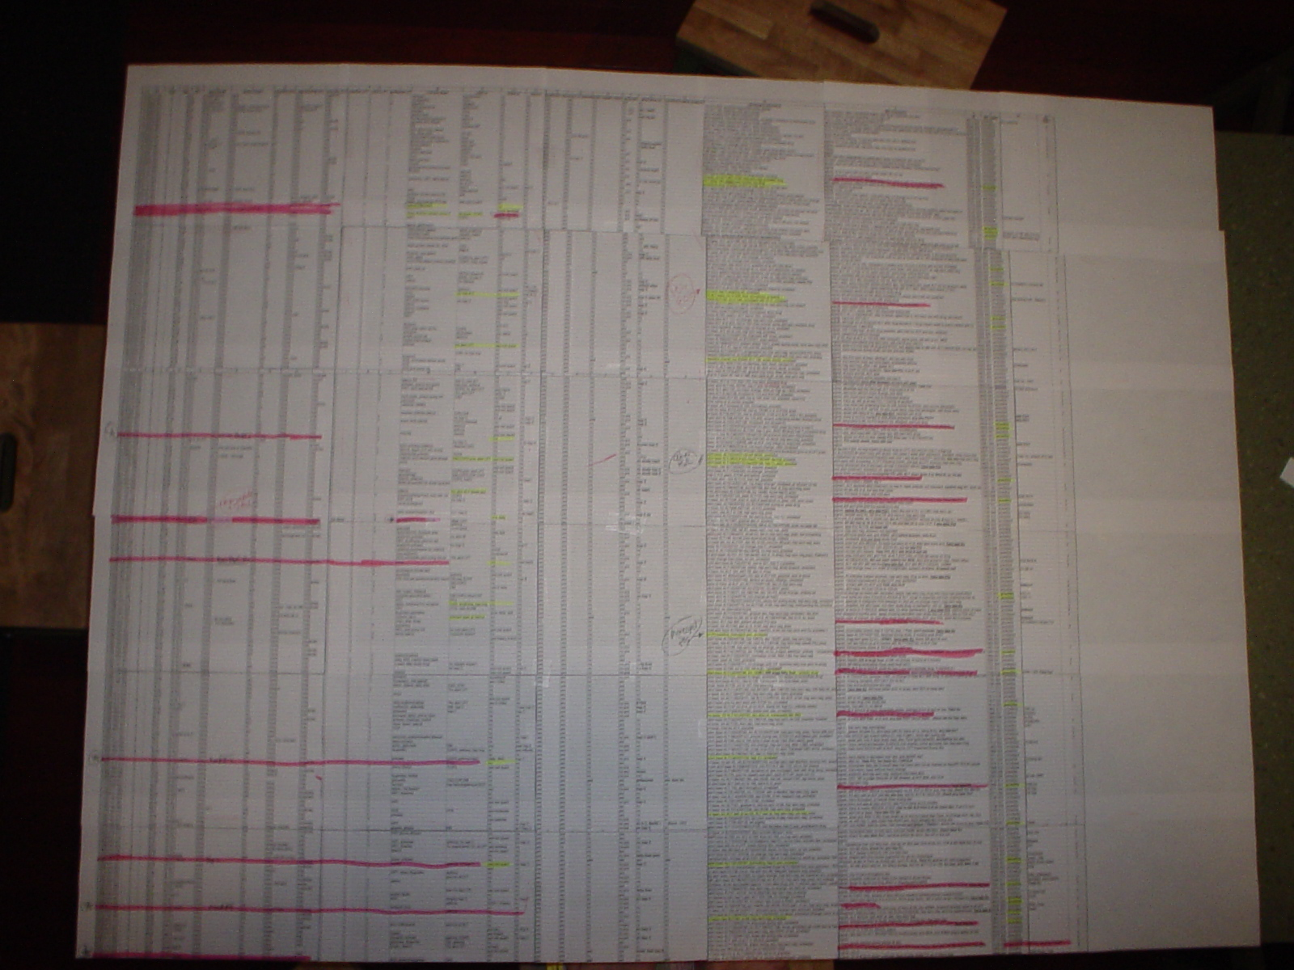
Notes:
Problem Statement
Most presentations on safety data convey information in tabular form. In general, tables are difficult to understand, especially when the data are complex.
Value of Graphs
Graphics can more effectively and efficiently communicate critical safety information to a variety of stakeholders.
Encouragement of consistent or standardized presentation of visual information is needed.
There is a need to promote best practices in the use of graphical visualization of clinical safety information.

Slide 7
Example 1: Understanding the Trend
Tabular Summary of Systolic Blood Pressure Over Time:
 | Active Drug |  |  |  |  | Control Drug
Visit | N | Mean | SD | 95% CI |  | N | Mean | SD | 95% CI
1 | 112 | 118.1 | 1.3 | (115.9, 120.3) |  | 113 | 119.1 | 1.2 | (117.0, 121.2)
2 | 112 | 122.7 | 1.4 | (120.4, 125.0) |  | 112 | 119.1 | 1.1 | (117.0, 121.2)
3 | 111 | 125.6 | 1.0 | (123.6, 127.6) |  | 110 | 114.4 | 1.2 | (112.3, 116.5)
4 | 110 | 133.1 | 1.2 | (131.0, 135.2) |  | 108 | 124.2 | 1.4 | (121.9, 126.5)
5 | 110 | 136.7 | 1.2 | (134.6, 138.8) |  | 108 | 123.8 | 1.2 | (121.7, 125.9)
6 | 108 | 134.2 | 1.1 | (132.1, 136.3) |  | 108 | 114.9 | 1.1 | (112.8, 117.0)
7 | 106 | 131.0 | 1.2 | (128.9, 133.1) |  | 104 | 120.1 | 1.2 | (118.0, 122.2)
8 | 105 | 126.2 | 1.3 | (124.0, 128.4) |  | 103 | 121.6 | 1.2 | (119.5, 123.7)
9 | 104 | 124.3 | 1.2 | (122.2, 126.4) |  | 100 | 118.6 | 1.1 | (116.5, 120.7)
10 | 102 | 125.1 | 1.2 | (123.0, 127.2) |  | 100 | 117.7 | 1.3 | (115.5, 119.9)

Slide 8
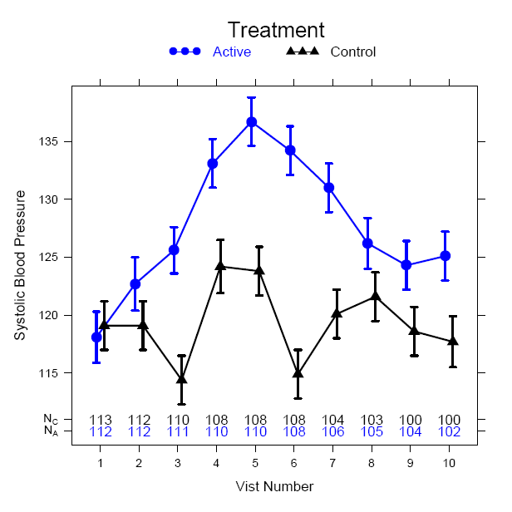
Example 1: Understanding the Trend
Systolic Blood Pressure
Visit Number
Notes:
Can see how much easier it is to see the trend with a graph.
Reasons to Include Graphic Summaries
Complex statistical concepts and data structures can be conveyed at a level which is within reach to those with little statistical training
Ability to highlight key safety signals from large data bases
Paradigm is to actively assess the data in a manner that is visual, intuitive, and geometric

Slide 9
Barriers to Graph Creation
Lack of Training: Statistical coursework typically does not include classes/training on graphic construction or on good graphical principles
Limited Publications: Publications of graphical approaches for clinical trial data are few and far between
Time restraints
  May require creation after data base lock
Software dependency
  Software needed may not be allowed/available
  Can be a big learning curve for new software
Notes:
It is prohibitive from a resource perspective to bring in new software to a big company.

Slide 10

Remove the Barriers – Key for Future

Slide 11
FDA/Industry/Academia Working Group
Background
  Formed: Fall 2009
  Membership
    Regulatory (xx members): FDA
    Industry (xx members): Shering-Plough, Pfizer, GSK, Johnson and Johnson, Novartis, Eli Lilly, Merck, Sanofi-Aventis, Roche, Amgen, Actelion
    Academia (2 members): Vanderbilt, UC-Davis

Slide 12
Project Objectives
Develop a palette of statistical graphics for reporting on clinical trial safety data.
Identify areas particularly applicable or useful to regulatory review in which graphics can enhance understanding of safety information.
Recommend graphics for clinical data based on good scientific principles and best practices.
Create a publicly-available repository of sample graphics (ensuring appropriate credits are given for contributions), including data sets and code.
Educate and engage stakeholders through outreach activities.
Consider publishing with authorship/acknowledgments as is consistent with contributions and policy of the affiliated institution.

Slide 13
Working Group Structure
Invited membership and time/resources are based on a volunteer basis
Four Subgroups
ECG/Vitals
General Adverse Events
Labs/Liver
General Principles

Slide 14

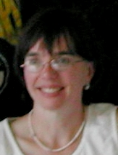






General Principles Subgroup
Rich Forshee, co-lead
Fabrice Bancken,
co-lead
Susan Duke
Mat Soukup
Mary Banach
Brenda Crowe
Frank Harrell
Andreas Krause
Plus Qi Jiang, Larry Gould

Slide 15
Addressing the Barriers
Lack of Training: Developing materials to help scientists select the right graph; outreach through presentations
Limited Publications: Materials will be presented in a public forum (more to follow)
Time Restraints: Standard set of views reduces time to develop graphical approaches, can be planned upfront
Software Dependency: Code to create graphics will be publicly available; examples are included from multiple software packages

Slide 16
Distribution of Content
Information is becoming publicly available at CTSpedia (www.ctspedia.org)
CTSpedia is an online collection of best practices, tools, educational materials, and other items about biostatistics, ethics, and research design.
Site is constantly updated/changed to help users.
Notes:
Mary Banach wants me to tell people that she appreciates any comments or suggestions that users give her.

Slide 17
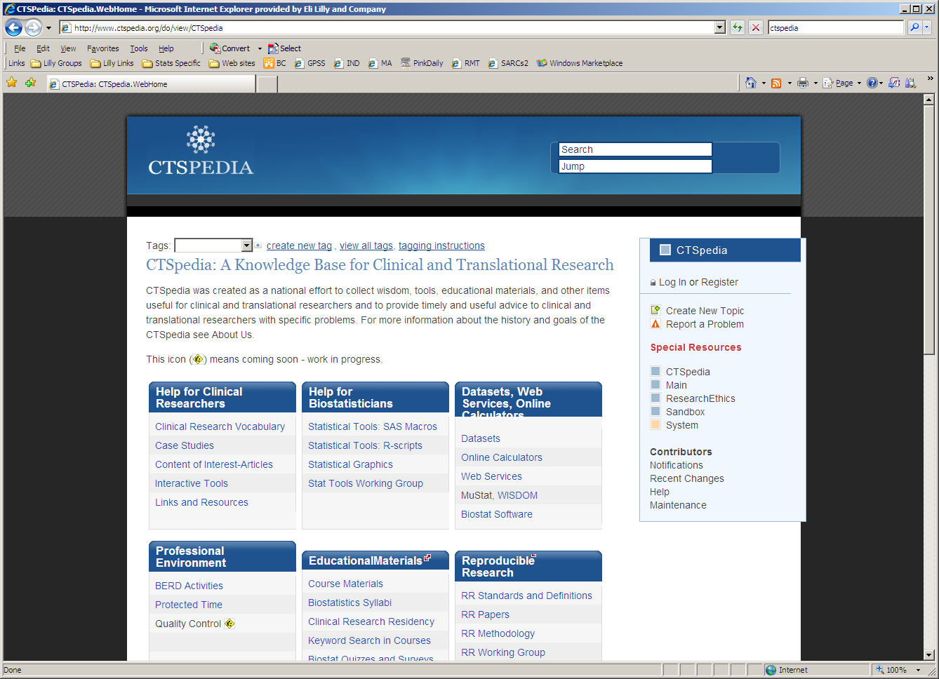
CTSpedia Screenshot

Slide 18
CTSpedia Screenshot

Slide 19
CTSpedia Screenshot

Slide 20
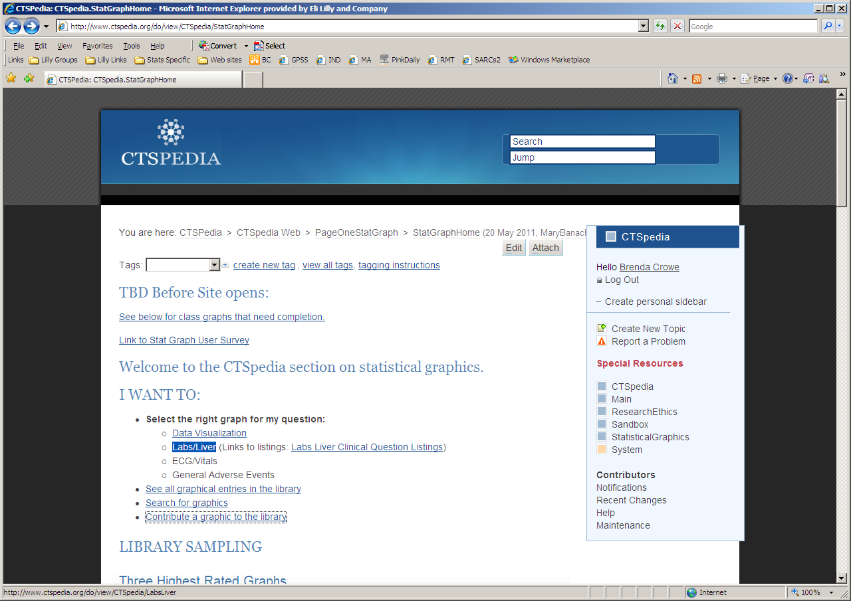

Slide 22
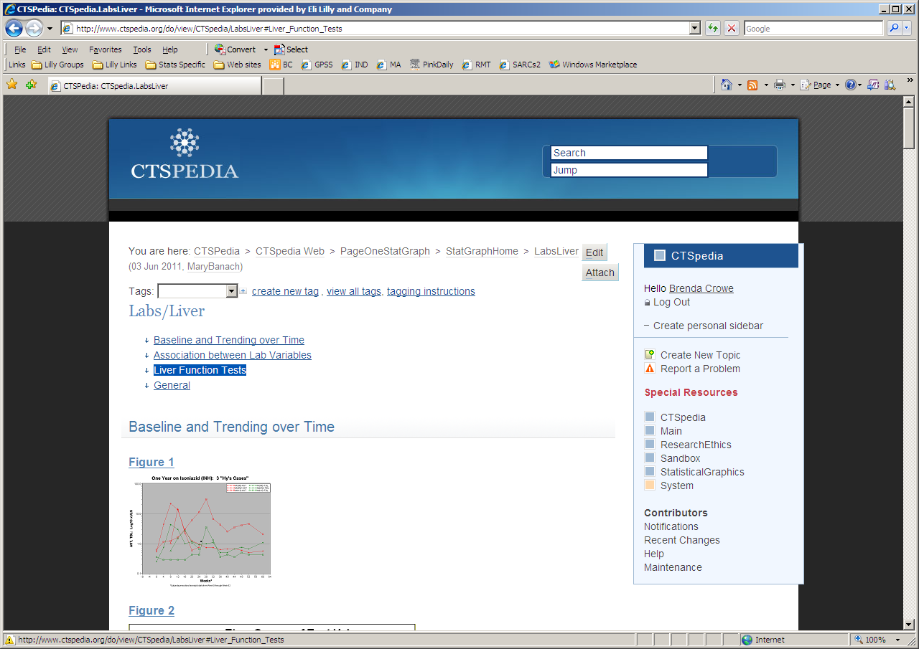

Slide 24
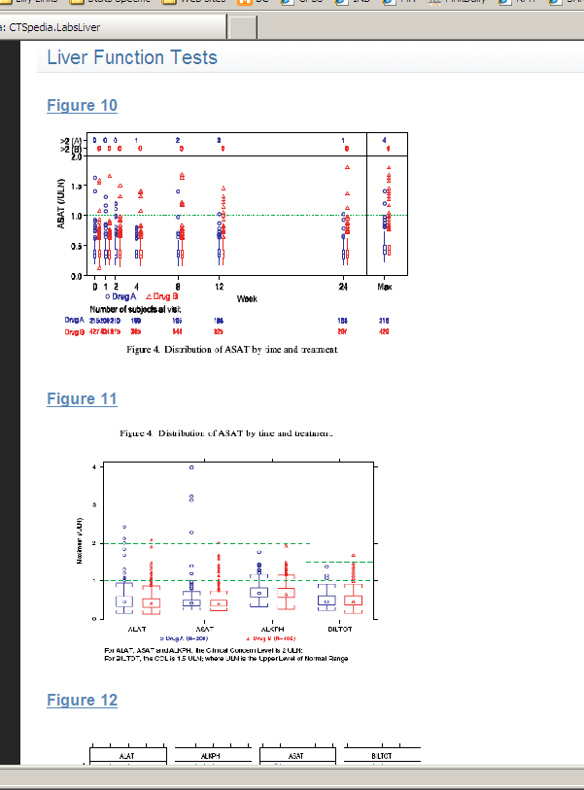

Slide 25
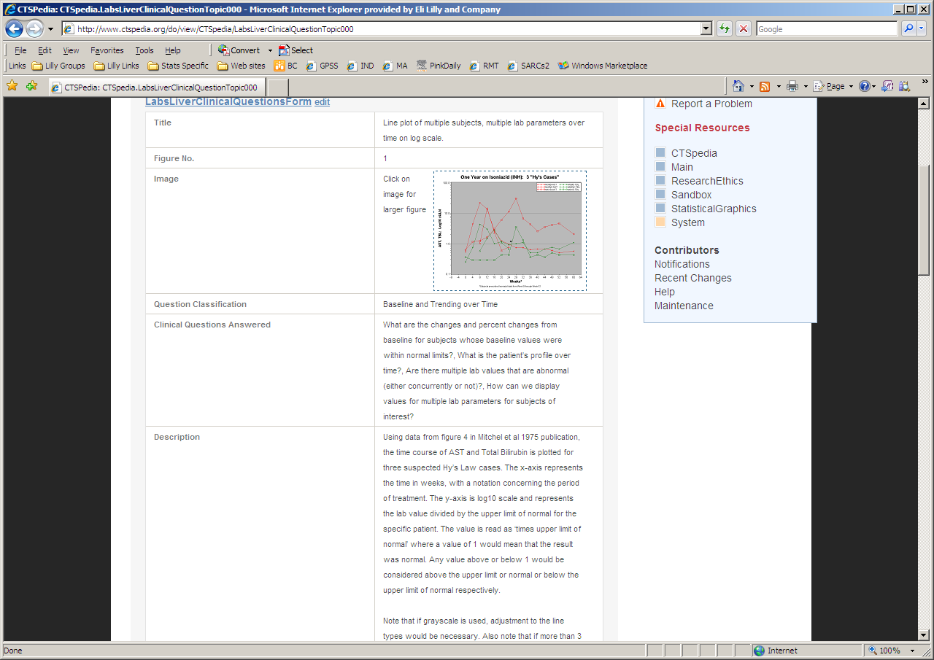

Slide 26
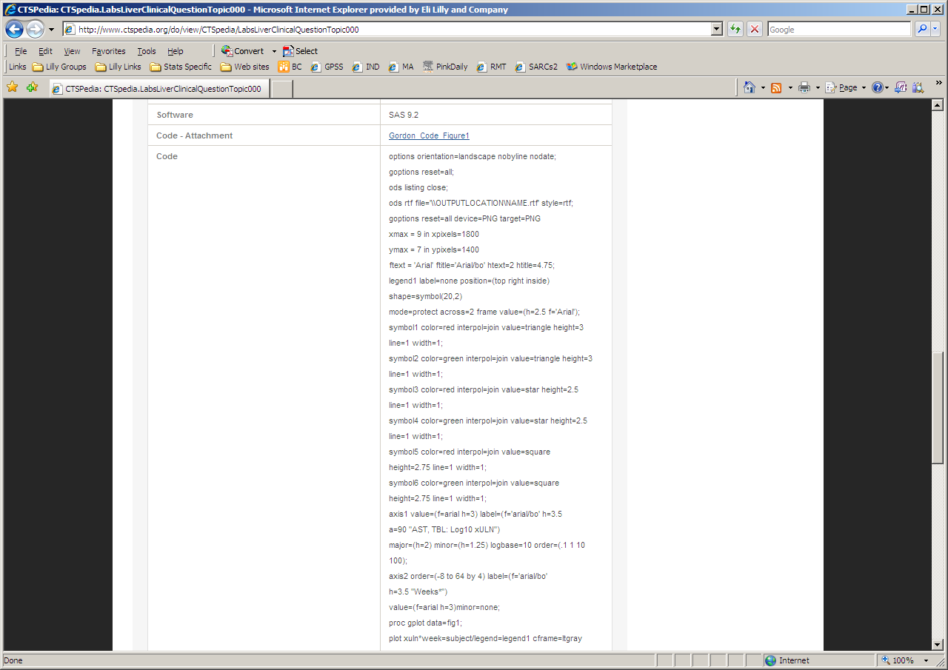

Slide 27
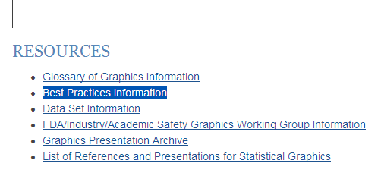
Notes:
There is a Resources section

Slide 28
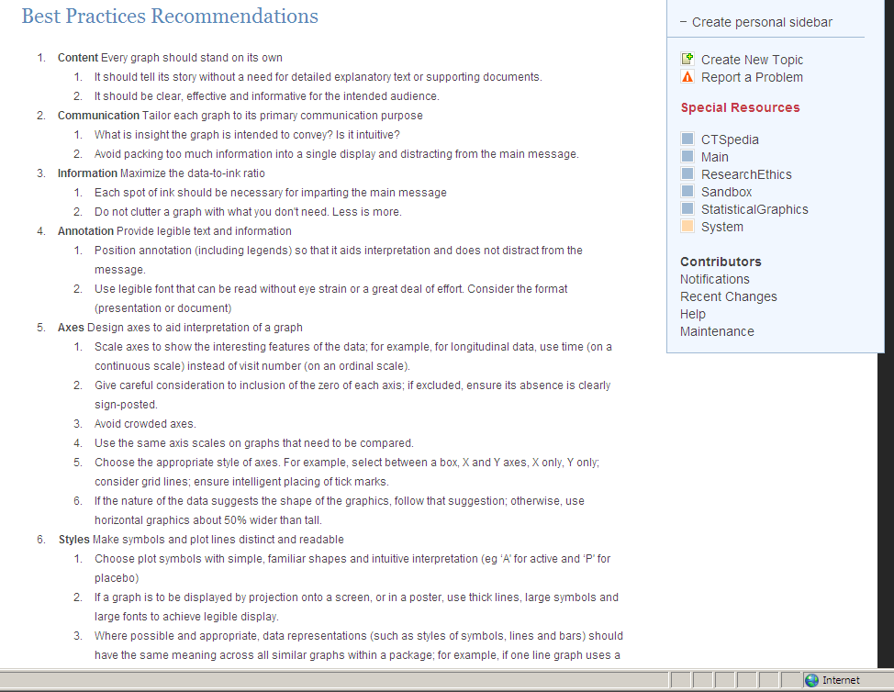
Best Graph Practices
Adapted from GlaxoSmithKline Graphics Principles (used with permission)
Notes:
Best practices on the website are a great thing to read. The following examples will illustrate some of them.

Slide 29
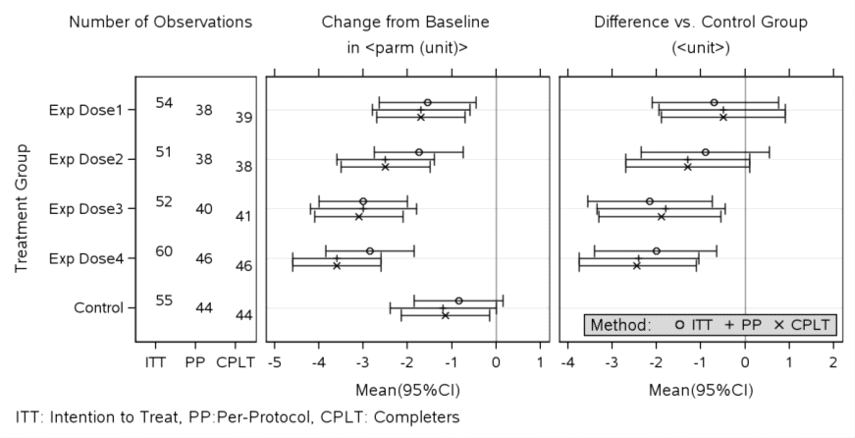
Example 2: Interest is Dose Vs. Control
This plot shows all dose groups for different analysis groups (ITT, Per Protocol, Completers)
Notes:
The first advice may seem obvious, but for placebo- or active-controlled studies, it is not uncommon to see only a plot a change from baseline within each treatment group at the endpoint, even if one is interested in the contrast vs. control. Do we expect the reader to guess what the difference would be ? And its 95%CI. ?
Another typical example is that throughout presentations you typically see error bars representing in turn different quantities, sometimes a SD, or a SE or a 95%CI. If a message is around 95% confidence limits, don’t display SEs to support the message hoping that the reader will visually compute the 95%CIs .... This then asks the reader to spend unnecessary time on the graph ... Making it less efficient.

Slide 30
Example 2: Interest is Dose Vs. Control
Displays the quantity of interest and doesn’t assume the reader can ‘visually subtract’
Notes:
In this example, we see a ‘dashboard view’ of the number of subjects in play, the mean changes from baseline obtained within each treatment group, but also the contrast / difference vs. the control group.

Slide 31
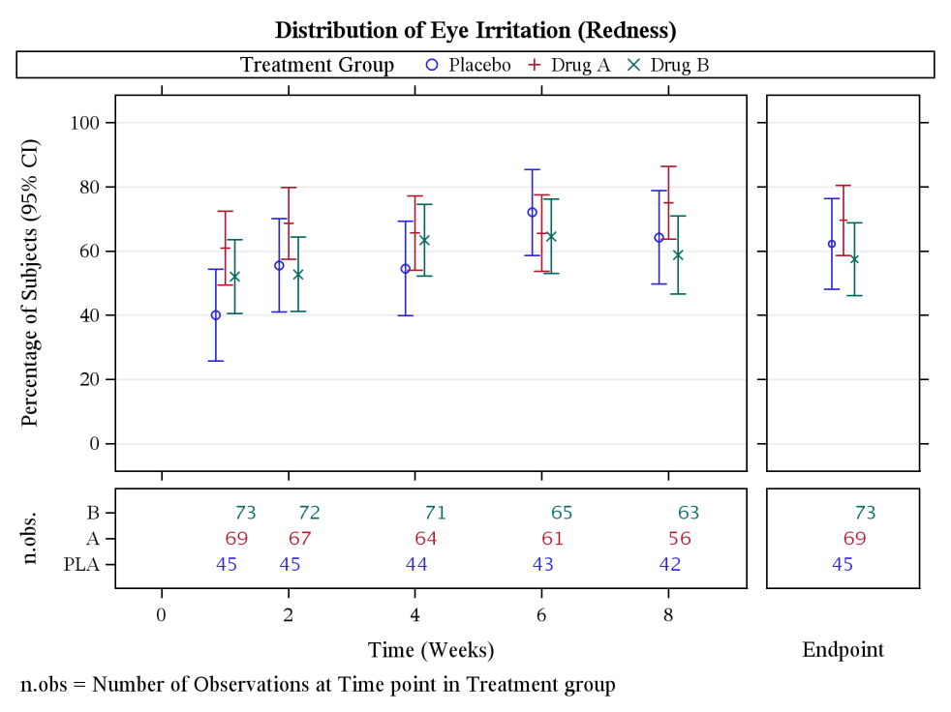
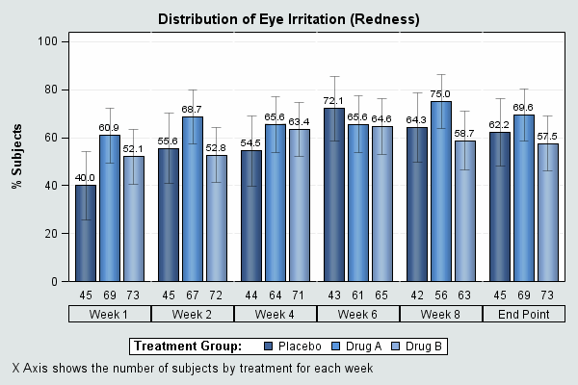
Example 3
Maximize the data-to-ink ratio
Use quantitative scales ... for quantitative variables
Notes:
The left graph uses a lot of ink and it is hard to see what is going on. The right graph is a much better use of the space and conveys the information better.
I think barplots are overused.
3. Information Maximize the data-to-ink ratio
Each spot of ink should be necessary for imparting the main message
Do not clutter a graph with what you don't need. Less is more.

Slide 32

Example 3: Lots of Ink Version
Notes:
There is a lot of ink here, but the main information is in the percent of subjects, with confidence intervals (or some measure of variability—it is not clear what it is).
Using weeks and end point as categorical variables doesn’t show the time differences between them.

Slide 33
Example 3: Less Ink Version is Easier to Follow
Notes:
This also shows making the time in weeks as a quantitative variable, rather than categorical. It is subtle here, but now weeks 1 and 2 are visually closer than weeks 2, 4, 6 and 8. Endpoint is clearly separated from the time in weeks.

Slide 34
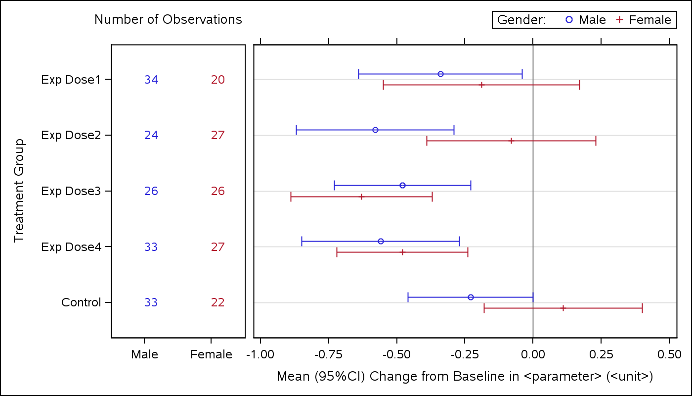
Example 4
Bring items the reader needs to compare closer
  Dose-Response relationship ? Consistent effects across subgroups?
Notes:
If the reader needs to compare/benchmark items, bring these items as close as possible in the graph. This illustration shows how you can fulfill actually two such comparisons. You can see if there is a consistent effect across subgroups by comparing the blue and red error bars within a Y –level, and at the same time see whether there is a general dose-ranging pattern of effect. A vertical shift has been applied to avoid error bars to overlap. However this shift was taken sufficiently small so that to allow an easy male/female comparison, and also to keep the Dose levels rather separated visually.
Can also mention the colors—matching to n’s.

Slide 35
Example 4
Provides visual anchors (but less prominent than data)
Uses meaningful reference lines, mirror tick mark onto right and upper axes
Notes:
Again, the objective here is to provide the reader with some visual items that will make the decoding of information more efficient.
In this illustration, one sees the reference line representing no change from baseline, and tick marks are mirrored onto the upper axis. This allows the reader to quantitatively locate the upper CIs more easily.
Side comment: if one of the categorical variables displayed is ordinal, use this to order the levels in the graph as well.

Slide 36
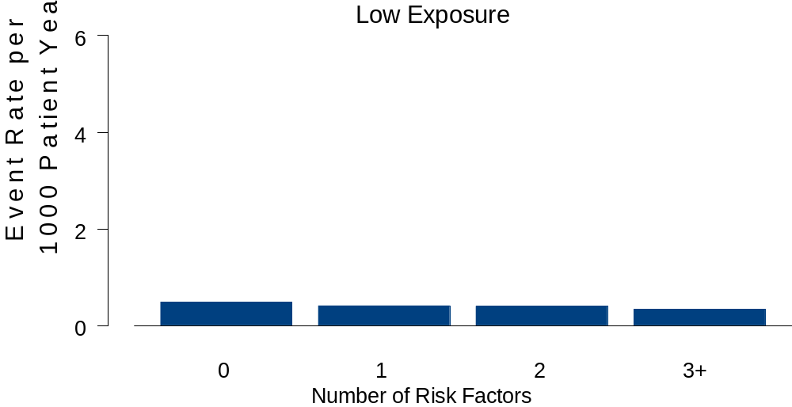
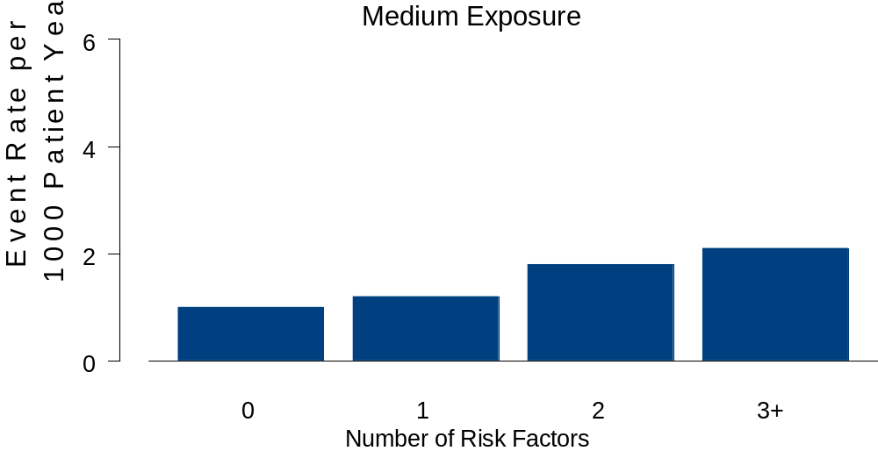
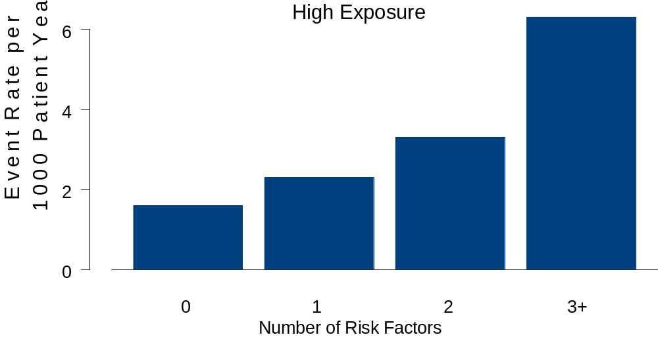
Example 5
* Modified from an example in Heiberger and Holland’s book: Statistical Analysis and Data Display, 2004, Springer
Notes:
This example assumes we are interested in looking at the relationship between exposure (low, medium, high), number of baseline risk factors for an event, and the event rate (per 1000 pt years). The 3 barplots are based on what was actually published in a manuscript, though for a different problem. The final plot is a plot that we think is a better display of the information. Next slides show larger versions, as people likely can’t read these.

Slide 37
Example 5
Notes:
This example assumes we are interested in looking at the relationship between exposure (low, medium, high), number of baseline risk factors for an event, and the event rate (per 1000 pt years). The first 3 barplots are based on what was actually published in a manuscript. The final plot is a plot that we think is a better display of the information.

Slide 38
Example 5

Slide 39
Example 5

Slide 40
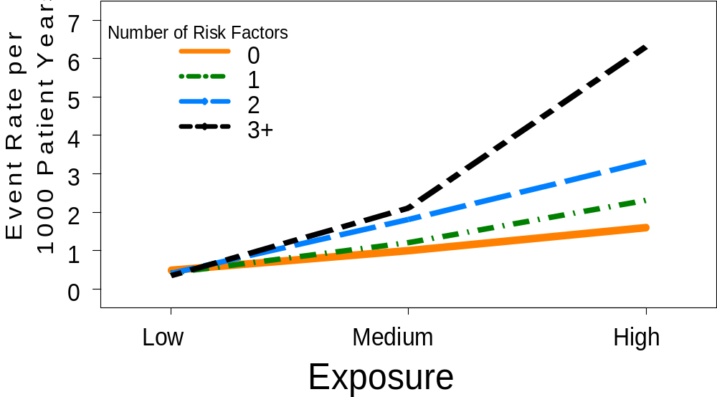
Improved Graph for Example 5
Shows all relationships on 1 slide (with less ink)
Colors are distinct; symbols and plot lines distinct and readable (and would be so if printed in black and white)
Text can be read without eye strain
Notes:
I think this plot is a preferable way of representing the data from the past 3 barplots. This plot fits several of the principles. It stands on its own. It nicely conveys the insight that there is an interaction between drug exposure and number of baseline risk factors. Plot lines are distinct and readable. Colors are (I hope) clearly visible and contrast. Because I used different line styles for the lines, it conveys the information even if printed in black and white (or if someone is color blind). Lines are thick, so that they should be readable on-screen.
What’s missing? Some visual representation of variability. Others?

Slide 41
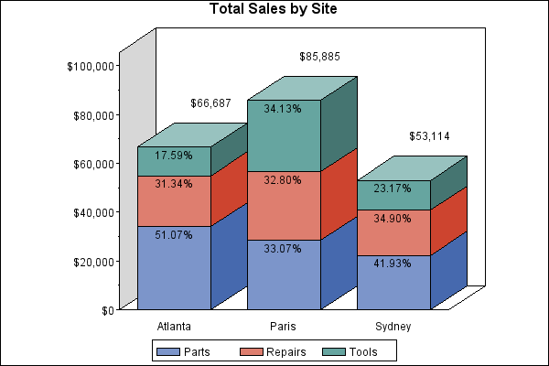
Example 6
Violates the following:
Maximize the data-to-ink ratio
Don’t use unnecessary dimensions
Avoid stacked bar plots
Notes:
This plot violates all the principles—lots of ink for little data, it has an unnecessary third dimension (that will usually visually distort the magnitudes). Stacked barplots are a poor way to present these data by subgroups.

Slide 42
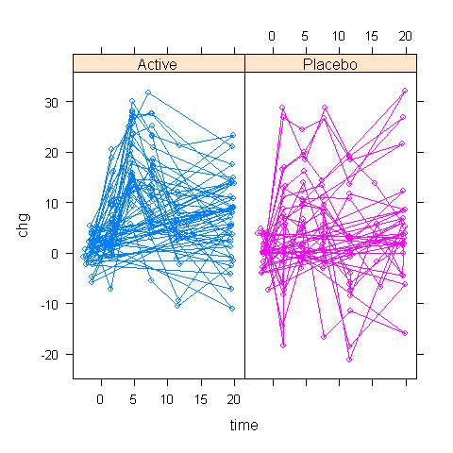
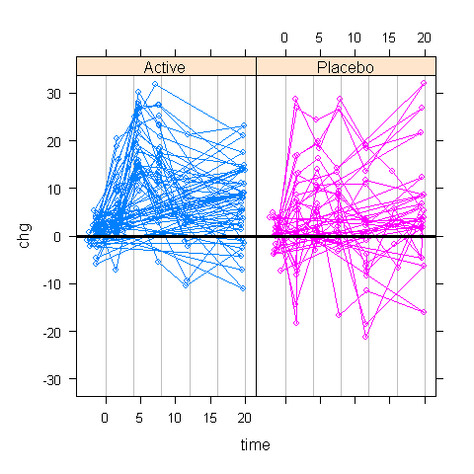
Example 7: Change from Baseline
To avoid misleading visual perception, consider a graph symmetric around “no change” (as in right graph)
Right graph has better text font and light vertical lines at each time point
Change
Time
Notes:
Graph on right is much better for putting change in perspective. Both of these are using a trellis plot (active on one side, placebo on the other)
It helps to show placebo and active on the same scale.

Slide 43
Potential Improvements from Using Effective Graphics
Clinical trial results are more transparent
Increases the likelihood of detecting key safety signals
Improves the ability to make clinical decisions
Allows for more productive interactions between sponsors and regulatory bodies
Improves communication with the public
Notes:
Possibly talk through this. Re #1: hard to hide the data if all are shown

Slide 44
A Community for Graphics
Several advantages exist for using a public community
  Increases the talent pool for developing new approaches
    Anyone (who registers) can contribute graphs
  Provides access to the latest information
  Access to code reduces resources needed to implement the approach
  Evolution towards a best practice in reporting safety information
Notes:
By 'public community' do you mean the pedia site? Also, is the CTSpedia the end product coming out of the working group? How audience can contribute to the pedia site? Any other plan/initiative the working group will be working on? What are some future pictures in this area
Once we are open, I believe that we will be very similar to wikipedia. We do require everyone that wishes to contribute to register. (We were getting constantly spammed when we allowed anyone to add information to the wiki.) I did design forms for entering contributions because they make it much easier to gather, sort, and prepare automatic listings of data. Anyone can send me their graphics and I will enter them into the system. (I will add that information to the top of the contributions page.) When you click on “Contribute a graphic to the library,” you get to this page http://www.ctspedia.org/do/view/CTSpedia/ContributeGraphics. I have to finish the instructions for the Labs/Liver and ECG/Vitals. Please let me know if the instructions makes sense. I have found that I usually need to work with people on their first submission.
I am working on a “How You Can Help” box for the CTSpedia Home Page. Sally Thurston from Rochester would like to list specific contributions that people can make to the wiki.

Slide 45

Cartoon Source: http://epiac1216.livejournal.com/271306.html

