Slide 1


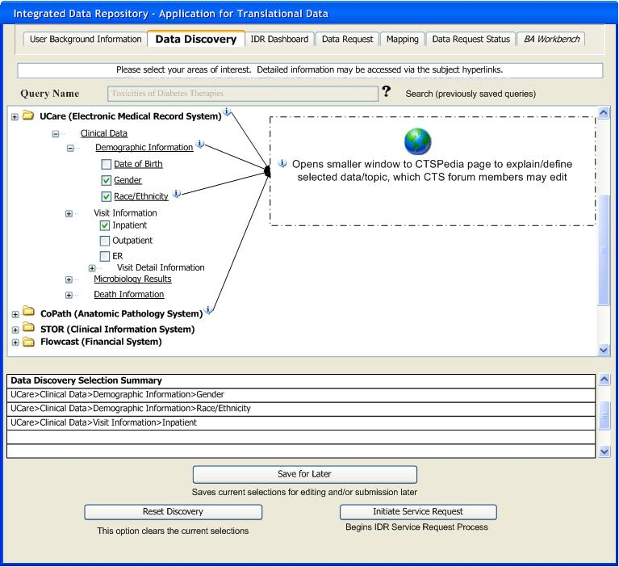
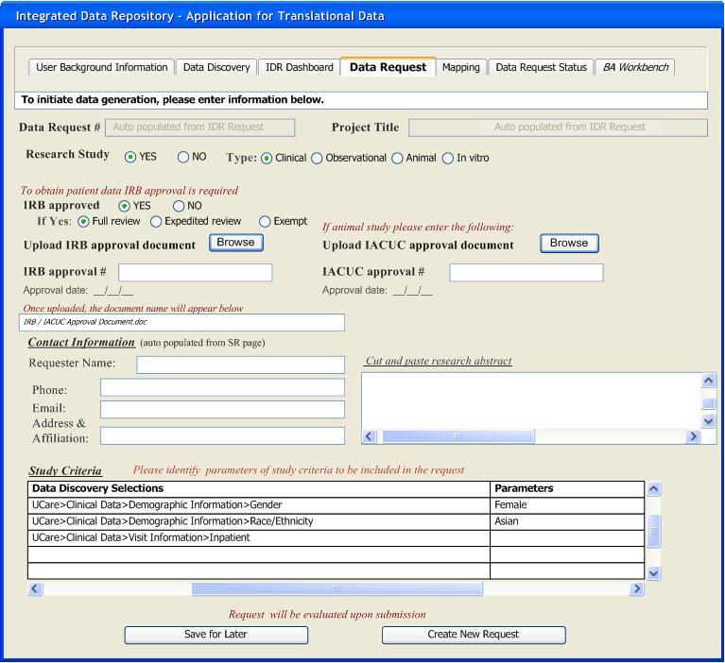
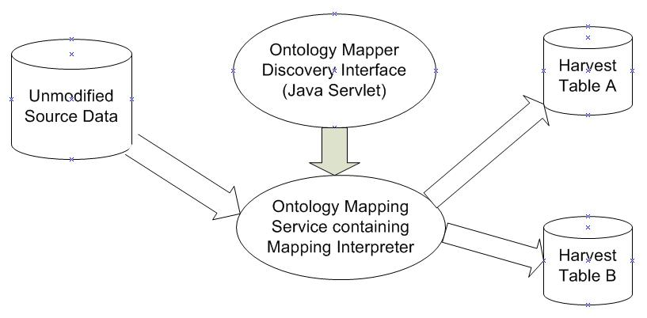
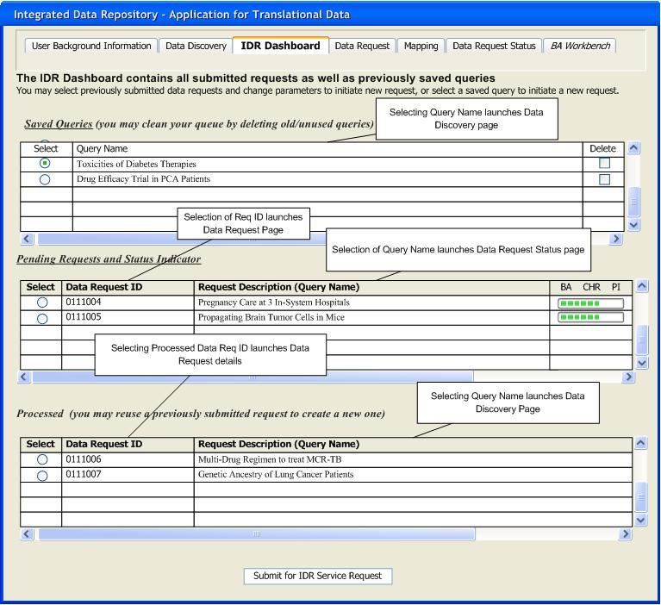
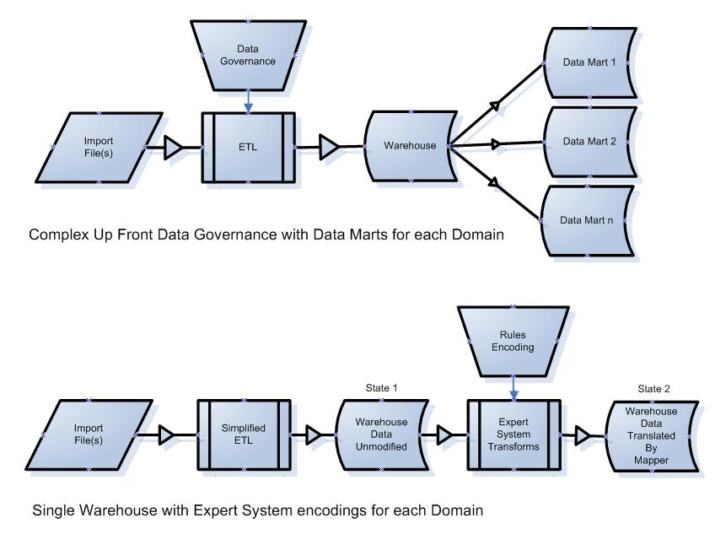
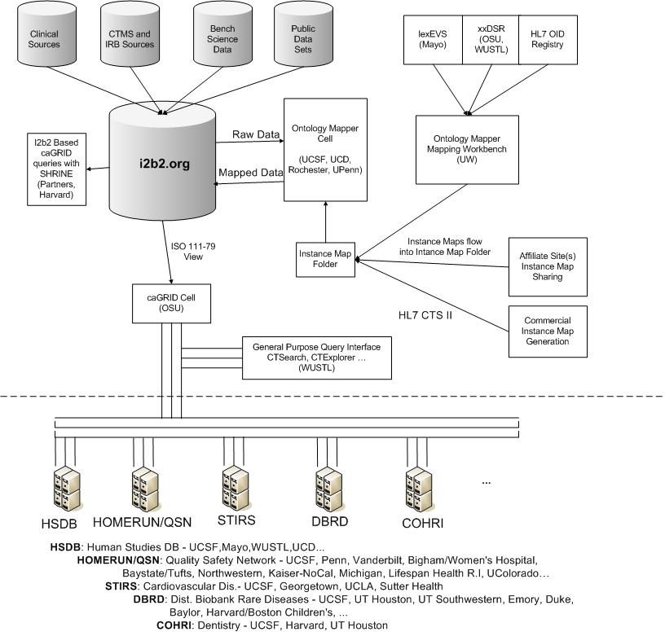
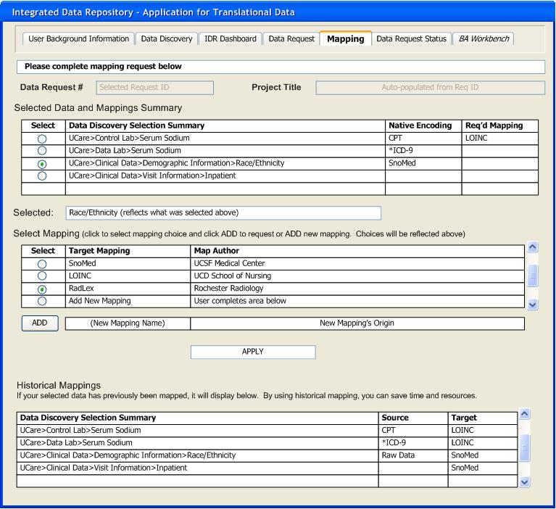
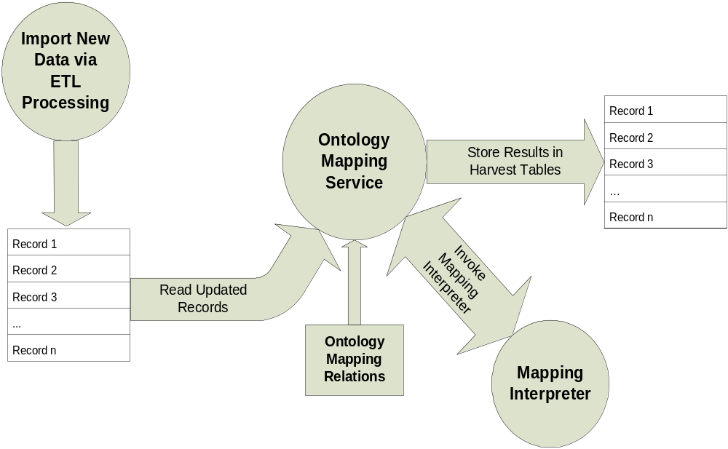
The Integrated Data Repository (IDR): Ontology Mapping
and Data Discovery for the Translational Investigator
¹Rob Wynden, BSCS, ¹Russ J. Cucina, MD, MS, ²Maggie Massary, ³Davera Gabriel, RN, ⁴Marco Casale, MS, ¹Ketty Mobed, PhD, MSPH,
²Mark G. Weiner, MD, ¹Prakash Lakshminarayanan, MBA, ¹Hillari Allen, ¹Michael Kamerick, BSCS
¹University of California, San Francisco, CA; ²University of Pennsylvania, Philadelphia, PA;³University of California, Davis, CA; ⁴University of Rochester, Rochester, NY
Introduction
An integrated data repository (IDR) containing aggregations of clinical, biomedical, economic, administrative, and public health data is key components of an overall translational research infrastructure.
The traditional approach to data warehouse construction to heavily reorganize and frequently modify source data is not well suited and impractical for the construction of data warehouses to support translational biomedical science.
An ontology mapping software service that runs inside of an IDR would represent a fundamental shift in both how data is represented within the IDR and in how a shift in how resources are allocated for servicing translational biomedical informatics environments.
Figure 3 a-d. User Interfaces (UI) facilitating the process
from Data Discovery to Data Mapping
Figure 4. Ontology maps and association
with Harvest tables
Additional Properties
The ontology mapper maps local data into standard data models. It does not create associations between elements within data models, but instead provides instance mapping of local data into ISO111-79 data models.
Ontology Mapper instance-map-xml files are shareable over the new HL7 CTS II protocol. Instance maps can be shared inter-institutionally under the Creative Commons License or sold commercially under a commercial license.
Although our initial deployment is focused on support for caGRID based data sharing, the Ontology Mapper could also be deployed within other contexts such as a plug-in for the ca-Adapter system within caBIG or as a support environment for biostatistics.
3a. Data Discovery UI
3b. Data Request UI
3c. IDR Dashboard UI
The maps, relationships, and data transform structures are represented by the Ontology Map and mapping tables.
Maps will have associated identifiers not only about themselves, but also their relationship to a Harvest table.
These 4 illustrations are an example of how an investigator would initiate data discovery and request specified data for research purposes using web-based UIs.
The investigator is at liberty to save and change data specifications until the request is formally submitted to the Business / Research Analyst (BA/RA).
Figure 1. Complex data governance can be
exchanged for rules encoding
Figure 5. Snapshot of Data Flow and Ontology Mapping Process
which is currently being piloted at UCSF, several other
academic medical institutions and private industry
Instead of relying on an inflexible, pre-specified data governance and data model (top), the proposed architecture shifts resources to handling user requests for data access via dynamically constructed views of data (bottom). Therefore, data interpretation happens as a result of an investigator’s specific request and only as required.
References
Noy NF, Crubézy M, Fergerson RW, Knublauch H, Tu SW, Vendetti J, Musen M. Protégé-2000: an open-source ontology-development and knowledge acquisition environment. Proc. AMIA Symp. 2003; 953.
Brinkley JF, Suciu D, Detwiler LT Gennari JH, Rosse C. A framework for using reference ontologies as a foundation for the semantic web. Proc. AMIA Symp. 2006; 96-100.
Gennari JH, Musen MA, Fergerson RW, Grosso WE, Crubézy M, Eriksson H, Noy NF, Tu SW. The evolution of Protégé: an environment for knowledge-based systems development. International Journal of Human Computer Studies 2003; 58(1):89-123.
Advani A, Tu SW, O’Connor M, Coleman R, Goldstein MK, Musen M. Integrating a modern knowledge-based system architecture with a Legacy VA database: The ATHENA and EON projects at Stanford. Proc. AMIA Symp. 1999; 653-7.
3d. Mapping UI
Figure 2. The major architectural elements
of an Ontology Mapping Service
The use of knowledge mapping tools enables the translation of ontology mapping relations, and subsequently selects those rules for execution via the mapping tab.
The mapping interpreter runs as a background service and performs the selected mapping functions.
  As data is imported it is translated into one or more standard formats with the Ontology Mapper Cell.
  The Ontology Mapper uses HL7 CTSII shareable data translation rules to translate local data into standard format(s). (It is a general purpose instance mapper).
  One-to-one maps, aggregates and can be ‘materialized’ into physical data marts if required. archetype generation are all supported. The Ontology Mapper then publishes data into a data mart.
  Ontology Mapper data marts are database views which can be ‘materialized’ into physical data marts if required.
*Supported and funded by UCSF and CTSA Grant
#1U54RR023566-01

