Slide 1
George Howard, DrPH
UAB School of Public Health
Keyword: Hypothesis Testing, Statistical Test

Slide 2
Hypothesis Testing 101
We want to prove that a risk factor (HRT) is associated with some outcome (CHD risk)
Scientific method
  1: Assume that whatever you are trying to prove is not true – that there is no relationship (null hypothesis)
  2: Collect data
  3: Calculate a “test statistic”
    Function of the data
    “Small” if the null hypothesis is true, “big” if the null hypothesis is wrong (alternative hypothesis)

Slide 3
What does a p-value really mean?
(continued)
Scientific method (continued)
  4: Calculate the chance that we would get a test statistic as big as we observed under the assumption of no relationship. The p-value!
  5: If the observed data is unlikely under the null then:
    We have a strange sample
    The null hypothesis is wrong and should be rejected

Slide 4
Example of a Statistical Test
Return to our data regarding your success
How can be calculate the chance of getting data this different for these with and without the course?
Step 1: Assume the course has no impact

Slide 5
Example of a Statistical Test
Step 2: Calculate row %
If the course has no impact, then what is the “best” estimate of the chance of being full prof?

Slide 6
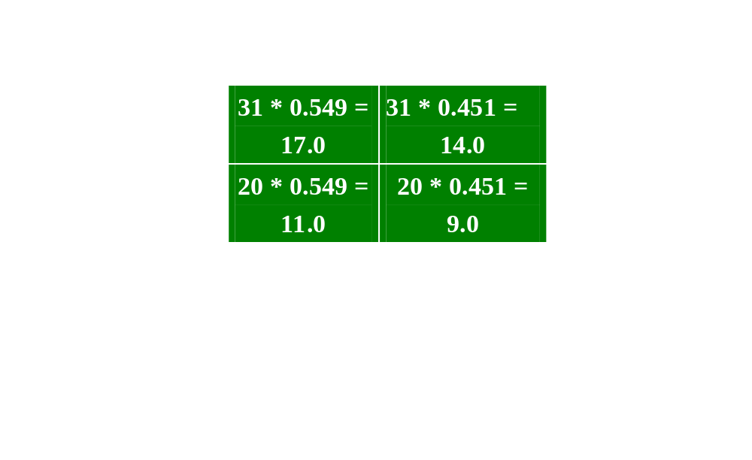
Example of a Statistical Test
Step 3: Calculate expected cell counts (null hypothesis of no difference between groups)
If there is no real impact of the course, then the observed cell counts should be close to those under the assumption of no impact

Slide 7
Example of a Statistical Test
Step 3: Calculate test statistic (just a function of the data that is “small” if the null hypothesis is true)
If null hypothesis is true, then observed and expected cell counts should be close
= 0.5219 + 0.6353 + 0.8090 + 09845
=2.95

Slide 8
Example of a Statistical Test
Step 4: Decide if the test statistic is “big”
  When the test statistic is calculated in this manner, only 5% of the time is the value bigger than 3.84 by chance alone (work by others, but tables exist)
  We have a test statistic value of 2.95
  Our test statistic is not “big” (i.e., 2.95 is less than 3.85)
  The chance that the we will get a test statistic this big by chance alone is not uncommon (p > 0.05)
  There is not evidence in these data that you are currently spending your time wisely

Slide 9
Example of a Statistical Test
Step 5: Make a decision
  Since our test statistic is not “big” we cannot reject the null hypothesis
  Note that you do not “accept” the null hypothesis of no effect, you just don’t reject it
  If the test statistic were bigger than 3.84, then we would have rejected the null hypothesis of no difference and accepted the alternative hypothesis of an effect

Slide 10
Major take home points about hypothesis testing`
Hypothesis testing is making a yes/no decision
The order of steps in a test is important (most important – make hypothesis before seeing data)
Two ways to make a mistake
  Say there is a difference when there is not one
    In design, the α level gives the chance of a Type I error
    P-value is the chance in the specific study
  Say there is not a difference when there is one
    In design, the β level gives the chance of a type II error, with 1- β being the “power” of the experiment
    Power is the chance of seeing a difference when one exists
P-value should be interpreted in the context of the study
Adjustments should be made for multiple peeks

