Slide 1
George Howard, DrPH
UAB School of Public Health
Keyword: Post-Hoc Relationships, Multiple looks at the data

Slide 2
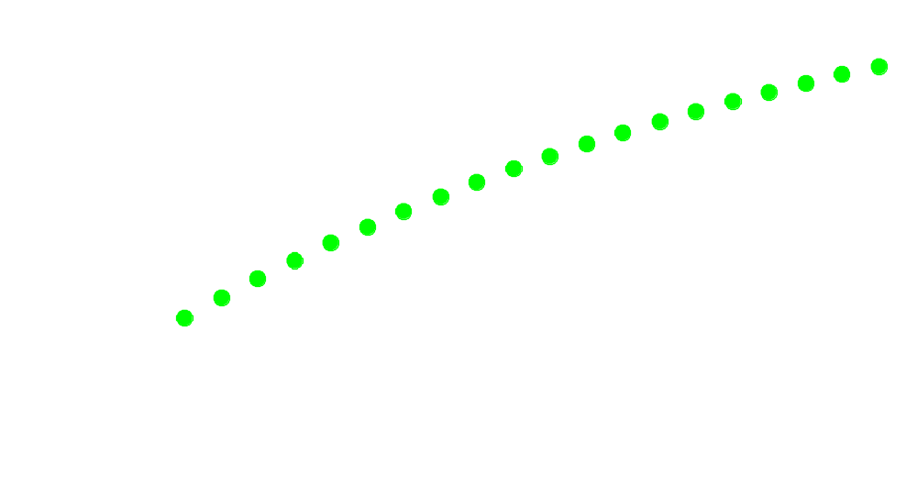
What is the impact of looking multiple times at a single question
If we look once at the data, the chance of a spurious finding is 0.05.
What happens to the chance of spurious findings with multiple “peeks”?

Slide 3
How do we take peeks (without thinking about it)
Interim examinations of study results
Looking at multiple outcome measures
Analyzing multiple predictor variables
Subgroup analysis in clinical trials
All of these can be done, but it requires planning

Slide 4
Reporting Post-Hoc Relationships
In reviewing data, suppose you discover a previously unknown relationship
Because you are not hypothesis driven, the interpretation of the p-value is not reliable
Should you present this relationship in the literature?
Absolutely, but must honestly describe conditions of discovery:
  In exploratory analysis, we noted an association between X and Y. While the nominal p-value of assessing the strength of this association is 0.001, because of the exploratory nature of the analysis we encourage caution in the interpretation of this p-value and encourage replication of the finding.
We were poking around in our data and found something that is really neat. We want to be on record as the first to report this, but because we were just poking around when we found the relationship it could really be misleading. We sure do hope that you other guys see this in your data too.

