Slide 1
George Howard, DrPH
UAB School of Public Health
Keyword: PValue, Messing up the PValue

Slide 2
The Almighty P-value
The “p-value” is the chance that this sample could have happened under the null hypothesis
What constitutes a situation where it is “unlikely” for the data to have come from the null
  That is, how much evidence are we going to require before we “reject” the null?

Slide 3
The Almighty P-value
Standard: if the data has less than a 5% chance (p < 0.05) of happening by chance alone, then it is considered as “unlikely”
This is an arbitrary number
New software gives you the exact probability of the sample under the null
  If you get p = 0.0532 versus p = 0.0495 do you really want to have different conclusions?
  More modern thinking “interprets” the p-value
Interpretation may depend on the context of the problem (should you always require the same level of evidence?)

Slide 4
Ways to really mess up a p-value
Order of the steps in hypothesis testing is critical to the interpretation of p-value
Common pitfall (data dredging)
  Look at data – create hypothesis – test hypothesis – obtain p-value
  Hypothesis created from data
  1 of 20 relationships will be significant by chance alone
  Approach does not test relationships is in the data that are not “eye-catching” (and no count is made)
  Example of introducing spurious findings (discussed later) and leads to p-values that are not interpretable

Slide 5
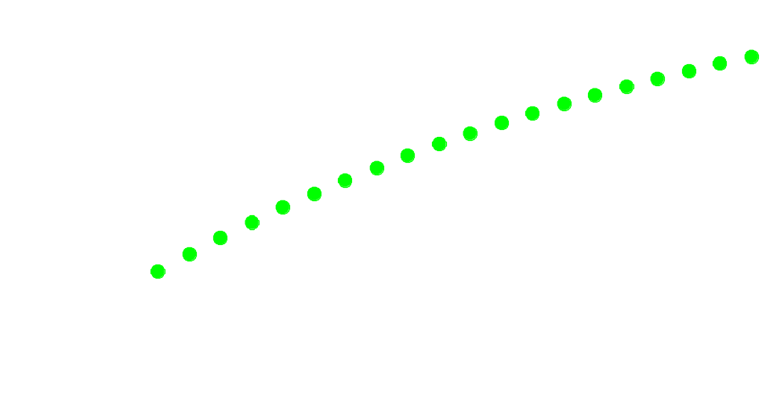
What is the impact of looking multiple times at a single question
If we look once at the data, the chance of a spurious finding is 0.05.
What happens to the chance of spurious findings with multiple “peeks”?

