Slide 1
George Howard, DrPH
UAB School of Public Health
Keyword: Statistical Tests, Approaches

Slide 2
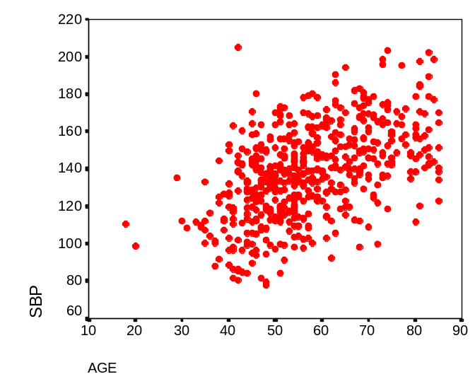
Statistics as a “Bag of Tools”
Is it reasonable to expect the analysis of these to types questions to be the same?
Hyper- Normo-
tensive tensive Total
Men 62 38 100
Women 51 49 100
Total 113 87 200
Obviously not --- just as a carpenter needs a saw and hammer for different tasks, a statistician needs different analysis tools

Slide 3
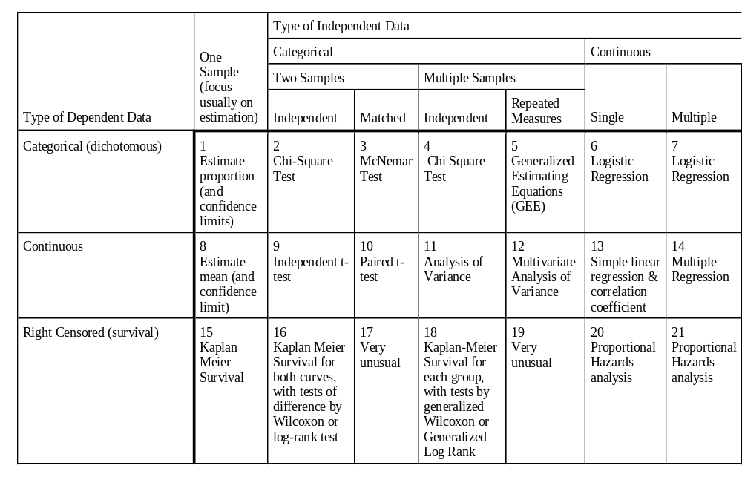
Types of Statistical Tests and Approaches
2
Chi-Square Test
Gender and hypertension
13
Simple Regression
Age & SBP

