Slide 1
Presenter Disclosure Information
George Howard
Multivariable Statistics #1
FINANCIAL DISCLOSURE:
No conflicts to disclose
UNLABELED/UNAPPROVED USES DISCLOSURE:
No discussion of unlabeled or unapproved products

Slide 2
It’s Monday
It’s 8:30 AM
You’re inside in a climate-controlled room while at Tahoe
It’s Biostatistics
Ain’t life grand!

Slide 3
Objectives
Understand how multivariable analysis provides an understanding of the joint effect of two (or more) predictor variables.
Understand how multivariable analysis can be used to address confounding and effect modification

Slide 4
Multivariate Statistics #1
(How You Can be Fooled by Simple Looks at the Data)
George Howard

Slide 5
Background
Focusing on a modeling approach:
  Univariate regression model
    Z = a + b*x
  Can be generalized into multivariable model
    Z = a + b*X + c*Y ….

Slide 6
Background (continued)
Why bother?
  We don't live in a univariate world
  We can be misled by simple views of data
  To assess the independent role of risk factors

Slide 7
Background (continued)
Problem:
  How are age (AGE) and systolic blood pressure (SBP) related to the intimal-medial wall thickness (IMT) in the TAHOE study?

Slide 8
Multivariable Regression (Joint Effects)
What is the average level of "Z" given both "X" and "Y"
  Generalize the univariate equation
    IMT = a + b*AGE + c*SBP
Interpretation
  "b" is the change in IMT per unit change in AGE at a fixed SBP
  "c" is the change in IMT per unit change in SBP at a fixed AGE

Slide 9
Example #1: Relationship of SBP and AGE
Age, but not SBP, Related to IMT; no Correlation of AGE and SBP
170
r² = 0.00
160
p = 0.86
150
SBP (mmHg)
140
130
120
110
40
50
60
70
Age (years)

Slide 10
Example #1: Relationship of Age and IMT
Age, but not SBP, Related to IMT; no Correlation of AGE and SBP
2100
IMT = 938 + 15*AGE
2000
r² = 0.72
1900
p(AGE) = 0.0001
IMT (μm)
1800
1700
1600
1500
1400
40
50
60
70
Age (years)

Slide 11
Example #1: Relationship of SBP and IMT
Age, but not SBP, Related to IMT; no Correlation of AGE and SBP
2100
2000
IMT = 1533 + 1*SBP
1900
r² = 0.01
p(SBP) = 0.44305
IMT (μm)
1800
1700
1600
1500
1400
110
120
130
140
150
160
170
SBP (mmHg)

Slide 12
Example #1:
Relationship of Age and SBP with IMT
Age, but not SBP, Related to IMT; no Correlation of AGE and SBP
IMT = 779 + 1*SBP + 15*AGE
IMT
r² = 0.73
2084
p(AGE) = 0.0001
p(SBP) = 0.2352
1873
1662
70
60
1451
50
AGE
163
146
40
129
SBP
112

Slide 13
Conclusions to Example #1
We were not misled by the univariate analysis
  Univariate Coeff: AGE=15, SBP=1 (ns)
  Multivariable Coeff: AGE=15, SBP=1 (ns)
We could NOT explain a lot more of the variation in IMT
  Univariate: r² = 0.72 for age
  Multivariable: r² = 0.73

Slide 14
Example #2: Relationship of SBP and AGE
Age, but not SBP, Related to IMT; Correlation of AGE and SBP
170
160
150
r² = 0.36
p = 0.0001
140
130
SBP (mmHg)
120
110
100
90
80
70
40
50
60
70
Age (years)

Slide 15
Example #2: Relationship of Age and IMT
Age, but not SBP, Related to IMT; Correlation of AGE and SBP
1800
IMT = 719 + 15*AGE
1700
r² = 0.91
1600
p(AGE) = 0.0001
IMT (μm)
1500
1400
1300
1200
40
50
60
70
Age (years)

Slide 16
Example #2: Relationship of SBP and IMT
Age, but not SBP, Related to IMT; Correlation of AGE and SBP
1800
IMT = 892 + 6*SBP
1700
r² = 0.38
1600
p(SBP) = 0.0001
IMT (μm)
1500
1400
1300
1200
70
80
90
100
110
120
130
140
150
160
170
SBP (mmHg)

Slide 17
Example #2:
Relationship of Age and SBP with IMT
Age, but not SBP, Related to IMT; Correlation of AGE and SBP
IMT
IMT = 685 + 1*SBP + 14*AGE
1805
r² = 0.91
p(AGE) = 0.0001
p(SBP) = 0.2366
1637
1468
70
60
1299
AGE
140
50
118
97
40
SBP
75

Slide 18
Conclusions to Example #2
We WERE misled by the univariate analysis
  Univariate Coeff: AGE=15, SBP=6
  Multivariable Coeff: AGE=14, SBP=1 (ns)
Happened despite only "moderate" correlations
This is a product of age being correlated to both IMT and SBP.
Example of "confounding"
We are not focusing on r²

Slide 19
Example #3: Relationship of SBP and AGE
Age Positively and SBP Negatively Related to IMT; Correlation of AGE and SBP
200
190
180
r² = 0.67
p = 0.0001
170
160
SBP (mmHg)
150
P
140
B
130
S
120
110
100
90
40
50
60
70
Age (years)

Slide 20
Example #3: Relationship of AGE and IMT
Age Positively and SBP Negatively Related to IMT; Correlation of AGE and SBP
1700
1600
IMT = 510 + 16*AGE
r² = 0.73
1500
p(AGE) = 0.0001
1400
IMT (μm)
1300
1200
1100
1000
900
40
50
60
70
Age (years)

Slide 21
Example #3: Relationship of SBP and IMT
Age Positively and SBP Negatively Related to IMT; Correlation of AGE and SBP
1700
1600
IMT = 925 + 3*SBP
1500
r² = 0.18
p(SBP) = 0.0023
1400
IMT (μm)
1300
1200
1100
1000
900
90
100
110
120
130
140
150
160
170
180
190
200
SBP (mmHg)

Slide 22
Example #3:
Relationship of Age and SBP with IMT Age Positively and SBP Negatively Related to IMT; Correlation of AGE and SBP
IMT = 701 - 7*SBP + 29*AGE
IMT
r² = 0.98
1663
p(AGE) = 0.0001
p(SBP) = 0.0001
1456
1249
70
60
1042
50
AGE
179
149
119
40
SBP
89

Slide 23
Conclusions to Example #3
We were VERY misled by the univariate analysis
  Univariate Coeff: AGE=16, SBP=3
  Multivariable Coeff: AGE=29, SBP=-7
Happened with larger correlations
Another example of confounding, but here conclusions are remarkably changed
We are not focusing on r²

Slide 24
Example #4: Relationship of SBP and AGE Both Age and SBP Inconsistently Related to IMT, no Correlation of AGE and SBP
170
160
r² = 0.00
p = 0.86
150
SBP (mmHg)
140
130
120
110
40
50
60
70
Age (years)

Slide 25
Example #4: Relationship of Age and IMT
Both Age and SBP Inconsistently Related to IMT; no Correlation of AGE and SBP
1300
IMT = 512 + 7*AGE
1200
r² = 0.49
p(AGE) = 0.0001
1100
1000
IMT (μm)
900
800
700
40
50
60
70
Age (years)

Slide 26
Example #4: Relationship of SBP and IMT
Both Age and SBP Inconsistently Related to IMT, no Correlation of AGE and SBP
1300
IMT = 737 + 1*SBP
1200
r² = 0.02
p(SBP) = 0.2985
1100
1000
IMT (μm)
900
800
700
110
120
130
140
150
160
170
180
SBP (mmHg)

Slide 27
Example #4:
Relationship of Age and SBP with IMT
Both Age and SBP Inconsistently Related to IMT, no Correlation of AGE and SBP
IMT = 382 + 7*AGE + 1*SBP
IMT
r² = 0.99
p(AGE) = 0.0001
1104
p(SBP) = 0.2047
IMT = 4739 - 78*AGE - 30*SBP + 0.59*AGE*SBP
r² = 0.99
971
p(all) = 0.0001
839
70
60
706
50
AGE
163
146
129
40
SBP
112

Slide 28
Example #4:
Relationship of Age and SBP with IMT
Both Age and SBP Inconsistently Related to IMT, no Correlation of AGE and SBP
IMT = 4739 - 78*AGE - 30*SBP + 0.59*AGE*SBP
Relationship for SBP when AGE = 65:
IMT = 4739 - 78*AGE - 30*SBP + 0.59*AGE*SBP
= 4739 – 78*65 – 30*SBP + 0.59*65*SBP
= - 331 + 8.4 * SBP
Relationship for AGE when SBP = 120:
IMT = 4739 - 78*AGE - 30*SBP + 0.59*AGE*SBP
= 4739 – 78*AGE – 30*120 + 0.59*AGE*120
= 1139 - 7.2 * AGE
Relationship for AGE when SBP = 150:
IMT = 4739 - 78*AGE - 30*SBP + 0.59*AGE*SBP
= 4739 – 78*AGE – 30*150 + 0.59*AGE*150
= 239 +10.5 * AGE
IMT
Relationship for SBP when AGE = 45:
IMT = 4739 - 78*AGE - 30*SBP + 0.59*AGE*SBP
= 4739 – 78*45 – 30*SBP + 0.59*45*SBP
= 898 – 3.5 * SBP
1104
971
839
70
60
706
50
AGE
163
146
129
40
SBP
112

Slide 29
Conclusions to Example #4
We were VERY misled by the univariate analysis, but not because of the coefficients:
  Univariate Coeff: AGE=7, SBP=1
  Multivariable Coeff: AGE=7, SBP=1
But because the magnitude of one coefficient depends on the other (they "interact")
Requires additional modeling terms (interactions)
Not a function of correlation of X and Y
Example of "effect modification"
We are not focusing on r²

Slide 30
Example #5: Relationship of Age and IMT
Both Age and SBP Related to IMT; but a "Super" Correlation of AGE and SBP
1700
IMT = 749 + 12*AGE
1600
r² = 0.87
p(AGE) = 0.0001
1500
IMT (μm)
1400
1300
1200
40
50
60
70
Age (years)

Slide 31
Example #5: Relationship of SBP and IMT
Both Age and SBP Related to IMT, but a "Super" Correlation of AGE and SBP
1700
IMT = 576 + 6*SBP
1600
r² = 0.87
p(SBP) = 0.0001
1500
IMT (μm)
1400
1300
1200
110
120
130
140
150
160
170
SBP (mmHg)

Slide 32
Example #5:
Relationship of Age and SBP with IMT
Both Age and SBP Related to IMT, but a "Super" Correlation of AGE and SBP
IMT
IMT = 616 + 4*SBP + 3*AGE
r² = 0.87
1631
p(AGE) = 0.1275
p(SBP) = 0.6179
1486
1341
70
60
1196
AGE
170
50
151
132
40
SBP
113

Slide 33
Conclusions to Example #5
Well... the answers we got were....
  Univariate Coeff: AGE=12, SBP=6
  Multivariable Coeff: AGE=3 (ns), SBP=4 (ns)
It's clear the multivariate answer is misleading
However, the univariate answer may also not be completely informative
  Position 1: There are not really two indepedent variables (AGE, SBP), but one that is a combination of the two.
  Position 2: The analysis of both AGE and SBP are correct, but we just cannot understand their joint effects.

Slide 34
Overall Conclusions
Univariate analysis is still the answer to "Is X associated with Z?"
Multivariate analysis allows:
  Reflection of the real world, where participants have multiple characteristics.
  Understanding of the "joint" or "independent" effects of variables, that may clarify univariate analyses
But it does not solve all problems
  Colinearity can be a problem
  Requires larger sample size and assumptions
  How to select which variables to use in the model is not always straightforward

Slide 35
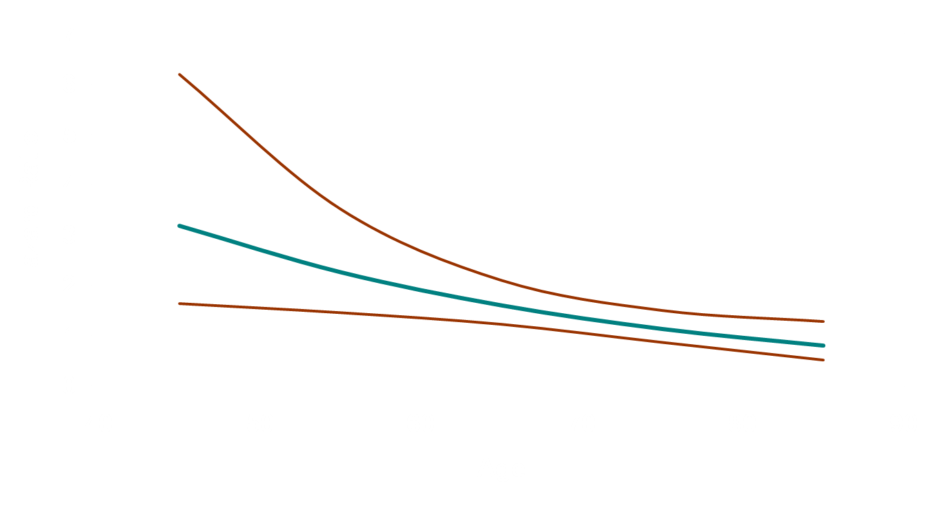
B/W Hazard Ratio (and 95% CI) as a function of Age

Slide 36
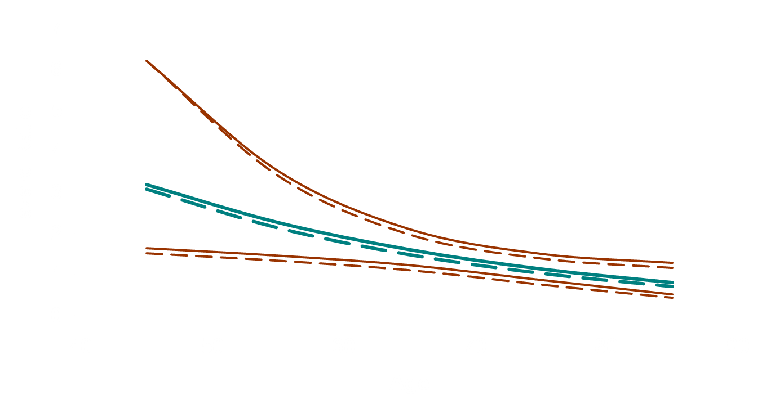
B/W Hazard Ratio (and 95% CI) as a function of Age
(solid: demographic model; long dash: risk factor model)
Risk model adjusted for hypertension, diabetes, smoking (current/past), atrial fibrillation, and dyslipidemia

Slide 37
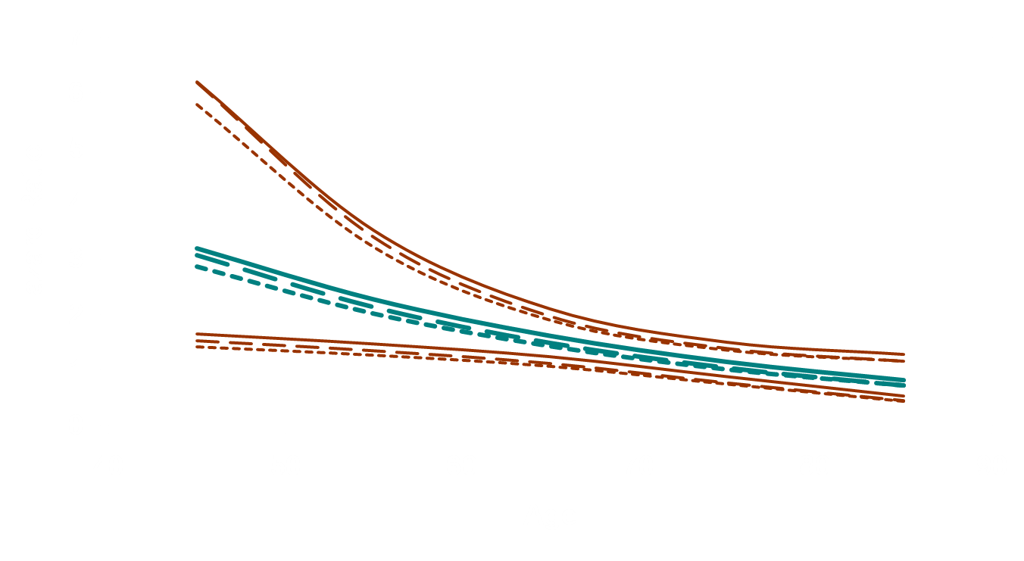
B/W Hazard Ratio (and 95% CI) as a function of Age
(solid: demographic model; long dash: risk factor model; short dash: SES model)
Risk model adjusted for hypertension, diabetes, smoking (current/past), atrial fibrillation, and dyslipidemia
SES Model further adjusted for income and education

