Slide 1
Segment 3
Introduction to Random Variables
- or -
You really do not know exactly what is going to happen
George Howard

Slide 2
Outcomes for this Course
In the “real world” there are many types of outcome variables
However, in most research studies there are two major kinds of outcomes:
  A dichotomous (categorical variable with two levels) outcome
  A continuous outcome that follows something like a “bell shape”
For purposes of this course, these are the only two kinds of outcomes
However, please remember that this accounts for only about 95% of the real world

Slide 3
Consider Tossing Coins
(The Dichotomous Outcome)
Suppose that we have a “fair” coin ---
  What is a “fair” coin?
  A 50% chance of being heads
  p = 0.50
If you flip the coin twice, how many heads will you get?
OK, suppose that we do flip the coin twice
  What are the chances of both being heads
    0.5 on the first try
    0.5 on the second try
    0.5 * 0.5 to get both heads
    So there is a 25% chance of getting two heads
  What are the chances of two tails - 25% (same logic)

Slide 4
Consider Tossing Coins
(continued)
So what is the chance of one head and one tail?
  Approach 1 (logic and exclusion):
    If we don’t get two heads, and we don’t get two tails, then we must have one head and one tail
    There is a 25% chance of two heads (HH), and a 25% chance of two tails (TT)
    Chance of two heads or two tails = 0.25 + 0.25 = 0.50
    So there must be a 50% of something else happening --- i.e. one head & one tail

Slide 5
Consider Tossing Coins
(continued)
So what is the chance of one head and one tail?
  Approach 2 (mathematical)
    Thoughts on the approach
      There are two ways of getting one head and one tail
        First flip heads : Second Flip tails (HT)
        First flip tails : Second flip heads (TH)
      The chance of HT is 0.5 * 0.5 = 0.25
      The chance of TH is 0.5 * 0.5 = 0.25
    Putting it together
      There are two ways of getting one head and one tail
      Each has a 0.25 chance of happening
      All together there is a 0.5 (50%) chance of one head and one tail
    What we are doing is finding the chance of it happening, multiplied times the number of ways it can happen

Slide 6
Consider Tossing Coins
(continued)
So have I shown you my “special” coin?
  I have a coin with a 30% chance of heads
  p = 0.3
  What is the chance of two heads?
    There is only one way to get two heads (HH)
    What is the chance of getting (HH)
      0.3 chance on the first toss
      0.3 chance on the second toss
      0.09 chance (0.3 * 0.3) on both tosses
    Again chance of it happening times the number of ways it can happen

Slide 7
Consider Tossing Coins
(continued)
So have I shown you my “special” coin?
  What is the chance of two tails?
  p = 0.3 so the chance of a tail is (1-p) or (1-0.3)=0.7
  There is only one way to get two tails (TT)
    (1-p) = 0.7 chance on the first toss
    (1-p) = 0.7 chance on the second toss
    (1-p)*(1-p) = 0.7 * 0.7 = 0.49 on both tosses
  Again chance of it happening times the number of ways it can happen

Slide 8
Consider Tossing Coins
(continued)
So have I shown you my “special” coin?
  Chance of one head and one tail?
  This can happen in two ways (HT) or (TH)
  What is the chance of these happening?
    HT = p * (1-p) = 0.3 * (1-0.3) = 0.3 * 0.7 = 0.21
    TH = (1-p) * p = (1-0.3) * 0.3 = 0.7 * 0.3 = 0.21
    Note that the order of things happening doesn’t affect the chance of a certain number of heads
  There are two ways of getting one head, each has a 0.21 chance of occurrence
  Overall, there is a 0.42 chance of one H and T

Slide 9
Consider Tossing Coins
(continued)
Special coin summary (for two flips)
  Outcomes
    Chance of two heads = 0.09
    Chance of one head & one tail = 0.42
    Chance of two tails = 0.49
  Importantly the chance of “something” happening is 0.09 + 0.42 + 0.49 = 1.0
    That is, if the probabilities of all possible outcomes are added together, the sum will ALWAYS be 1.0

Slide 10
Consider Tossing Coins
(continued)
What if I flip my coin 3 times (p = 0.3)?
  All heads or three heads
    One way (HHH)
    Chance is p * p * p = 0.027
  Two heads
    Three ways (HHT) (HTH) (THH)
    Each has the chance p * p * (1-p) = .063
    Overall chance is 3 * 0.063 = 0.189
  One head
    Three ways (HTT) (THT) (TTH)
    Each has a chance p * (1-p) * (1-p) = 0.147
    Overall chance is 3 * 0.147 = 0.441

Slide 11
Consider Tossing Coins
(continued)
What if I flip my coin 3 times (p = 0.3)?
  No heads
    One way (TTT)
    Chance is (1-p) * (1-p) * (1-p) = 0.343
  Overall
    Chance of 3 heads = 0.027
    Chance of 2 heads = 0.189
    Chance of 1 head = 0.441
    Chance of 0 head = 0.343
    And 0.027 + 0.189 + 0.441 + 0.343 = 1.0

Slide 12
Consider Tossing Coins
(continued)
What if I flip my coin “n” times (p = 0.3)?
  What is the chance of “k” heads?
  Same approach, what is the chance of one occurrence of “k” heads time the number of ways that it can happen
  Chance of any occurrence
    Chance of “k” heads is the product of “p” taken “k” times ( p * p * … * p) = p^{k}
    If there are “k” heads, then there must be (n-k) tails, so we have the product of (1-p) taken “n-k” times or (1-p)^{(n-k)}

Slide 13
Consider Tossing Coins
(continued)
What if I flip my coin “n” times (p = 0.3)?
  For example, what if I flip this coin 10 times, what is the chance of any occurrence of four heads
  Same question as “what is the chance of 4 heads and 6 tails?”
  prob = p^{k} * (1-p)^{(n-k)} = 0.3⁴ * 0.7⁶ = 0.0081*0.1176 = 0.000953
  This is the chance of any of one multiple ways this can happen, but how many ways can it happen?

Slide 14
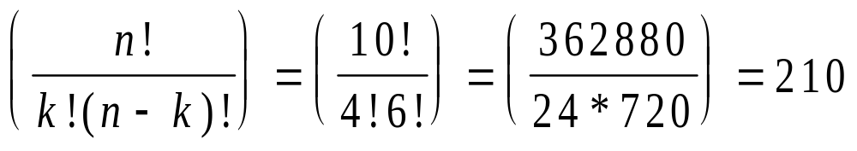
Consider Tossing Coins
(continued)
What if I flip my coin “n” times (p = 0.3)?
  In general, the what is the number of ways to get “k” heads out of “n” tries is:
  And so there are 210 ways to get 4 heads
  So the overall chance of getting 4 heads (and 6 tails) is = 210 * 0.000953 = 0.20

Slide 15
Generalizations
This is the chance of having “k” events of “n” tries in coin flipping, but who cares about coins?
The chance for any process that produces dichotomous outcomes from “n” independent tries
  Given a 30% recovery rate rate, in a study of 10 patients, what is the chance that 4 patients recovered?
    “Recovery” is the “event” and p =0.3
    Each patient is independent of other patients (just like coins)
    Same process, so there is a 20% chance of exactly 4 recoveries

Slide 16
Generalizations
How about the probability that 4 or fewer patients recover
  How can this happen? Must be 0, 1, 2, 3, or 4 patients recovering?
    Must be 0, 1, 2, 3, or 4 patients recovering?
    0.0282+0.1211+0.2335+0.2668 +0.2001 = 0.8497
    Chances are about 85% that 4 or fewer patients will recover
    By the way this implies a 0.1503 chance that 5 or more will recover (so there is only 15% chance that 5 or more patients will recover)

Slide 17
Generalizations
Dichotomous outcomes are very common
  Chance of hypertension at baseline
  Chance of surviving cancer to 1 year
  Chance of premature delivery
  Chance of stopping smoking
In each of these, we have just derived the “Binomial” distribution that allows us to calculate the chance of occurrences given we know the parameter “p”

Slide 18
Distribution?
Distributions provide the mathematical description of the chance of an outcome that occurs with uncertainty
That is, we have a variable “X” that has some outcome “x”, but “x” changes from observation to observation
  What is the chance of 4 recoveries in 10 patients?
  In this case X is the number of patients that recover
    Sometimes it is 3, sometimes it is 4, sometimes …
    We want to know the chance that it is 4, that is P(X=4)
  X is called a “random variable” or RV
  The “distribution” describes the behavior of a RV, that is it gives the probability of each possible outcome
  We now know the distribution of the likelihood of “k” events in “n” independent trials given “p”
  Sum of all probabilities of all outcomes is always 1.0

Slide 19
Consider Tossing Coins
(continued)
Calculating these by hand must be a pain
We also may want to know the chance of
  Less than or equal to “k” heads
  Greater than or equal to “k” heads
Look up probabilities in a Table or use program
  EXCEL: BINOMDIST(number_s, trials, probability_s, cumulative)

Slide 20
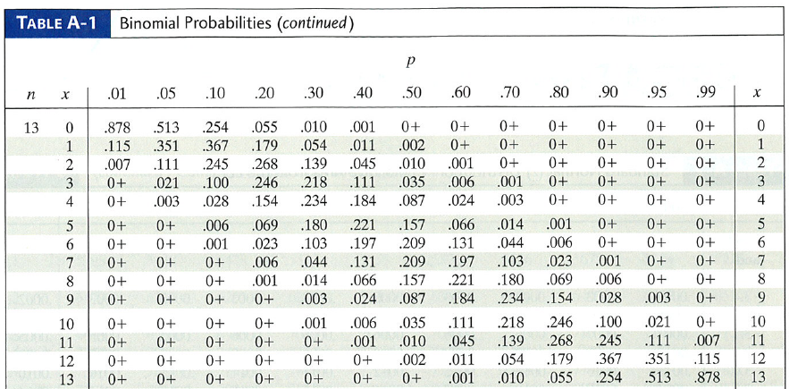

Slide 21
Consider Tossing Coins
(note that this is the same as “tossing smokers”)
Suppose that we have a study of 20 smokers
Through a program of intensive intervention, we believe that the chance of any of the smokers quitting is 40%
  What is the chance that 5 or fewer smokers quit?
  What is the chance that 4 or fewer smokers quit?
  What is the chance that exactly 5 smokers quit?
  What is the chance that 10 or more smokers quit?

Slide 22
Back to the “Universe” and the “Sample”
We have been working on the chance of specific outcomes given that we know “p”
In the real world, you do not get to know “p”
  If the outcome is binomial, then “p” is the parameter in the universe that you try to guess by an estimate in a sample
Examples
  Chance of hypertension at baseline
  Chance of premature delivery
  Chance of stopping smoking

Slide 23
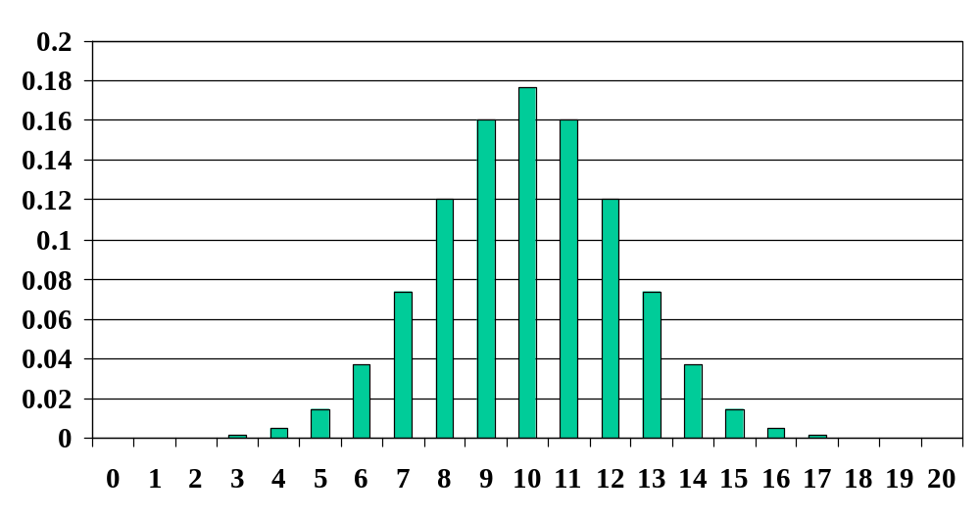
Binomial Distribution
What happens if we have more than 20 trials?
Consider 20 trials with p = 0.5

Slide 24
The “Bell Shaped Curve”
If n becomes large in the binomial distribution --- the histogram approaches the “bell shaped curve”
Several names for the “bell shaped curve”
  Normal distribution
  Gaussian distribution
Common in nature
  Heights of British soldiers
  IQ scores
  Processes where the outcome is the sum of many little parts

Slide 25
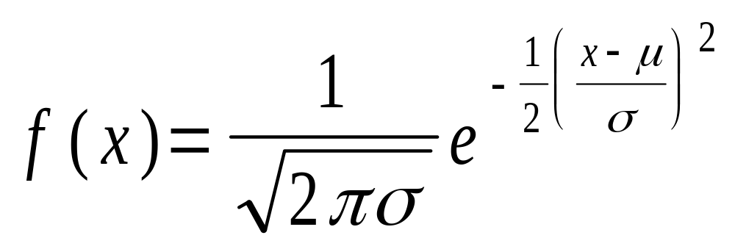
The “Bell Shaped Curve”
Mathematically, its pretty messy, but it is only a function of the mean (μ) and the standard deviation (σ)
That this is only a function of the mean (μ) and the standard deviation (σ)
  Is the first time you see why the standard deviation is important
  Makes the whole process simple

Slide 26
What happens to the shape of the normal curve if we mess with μ and σ?

Slide 27
The “Bell Shaped Curve”
Suppose that we somehow know the mean and the standard deviation of the particulate level at a sampling station
  Mean = 310
  Standard Deviation = 45
What does the shape of the curve look like?
What is the impact on how the curve looks for different means and standard deviations?

Slide 28
The “Bell Shaped Curve”
If the data are normal
  The mean and median are the same (duh, the distribution is symmetric)
  50% of the data are less than the mean (duh, the mean and the median are the same --- and that is the definition of the median)
  67% of the are within one standard deviation of the mean
  95% of the data are within two standard deviations of the mean

Slide 29
The “Bell Shaped Curve”
Suppose that we still have the normal distribution of particulate matter as normal
  Mean = 310
  Standard Deviation = 45
What is the likelihood that a particular day is between 330 and 350?

Slide 30
Normal Distribution
If X is a random variable with a normal distribution with mean (μ) and the standard deviation (σ)
  The probability that X is between “l” and “h” is the area under the curve between “l” and “h”
  I don’t like to mess with the messy formula
    I have a data from a normal random variable with mean μ and standard deviation σ
    Subtract the mean (μ) from all variables, then the new mean must be zero (0.0)
    Divide all values by the standard deviation, then the new standard deviation must be one (1.0)
    I now have a “standard normal” (and I can use tables)

Slide 31
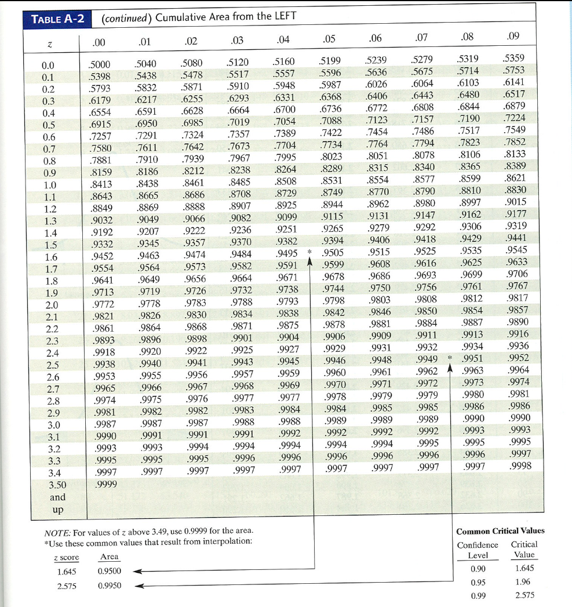

Slide 32
The “Bell Shaped Curve”
If the data are normal, then the number between 330 and 350 is the same as the number between
  (330 – 310) / 45 = 0.444
  (350 – 310) / 45 = 0.889
Again, look up in the table or do by SPSS
  Lots of handy programs:
    http://davidmlane.com/hyperstat/z_table.html

Slide 33
Back to the “Universe” and the “Sample”
We have been working examples where you know the mean (μ) and the standard deviation (σ)
In the real world, you don’t know μ and σ
  These are the parameters in the universe that you try to estimate in your sample
Examples
  What is the mean (and standard deviation) of suspended particulate matter?
  What is the mean (and standard deviation) of systolic blood pressure of Alabama residents?

Slide 34
Summary of Segment
We have focused on types of outcomes
  Binomial: the mathematical description of most common way that dichotomous outcomes happen
  Normal: the mathematical description most common way that continuous outcomes happen
For both, we have discussed how to use the “distribution” the likelihood of specific outcomes if we know the parameters
  Binomial: the percent with the trait is “p” and this is the single parameter (we know n)
  Normal: the mean (μ) and standard deviation (σ) are the two parameters

Slide 35
Summary of Module
(continued)
Normally (no pun intended), we do not know the parameters, but these have to be estimated in a sample
Guessing (estimating) these parameters is the topic of the next module

