Slide 1
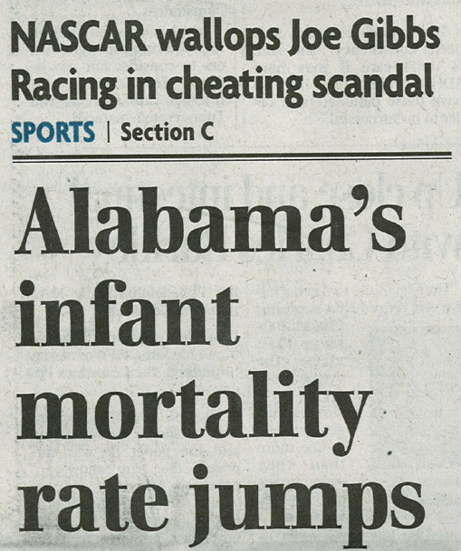
Dual Tragedies in the B-ham Paper

Slide 2
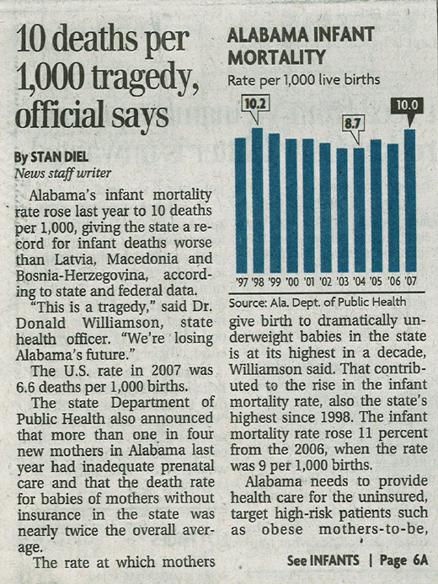

Slide 3
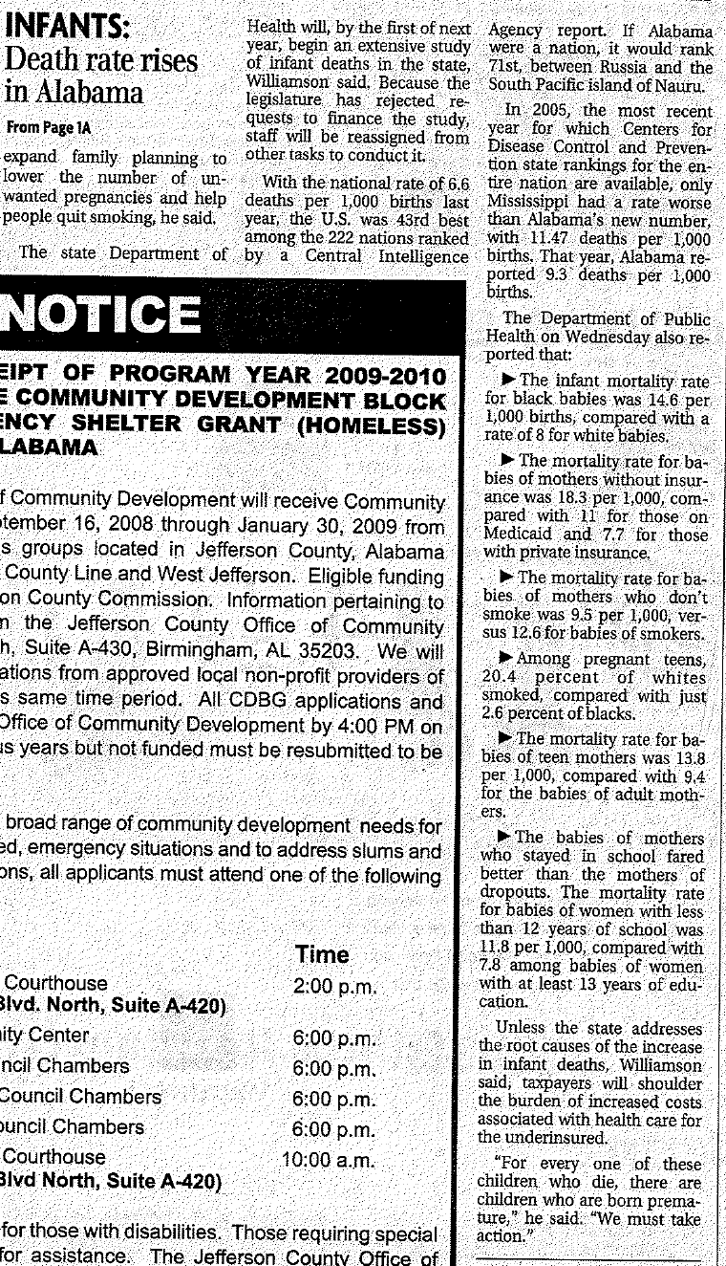

Slide 4
Module 2
Simple Descriptive Statistics and Univariate Displays of Data
A Tale of Three Cities
George Howard, DrPH

Slide 5
A Tale of Three Cities
Background
There were substantial differences in cancer rates between regions of Alabama
  Birmingham 143/100,000
  Mobile 110/100,000
  Montgomery 94/100,000
Could these differences be due to the horrible air pollution largely caused by highway 280 in Birmingham?
The suspect agent is suspended particulate matter

Slide 6
A Tale of Three Cities
Collection of Data
Montgomery (n=28)
113
155
100
94
146
111
145
92
173
100
105
110
106
114
136
151
98
94
118
137
123
159
96
128
127
120
80
230
Mobile (n=25)
139
160
126
168
140
142
211
152
170
103
170
141
139
121
178
165
123
178
219
131
174
112
160
168
162
Sampled suspended particulate matter (ppm) in the three cities on randomly selected days.
What are the patterns here?
What are the differences between these cities?
Describe the variables in this analysis
Birmingham (n=15)
150
131
136
149
126
141
122
135
110
123
87
116
128
130
127

Slide 7
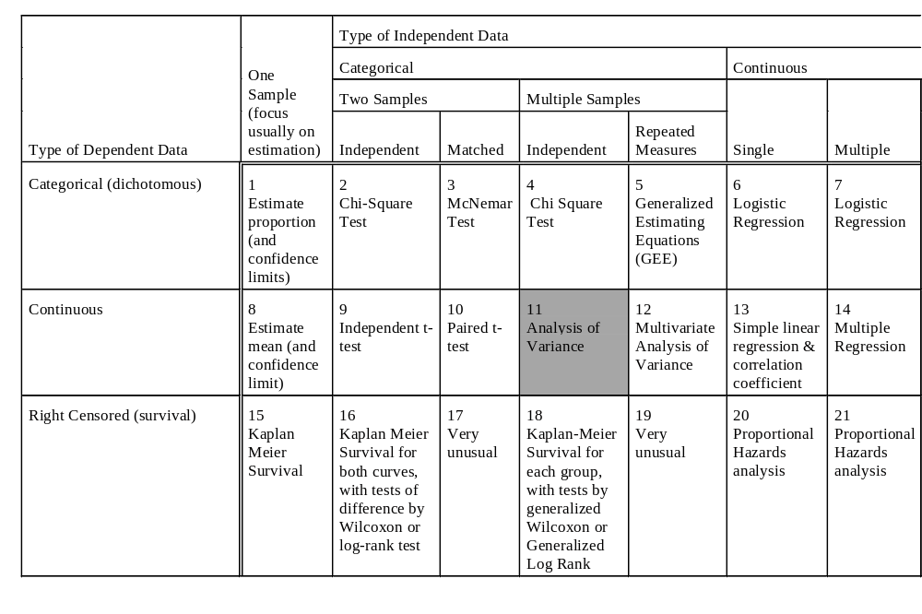
Types of Statistical Tests and Approaches

Slide 8
Consider the Birmingham Data
Place the data in equally spaced categories
  Interval Mid # %
  82.5<X<97.5 90 1 6.7
  97.5<X<112.5 105 1 6.7
  112.5<X<127.5 120 5 33.3
  127.5<X<142.5 135 6 40.0
  142.5<X<157.5 150 2 13.3
Clustering of points around 112-142 categories, with fewer points on either side
Birmingham (n=15)
150
131
136
149
126
141
122
135
110
123
87
116
128
130
127

Slide 9
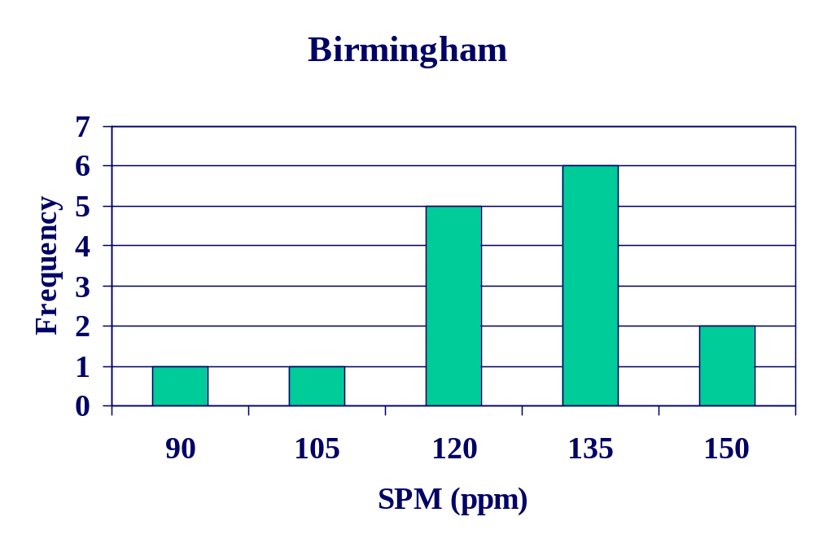
A Tale of Three Cities
Description of Birmingham SPM

Slide 10
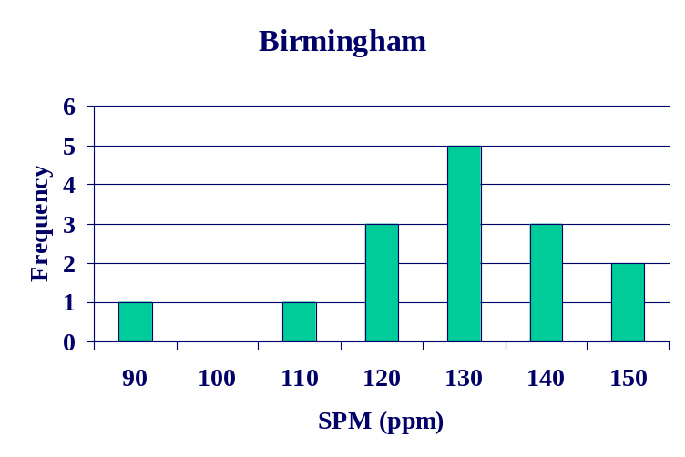
A Tale of Three Cities
Description of Birmingham SPM
How do you choose how many intervals to have in a histogram?
  Rule of thumb: 3+ observations per category
Remember where you make the cutpoints is also an arbitrary decision --- that changes how the histogram looks

Slide 11
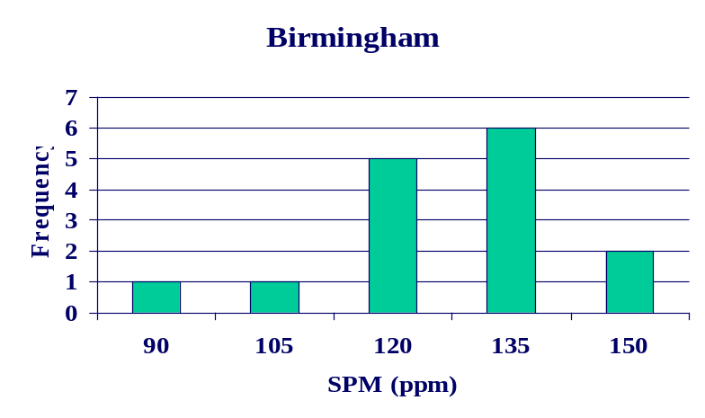
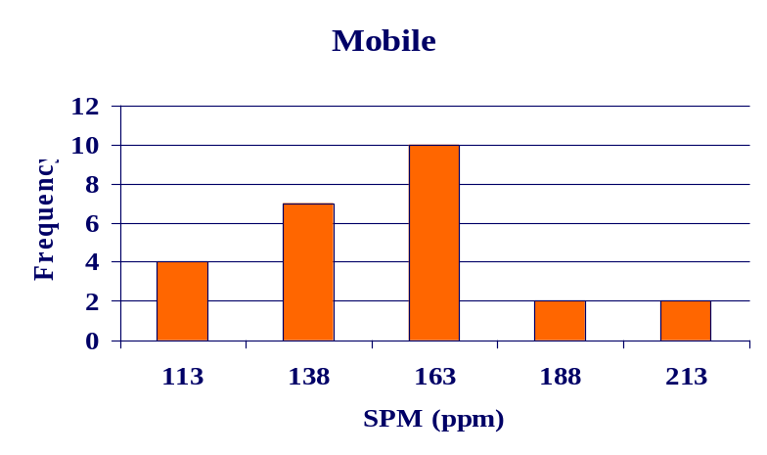
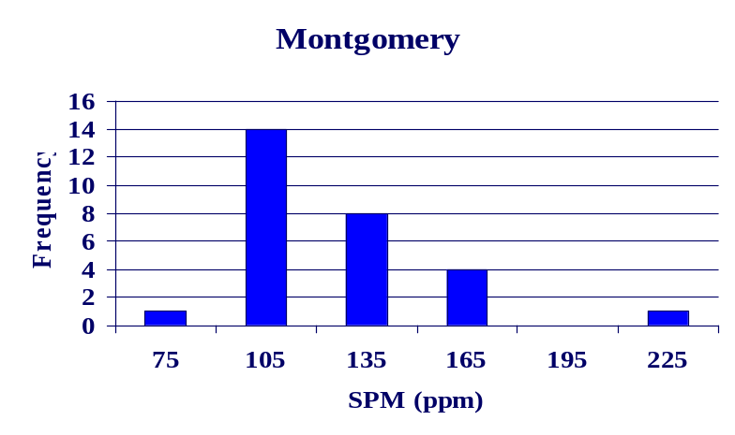
A Tale of Three Cities
Comparison of the three cities
(what’s wrong with this picture?)

Slide 12
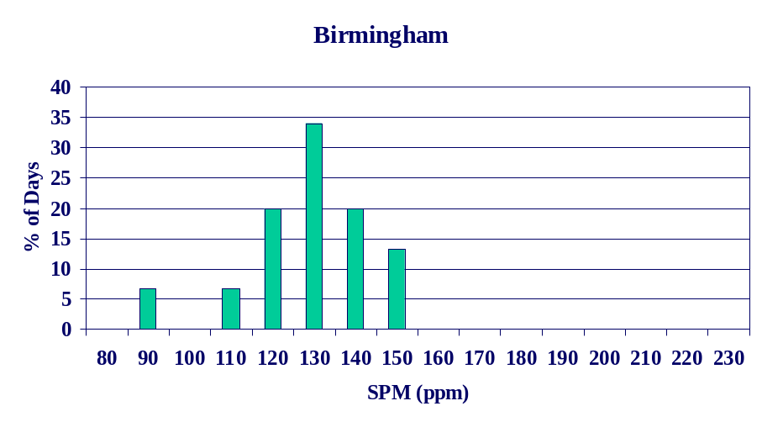
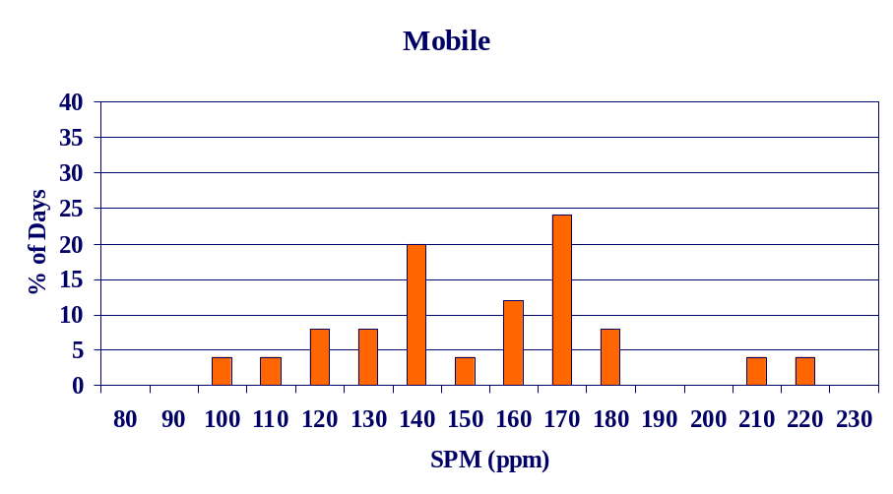
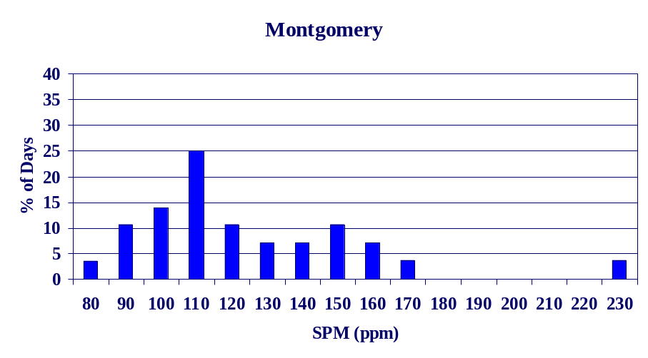
A Tale of Three Cities
Comparison of the three cities
(now drawn on same scales)

Slide 13
How do we describe these cities with a few simple numbers?
Where is the middle of the data (that is an “average” value)?
How spread out are the numbers?
Are there other measures that may be important to describe these data?

Slide 14
Gee, what do we mean by “average” anyway
Measures of “central tendency”
There are MANY ways to calculate an average
Two most common ways
  The arithmetic mean
  The median
There are other approaches

Slide 15
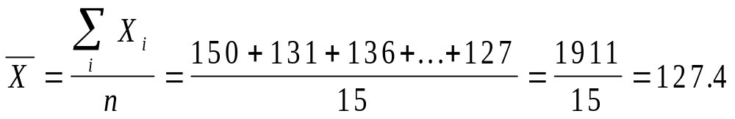
The Arithmetic Mean
Step 1: Add up the numbers
Step 2: Divide the sum by the number of observations
Birmingham (n=15)
150
131
136
149
126
141
122
135
110
123
87
116
128
130
127

Slide 16
The Median
The point where half the data are bigger (and half less)
There are at least 4 rules to find the median (and other percentiles)
The rules differ if there are an odd or even number of data points
  If odd, then the “middle” data point
  If even, then the average of the “two middle” data points

Slide 17
The Median
(continued)
Step 1: Sort the data
Step 2: Pick the median
Consider Birmingham data (note that there are an odd number of data points)
Median is 128
Birmingham (n=15)
87
110
116
122
123
126
127
8th of 15 data points==> 128
130
131
135
136
141
149
150

Slide 18
The Median
(continued)
Suppose we only had 14 data points in Birmingham
Step 1: Find the middle two data points
Step 2: Take the average difference between these two observations
Median = 127.5
Birmingham (n=now with 14 points)
87
110
116
122
123
126
7th of 14 data points==> 127
8th of 14 data points==> 128
130
131
135
136
141
149

Slide 19
A Tale of Three Cities
Measures of Central Tendency
Mean = 127.4
Median = 128
Mean = 154.0
Median = 154
Mean = 123.6
Median = 116

Slide 20
Measures of Central Tendency
Birmingham and Montgomery have lower measures of central tendency than Mobile
For Birmingham and Mobile, the mean and median are almost the same value
  This happens when distributions are symmetric
For Montgomery, the mean is quite a bit higher than the median
  The mean is “pulled up” by outliers
  The median is not sensitive to outliers

Slide 21
How “spread out” are the measures
Measures of “dispersion”
The range is the most simple measure
  Birmingham: 150 - 87 = 63
  Mobile: 219 - 103 = 116
  Montgomery: 230 - 80 = 150
It appears that data from Montgomery are very spread out, Mobile is not as spread out, and Birmingham is very “compact”
Range is influenced by the outliers

Slide 22
How “spread out” are the measures (continued)
The range is influenced by outliers (just like the mean) ---
  But the median is not influenced by the outliers
  Is there some measure of dispersion that will not be so affected by 1 (or 2) points

Slide 23
Measures of Dispersion
Percentiles
The k^{th} percentile is that place in the data where k-% of the data are below the cutpoint
There are many alternative approaches to define percentiles
In one approach, they are determined by the function k*(n+1)
  If integer, then pick that data point
  If non-integer, then average the two data points around that point

Slide 24
Measures of Dispersion
Percentiles (continued)
For example, consider the 25%-tile from Birmingham
  Step 1: calculate k*(n+1) = 0.25*(15+1) = 4
  Step 2: since this is integer, then pick the 4th data point
  25%-tile is 122
Consider the 33%tile from Birmingham
  Step 1: calculate k*(n+1) = 0.33*(15+1) = 5.3
  Step 2: average the 5th and 6th data points
  33%-tile is 1/2 way between 123 and 126 or 124.5
Birmingham (n=15)
87
110
116
122
123
126
127
128
130
131
135
136
141
149

Slide 25
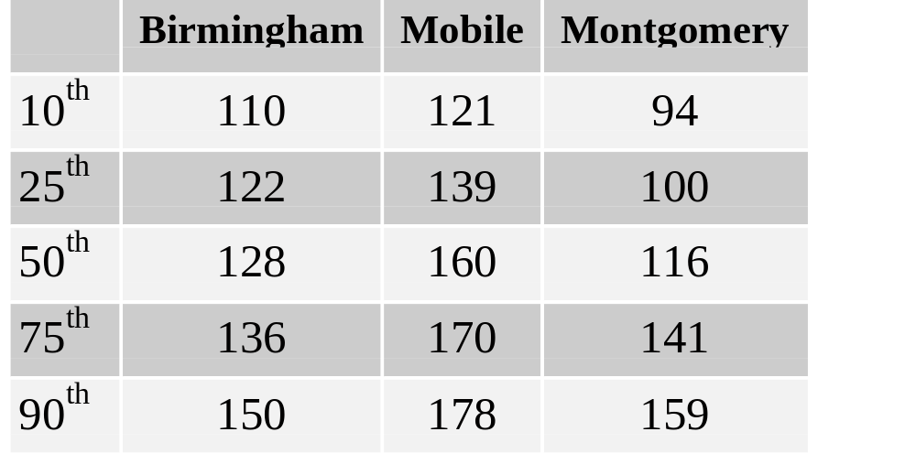
Percentiles from the 3 Cities

Slide 26
Measures of Dispersion
Percentiles (continued)
Special names for percentiles
  The 50th percentile is called the median
  The 25th, 50th and 75th percentiles are called the quartiles
  the 33rd and 67th percentiles are called the tertiles
  the 10th, 20th, … and 90th are called the deciles
The percentile rule picks the 8th data point for the median (0.5*(15+1) = 8), so we get the “right answer”
Is there a way to use these percentiles as a simple measure of dispersion?

Slide 27
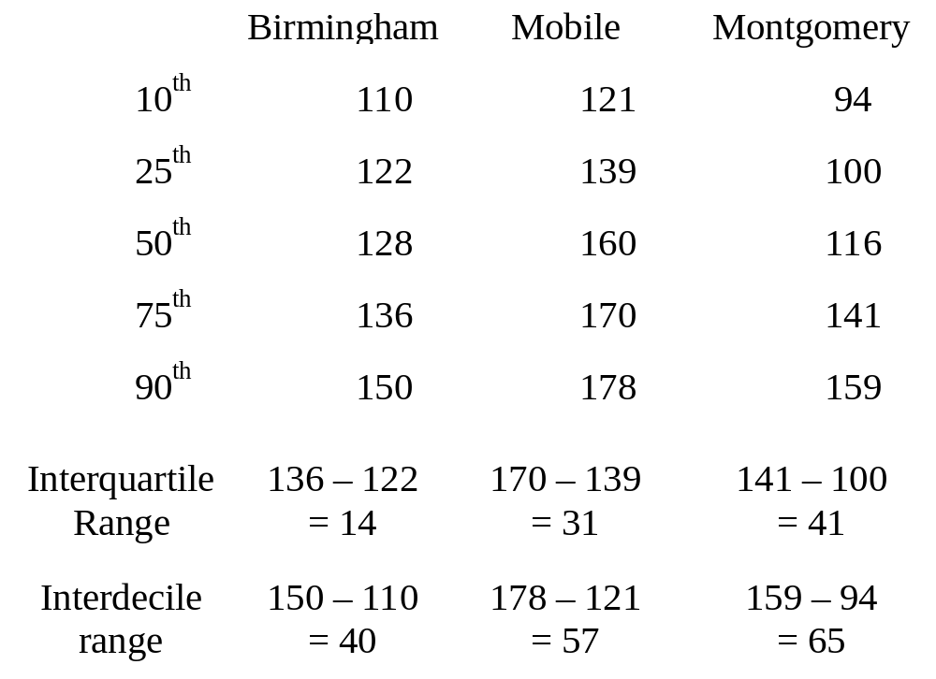
Percentiles from the 3 Cities

Slide 28
Percentiles from the 3 Cities
Percentiles are relatively insensitive to “outliers”
How do we define outliers
  Rule of thumb --- If a data point is an “outlier”
    Above 1.5 interquartile ranges over the 75th percentile
    Below 1.5 interquartile ranges under the 25th percentile
  Consider Montgomery data
    Interquartile range is 41
    75th percentile is 141
    Outliers are above 141+1.5*41=202.5
    The value at 230 is an “outlier”

Slide 29
Percentiles from the 3 Cities
So, percentiles are “neat”
  But with even 3 cities we have to think about 21 or more numbers
    10th, 25th, 50th, 75th, 90th, percentiles
    interquartile range, interdecile range
Isn’t there some way to look at these graphically and to see the outliers
Box and whisker plots

Slide 30
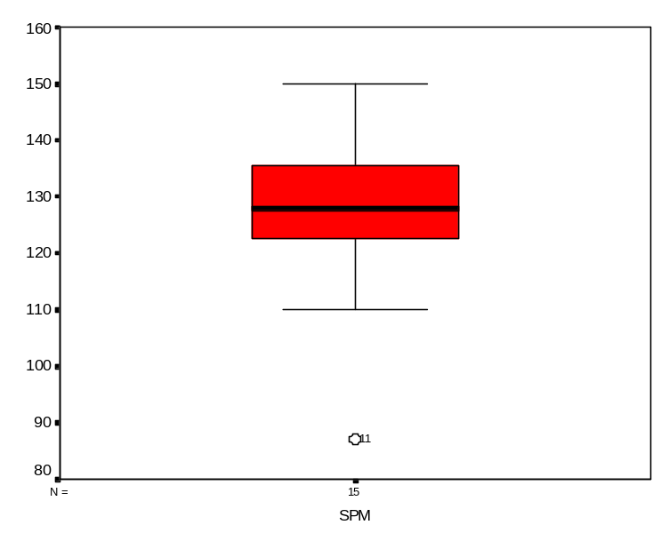
Percentiles from the 3 Cities
Box and Whisker Plots
Birmingham (n=15)
87
110
116
122
123
126
127
128
130
131
135
136
141
149
Draw box
  Top of box is the 75th-ptile (136)
  Bottom of box is 25th- ptile (122)
  Line is 50th ptile (median=128)
Find outliers
  Below 122-1.5*14=101
  Above 136+1.5*14= 157
  Plot outlier(s) as a point (87)
Draw “whiskers” to the the highest non-outlier (149) and lowest non-outlier (110) points
Plot outliers as single data points

Slide 31
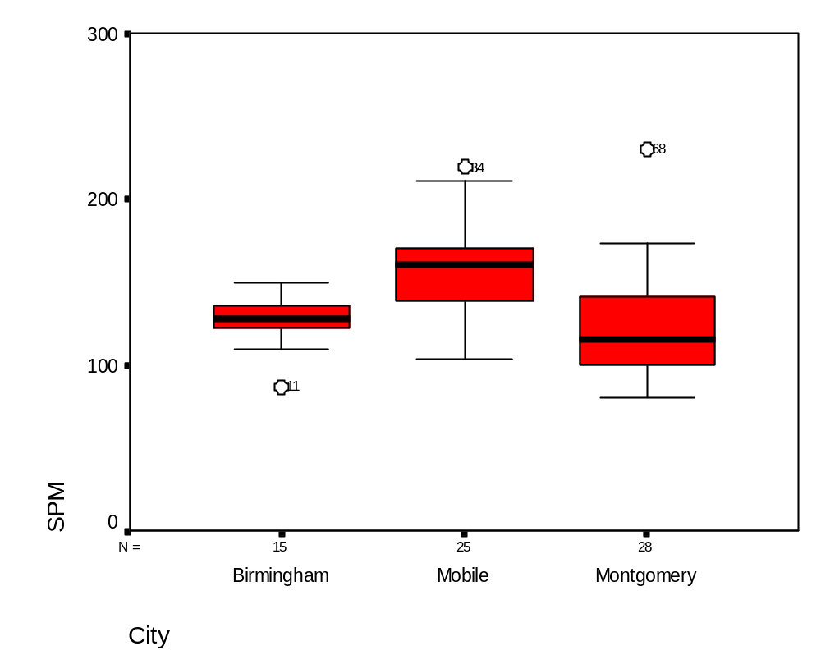
Percentiles from the 3 Cities Box and Whisker Plots
Box and Whisker plots make for easy comparison of groups
  B-ham doesn’t have much spread
  Mobile is considerably above B-ham or Montgomery
  B-ham and Mobile are fairly symmetric

Slide 32
Measures of Dispersion
Standard Deviation (and Variance)
So far we have two measures of dispersion
  Range
  Percentiles (and differences between percentiles)
Is there another single number that summarizes how spread out the data are?
Consider measures of how far the data are from the mean
  If data are far from the mean, then they are really spread out
  This is the idea for the Standard Deviation

Slide 33
Measures of Dispersion
Standard Deviation (and Variance)
Idea #1 (a logical but dumb one)
  Calculate the average distance each data point is from the mean (absolute value)
  Take the average of these numbers
  Mean absolute deviation

Slide 34
Measures of Dispersion
Standard Deviation (and Variance)
Idea #2 (a great one --- although it seems illogical)
Take the square root of the sum of the squared deviations divided by the n-1
The variance is the standard deviation squared (15.6)²=245.0

Slide 35
A Tale of Three Cities
Descriptive Statistics
Mean = 154.0
Median = 154
Range = 116
IQR = 31
SD = 28.0
Mean = 127.4
Median = 128
Range = 63
IQR = 14
SD = 15.6
Mean = 123.6
Median = 116
Range = 150
IQR = 41
SD = 31.3

Slide 36
Summary: Descriptive Statistics and Simple Graphs
What we have talked about
  Histogram
  Measures of Central Tendency
    Mean
    Median
  Measures of Dispersion
    Range
    Percentiles
      Interquartile range
      Interdecile range
    Standard deviation
  Box and Whisker plots

Slide 37
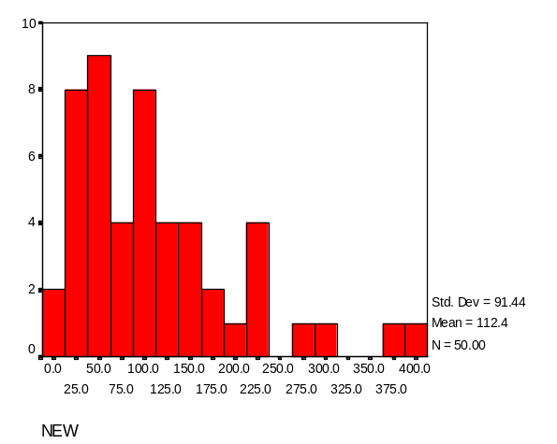
Summary: Descriptive Statistics and Simple Graphs
What we have not talked about
  Simple descriptive statistics to describe skew
  Simple descriptive statistics to describe kurtosis
There are many other kinds of graphs not discussed

Slide 38
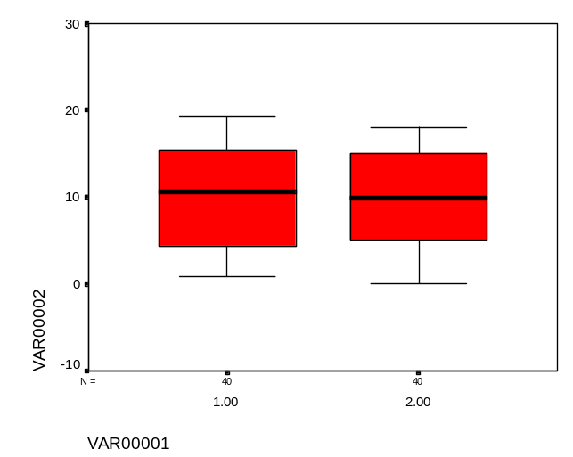
Summary: Descriptive Statistics and Simple Graphs
Don’t be fooled by simple looks at the data
Consider two populations
  Box plots ----->
  Descriptive Stats
    Mean 10.0 9.9
    SD 5.8 5.5
    25th-ptile 4.3 5.1
    Median 10.5 9.8
    75-ptile 15.3 15.0
These two groups sure look alike!!!

Slide 39
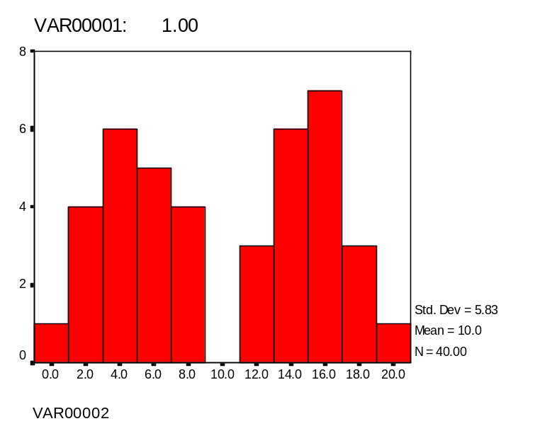
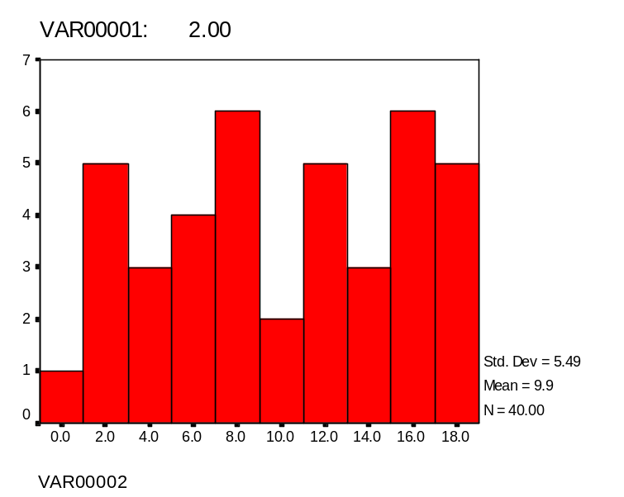
But ---
Here are the two distributions

Slide 40
A Tale of 3 Cities
Conclusions
B-ham appeared to have consistently lower levels of SPM than either Mobile or Montgomery
  Lower measures of central tendency
  Less dispersion
It would seem hard to argue that high levels of SPM is the cause of the higher cancer rates

Slide 41
Dual Tragedies in the B-ham Paper

