Slide 1
Segment 4
Sampling Distributions
- or -
Statistics is really just a guessing game
George Howard

Slide 2
Statistics as organized guessing
One of the two major tasks in statistics is “estimation” (the technical term for guessing)
Suppose that there is some huge group of people (or whatever we are studying)
The huge group is called the universe
This population arises from some distribution
  We have talked about arising from either binomial or normal
  Then this large population can be described by parameters
    p for the binomial
    μ and σ for the normal
  Our task is to estimate (guess) the parameters

Slide 3
How do we estimate the parameters?
Approach 1: measure everyone
  Advantages
    You will get the correct answer
  Disadvantages
    Expensive
    Impractical
Approach 2: estimation
  Take a sample of the big group and try to guess
  That is: we guess at the parameters in the universe by using estimates from a sample

Slide 4
Characteristics of Estimates
Expectation
  We take an sample and produce estimates
  We take another sample and produce estimates again
  We will get different answers
Consider the most simple example, estimating the mean of a normal distribution (μ)

Slide 5
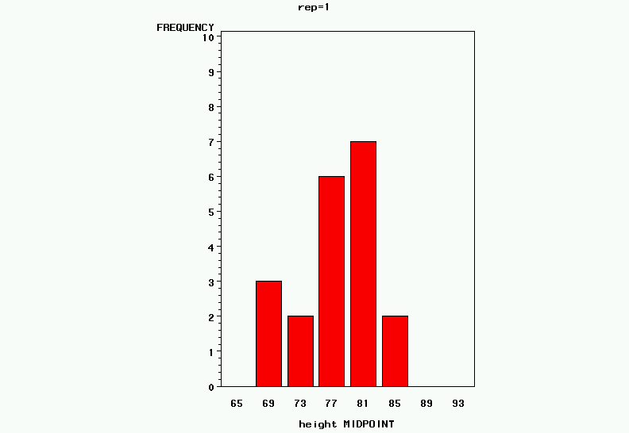
Suppose that we draw a sample of 20 individuals from a N(80,5)
In this sample we use the formulas from previous lectures to get:
Estimated mean = 77.5
Estimated SD = 4.7
Hence, we are “pretty close” to guessing the correct mean and standard deviation
But what happens if we
draw another sample?

Slide 6
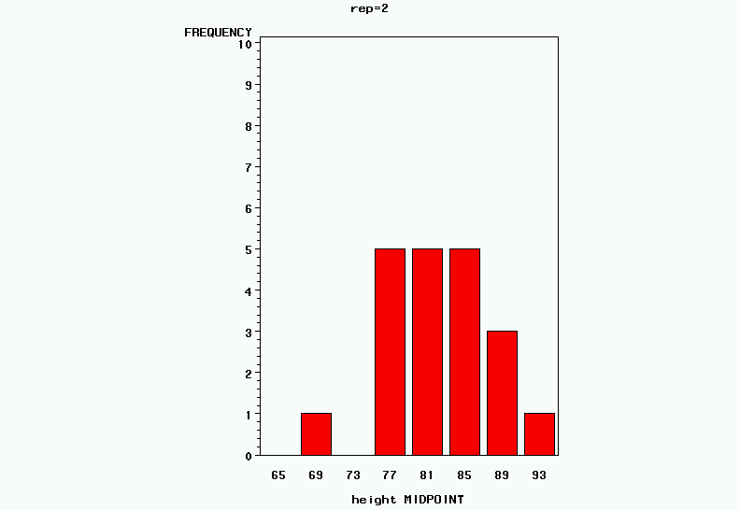
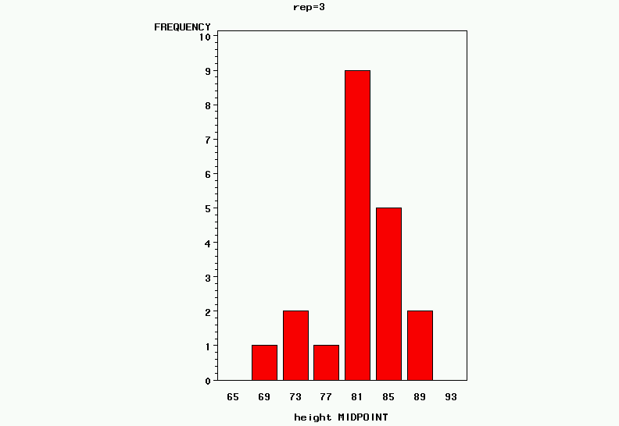
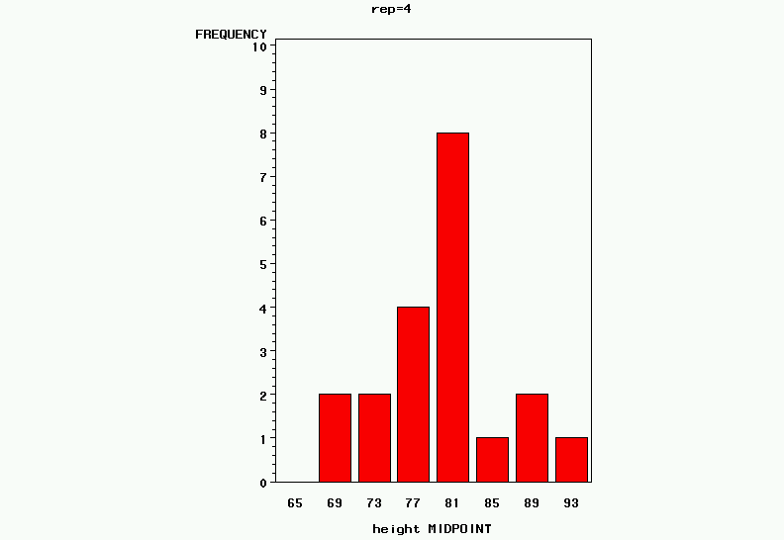
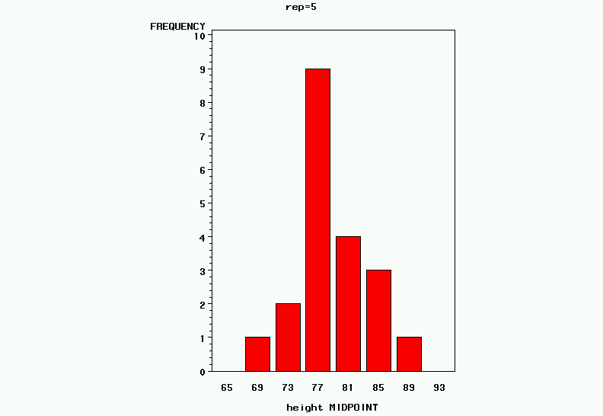
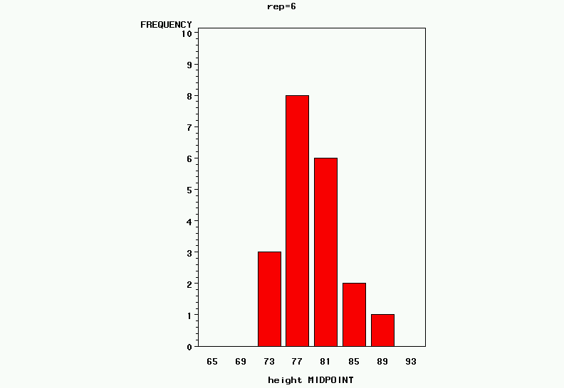
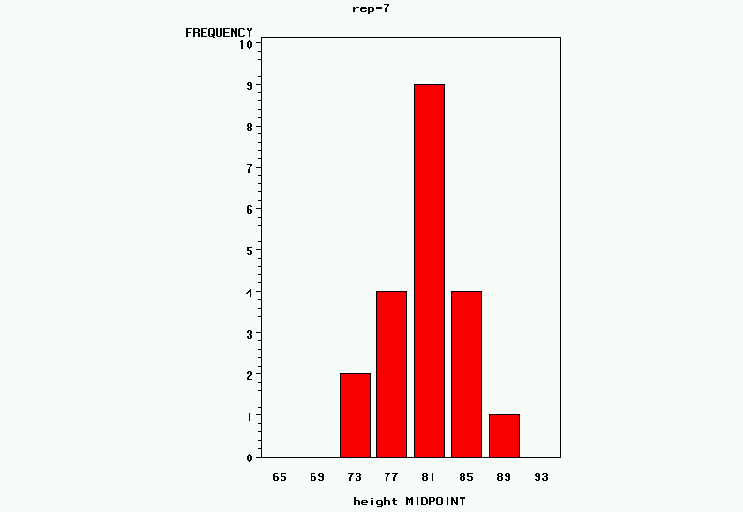
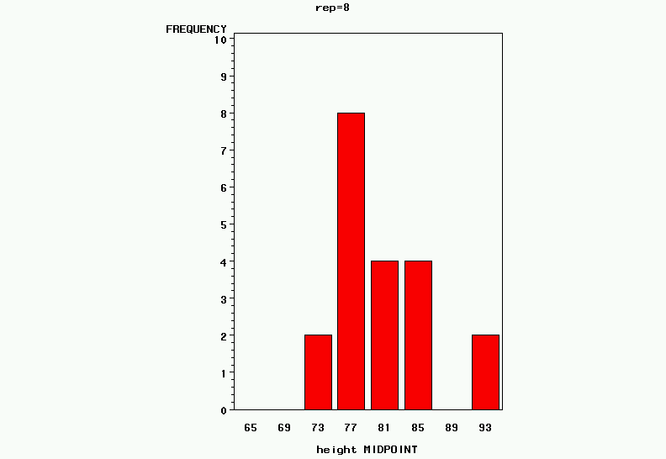
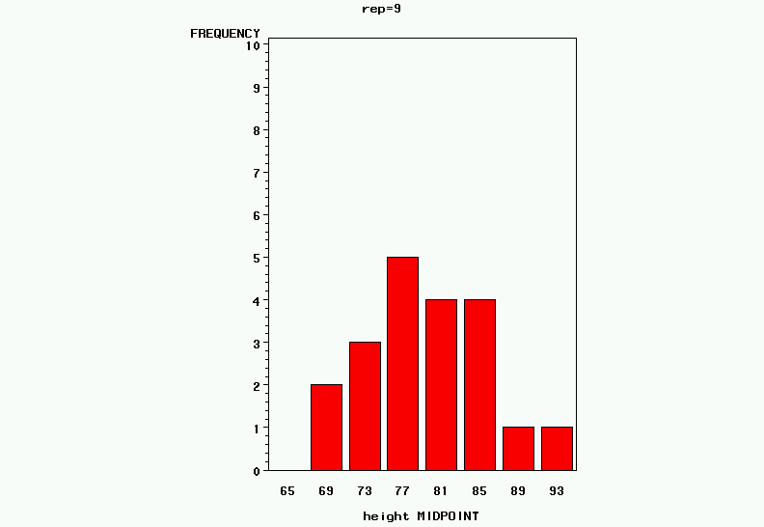
Estimated mean and SD of 10 samples, each with 20 observations from a N(80,5)
(mean, standard deviation) of the sample
(77.5, 4.7)
(82.4, 5.7)
(81.3, 4.8)
(80.1, 6.1)
(78.6, 5.3)
(79.3, 3.8)
(80.6, 4.5)
(80.2, 5.4)
(79.5, 6.3)
(79.1, 5.4)

Slide 7
Summary of 10 samples of 20 individuals from N(80,5)
For each sample
  Mean was “close” to 80
  Standard deviation was “close” to 5
But remember that we are interested in estimating the mean of the “universe”
What about the distribution of the sample means?
  The means we observed were: 77.5, 82.4, 81.3, 80.1, 78.6, 79.3, 80.6, 80.2, 79.5, and 79.1
  What does the distribution of these look like?

Slide 8
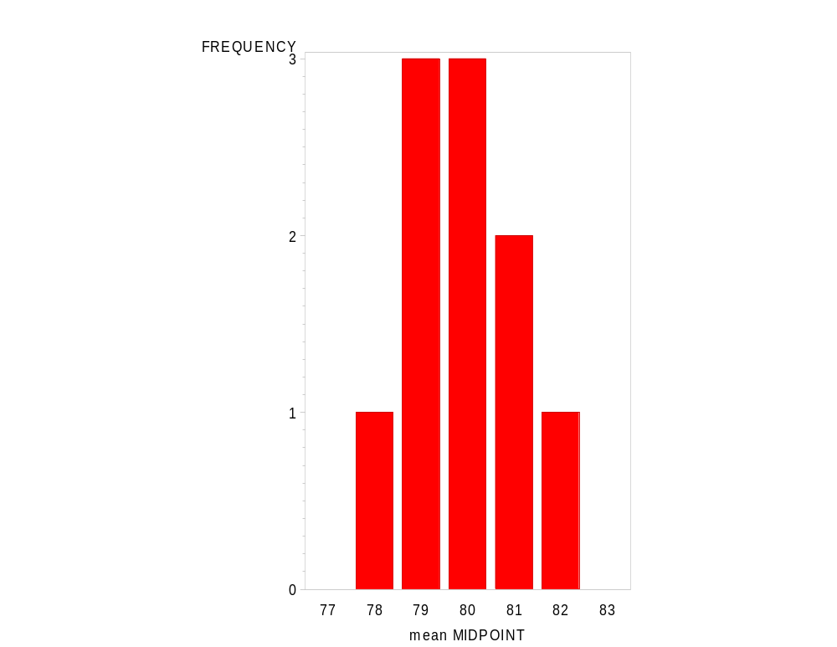
Mean and Standard Deviation of the Means Estimated from the 10 Samples
The mean of the means = 79.9,
The standard deviation of the means = 1.4

Slide 9
Considering the means of the 10 samples of 20 patient drawn from N(80,5)
So across the means of the 10 samples
  Have a mean very close to 80
  Have a standard deviation much smaller than 5
This follows common sense, if data are coming from a normal distribution
  The mean of repeated samples will be the mean of the universe
  There will be less variation between the means than there is in the data
What determines the SD of the means?

Slide 10
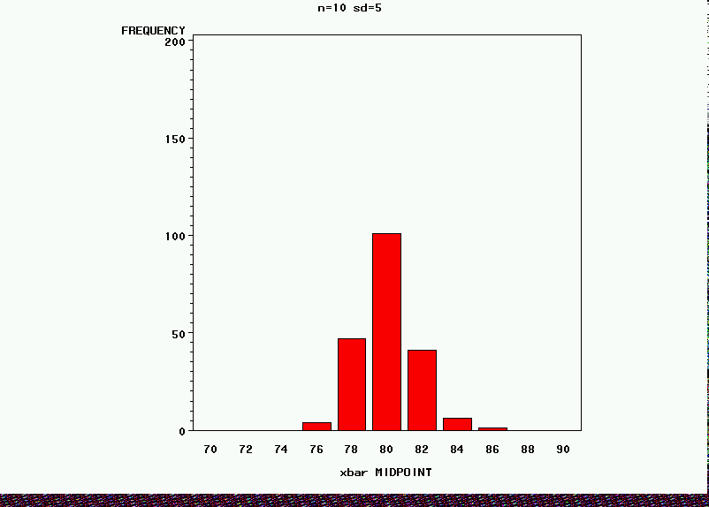
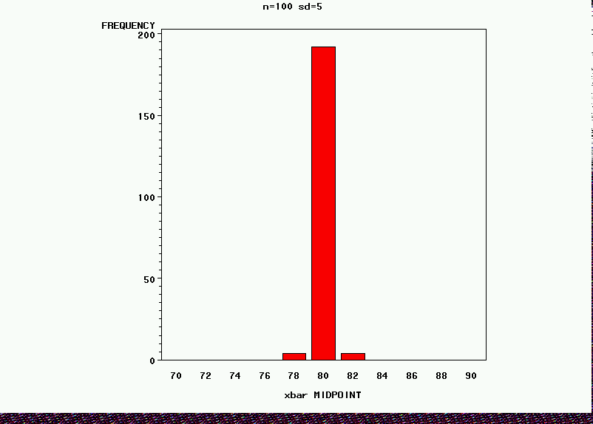
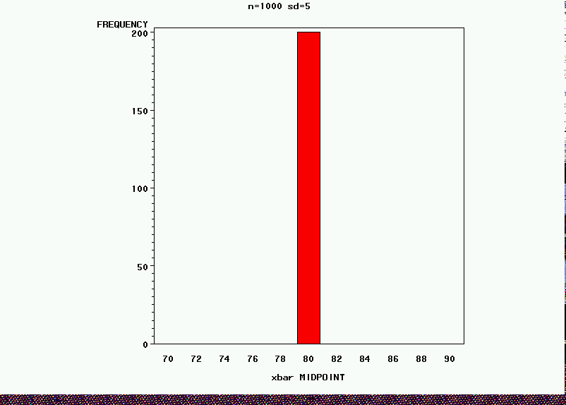
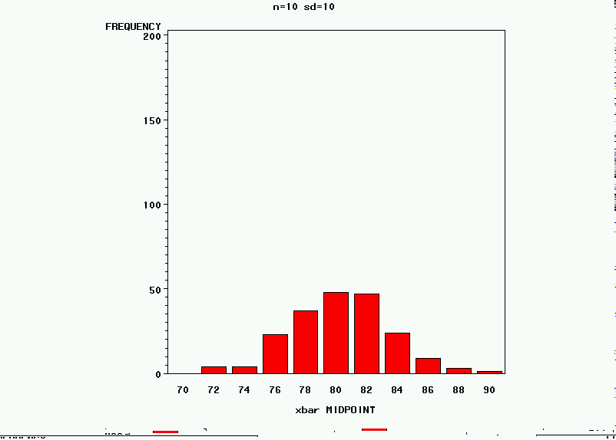
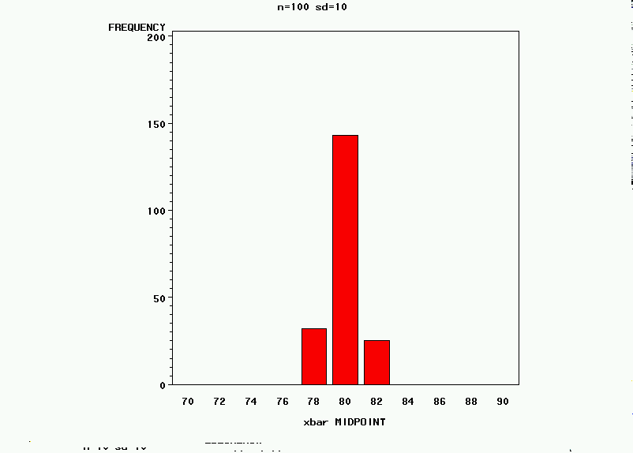
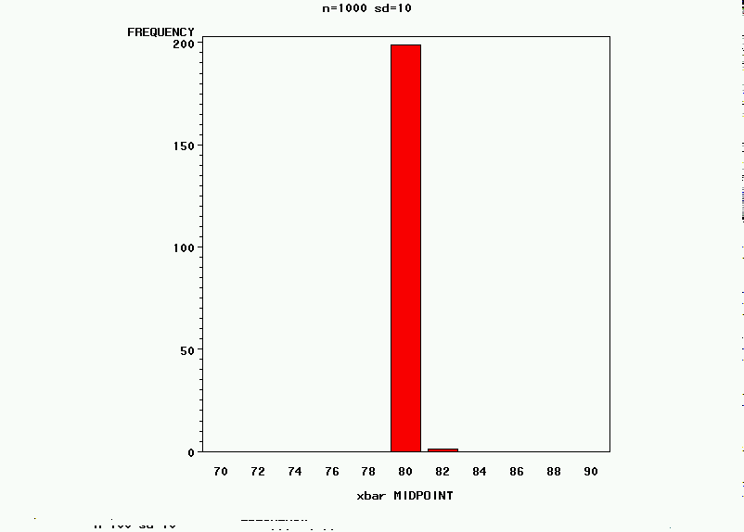
But what happens if the sample size or standard deviation changes?
200 Replicate Samples of size n taken from N(80,SD)
n=10 n=100 n=1000
Mean=79.9 Mean=80.0 Mean=80.0
SD=1.6 SD=0.5 SD=0.1
Mean=80.2 Mean=80.0 Mean=80.0
SD=3.3 SD=0.9 SD=0.3
SD=5
SD=10

Slide 11
The Estimation of Parameters from a N(80,5)
The mean of the estimated means across samples will be the same as the mean of the universe
  If a estimate of a parameter is correct on average, then we call it an unbiased estimator
The standard deviation of the estimated means is smaller than the standard deviation of the population
  But increases with the standard deviation of the universe
  Decreases with the sample size

Slide 12
The Standard Deviation of the Estimated Mean
A “good” estimate of the mean should be unbiased and stable (that is, correct on average and would not change much if the experiment is repeated)
ANY estimate has variation between repeated experiments, and “good” estimates will have small standard deviations across repeated experiments
Estimates with low variability are called reliable (and the estimates with the smallest variation are sometimes called minimum variance estimators)
In general we do not repeat experiments, so how can I know what the standard deviation of the estimate would be if I did repeat the experiment?

Slide 13
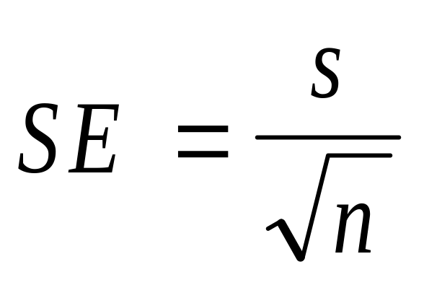
The Standard Deviation of the Estimated Mean
The estimated standard deviation of the mean (if the experiment were repeated) is called the Standard Error (of the Mean)
Every estimate has a standard error
The formula for the standard error of the mean is:

Slide 14
The Standard Error
From the very first sample we drew,  = 77.5 and s =4.7
Then the estimated standard error from this individual sample is SE = 4.7 / sqrt(20) = 1.1
The standard deviation of estimated mean from the 10 samples was 1.4
These are estimating the same parameter, and are pretty close together
But using the formula allows estimating the standard error without repeating the experiment

Slide 15
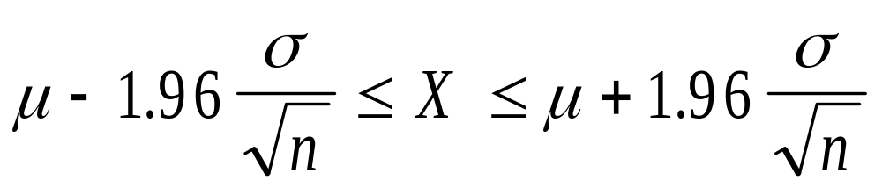
Confidence Limits on the Mean
Remember from the previous lecture that 95% of observation are from within approximately 2 SD of the mean
I lied, but you can use the Normal Table (handout) to see 95% is between -1.96 and 1.96
So if we know μ and σ we can calculate a range that will include 95% of the estimated means

Slide 16
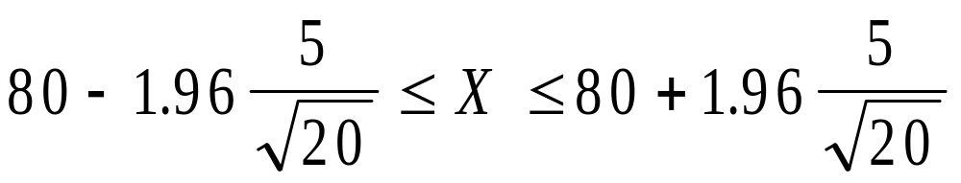
Confidence Limits on the Mean
In the case of our British soldiers N(80,5), then if we are taking samples of 20 soldiers and calculating the mean, 95% of the estimated means should be between
Or between 80 - 2.2 = 77.8 and 80 + 2.2 = 82.2
So if we repeat the experiment a large number of times, 95% of the means will be between 77.8 and 82.2

Slide 17
Confidence Limits on the Mean
Well, that is interesting, but it is even hard to think of a case were we have μ and σ
What happens if we substitute  and s for μ and σ
First, we have to pay a small penalty for the “extra” uncertainty introduced by using estimates instead of parameters (the t-distribution)
Table at the right is the t with 0.025 in each tail (just the same as we used from the normal table) and is a Table in the book
We need to think about the interpretation
df (n-1) t_{n-1}
1 12.7
2 4.3
5 2.6
10 2.2
20 2.1
60 2.0
∞ 1.96

Slide 18
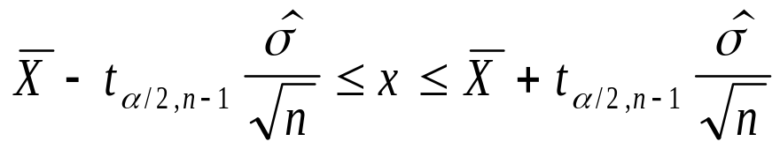
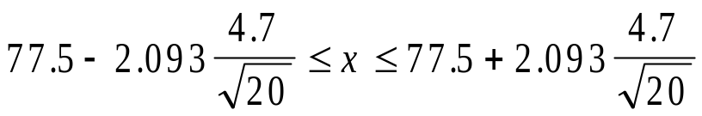

Confidence Limits on the Mean
From the first sample
  Estimated mean = 77.5
  Estimated standard deviation = 4.7
  Sample size 20
95% confidence limits on the estimated mean

Slide 19
Interpretation of the Confidence Limits on the Estimated Mean
The 95% confidence limits are now no longer centered on the mean from the universe, but the estimated mean from the sample
  We should not expect 95% of the means to fall in this range (but rather the range centered on the true mean)
  Common (and slightly incorrect) interpretation: “I am 95% sure that the true mean is in this range”
  The technically correct interpretation of 95% confidence limits is “If I were to repeat the experiment a large number of times, and calculate confidence limits like this from each sample, 95% of the time they would include the true mean”

Slide 20
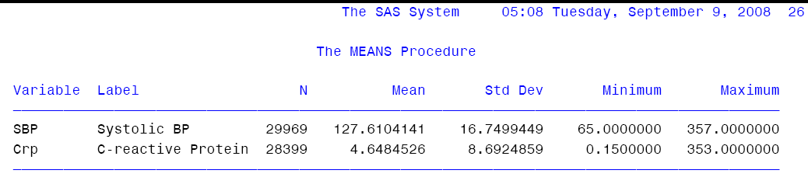
Printout Examples
Simple description (PROC MEANS) of systolic blood pressure and c-reactive protein in the REGARDS Study

Slide 21
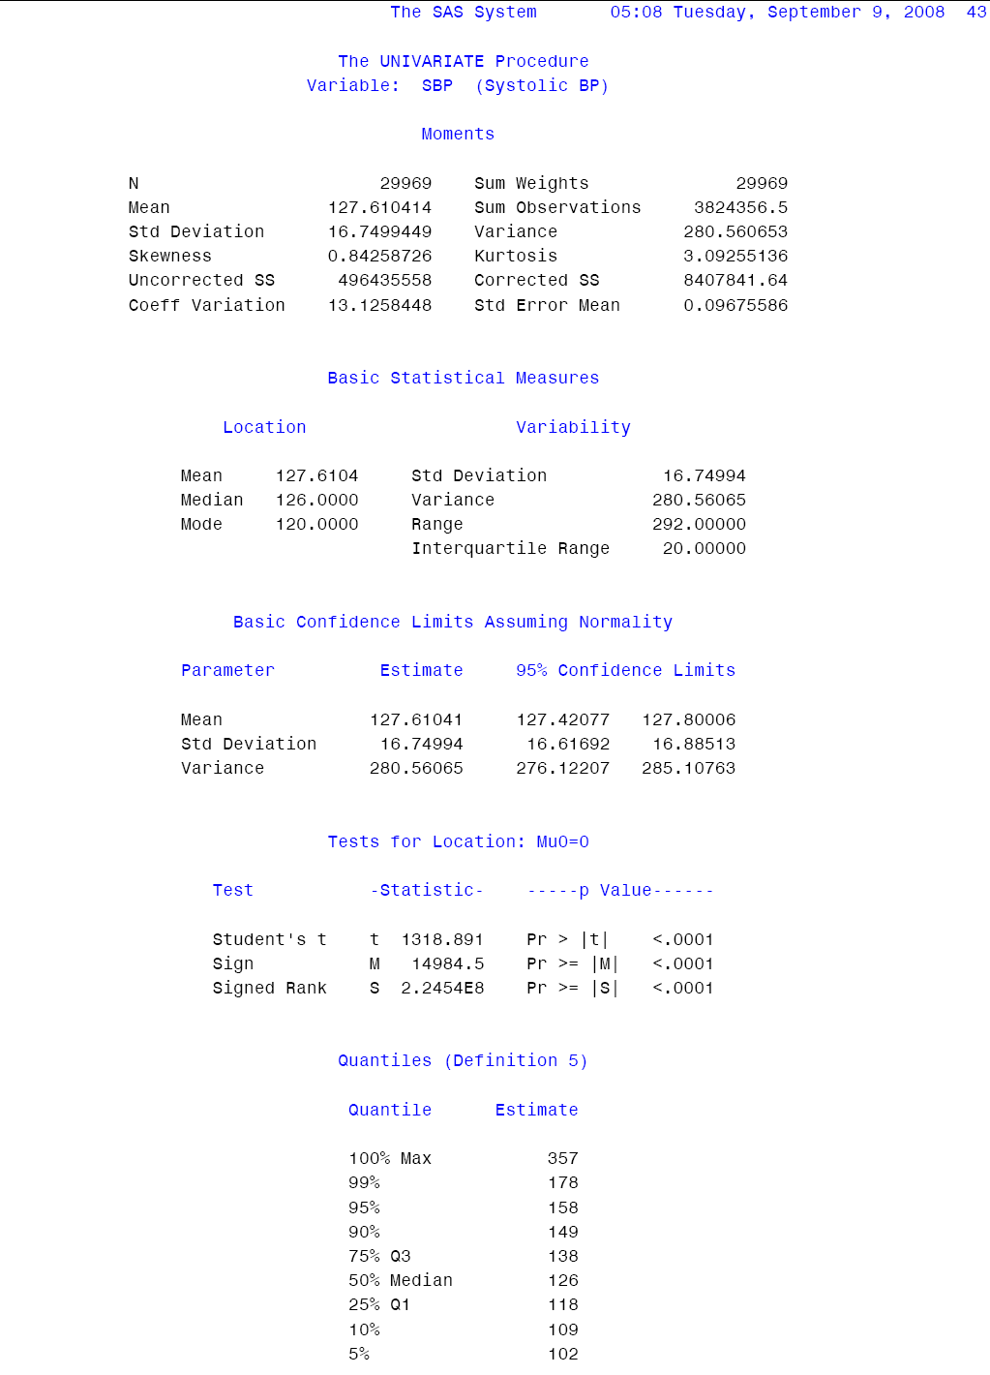
Printout Examples
Detailed description (PROC UNIVARIATE) of systolic blood pressure and c-reactive protein in the REGARDS Study
Page 1 of 6

Slide 22
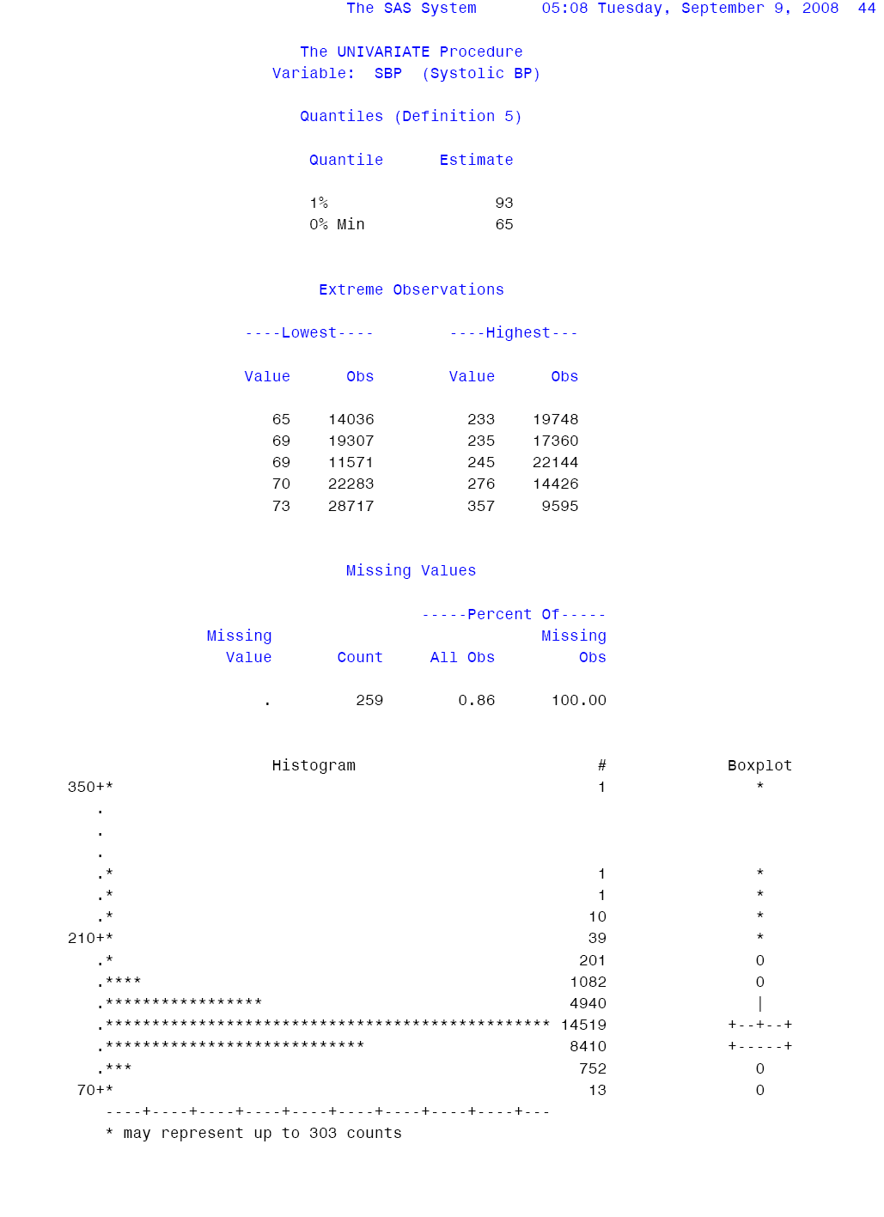
Printout Examples
Detailed description (PROC UNIVARIATE) of systolic blood pressure and c-reactive protein in the REGARDS Study
Page 2 of 6

Slide 23
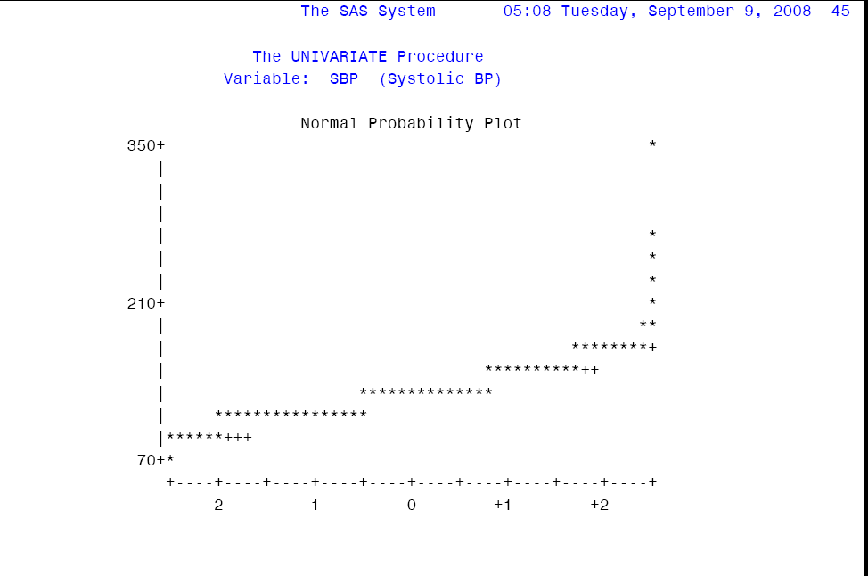
Printout Examples
Detailed description (PROC UNIVARIATE) of systolic blood pressure and c-reactive protein in the REGARDS Study
Page 3 of 6

Slide 24
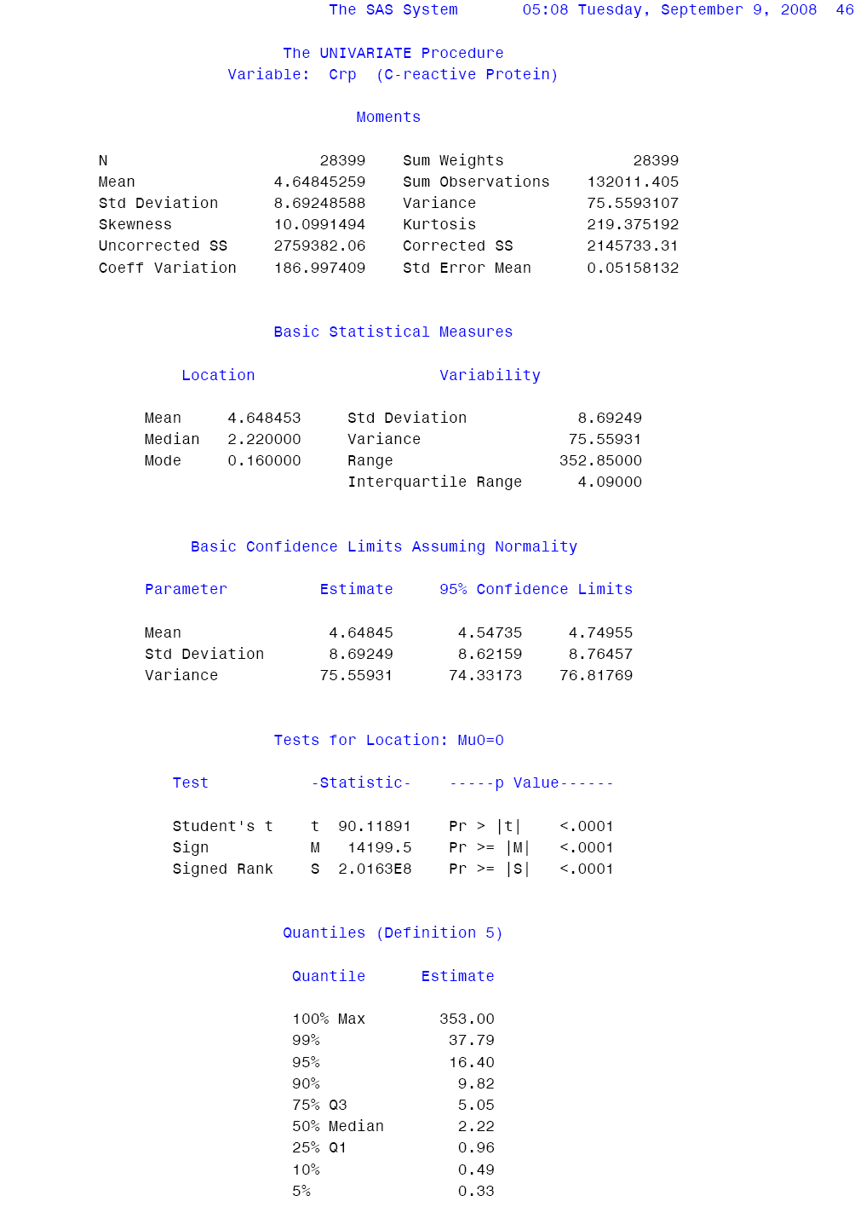
Printout Examples
Detailed description (PROC UNIVARIATE) of systolic blood pressure and c-reactive protein in the REGARDS Study
Page 4 of 6

Slide 25
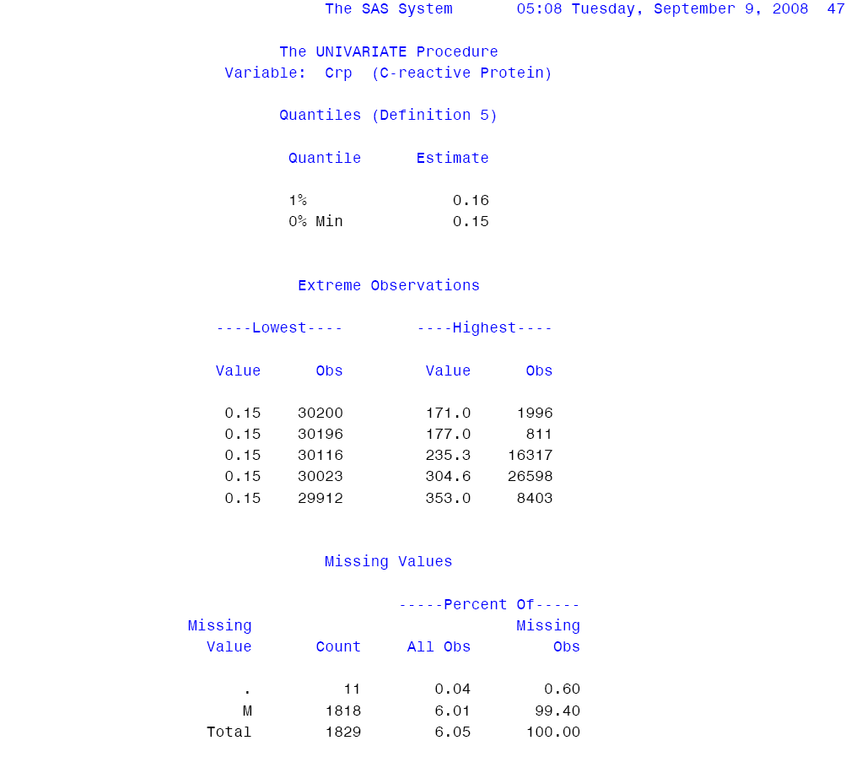
Printout Examples
Detailed description (PROC UNIVARIATE) of systolic blood pressure and c-reactive protein in the REGARDS Study
Page 5 of 6

Slide 26
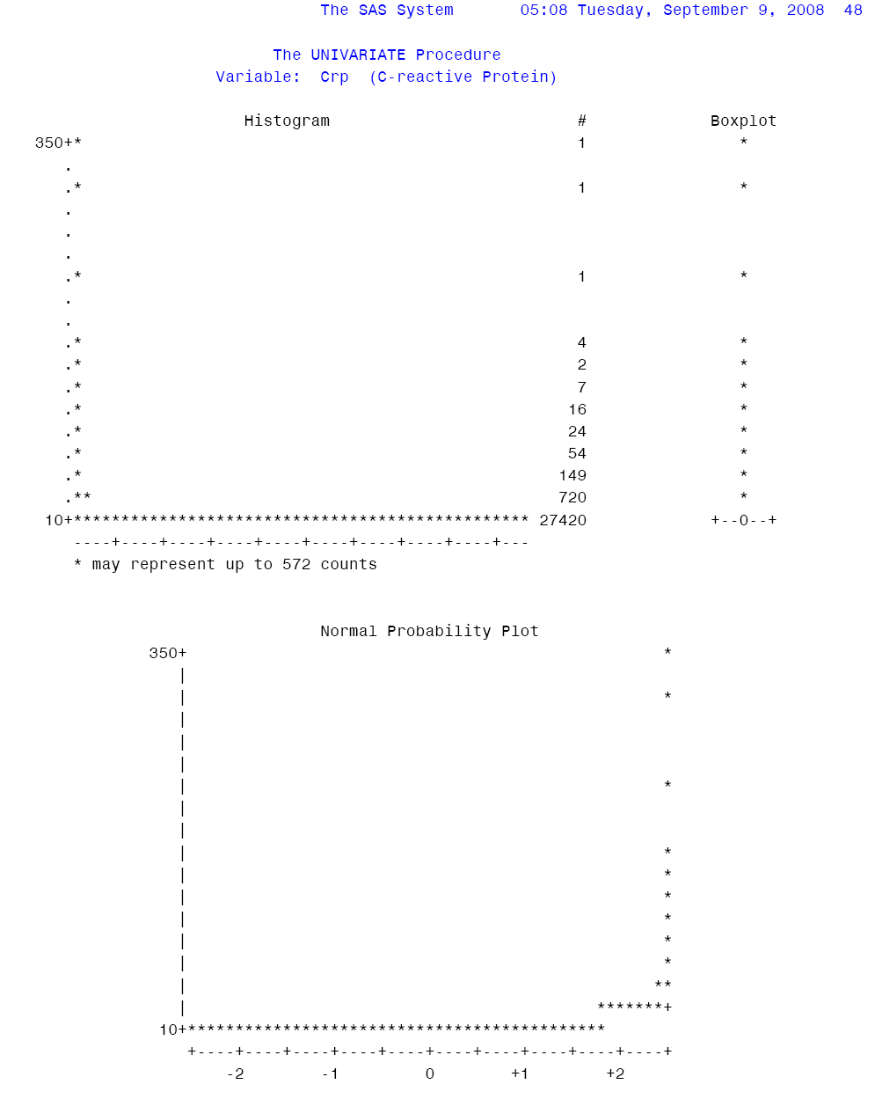
Printout Examples
Detailed description (PROC UNIVARIATE) of systolic blood pressure and c-reactive protein in the REGARDS Study
Page 6 of 6

Slide 27
General Confidence Limit Thoughts
The estimate for any parameter from any distribution has a standard error
95% confidence limits can be calculated on estimates from any parameter
General form:
  estimate - (dist area)(SE) < x < estimate + (dist area)(SE)
This is really, really important … you will see this many, many times in this course

Slide 28
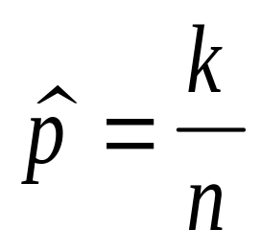
Can We Use this Approach in the Binomial Distribution?
For example, suppose we have data coming from the binomial distribution with n = 200
We take a sample and observe 40 “events”
We want to estimate the parameter p
Not surprising that the estimate of p is
Then the estimated p = 40/200 = 0.20

Slide 29
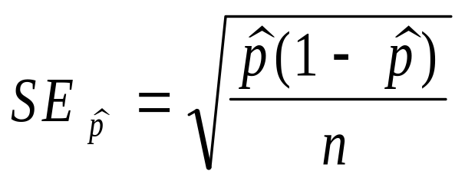
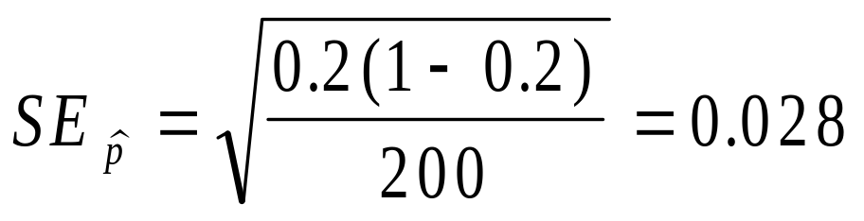
Can We Use this Approach in the Binomial Distribution?
But as noted above, every estimate must have a standard error
If the sample size (n) is “big,” then in the case of the estimated proportion from a binomial, the standard error is:

Slide 30
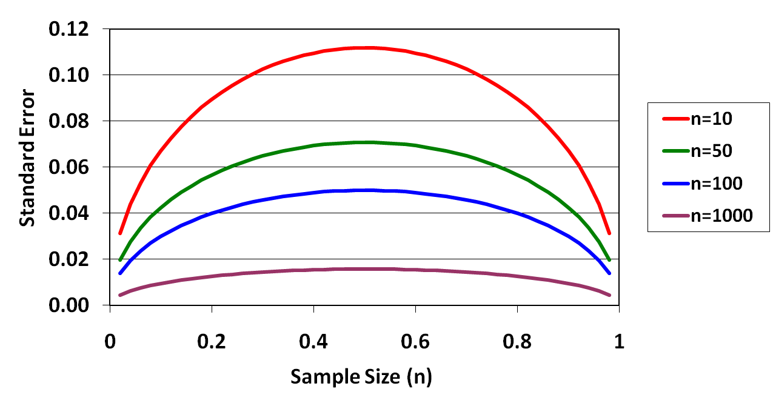
So What Does the Standard Error of a Binomial Look Like?

Slide 31
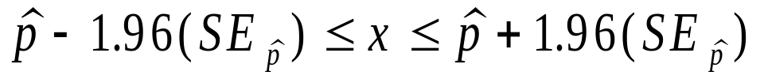
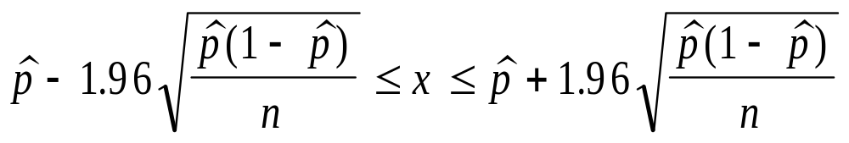

Can we calculate 95% confidence limits on the estimated proportion?
Use exactly the same approach
  estimate-(dist area)(SE) < x < estimate+(dist area)(SE)
But what probability should be use?
  If n is large, then there is no real difference between z_{α/2} and t_{α/2, n-1} ---- so just use z_{0.05/2} =1.96

Slide 32
Can we calculate 95% confidence limits on the estimated proportion?
So most folks would say that we are 95% sure that the true proportion is between 0.145 and 0.255
This is (slightly) wrong
Really, if we repeated the experiment a large number of times, and calculated confidence limits on the estimated proportion this way each time, then these confidence limits would include the true proportion 95% of the time

Slide 33
Important Points in Closing
Half of what statistics is useful for is estimation
  Given a distribution (the universe) with parameters
  We take a sample and make estimates (of the parameters)
  Some estimates are good, some are bad
    Unbiased (correct on average)
    Reliable (measured by standard error of estimates)
  95% confidence limits on estimated parameters can be made using the general approach
    estimate - (dist area)(SE) < x < estimate + (dist area)(SE)
  We did this for the estimated mean from a normal and the estimated proportion from a binomial

Slide 34
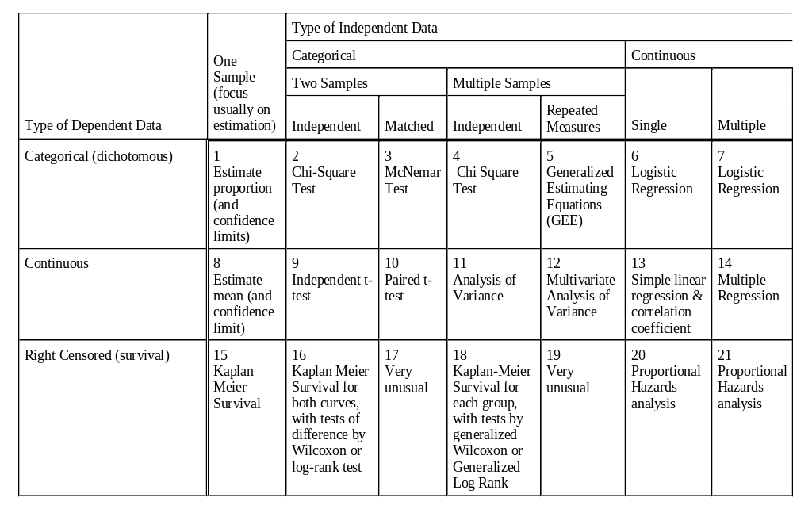
Where Have we Been Working in the “Big Picture”
1
Estimate proportion (and confidence limits)
8
Estimate mean (and confidence limits)

