Slide 1
An Update from the FDA / Industry / Academia Safety Graphics Working Group:
Adverse Event Sub Team
Qi Jiang and Liping Huang
on Behalf of the Adverse Event Sub Team
FDA/QSPI Summit, March 2012

Slide 2
The Disclaimer
The views expressed herein represent those of the presenters and do not necessarily represent the views or practices of the presenters’ employers or any other party

Slide 3
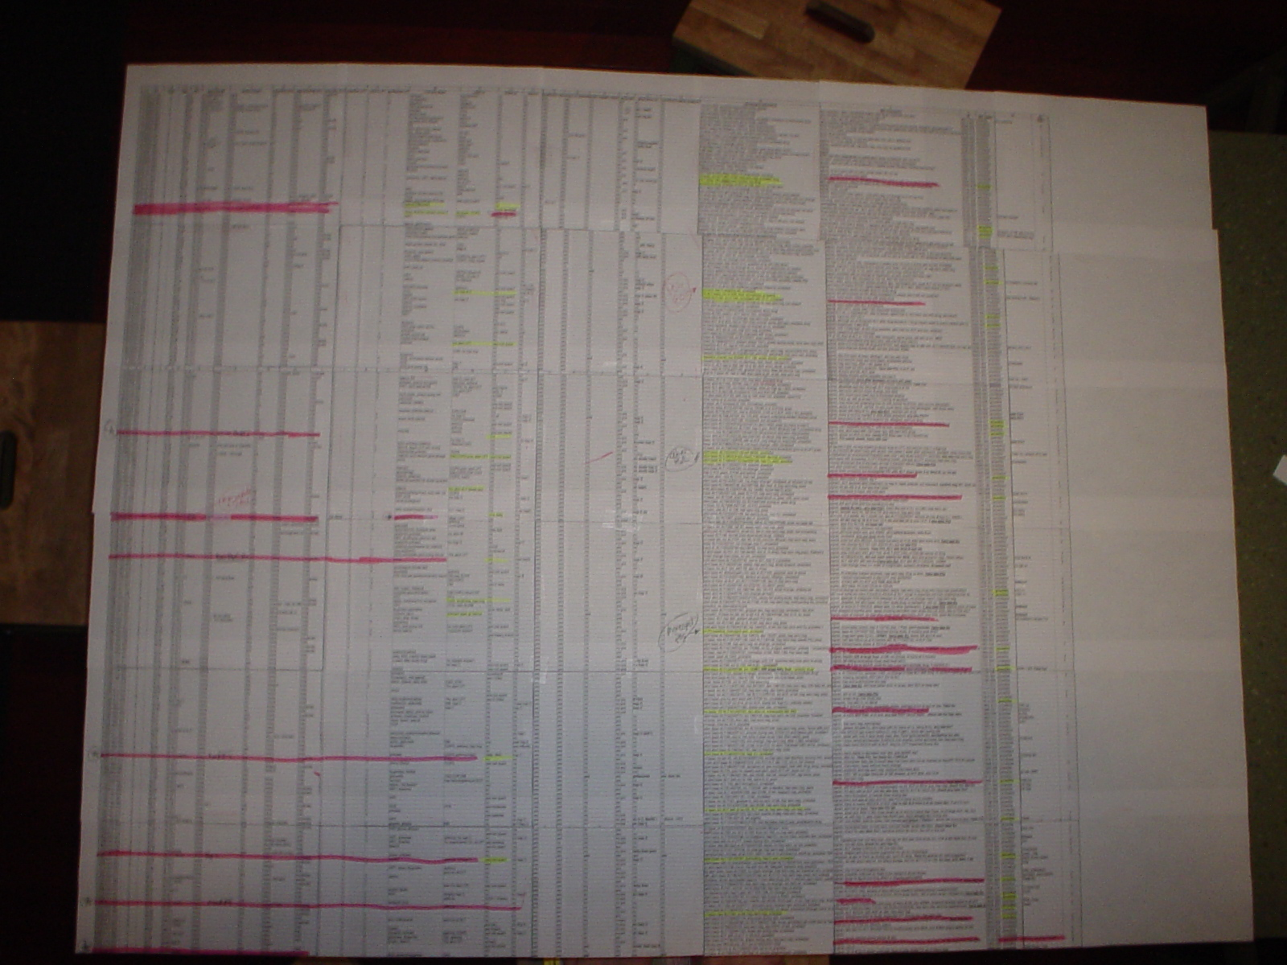
Notes:
Problem Statement
Most presentations on safety data convey information in tabular form. In general, tables are difficult to understand, especially when the data are complex.
Value of Graphs
Graphics can more effectively and efficiently communicate critical safety information to a variety of stakeholders.
Encouragement of consistent or standardized presentation of visual information is needed.
There is a need to promote best practices in the use of graphical visualization of clinical safety information.

Slide 4
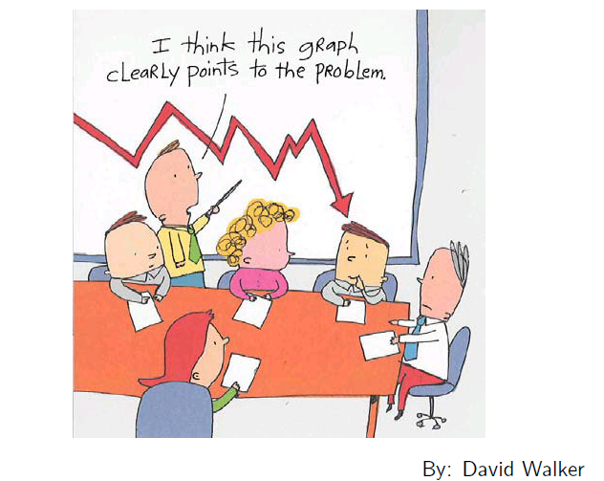
How to Achieve This?

Slide 5
Motivations
Information regarding adverse events in drug development is complex
Communicating information effectively and efficiently is crucial in detecting safety signals and helping decision-making
Notes:
ICSA 2011

Slide 6
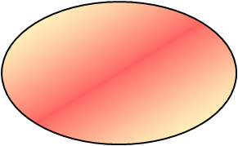
Frequently Asked Questions Regarding Adverse Events
Decision
Making
Any AEs?
What are they?
Are they
safety signals?
Background
Rate?
Risk Factors?
Drug Safety
Comparison with
other regimens
Relationship
with Other AEs?
Withdraw/
Interruption?
Time to an
Event?
Relationship
with Dosage?
Relationship
with efficacy?
Notes:
ICSA 2011

Slide 7
Categories of Graph
Demographics and incidence of AEs
AE occurrence over time across treatment groups
Dosage and exposure
Potential risk factors and their temporal relationship to AEs
Withdrawal and interruption of treatment in relation to the occurrence of AEs
Patient profile
Notes:
ICSA 2011

Slide 8
Graphical Displays Addressing Key Clinical and Safety Issues
Notes:
ICSA 2011

Slide 9
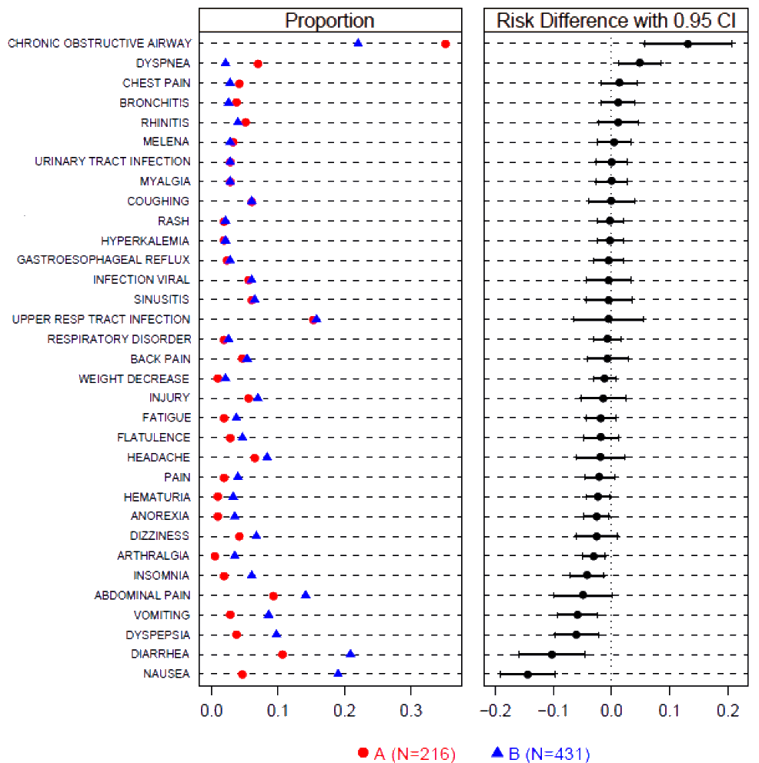
Most Frequent On-Therapy AE Sorted by Risk Difference
Clinical Question: Which AEs are elevated in treatment vs. control?
Type:
  Grouped Dotplot
Contributed by: Frank E Harrell, Jr. modification of Amit et al 2008
Notes:
ICSA 2011

Slide 10
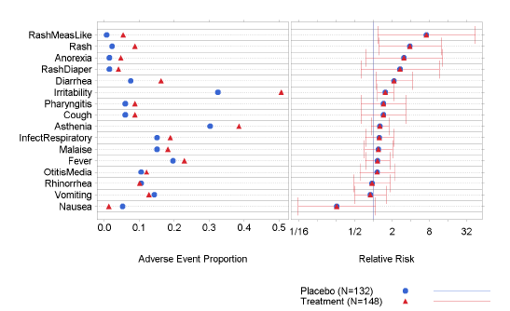
Alternative Approach:
Which AE Could Be A Safety Signal?
Dot Plot: Adverse Event Sorted by Relative Risk to address which AE could be caused by the drug
Trt > Plc
Plc.> Trt
Source: Amit, Lane, Heiburger
Notes:
ICSA 2011

Slide 11
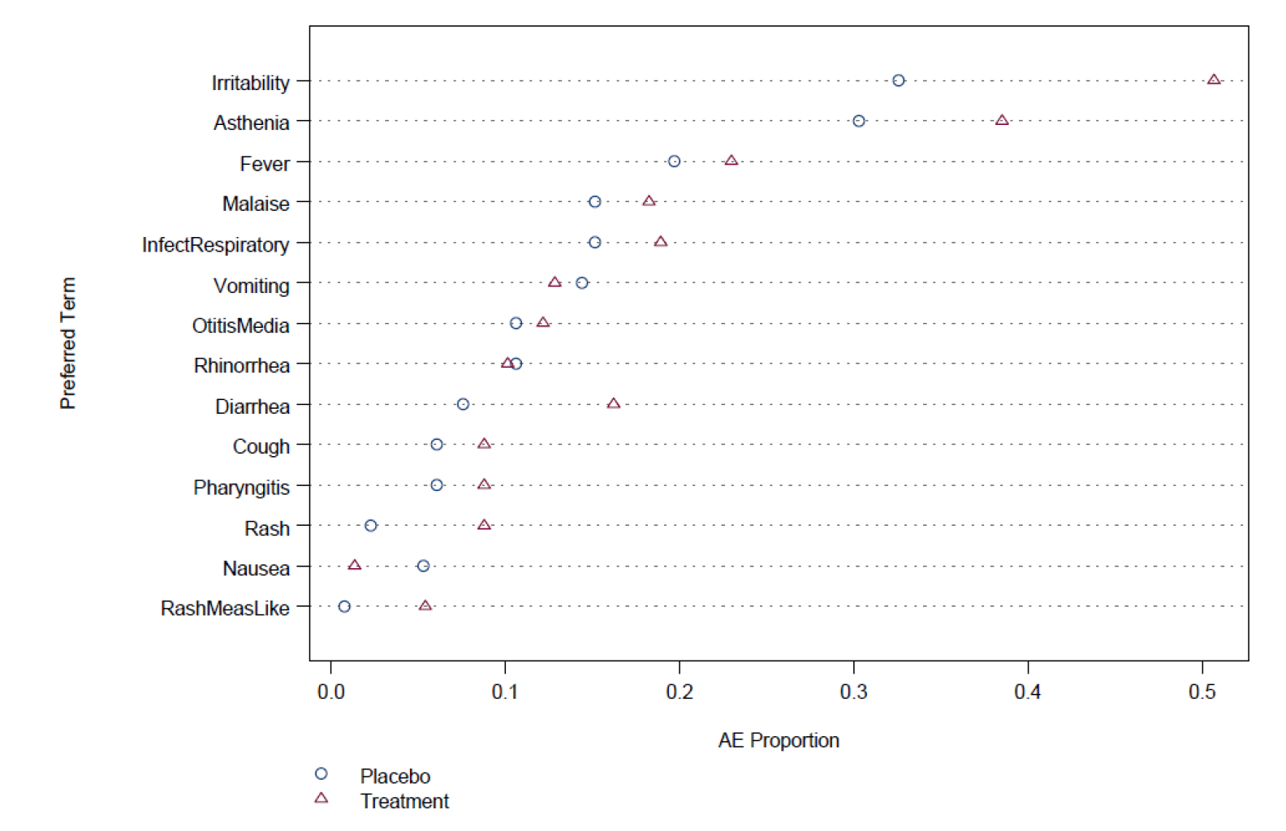
Another Alternative:
Which AEs Were Elevated?
Dot Plot: Proportions of AE Occurrence Between Treatment and Placebo
Source: Michael O’Connell “Graphical Analysis and Reporting of Safety Data”
Notes:
ICSA 2011

Slide 12
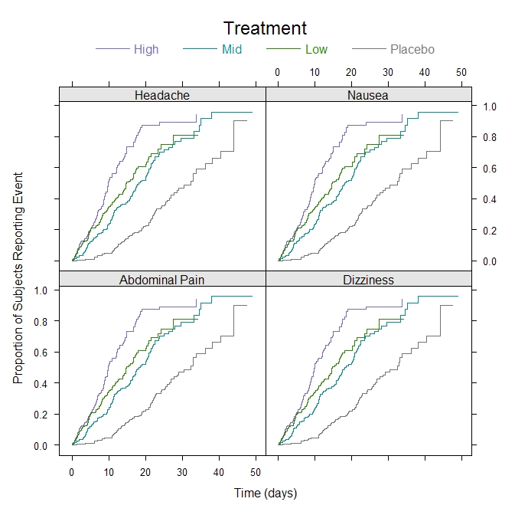
Adverse Event Occurrence Over Time
Clinical Question:
  Is there a difference in the time to event across treatment groups?
Type:
  Grouped Trellis Kaplan-Meier Plot
Software: R
Contributed by:
  Mat Soukup
Notes:
ICSA 2011

Slide 13
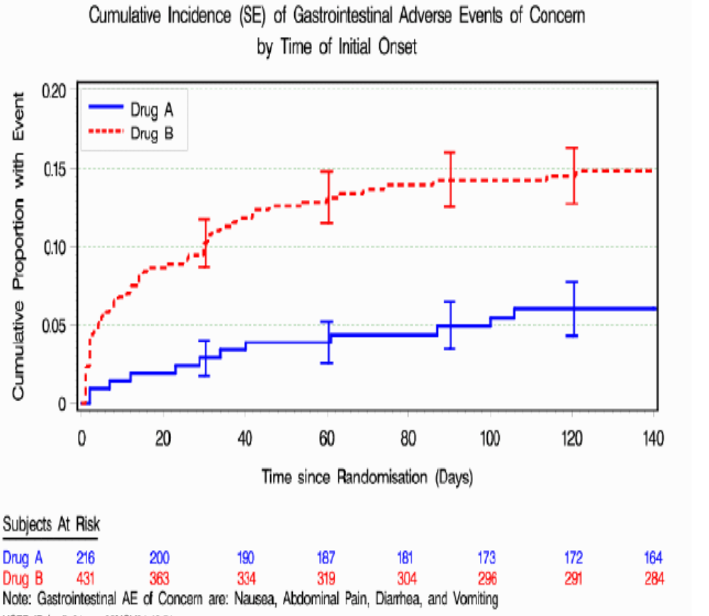
Cumulative Incidence of AE by Time of Initial Onset
Clinical Question:
Is there a difference in the time to event across treatment groups?
Contributed by:
  Liping Huang
Notes:
ICSA 2011

Slide 14
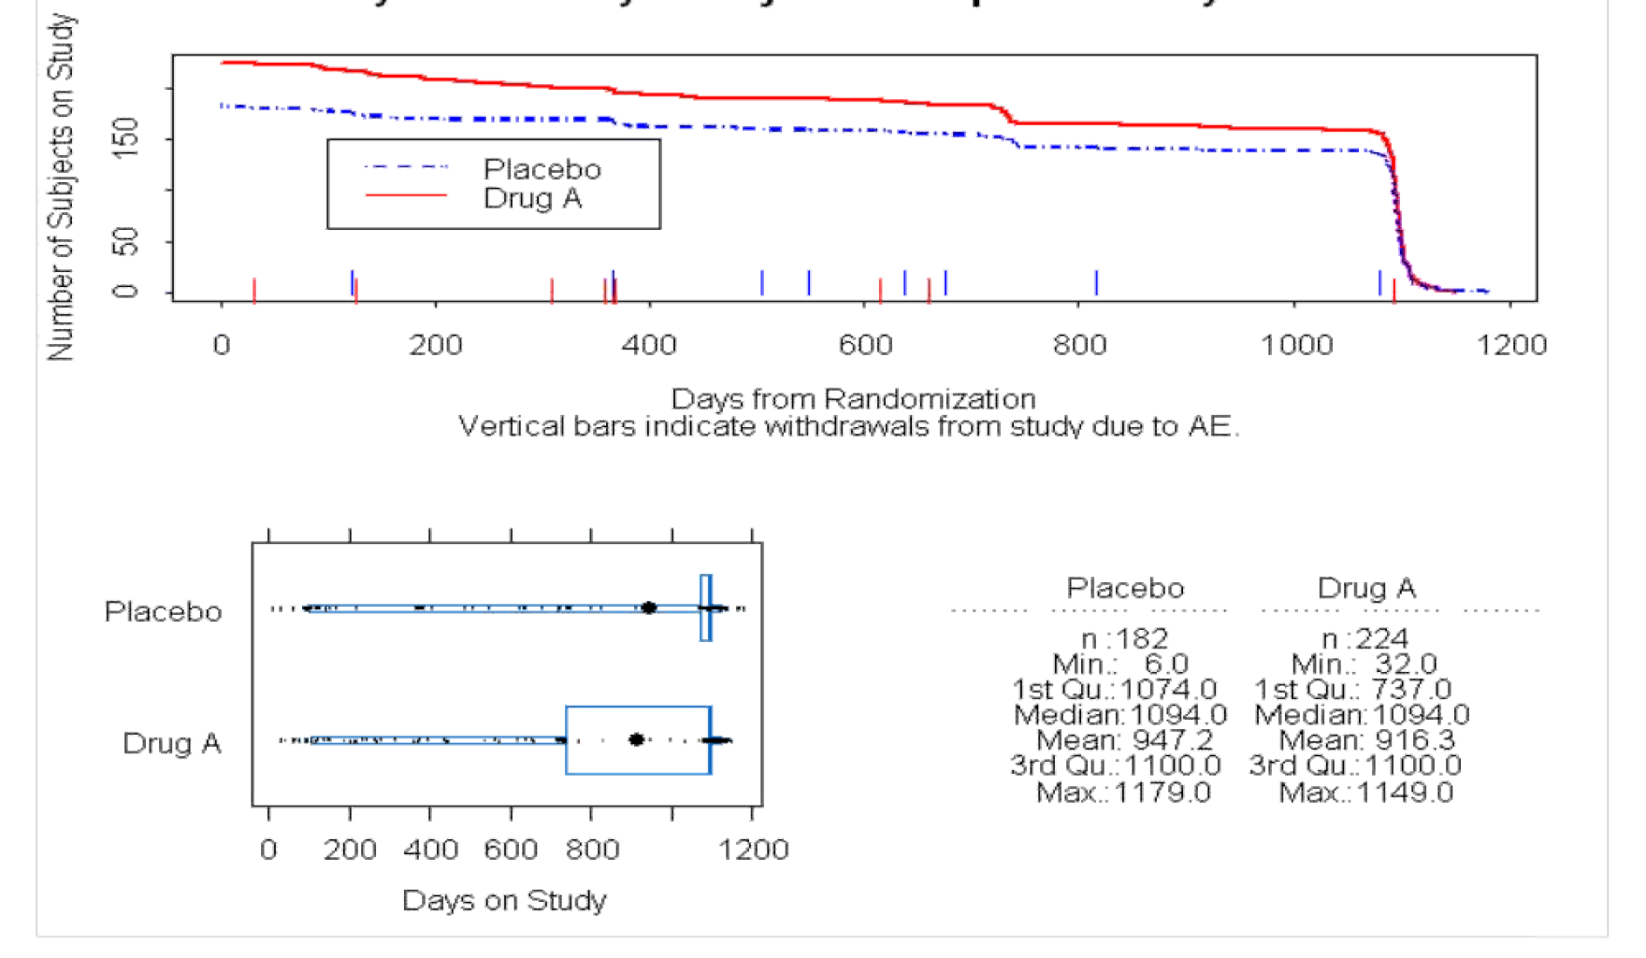
Summary of Safety Subjects Exposure to Treatment
Clinical Question:
What is the safety profile of the drug?
Are there any AEs associated with dropouts?
Contributed by:
  Qi Jiang
Notes:
ICSA 2011

Slide 15
A Few More Graphical Displays Addressing Key Clinical and Safety Issues
Notes:
ICSA 2011

Slide 16
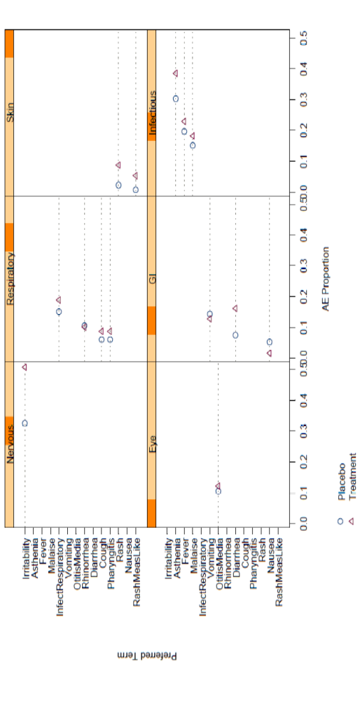
Which AEs Were Elevated in Treatment vs. Placebo?
Grouped Trellis Dot Plot: AEs by Group of Special Interest
Source: Michael O’Connell “Graphical Analysis and Reporting of Safety Data”
Notes:
ICSA 2011

Slide 17
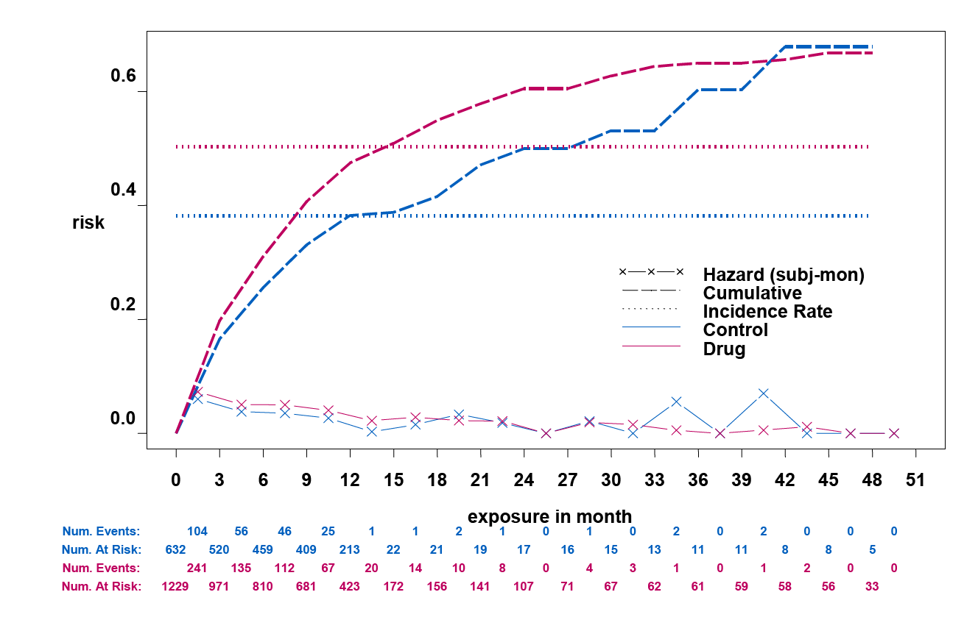
Is There A Special Pattern of AE Onset?
Risk Over Time Plot for Adverse Event
Cumulative
Incidence rate
Hazard
Source: Qi Jiang, Amgen
Notes:
ICSA 2011

Slide 18
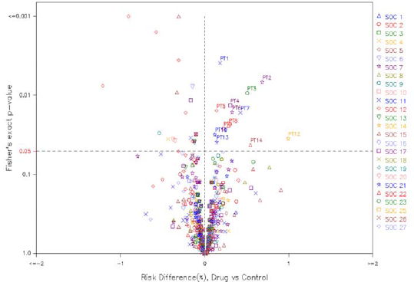
Which AE Could be A Safety Signal?
Volcano Plot:
  Relationship Between Risk Difference and P-Value for AEs by SOC
  Visualizations with different adjustments for multiplicity and shows impact of multiplicity adjustments
Source: Qi Jiang, Amgen
Notes:
ICSA 2011

Slide 19
Conclusions
Clear and informative graphs enhance the ability to understand the data
Suitable graphical presentation for adverse events could increase the likelihood of detecting safety signals
Graphs convey information more efficiently and better meet regulatory requirements for ongoing safety evaluation
Notes:
ICSA 2011

Slide 20
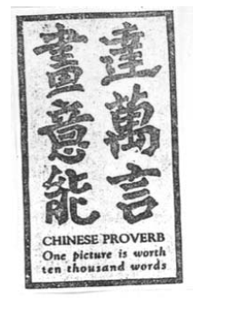
Conclusions
Notes:
ICSA 2011

Slide 21
Special Thanks
FDA / Industry / Academia Safety Graphics Working Group
Working Group Adverse Events Sub Team Members:
  Liping Huang (co-lead) - CSL Behring
  Qi Jiang (co-lead) - Amgen
  Fabrice Bancken - Novartis
  Andreas Brueckner - Bayer Healthcare
  Larry Gould - Merck
  Kenneth Koury - Merck
  Mat Soukup - CDER
  Former Sub Team Members:
  Janelle Charles (co-lead) - CDER
  Stephine Keeton (co-lead) - PPD
  Suzanne Demko - CDER
  Navdeep Boparai - Merck
  Jeff Summers - CDER
  Yaning Wang - CDER
In addition, Amgen Safety Biostat Graphical Team

Slide 22
        Thank You!

