Slide 1
Organizing a project, making a table
Biostatistics 212
Lecture 7
Notes:
Welcome to class! This is the first session ever of Biostatistics 212 – introduction to statistical computing in clinical research (or ISCCR, as Lee dubbed it).

Slide 2
Housekeeping
Lab 6 issues
  Saving, naming graphs and combining graphs
  demo
Lab 5 issues
  Review p-values
Evaluations
Final Project
  Print and hand in to Olivia or Allison (5th floor) by the end of the day on 9/22/09
  20 points docked for each 1 day late
  Email or call for help!

Slide 3
Saving, naming, and combining graphs
Name a graph
  option: name(graphname)
  graph drop _all at beginning of the do file
Save a graph
  option: saving(graphname.gph)
Combine graphs
  graph combine graph1 graph2…

Slide 4
Final Project
Follow instructions in the handout
Any reasonable table and figure is acceptable

Slide 5
Final Project, grading
Grading
  80% required to get a “Satisfactory” score in the class
  Also need to turn in all the Labs, even if they are late

Slide 6
Final Project, grading
Final Project will count for almost half of the points (170 total)
  Table – 85 points
    35 for do file log
      Housekeeping commands: open/close log, use dataset, etc
      Analysis: generate numbers in the Table
    50 for Table itself
      Architecture
      Documentation
      Formatting/appearance

Slide 7
Final Project, grading
Final Project will count for almost half of the points (170 total)
  Figure – 85 points
    35 for do file log
      Housekeeping commands: open/close log, use dataset, etc
      Analysis
    50 for Figure itself
      Design
      Documentation
      Formatting/appearance

Slide 8
Final Project, grading
Advice
  Find a classmate, give them your Table and Figure, and get their critiques.
    See if they can understand it without any verbal explanation

Slide 9
Final Project, grading
Extra credit
  10 points extra credit and bragging rights for the most artistic, creative, and clear figure turned in

Slide 10
Today...
How do you keep all those datasets, do files, and log files organized?
Steps in making a Table
Formatting a Table with Microsoft Word
Formatting a Table with Microsoft Excel

Slide 11
Organizing your Stata files
Pitfalls
  Proliferating dataset
  Can’t remember what you did
  Can’t remember why you did it
  Can’t easily redo with new data

Slide 12
Organizing your Stata files
My system (it’s not perfect)
  1) Import data into Stata, and SAVE raw dataset
  2) Write a do file that “cleans” your data, and saves it as a new clean dataset
  3) Write do files for each component of your analysis

Slide 13
My organizational scheme
Raw data.xls

Slide 14
My organizational scheme
Raw data.xls
Cut and paste
Raw data.dta

Slide 15
My organizational scheme
Raw data.xls
Cut and paste
Raw data.dta
In Stata

Slide 16
My organizational scheme
Raw data.xls
Cut and paste
Raw data.dta
Clean data.dta
In Stata
Data prep.do
Data prep.log

Slide 17
My organizational scheme
Raw data.xls
Cut and paste
Raw data.dta
Clean data.dta
Table 1.log
In Stata
Data prep.do
Data prep.log
Table 1.do

Slide 18
My organizational scheme
Raw data.xls
Table 1.xls
Cut and paste
Cut and paste
Raw data.dta
Clean data.dta
Table 1.log
In Stata
Data prep.do
Data prep.log
Table 1.do

Slide 19
My organizational scheme
Table 1.doc
Raw data.xls
Cut and paste
Table 1.xls
Cut and paste
Cut and paste
Raw data.dta
Clean data.dta
Table 1.log
In Stata
Data prep.do
Data prep.log
Table 1.do

Slide 20
My organizational scheme
Table 1.doc Table 2.doc
Raw data.xls
Cut and paste
Table 1.xls Table 2.xls
Cut and paste
Cut and paste
Raw data.dta
Clean data.dta
Table 1.log
Table 2.log
In Stata
Data prep.do
Data prep.log
Table 1.do
Table 2.do

Slide 21
Organizing your Stata files
My system, Step 1
Import data
  Minimal pre-processing before importation
  Save your raw file – this is the ONLY time you should save a Stata dataset “manually” (i.e. not from a do file)

Slide 22
Organizing your Stata files
My system, Step 2
Do file to clean the data should:
  Load the RAW data
  Generate, modify and label variables as needed
  Save the CLEAN data (save command in the do file)
  Log the output

Slide 23
Organizing your Stata files
My system, Step 3
Analysis do files should
  Load the CLEAN data
  Do the analysis
  Log the output
  EVERY number in every table, figure and in the text should be in the logged output

Slide 24
Organizing your Stata files
You will end up with:
  2 Stata datasets
    Data, from Excel.dta
    Data.dta
  1 do file used for cleaning
    Data prep.do
  1 do file to create each Table and Figure
    Table 1.do, Figure 1.do, Text data.do, etc
  Matching log files (with the same names) for each do file
    Data prep.log, Table 1.log, Figure 2.log, Text data.log, etc

Slide 25
Organizing your Stata files
Put them all in one folder called, “Stata files”, sort by file type.
Example

Slide 26
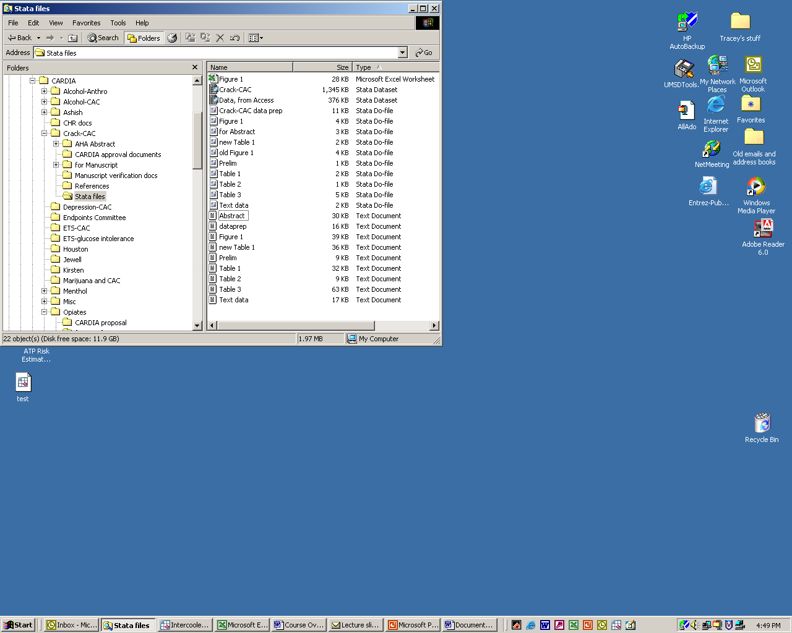

Slide 27
Organizing your Stata files
What do you do if…
You want to try 2 different ways of doing something
  DON’T create more datasets
  DO add more variables in the Data Prep.do (agecat1, agecat2), or add to your analysis do file

Slide 28
Organizing your Stata files
What do you do if…
You can’t remember what you did
  Just look up the correct do file/log file and see

Slide 29
Organizing your Stata files
What do you do if…
You can’t remember why you did it
  DOCUMENT your reasoning with comments in both data prep and analysis do files
  Remember how to insert comments:
    * Comment on 1 line only
    /* Comment on
    multiple lines */

Slide 30
Organizing your Stata files
What do you do if…
You need to redo with new data
  Import the new data, save over the RAW dataset
  Rerun your Data Prep.do file
  Rerun your analysis do files

Slide 31
Organizing your Stata files
What do you do if…
You need to redo with new age categories, etc
  Fix your Data Prep.do file
  Rerun your Data Prep.do file
  Rerun your analysis do files

Slide 32
Organizing your Stata files
What do you do if…
You need to redo with new analytic approach
  Fix your analysis do file
  Rerun your analysis do file

Slide 33
Organizing your Stata files
Questions?

Slide 34
My organizational scheme
Table 1.doc Table 2.doc
Raw data.xls
Cut and paste
Table 1.xls Table 2.xls
Cut and paste
Cut and paste
Raw data.dta
Clean data.dta
Table 1.log
Table 2.log
In Stata
Data prep.do
Data prep.log
Table 1.do
Table 2.do

Slide 35
My organizational scheme
Table 1.doc Table 2.doc
Raw data.xls
Cut and paste
Table 1.xls Table 2.xls
Cut and paste
Lecture 3
Cut and paste
Raw data.dta
Clean data.dta
Table 1.log
Table 2.log
In Stata
Data prep.do
Data prep.log
Table 1.do
Table 2.do

Slide 36
My organizational scheme
Table 1.doc Table 2.doc
Raw data.xls
Cut and paste
Table 1.xls Table 2.xls
Cut and paste
Lecture 3
Lecture 5
Cut and paste
Raw data.dta
Clean data.dta
Table 1.log
Table 2.log
In Stata
Data prep.do
Data prep.log
Table 1.do
Table 2.do

Slide 37
My organizational scheme
Lecture 7
Table 1.doc Table 2.doc
Raw data.xls
Cut and paste
Table 1.xls Table 2.xls
Cut and paste
Lecture 3
Lecture 5
Cut and paste
Raw data.dta
Clean data.dta
Table 1.log
Table 2.log
In Stata
Data prep.do
Data prep.log
Table 1.do
Table 2.do

Slide 38
Tables
Two main purposes
  Present the facts in a compact format
  Provide side-by-side comparisons
Six main components:
  Data
  Title, row heading, column headings
  Row names
  Footnotes
Browner, W. Publishing and Presenting Clinical Research

Slide 39
Steps to making a Table
Decide what the Table will be about
Make the dummy table
  Do this FIRST!!
Write a do file that will produce each number you need
Copy and paste the data in (if possible)
Format so it looks nice

Slide 40
Steps to making a Table
Deciding what the Table will be about
  I like to sketch it out first (on paper)
  Logical flow
    Table 1 describes the sample (stratified by a predictor?)
    Table 2+ explores bivariate relationship of main predictor with the outcome
    Table 3+ explores results of adjusting for confounders
    Other Tables, Figures for interactions, etc.

Slide 41
Steps to making a Table
Make the dummy table first
  Makes you specify what you actually want!
  Guides the analysis
  Excel or Word

Slide 42
Steps to making a Table
Write a do file that will produce each number you need
  Iterative process, as you know

Slide 43
Steps to making a Table
Copy and Paste the data in
  Copy and Paste each number, or
  “Copy Table” (under the “Edit” menu)
    http://www.stata.com/support/faqs/data/copytable.html
  Minimize manual retyping, rounding
  Use Excel to calculate and round for you

Slide 44
Steps to making a Table
Format it so it looks nice
  Choose a journal you like, copy the format!
    You should be able to duplicate it exactly
    Note horizontal lines, not vertical ones…
    Double-space your version
    Footnote as you go - *, †, ‡, §, ║, ¶ (or a,b,c,d,…)
  Create a template

Slide 45
Word vs. Excel for Tables
Stata → Word
  Fewer steps, fewer files
  But…
    More cells to create
    Can’t cut and paste full tables
    Doesn’t do any calculations for you

Slide 46
Word vs. Excel for Tables
Stata → Excel → Word
  Can cut and paste values or whole tables
  Set rounding, do calculations easily
  Formatting easier?
  Copy and Paste into Word (extra step)

Slide 47
Demo
Table 1 for “Moderate drinking and coronary calcium in young adults: The CARDIA Study”
  Basic content
  Sketch
  Mock-up in Excel
  Generate numbers in Stata
  Transfer numbers to Excel
  Copy and paste into Word

Slide 48
Summary
It’s worth putting thought into your file organization
Document everything you do!
Mock up your table before doing the analysis
Make your tables clear, and pretty

Slide 49
Lab today
Your time to work on the Final Project
But first – Do Your Evaluation

Slide 50
Thank you!
For your active participation in the course
Good luck!

