Slide 1
Do files, log files, and workflow in Stata
Biostatistics 212
Lecture 2
Notes:
Welcome to class! This is the first session ever of Biostatistics 212 – introduction to statistical computing in clinical research (or ISCCR, as Lee dubbed it).

Slide 2
Housekeeping
Everyone connected to web, servers, etc?
Questions from Lab 1
  Page up to repeat/edit a command
  Storage types (help data_types)
  Brackets, italics, commas, etc in a Stata command – see handout
    tabulate var1 var2 [, chi2] comma optional (note brackets)
    ttest contvar, by(catvar) comma required
  Definition of a p-value
  Death as an outcome, SE of a proportion, etc
  P=.000?
  Sig figs
  Why is summarize caccat wrong?
Final Project
Anything else?

Slide 3
Today...
Rationale for Do and Log files
How they work
Demonstrations
Lab

Slide 4
Last week
Using Stata interactively for immediate analysis
  Fill in the blanks
  Like a calculator

Slide 5
What happens if…
A question arises about your results?
You decide to do something differently?
  Add a new variable to your model
  Categorize a variable differently
You get new data?
You lose something?
  Overwrite your data file, computer crash, etc

Slide 6
What happens if…
A question arises about your results?
You decide to do something differently?
  Add a new variable to your model
  Categorize a variable differently
You get new data?
You lose something?
  Overwrite your data file, computer crash, etc
ALL OF THESE THINGS WILL HAPPEN TO YOU!

Slide 7
Cardinal Principles
Keep your source data pristine and secure
Document everything you do to it
Document every analysis
Make sure you can repeat everything you do easily and quickly and accurately

Slide 8
Cardinal Principles
Keep your source data pristine and secure
Document everything you do to it
Document every analysis
Make sure you can repeat everything you do easily and quickly and accurately
Do and Log files make this easy!

Slide 9
One systematic approach
Import data
Save as a Stata dataset
Clean the data using a do file, save new dataset
Analyze the data using other do files
Document each step with a log file
Transfer results from log files to tables, figures, etc.
More on this later

Slide 10
Do files
A list of commands
Text
Create with the do file editor
Run
  With do file editor button, or
  do yourdofile.do

Slide 11
Do files
Demo
  Simple list of commands
  Different types of comments
  Run in three different ways
  “run” vs. “do”
Notes:
Do some of Lab 1 (tab dead, tab cac, tab male cac, chi row, etc)

Slide 12
Do files
“Comments” are a way to document your logic – here are the options
* Anything after asterix is comment
/* Anything until you reach the reciprocal symbol is comment */
Other options: // ///

Slide 13
Do files
Advantages
  Plan your analysis
  Cut and paste, find and replace, etc
  Repeat quickly and easily and reproducibly
  Comments enhance documentation
  Development cycle iterations
    You will get errors, make corrections, rerun, etc

Slide 14
Log files
A record of all Stata output
Plain text (.log) versus Stata formatted (.smcl)
  We use plain text for this course
Start and stop with button or commands
  log using yourlogname.log (open)
    , append (add to end)
    , replace (replace)
  log close (close)
  log off (pause)
  log on (un-pause)
Don’t edit log files!

Slide 15
Log files
Demo
  Start logging, run commands, close and look
  .smcl vs. .log
  long output command or lots of commands
Notes:
Explore predictors of ldl in CARDIA, interaction between male and race; list ldl hdl, scatter ldl hdl (graphs NOT in the log)

Slide 16
Log files
Advantages
  Complete documentation
  Time/date of run
  No “buffer” problem
  Documents analysis on data as it was at that time

Slide 17
Log files
Command logs, FYI
  List of commands you enter
  Control same as other logs
    cmdlog using
    cmdlog close
    cmdlog off
    cmdlog on
  I never use them! Use do files instead.

Slide 18
Using Do and Log files together
Open the log file WITHIN the do file!
  Everything documented every time
  Improves repeatability
Open your dataset WITHIN the do file!
  Subset for inclusions/exclusions in do file also
Save your dataset WITHIN the do file!
  And save it with a different name
  NEVER save manually except right after importing data into Stata
  Watch for “proliferating datasets” problem

Slide 19
Using Do and Log files together
Open the log file WITHIN the do file!
  Everything documented every time
  Improves repeatability
Open your dataset WITHIN the do file!
  Subset for inclusions/exclusions in do file also
Save your dataset WITHIN the do file!
  And save it with a different name
  NEVER save manually except right after importing data into Stata
  Watch for “proliferating datasets” problem

Slide 20
Using Do and Log files together
Demo
  Within do file:
    Open log, close log
    Open dataset
    “Capture log close”
    cd – PC vs. Mac
    Set more off/on

Slide 21
Using Do and Log files together
Advantages
  Full documentation
  Easy repeatability
  Data security and file management system

Slide 22
Using Do and Log files together
It’s worth the effort!

Slide 23
What happens if…
Revisited
A question arises about your results?
You decide to do something differently?
  Add a new variable to your model
  Categorize a variable differently
You get new data?
You lose something?
  Overwrite your data file, computer crash, etc

Slide 24
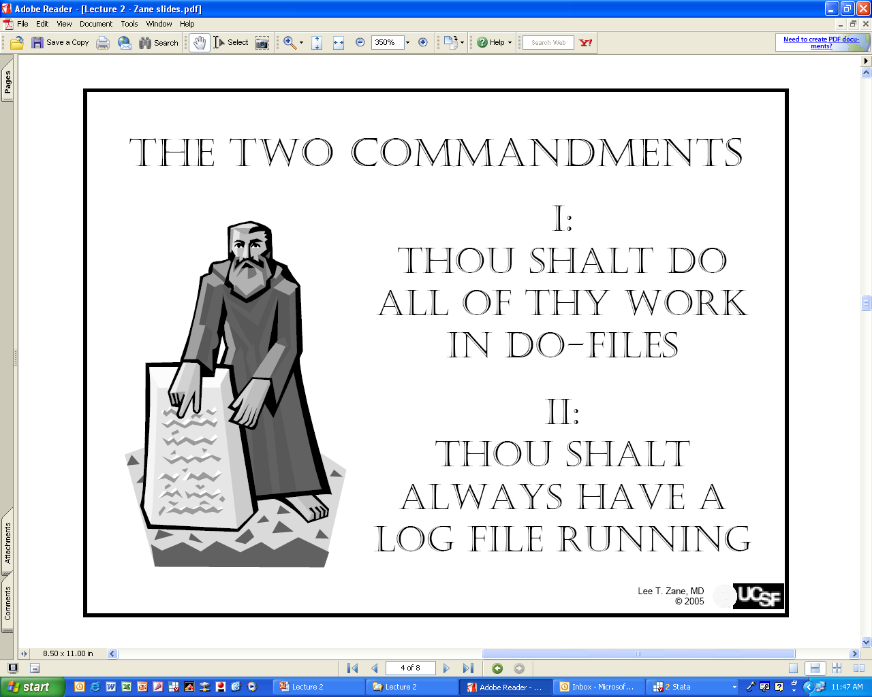
Advice from a former TA
(Lee Zane)

Slide 25
My Advice
Thou shalt do MOST of your work on do files
Thou shalt open a log WHEN YOU ARE READY to document your analysis
i.e. Feel free to explore your data, follow instincts, etc quickly without do/log files

Slide 26
Lab today
Lab 2
  Walks you through do and log files
  Set up template for future labs

Slide 27
Preview of next week…
Cleaning your data
  Generating new variables
  Manipulating data
  Labeling

