Slide 1
Mostly Dates… and a few other useful STATA commands
Jen Cocohoba, Pharm.D., MAS
Associate Clinical Professor
UCSF School of Pharmacy

Slide 2
In this portion of the lecture
How to manipulate dates in STATA
Performing loops
Basic “how to” merge datasets
“Follow along”
  No lab exercises
  Sample Excel spreadsheet “practicedates” on syllabus

Slide 3
Dealing with Dates in STATA
Dates in your research
STATA can help you manipulate dates
  Add, subtract, calculate time between dates
  Comparing dates (e.g. before 1999, after 1999)
  Extracts components of dates (year, day of week)

Slide 4
How STATA thinks about dates
Sees them as a number
“Counts” date as the # of days from a specific reference
  January 1, 1960 = 0
  January 2, 1960 = 1
  January 3, 1960 = 2
  December 31, 1960 = 364
This makes it “easy” for STATA to manipulate them mathematically
We will come back to this in formatting dates

Slide 5
Cleaning strings to STATA dates
Most often imported from a program (Excel)
You can follow along
  Practicedates.xls
  Open file
  Copy dates
  Paste into STATA data editor
  Look at dates …they are red!

Slide 6
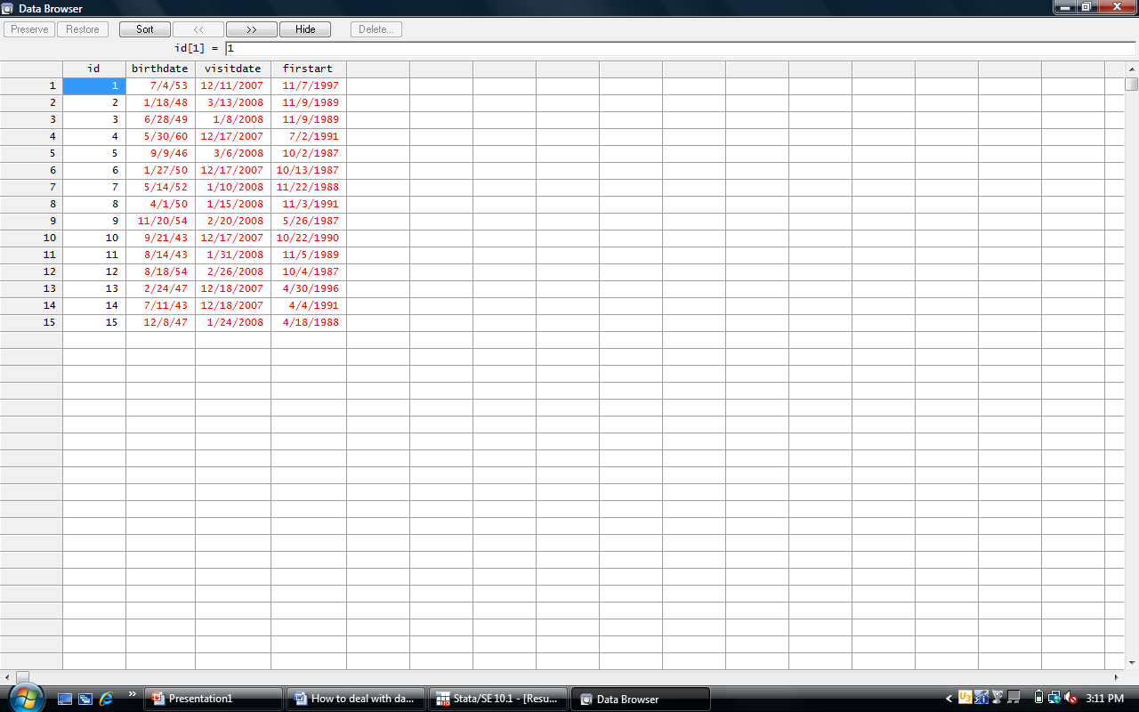

Slide 7
Cleaning STATA dates
STATA sees dates from Excel as text, not #
Even if you type dates directly into data editor, still seen as text
Date conversion
  Generate a new date variable using the date function
  Tell it which old variable contains the date you want to convert
  Give it a format (most common is month, day, year)
  Try it and look at results

Slide 8
New variable name
Date function
  generate dob = date(birthdate, “MDY”)
Old variable name
How the date is arranged

Slide 9
Number nonsense
dob
-2372
-4366
-3839
150
-4862
-3626
-2788
-3562
-1868
-5946
-5984
-1962
-4694
-6018
-4407
0
Can format (mask) the numerical date so that it is easier for you to understand
Command:
format dob %td

Slide 10
A series of two commands
Most will be like this 2-command example
  generate dob = date(birthdate, “MDY”)
  format dob %td
Change the first ART date to a STATA interpretable date
STATA has issues with dates with 2 digit years
  Try converting visitdate (2 digit years)
  Should get a “missing values” generated
  Need to add a “topyear” which is the cutoff value. STATA will interpret years up to this year.

Slide 11
Top year = if the year is “09” this is interpreted as 2009. If year is “11” then interpreted as 1911
New variable name
Date function
  generate vdate = date(visitdate, “MDY”, 2009)
Old variable name
How the date is arranged

Slide 12
Date formatted – what can you do with it?
Extract components of the date into new variables (columns)
  gen nameofdayvariable = day(datevariable)
  gen weekdayvariable = dow(datevariable)
    Lists as 0(Sunday) - 6(Saturday)
  gen monthvariable = month(datevariable)
  gen yearvariable = year(datevariable)

Slide 13
What can you do with dates
Find time between dates
Suppose you wanted to find participants’ age at the date of their study visit.
  Generate new variable called ageatvisit
  gen ageatvisit = vdate - dob
  Note this gives you their age in number of DAYS
  Can do this more efficiently by
  gen ageatvisit =(vdate – dob)/365.25
  *gen agevisityears = int(ageatvisit)*

Slide 14
Comparing dates
Suppose you wanted to categorize patients by their visit dates
  Those who had a visit before 12/31/07 = earlyvisit
Using literal dates
  Formatted as day month year (01jan1960)
  Must be denoted by parenthesis and letter d
  Example: d(01jan1960)
Example
  gen earlyvisit = 0
  replace earlyvisit = 1 if vdate <= d(31dec2007)
  replace earlyvisit =. if vdate==.

Slide 15
Programming loops
Same command to a bunch of variables
Example
  Test whether age at visit, number of side effects, and average severity of side effects differ by gender (sex)
Could do this…
  ttest ageatvisit, by(sex)
  ttest numsidefx, by(sex)
  ttest severity, by(sex)

Slide 16
Loop Syntax
Or tell STATA to run them all…
foreach var in ageatvisit numsidefx severity {
ttest `var’, by(gender)
}
foreach var in ageatvisit numsidefx severity {
summarize`var’, detail
}
List of variables
Command begin
Perform this command, replacing the `var’ with the variables in the list. NOTE the special apostrophe marks (the first one lies below the ~ on the keyboard, the other is a normal apostrophe)
Command end

Slide 17
Merging datasets, simplest example
Merge versus append
  Merge = add new variables from 2nd dataset to existing observations
  Append = add new observations to existing variables
Merging requires datasets to have a common variable (ID)
Nomenclature for two datasets
  One dataset is defined as the “master” (in memory) dataset
  The other dataset is called the “using” dataset
Many merge types
  One to one: master file w/demographics, using data has labs (merge 1:1)
  One to many: master file w/demographics, using file with multiple visits (merge 1:m)
  Many to one: Master file with multiple visits, using with demographics (merge m:1)
  Many to many: master with multiple visits + using file with multiple visits (merge m:m)

Slide 18
How to merge
Need to make sure they are sorted AND saved
  STATA 11 may do this automatically for you!
  sort idvariable
Steps
  Load the master dataset into memory
  Sort (just to be safe)
  Command
merge type commonvariable using “name of 2nd dataset.dta”
Example: merge 1:1 wihsid using “socdem.dta”
See appearance of a “merge” variable which tells you where the observations came from (dataset 1, dataset 2, etc.)

Slide 19
The wonders of STATA on the Web
Many things STATA can help you do
To figure out how…
  STATA help is one place to start
  I’ve had luck with Google searches
  UCLA has a helpful STATA site
  Other discussion strings
Good luck with your final projects

