Slide 1
Demo: RAID5/6 operations implementation in Haskell
Dongsheng Wei(卫东升)
12210140069@fudan.edu.cn

Slide 2

RAID5
RAID5 Disks codes : tolerant one disk failure
Constitution: [D] + P
$P=D_{1}⊕D_{2}⋯⊕D_{n}$

Slide 3
Two imported modules
Data.Bits
Defines bitwise operations for singed and unsigned integers
e.g. `xor`, `.&.`, `shift`.
Data.List
Operations on lists
e.g. ` elemIndices `, `head`, `take`

Slide 4
Some functions of RAID5
listxor
Generate P
raid5
Generate raid5
raid5recv
Recover when one block failed(D or P)

Slide 5
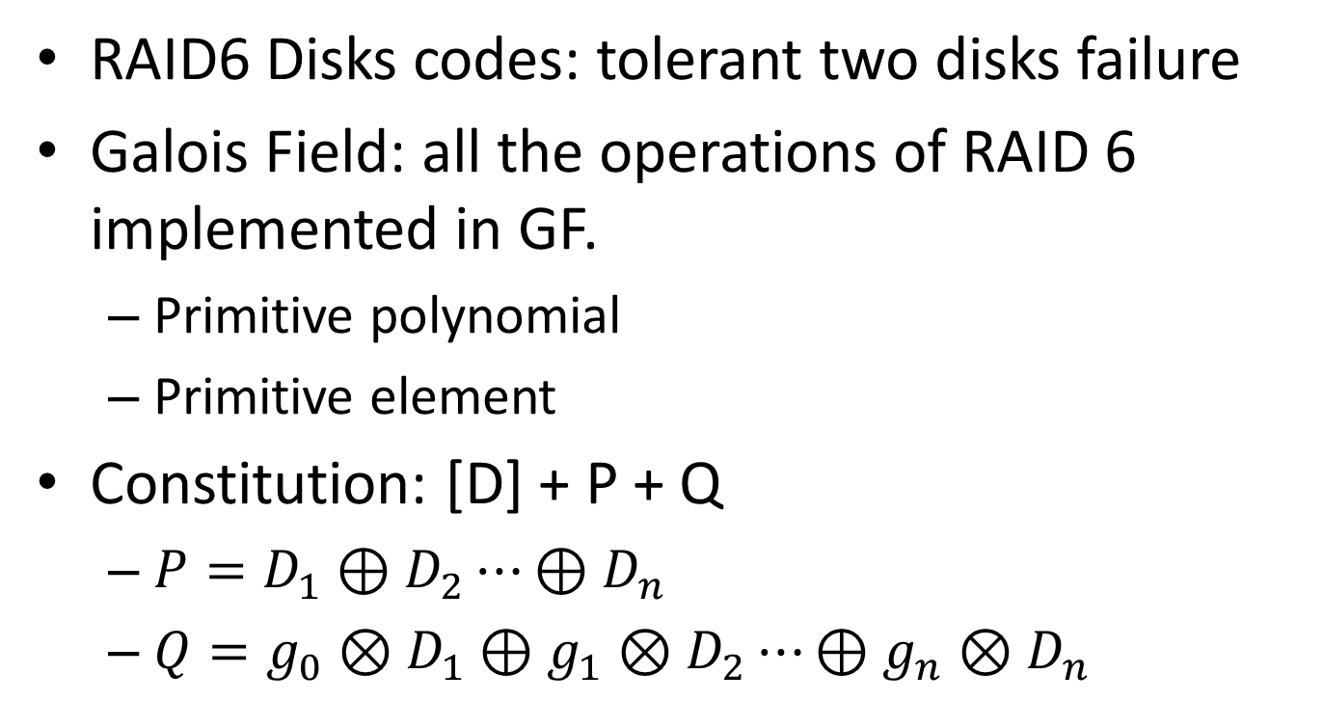
RAID6
RAID6 Disks codes: tolerant two disks failure
Galois Field: all the operations of RAID 6 implemented in GF.
Primitive polynomial
Primitive element
Constitution: [D] + P + Q
$P=D_{1}⊕D_{2}⋯⊕D_{n}$
$Q={g_{0}⊗D}_{1}⊕{g_{1}⊗D}_{2}⋯⊕g_{n}⊗D_{n}$

Slide 6
some basic functions of GF
gfilogList
Get elements in GF (e.g. GF(2^8))
gfilogtable
Show all the elements in GF
gfmul
Multiply operation in GF
gfdiv
Division operation in GF

Slide 7
Some basic functions of RAID6
listxor: generate P
rs: geenrate Q
Raid6: generate raid6
Raid6recv : recover when some blocks failed(num <= 2)
raid6recvOne
raid6OneD
raid6OneP
raid6OneQ
raid6recvTwo
raid6TwoDD
raid6TwoDP
raid6TwoDQ
raid6TwoPQ

Slide 8
Appendix: some auxiliary functions
sublist: get the sub list from original list
omitOneIndex: delete the given index value of list
omitListIndexs: delete the given indexs values of list
chgOneIndexWithValue: change the given index value
chgIndexsWithValues: change the given indexs values

Slide 9
Thanks!
git@github.com:wdskuki/GaloisField.git

