Slide 1
Editable illustrations of the presentation
Each following slide holds one drawing, stored as SVG (vector).
1. Right-click the drawing > Convert to Shape (PowerPoint 365 / 2021+): it becomes editable shapes.
2. Edit it (colours, lines, add elements...). Keep it grouped.
3. Select the group > right-click > Save as Picture... > type SVG.
4. Save it over the file named in the slide title, in the folder assets/icons/ of the presentation.
5. Run python build.py (or keep python build.py --watch running) and refresh the browser.
Tip: keep the same width/height ratio so that the drawing fits its place on the slide.

Slide 2
assets/icons/sota-building.svg

Slide 3

assets/icons/sota-material.svg

Slide 4
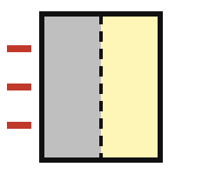
assets/icons/sota-wall.svg

Slide 5

assets/icons/tech-cavities.svg

Slide 6
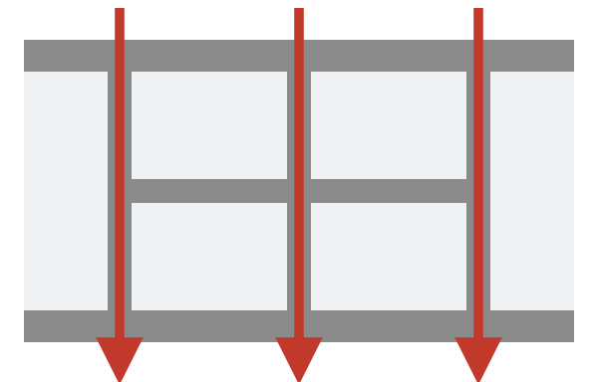
assets/icons/tech-lattice.svg

Slide 7

assets/icons/tech-multimaterial.svg

Slide 8

assets/icons/toc-conclusion.svg

Slide 9
assets/icons/toc-cosimulation.svg

Slide 10

assets/icons/toc-introduction.svg

Slide 11
assets/icons/toc-physical.svg

Slide 12
