Slide 1
Path Analysis Example: Bollen’s union sentiment model
The path diagram for this example is on p.83 in the text. The data were collected from non-union textile workers in the southern states. The sample size was 173. The study was trying to model the causal influences on attitudes towards unionization. The data we will look at are part of a larger study. Five variables are measured:
Exogenous:
Years in textile mill
Age of respondent
Endogenous:
Deference to managers
Support for labor activism
Sentiment toward unions

Slide 2














Path diagram for union sentiment model:
Years in mill= Age=
= deference , =labor activism, =union sentiment

Slide 3
This path model implies several causal claims:
First, age is only indirectly related to union sentiment through deference and support for activism. Tenure on the job IS directly related to union sentiment, apart from deference and support for activism.
Second, union sentiment is determined partly by deference and support for activism.
Third, tenure on the job has no direct relation to deference and support for activism.
Theory may also suggest the signs of the path coefficients, but we don’t have information on this theory.

Slide 4


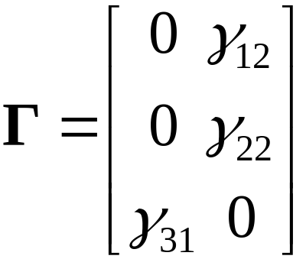
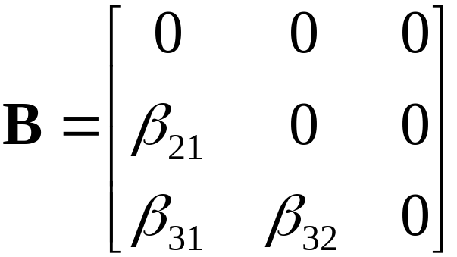
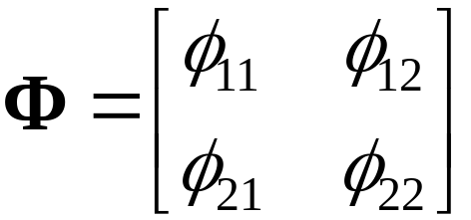
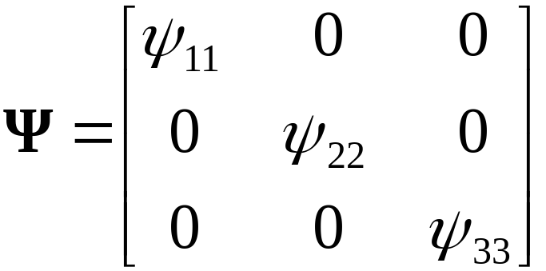

Slide 5


Is the model identified?
We have 12 parameters to estimate and given 5 variables, there are 15 unique elements in the covariance matrix. Hence
df = 15 – 12 = 3
The t-rule is satisfied. But this is a necessary condition.
The definitive check is that the model is recursive: is a lower triangular matrix, and is diagonal.
This is a sufficient condition for identification.

Slide 6
The program syntax for the first run:
TITLE: Bollen's union sentiment model p.83
DATA: FILE IS bollen_uniondat.txt;
TYPE IS cova;
NOBS IS 173;
VARIABLE: NAMES ARE defman activ senti years age;
ANALYSIS: TYPE IS general;
ESTIMATOR IS ml;
MODEL:
defman ON age;
activ ON defman age;
senti ON defman activ years;
OUTPUT:
sampstat stand res mod;

Slide 7
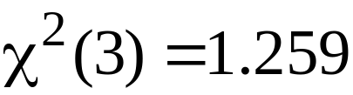
Results
The model fits well: p < .74
RMSEA = 0
CFI = 1.00 Standardized RMSR= .015
By even a conservative standard, these results indicate good fit.

Slide 8
Standardized Residuals (z-scores)
DEFMAN ACTIV SENTI YEARS AGE
___________________________________
0.029
-0.018 0.014
0.626 0.344 0.173
0.591 0.409 0.206 0.000
-0.004 0.003 0.685 0.000 0.000
The standardized residuals clearly indicate that the fit is good. There are no large residuals, and many are near zero.
Furthermore, all beta and gamma paths are statistically significant.

Slide 9
We can evaluate the variance in each endogenous variable that is explained by the causal model, using the squared multiple correlations for each equation.
Squared Multiple Correlations for Structural Equations
defman activ senti
-------- -------- --------
0.11 0.23 0.39
These squared correlations are large enough to be meaningful, but there is clearly a great deal of variance that is not accounted for by the causal influences in the model. Note that good fit need not mean high correlations or large amounts of explained variance.

Slide 10
Now suppose we had run the original model, omitting one of the paths: the path from Age to Labor Activism. The new path model is:
We have Age now related only indirectly to Labor Activism

Slide 11
The program syntax for this reduced model is:
TITLE: Bollen's union sentiment model p.83 omitted path
DATA: FILE IS bollen_uniondat.txt;
TYPE IS cova;
NOBS IS 173;
VARIABLE: NAMES ARE defman activ senti years age;
ANALYSIS: TYPE IS general;
ESTIMATOR IS ml;
MODEL:
defman ON age;
activ ON defman ;
senti ON defman activ years;
OUTPUT:
sampstat stand res mod;

Slide 12
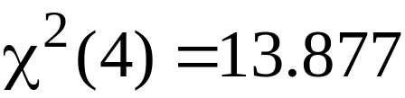
The fit of this reduced model is not so good:
p < .01
RMSEA = .119 with 90% confidence interval (.055, .191). These values are in the range for poor-fitting models.
CFI = .93, which is not a bad value.
Standardized RMSR = .081, which is not a great value.
Even though the CFI value is good, I would tend to doubt the fit of this model. I would examine local fit information to evaluate
the model.

Slide 13
The standardized residuals are:
Standardized Residuals (z-scores)
DEFMAN ACTIV SENTI YEARS AGE
________________________________________
0.025
-0.016 0.013
0.423 1.071 0.782
0.591 1.812 1.407 0.000
0.000 3.244 2.307 0.000 0.000
Note that unlike the first model run, here we have some larger residuals that involve Age. Age was involved in the omitted path, and so it makes sense that Age would show some larger residuals when the path is omitted.

Slide 14
We can also look at the modification indices and expected parameter change statistics for the path coefficients
Minimum M.I. value for printing the modification index 10.000
M.I. E.P.C. Std E.P.C. StdYX E.P.C.
ON Statements
DEFMAN ON ACTIV 12.167 0.941 0.941 0.817
ACTIV ON AGE 12.169 0.058 0.058 0.256
WITH Statements
ACTIV WITH DEFMAN 12.169 8.539 8.539 0.789

Slide 15
It seems clear that the local information indices reveal some problems with fit involving Age.
We would probably consider modifying the model to improve the fit, assuming that we had some justification theoretically for including a path from Age to Activism.
Model respecification following lack of fit must be done with caution. Simulation studies show that data-driven respecifications are unlikely to recover the true model structure. Respecification is especially futile when sample size is small, or the fit is very poor, with many modifications needed. Also, if respecification does improve the fit, it is probably best to replicate the model in another sample.

