Slide 1
Confirmatory Modeling: Overview
In confirmatory modeling, we try to translate our theory into a statistical model that can then be tested against the data at hand. A structural equation model (SEM) is one type of model that we will study intensively.
For SEM, we translate our theory into a set of linear equations that represent relations among a set of measured or unmeasured variables.
We then evaluate the model (i.e., set of equations) by how well the model is able to reproduce the relations found in the data. In the process, we estimate the model parameters and generate various indices of model fit.

Slide 2
Latent and Observed Variables
The “observed” variables are the measured variables in the data. These variables may be measured using a quantitative scale, or may be categorical in nature (e.g., gender). In some cases, we view the measured variables as indicators of an unmeasured, latent variable that produces the observed scores. Example: measured variables are item scores on a depression inventory, and these items reflect a latent variable of “depression” that is common across items and that produces responses to the items.
Latent variables are not directly measured, but are hypothesized constructs that we intend to measure using observed indicators. In the depression example, the latent variable is “depression”. In most cases, the latent variables are viewed as continuous and quantitative in scale.

Slide 3
Types of SEM’s
Measurement models: These models represent relations between measured variables and the latent variables that are believed to underlie the measured variables. The factor analysis model is the main measurement model of interest.
Path models in observed variables: These models represent causal relations among measured variables. No latent variables are included.
Path models in latent variables: These models represent relations among latent variables. A measurement model is ordinarily part of the path model in latent variables.

Slide 4

Path diagrams
Path diagrams are visual representations of path models, either with or without latent variables.
Variables in boxes are measured variables.
Variables in circles are latent variables.
Directional relationship.
X
X
Y

Slide 5
Example: Test anxiety and academic performance
Reference: Everson, Millsap, & Browne (1989) Anxiety Research, 1, 313-325.
Two theories about the relationship of test anxiety and academic performance:
The interference hypothesis says that test anxiety increases cognitive load, which in turn reduces the resources available for performance.
The deficit hypothesis states that test anxiety itself arises from a skills deficit, and it is the skills deficit that leads to poor performance. Here test anxiety is not directly related to performance.

Slide 6
Data are based on N=211 entering college students
Variables:
T1, T2, T3 = reading or math achievement test scores
GPA = high school grade point average
AW = Test Anxiety Inventory worry score
AE = Test Anxiety Inventory emotion score
The T1, T2, and T3 measured variables are taken as indicators of an achievement latent variable (either reading or math).

Slide 7











TAI Path Model
AW
T1
AE
T2
GPA
T3

Slide 8








Notation = Anxiety-Worry
= Anxiety-Emotion
= HS-GPA
= T1, T2, T3
measurement model
structural model

Slide 9
Model Specification
We begin by translating our theory into the form of a testable SEM (assuming that this is possible). Here “testable” means capable of being refuted by real data.
How many variables do we have? Which ones are observed, and which ones are latent?
Are the variables discrete (e.g., scored true/false) or continuous (e.g., height) in scale? Different models may be used depending on the scale of measurement for the variables.
If latent variables are included, what are the indicators of each latent variable?

Slide 10

With latent variables, you need to specify which indicators are linked to each latent variable.
More generally, you must specify linkages among all variables.
direct path
indirect path
Exogenous variables: no directional paths pointing to these.
Endogenous variables: these have at least one directional path pointed at them
X
Y
X
Z
Y

Slide 11

In most of the literature, X=exogenous measured variable, Y=endogenous measured variable.
In most path models, disturbance variables are included to account for unmeasured influences on each endogenous variable.
We assume
The disturbance accounts for all influences on Y that are not expressed through X. Unless we account for all variance in Y, there will always be a disturbance term in the model.
X
Y

Slide 12

Similarly, for indicators of latent variables, we will usually include error variables or unique factors to account for variance in the indicator that is not produced by the latent variable.
Common unique
Factor factor
We ordinarily assume that common and unique factors are uncorrelated in the model.
Each indicator has its own unique factor, but the common factor is shared among multiple indicators.
X

Slide 13





Model Identification
Let all parameters whose values are to be estimated
covariance structure for measured variables under the model.
We say that the model is identified if for any two different sets of parameter values and , we have
Otherwise, the model is not identified. If the model is not identified, estimation and fit evaluation often cannot proceed.

Slide 14
Estimation
Once an identified model is specified, some additional choices must be made.
Distributional assumptions for the variables must be specified. Multivariate normality is a common assumption, but we can operate with weaker assumptions as needed.
Independence assumptions are also needed. For example, we usually assume that disturbance variables are independent of the exogenous variables.
Sampling assumptions that concern the acquisition of data are needed. For example, we usually assume independence of observations.

Slide 15




Model Fit Evaluation
Fit evaluation examines the degree to which the model is able to reproduce the covariance structure found in the data. We can define four different covariance matrices that are relevant to any SEM application.
= population covariance structure
= population covariance structure under the model
= sample covariance structure
= sample covariance structure under the model

Slide 16


Here we define to be the covariance structure that we would obtain if we fit our model in population data. Ideally, we would like to have
This equality denotes perfect or exact fit of the model in the population. We do not generally know either of the above two covariance matrices. Instead, we investigate whether
Here is the covariance matrix that would be reconstructed or “fitted” by our model. Sampling error alone could prevent the above equality from holding even when the fit is perfect in the population.

Slide 17


Formal tests of exact fit
We can conduct a statistical hypothesis test that the population and population/model covariance matrices are identical:
The alternative hypothesis is that the model does not fit perfectly.
Under some assumptions, the null hypothesis can be tested using a chi-square statistic. Rejection of the null implies that the model is incorrect at some level.

Slide 18
Goodness of fit indices
If the model does not fit perfectly, the next question that might be asked is whether the model provides a good approximation to the data. Goodness of fit indices attempt to measure the adequacy of the approximation. How close is to ?
Many fit indices exist, and they are not always consistent. Researchers have developed “rules of thumb” regarding values of the indices that indicate a good fit.
As a researcher, you will need to understand the concept of model fit, and what the various fit indices can tell you about model fit.

Slide 19










How a model implies a covariance structure
Example: mediation path model
The model consists of two equations:

Slide 20

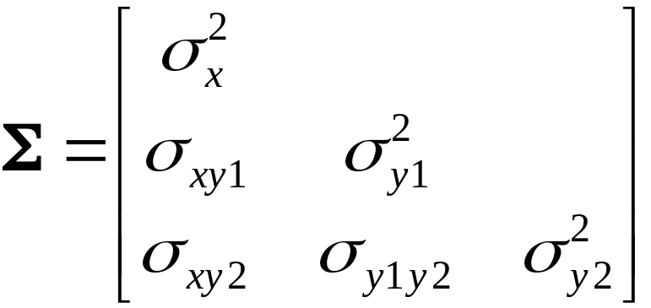
The covariance matrix for is given as
Each element of the covariance matrix can be expressed as a function of the model parameters, given the two equations that constitute the model and also the assumptions made about the variables involved.
The variance of is not a function of any of the model parameters because this variable is exogenous.

Slide 21
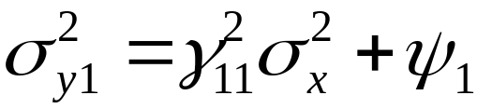
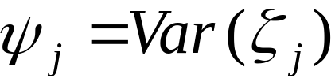
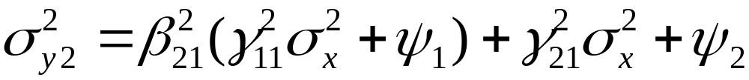
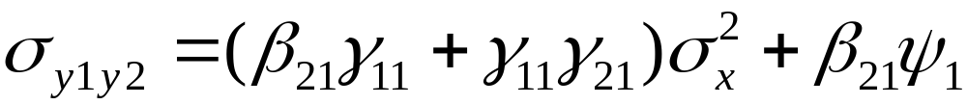
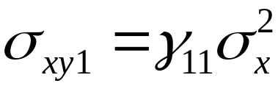
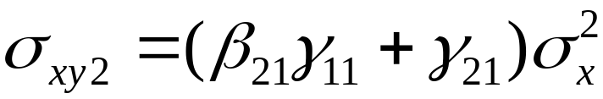
The expressions for the covariance matrix elements are
with
If the model and its assumptions are true, we should be able to perfectly reproduce the covariance elements once all parameters are estimated.

