Slide 1
Identification in CFA
The identification problem in CFA is more complex than the same problem in path analysis, but we have some results that are easy to apply and that cover many cases.
Identification here has the same meaning that it did when we discussed path analysis: the model is identified if we can find unique solutions for all parameters in the model.
For some CFA models, the rules for identification are quite simple. In other cases, rules that are fully general are still unknown, although partial results are available.
When in doubt, one can always try to rely on the software to check for identification, but the check is not 100% accurate.

Slide 2



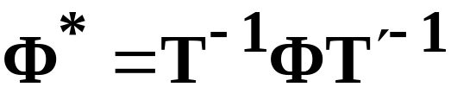
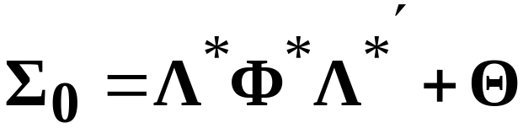
Rotational indeterminacy
One source of identification problems in CFA is the rotational indeterminacy of the common factors. Suppose that we have the usual factor model:
Suppose that we have no constraints on . Then for any nonsingular square matrix T, we can define
This results in
Both solutions give the same covariance structure.

Slide 3
We can divide CFA models into two types for purposes of looking at identification:
First, we have models in which each measured variable loads on only one common factor, possibly with multiple factors across variables.
Second, we have models in which some measured variables load on more than one common factor.
The second case is more complex, but in either case, a first step in identification is to add constraints needed to define a unit for each common factor. Common factors have no natural unit, and so we must define one when fitting the model.

Slide 4

Defining “units” for the common factor scale
We can do this in at least two different ways:
First, we can pick one measured variable for each factor to act as a reference variable for that factor. We fix this variable’s loading on the factor to a nonzero value (usually 1.0).
As an alternative method, we can fix the variance of each common factor to a nonzero value (usually 1.0). These variances are the diagonal elements of . This approach puts the common factors in standardized form.
Note that these constraints are NOT enough to identify the model.

Slide 5
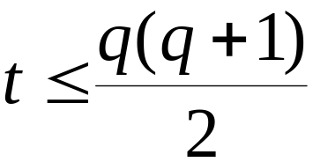
T-rule for CFA
We again have the t-rule as a condition to check when checking for identification. Let q equal the number of measured variables and let t be the number of free parameters in the specified factor model.
Then the factor model is identified only if
This is a necessary condition for identification, but is not sufficient.

Slide 6
Suppose that for q=3 measured variables, we try to fit a single factor model. The number of parameters to be estimated are:
3 factor loadings (one per variable)
1 common factor variance
3 unique factor variances
Total: t=7 parameters
Now q(q+1)=3(4)=12
12/2 =6
Conclusion, we have one more parameter than we have pieces of information to use to estimate it. Model is not identified.

Slide 7
Another example: Suppose that q=6 with r=2 factors. Is this model identified?
We have q(q+1)= 6(7) =42. Then 42/2=21
Then for the parameter count:
12 factor loadings
3 elements of the factor covariance matrix
6 elements of the unique factor covariance matrix
21 parameters
The number of parameters exactly matches the number of pieces of information. The model satisfies the t-rule.

Slide 8

Three-indicator rule
This rule represents a sufficient condition for identification. The model is identified if:
A unit is defined for all factors;
There are at least three measured variables per factor;
Each measured variable loads on one and only one factor:
is diagonal;
If the specified model follows this rule, we know that the model is identified.

Slide 9
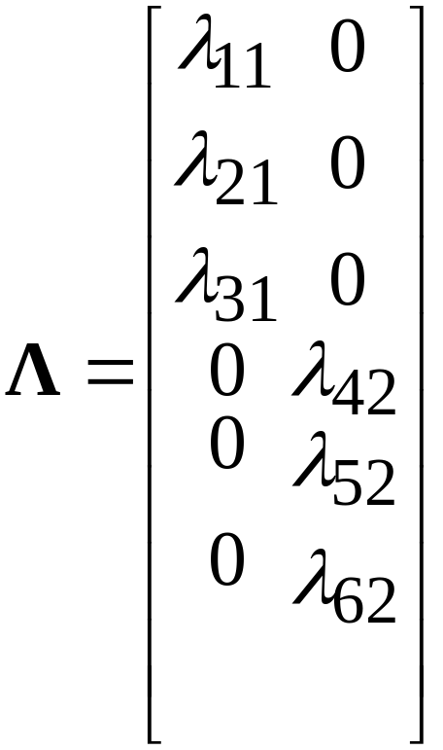
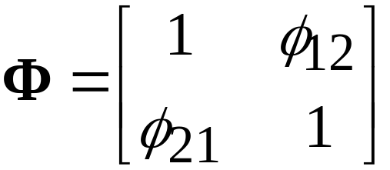
Examples of the three-indicator rule

Slide 10
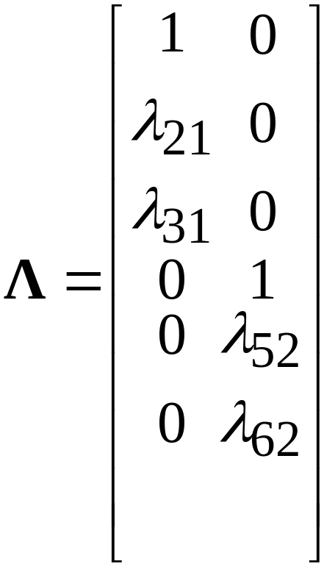
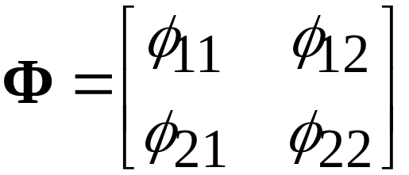
Three-indicator rule additional example:

Slide 11
Two-indicator rule
This condition is also sufficient for identification. The model is identified if:
Unit is set for each factor;
There are at least two measured variables per factor.
Each measured variable loads on one and only one factor;
is diagonal
has no zero elements.
Note that (5) is not required under the three-indicator rule. Condition (5) implies that the common factors must have nonzero correlations.

Slide 12
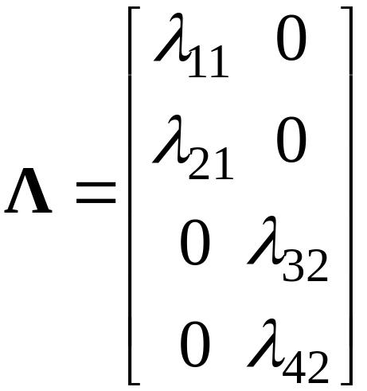
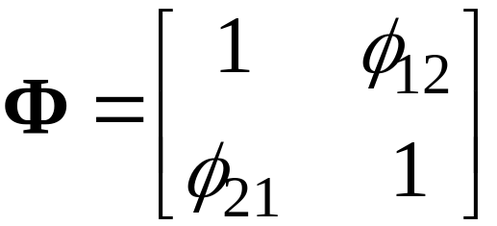
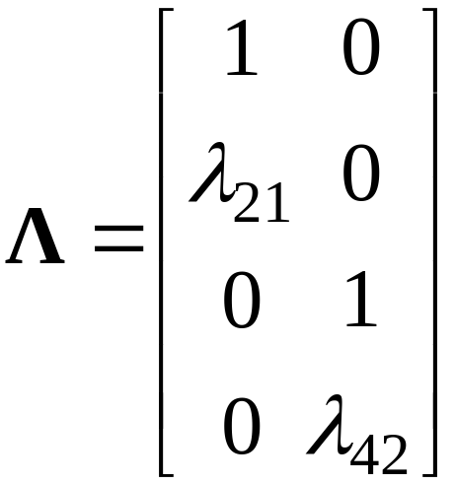
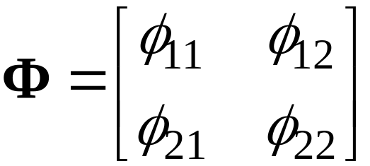
Two-indicator rule examples
4 measured variables, 2 factors: Two ways of implementing model.

Slide 13
More general identification conditions
Now we return to the case in which the measured variables are permitted to load on multiple common factors. Fully general identification conditions for this case are difficult to state.
For this case, we do know how to eliminate rotational indeterminacy in the factor model. In many cases, elimination of rotational indeterminacy may be enough to fully identify the model.
We will consider factor models in which all measured variables are permitted to load on all factors, aside from identification constraints. These models are essentially EFA models

Slide 14
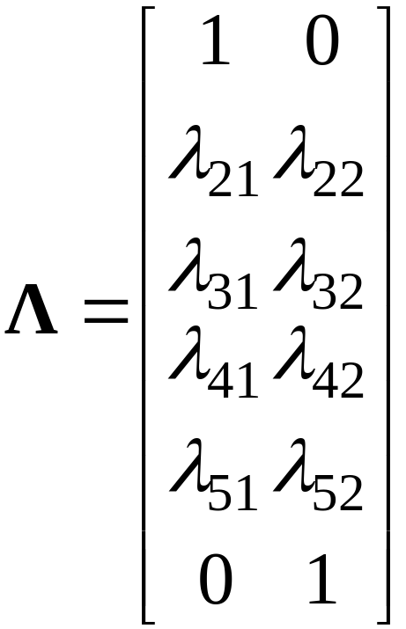

Examples: 6 measured variables, 2 common factors
Pick “reference variables” for each factor and fix their loadings on their respective factors to 1.0. All other loadings for the reference variables are fixed to zero. Example: ref variables are variable one for factor one, and variable six for factor two.
Here is left unconstrained.

Slide 15

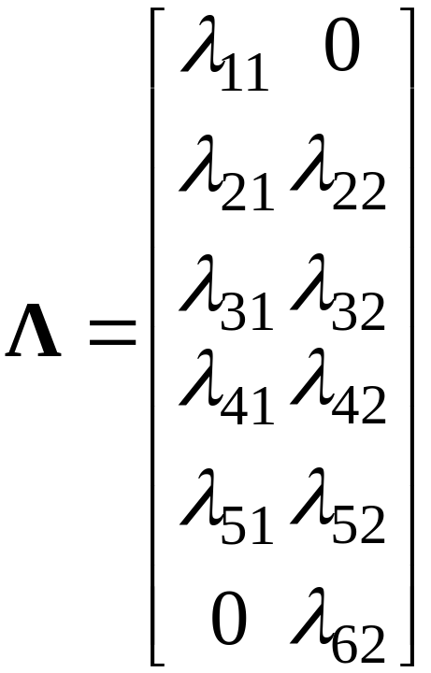
Another example: same as before, but with fixed 1.0 in

Slide 16

For this general case, two rules should be kept in mind:
First, for r common factors, a total of parameter constraints are needed to identify the model.
Second, one nonzero loading or factor variance must appear for each factor. These constraints set the unit for each factor.
When all else fails, you can try to rely on the software program to tell you about problems with identification.

