Slide 1

Infeasible parameter estimates in CFA
The parameter estimates arising in any SEM application, but especially in CFA, should always be checked for impossible or infeasible estimates under the model. Don’t ignore these problems!
Example: Negative unique factor variance
All diagonal elements of should be non-negative. If any estimate is negative, this fact should be noted. Two potential explanations for a negative estimate are (1) that the real value is close to zero and the estimate went negative due to sampling error, or (2) your model is inconsistent with the data. As an example of the latter, you may have asked for too many factors, or you may have their structure wrong.

Slide 2

The best course of action is to think about your model and whether the structure of the factor model may be at fault.
Another example: Phi is not positive definite.
This message tells you that the estimated factor covariance matrix does not have the structure that it should have if it is truly a covariance matrix. “Not positive definite” means that the matrix has at least one zero or negative eigenvalue, but a real covariance matrix should have all positive eigenvalues.
This problem has one of two possible sources: (1) at least one factor is a linear function of the other factors, or (2) the model does not fit the data. For (1), one option is to drop one of the common factors and try a model with fewer factors.

Slide 3
Reliability and the single-factor model
If a single-factor model holds for a set of items that make up a scale, we can use the model to estimate the reliability of either a single item or of the entire composite scale.
For a single item or other measure belonging to the single factor, we can estimate the reliability of the single measure as the squared multiple correlation for the measure in relation to the single factor. This correlation is the communality estimate for the measure, and it is always given directly in the Mplus output.
For the scale reliability, we will assume that the scale score is calculated as the unweighted sum or composite of the item scores. More complex scoring formulas are possible.

Slide 4


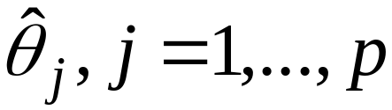
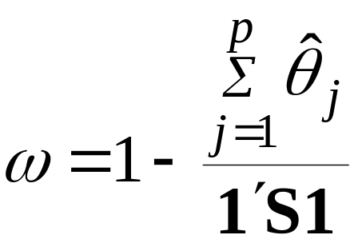
Let = sample covariance matrix pxp
= px1 unit vector
Then a lower-bound estimate for the reliability of the composite of the measured variables is
This estimate is called the “omega coefficient”. It is normally at least as large as alpha, possibly larger. It does require that the single-factor model be a good representation .

Slide 5
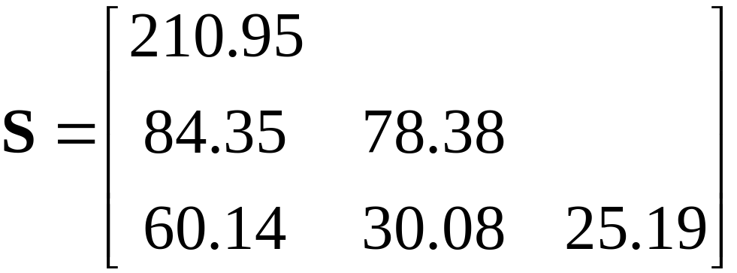
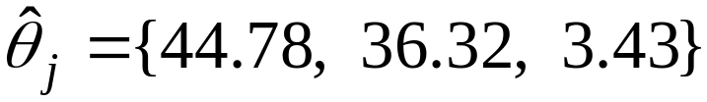
Example: Self-concept data
Consider a three-variable composite of the general self-concept measures from the SDQ, API, and SES scales. The 3x3 covariance matrix is
The unique variance estimates are

Slide 6
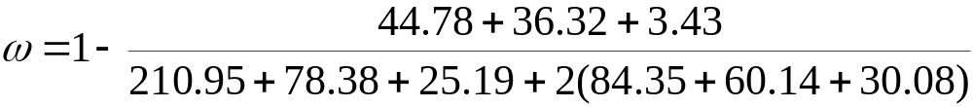
Then the calculation for omega is
The estimate is .87.
In contrast, the alpha value for the scale is .79. Omega is considerably larger in this case.
It can be shown that when all factor loadings are identical, alpha and omega will be equal. Conversely, omega will be larger than alpha when the factor model fits and the loadings are widely discrepant across variables.

Slide 7
Single-indicator “factors” in SEM
What if you don’t have multiple indicators, but you would still like to use the single indicator within an SEM model, possibly along with other latent variables and their indicators?
There are two ways to include single indicators in SEM within a latent variable model. You can:
Equate the “factor” to the indicator, assuming perfect reliability, or
2) Use an external reliability estimate to create a latent variable from the single indicator.

Slide 8
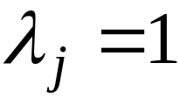
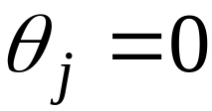
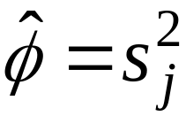

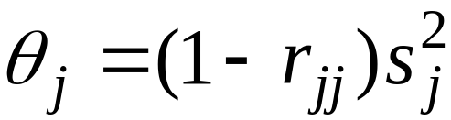
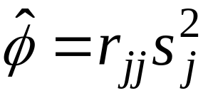
First, to equate the factor to the indicator, simply set:
These equalities create the “factor” as being identical to the observed variable, with the variance of the common factor being the same as the variable of the measured variable.
Second, suppose that is the reliability estimate for the single indicator variable. Then set:
This method permits you to, in effect, disattenuate the relations between the single indicator and other variables. You must have a good estimate of the reliability to make this a realistic strategy.

Slide 9
Power analysis in CFA (and SEM generally)
Given that we place such emphasis on testing fit in SEM, with the “null” hypothesis being that our proposed model fits, we should be very interested in the power of our fit tests. In the SEM context, power is the conditional probability: Given that our model does NOT fit, what is the probability that we will reject our model using a given fit testing procedure?
We are also interested in the question of whether our sample size is large enough to yield adequate power.
Power evaluation procedures are available for use with both the traditional chi-square test of exact fit, and tests involving the RMSEA.

Slide 10
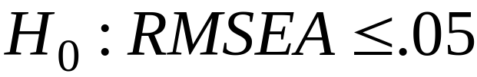
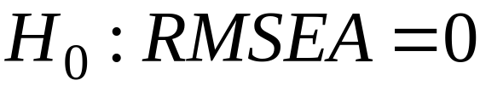


There are two broad methods of power analysis that are available, depending on whether our interest lies in global fit or local fit.
Power for global fit using the RMSEA
Here we want to evaluate the probability of rejecting the model, not in relation to a specific alternative model, but rather in relation to all alternative models. We can evaluate power in for tests of either exact fit or close fit, as defined by RMSEA < .05.
For close fit: For exact fit:

Slide 11
Power for a local alternative model
In this approach, we want to evaluate the power to detect a specific departure from our model, usually one that carries theoretical importance.
For example, we might omit certain paths and then want to know whether we have enough power to detect the omitted paths, assuming that their path coefficients are nonzero.
This power analysis approach is less easily used in comparison to the global approach. The local approach requires one to completely specify an alternative model, including values for any omitted paths that might be of interest.

Slide 12
Reference for the global approach:
MacCallum, R.C., Browne, M.W., & Sugawara, H.M. (1996). Psychological Methods, 1(2) 130-149.
Some results for the sample sizes needed to have power > .80.
DF Required N for close Required N for exact
2 3488 1926
4 1807 1194
6 1238 910
10 782 651
20 435 421
40 252 277
100 132 164

Slide 13
The global approach is much easier to use; tables are published and power figures can generally be read right off the tables. Otherwise, short SAS programs are available for calculating the required quantities.
The following website will provide you with an online tool based on the R language for evaluating power with the RMSEA:
http://www.quantpsy.org/rmsea/rmsea.htm
The disadvantage of the global approach is that one might have weak power globally, but still have good power for certain local alternative models.

