Slide 1
Higher-order factor models
In CFA, multiple factor models are nearly always specified so that the factors are permitted to correlate. These are “oblique” solutions in EFA terms.
The correlations among the factors raises a question: what explains the associations among the common factors? The factors themselves are supposed to explain the associations among the measured variables.
One answer to the question is that there exists a “second-order” factor that determines the “first-order factors”, and that these first –order factors determine scores on the measured variables.

Slide 2





Slide 3




To specify the model:
The model equations are
First order model:
Second order model:
The model for the covariance matrix is
The model for the means of the measured variables is

Slide 4
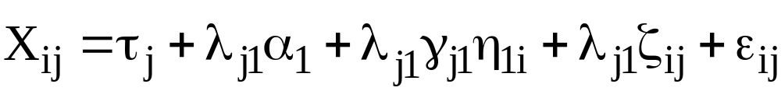
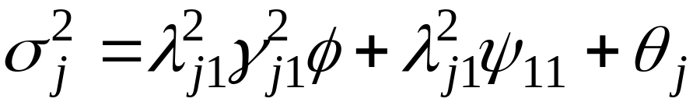
The second-order model splits the observed score into several portions:
This split in turn leads to the variance partitioning
The first piece is the variance explained by the second-order factor. The second piece is capturing systematic variance that is unrelated to the second-order factor. The first two pieces together account for the common factor variance. The third piece is just unique factor variance.

Slide 5
For a second-order factor model to be identified, you need at least three first-order factors. If fewer than three first order factors are present, some additional parameter constraints would be needed. With only three first-order factors, the addition of a higher order factor doesn’t change the fit.
To identify the factor loadings for the first order factors, the rule is to fix one loading per factor to 1.0. For the second order factors, either fix one loading per second-order factor, or fix the second-order factor variance to 1.0. All of this assumes that the loading pattern at the first-order is congeneric, with each indicator loading only on one factor.
The identification of the mean structure (intercepts, factor means) is not discussed very much in the literature…

Slide 6
Suppose that
p = number of measured variables
r = number of first-order factors (r > 2)
s = number of second-order factors (s < r)
For the mean structure, you have p means with which to estimate the latent intercepts and factor means.
But considering all intercepts and factor means, you have
p latent intercepts for the measured variables
r latent intercepts for the first-order factors
s second-order factor means
Clearly, we can’t estimate p+r+s parameters….

Slide 7
We therefore have several possible options:
1) Estimate the p intercepts for the measured variables and set the first-order intercepts and the second-order factor means to zero.
2) Estimate p-r of the intercepts for the measured variables, estimate the r first-order intercepts, and set the second-order factor means to zero.
3) Estimate p-r of the intercepts for the measured variables, estimate the r-s first-order intercepts, and estimate the s second-order factor means.

Slide 8
Bifactor models
These models are also used when you suspect that there might be a general factor in addition to the multiple common factors.
The general factor is here incorporated right in the loading matrix along with rest of the first order factors. The general factor is NOT specified with paths to the first order factors.
The model is NOT a congeneric factor model. Each measured variable loads on the general factor, and on one or more group factors.
The group factors might be of interest in themselves, or might be considered uninteresting but necessary common factors.

Slide 9
Identification in the bifactor model requires that the group factors be uncorrelated with the general factors. The group factors themselves may intercorrelate.
Ordinarily, the scale for the factors is set by fixing the variances of all factors to 1.0.
The mean structure is identified in the usual way. Either the factor means are set to zero, or a number of the latent intercepts equal to the number of factors are set to zero.
It is not unusual in this model to have some group factor loadings be non-significant.

Slide 10




Slide 11
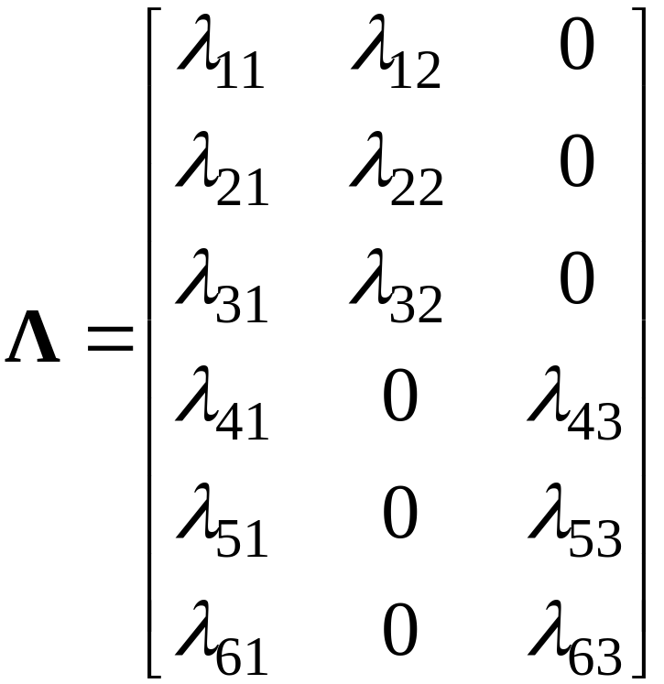
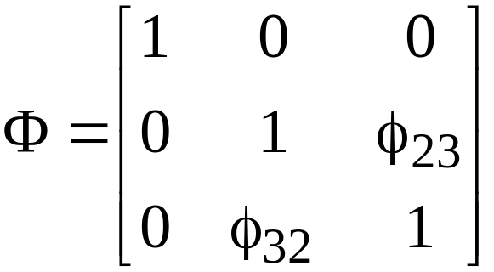

Slide 12
The bifactor and second-order models are closely related, but the bifactor model is less restrictive than the second-order model. Hence the bifactor model should give an overall fit that is at least as good as the second-order model.
The ideal application for the bifactor model is one in which you believe that there is mainly a general factor, plus some additional group factors that involve fewer variables.
Example: You believe that the set of items measure a general personality factor, but also that subsets of items code for group factors. The group factors represent features of the personality that go beyond the general factor, and are orthogonal to it.

