Slide 1
Path analysis with latent variables: Full SEM
We now will look at models that include latent variables under the CFA model, with a path structure among the latent variables themselves. These models are more restricted than ordinary CFA models because of the path structure among the latents, in place of just permitting unconstrained correlations among the latents.
The models differ from ordinary path analysis in permitting error of measurement: a measurement model is assumed to hold for the measured variables.
These models are collectively denoted structural equation models or path models among latent variables.

Slide 2
We usually distinguish between two portions of the structural equation model: the measurement model and the structural model.
The measurement model includes the portion of the model that relates the measured variables directly to the measured variables. This model is the CFA model.
The structural model includes the path structure among the latent variables, along with any disturbances in those path equations. This is a path model among latent variables.
Together these two pieces combine to create the structural equation model.

Slide 3






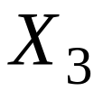






We can define some random variables:
= qx1 vector of measured exogenous variables
= px1 vector of measured endogenous variables
= vector of exogenous factor scores
= vector of endogenous factor scores

Slide 4
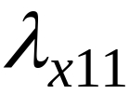

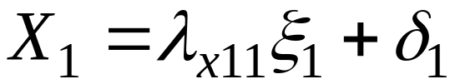
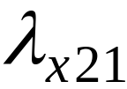
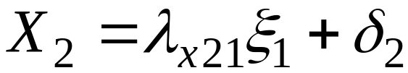

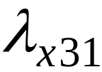
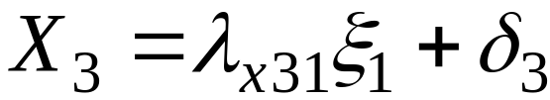

Measurement models
Separate measurement models for X and Y variables.
For exogenous X variables:

Slide 5
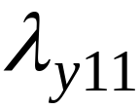

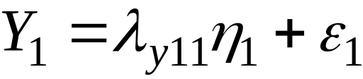
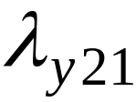
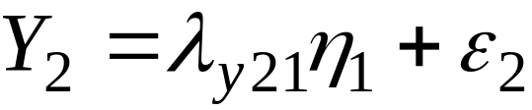



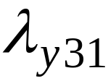
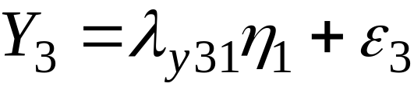


Measurement models
For endogenous Y variables:

Slide 6
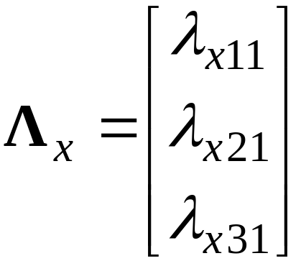

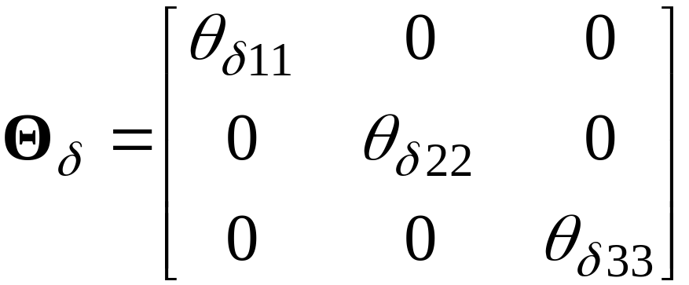
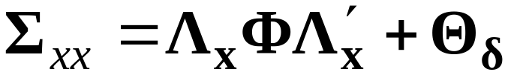
Measurement model matrices
For exogenous X

Slide 7
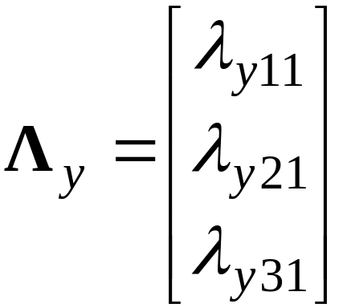
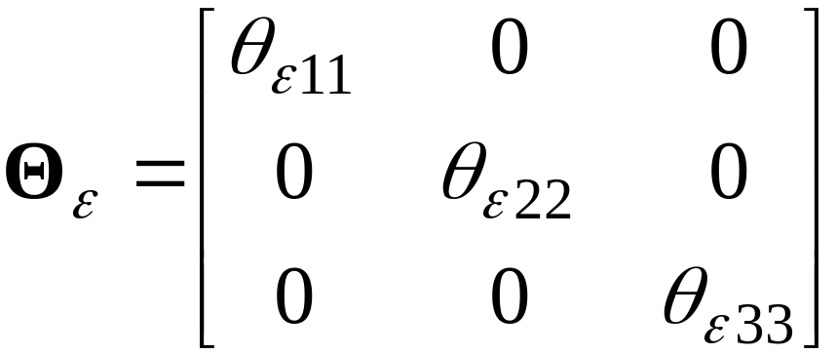
For endogenous Y variables:
No parameter for the variance of . This variance is a function of other matrices.

Slide 8



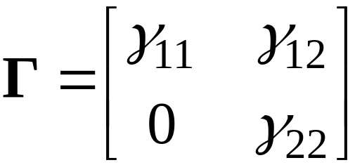




Structural model matrices
The gamma matrix contains path coefficients for paths from exogenous to endogenous latent variables. Example:
Omitted paths correspond to fixed zero elements in .

Slide 9

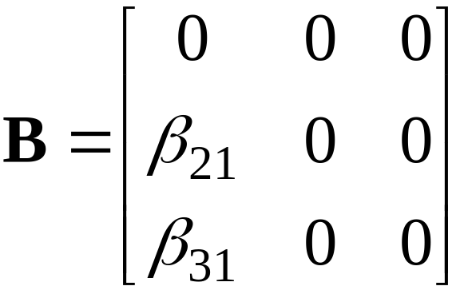

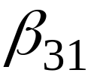

The matrix contains path coefficients for paths among the endogenous latent variables. Example:

Slide 10



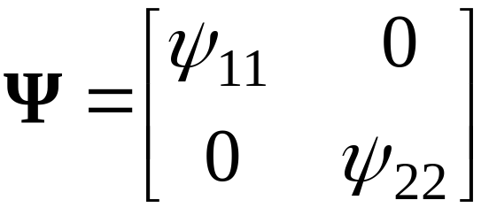
The matrix is a covariance matrix for the disturbance terms in the path equations for the endogenous latent variables.
In some models, is assumed to be diagonal, with no correlations among the disturbance terms. This assumption is rarely justified however.
Example:

Slide 11


Complete example

Slide 12
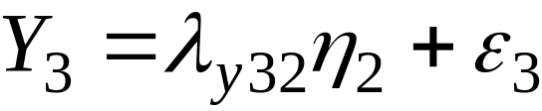
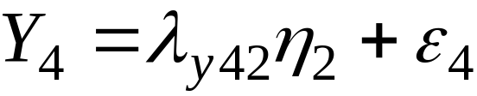
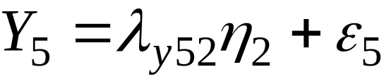
Measurement model equations
Exogenous latents
Endogenous latents

Slide 13

Measurement model matrices for exogenous latents
Variance of is the scalar
We assume throughout that the measured and latent variables are centered, with means of zero.

Slide 14
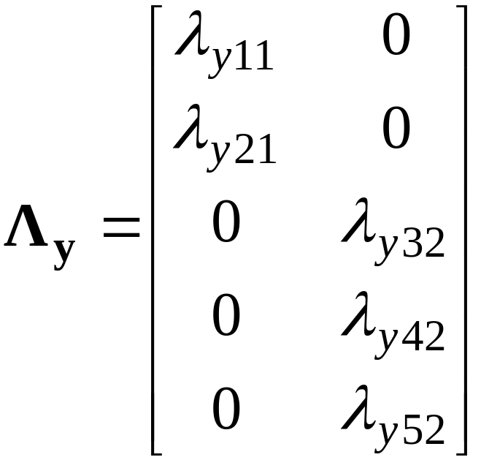
Measurement model matrices for endogenous latents
Identification constraints will be needed.

Slide 15
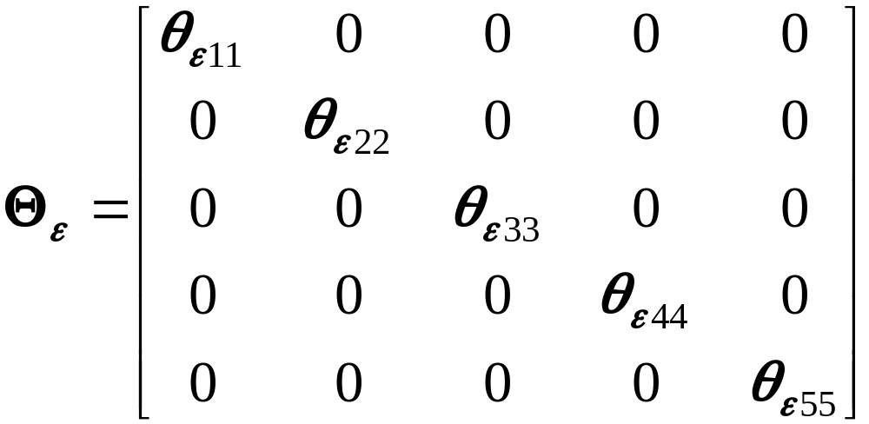
Unique factor covariance matrix for Y

Slide 16


Structural model equations
No structural intercept terms because all variables are taken here as centered.

Slide 17
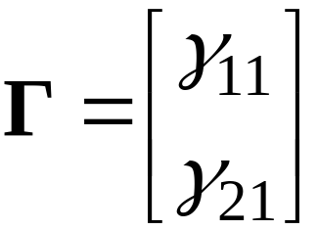
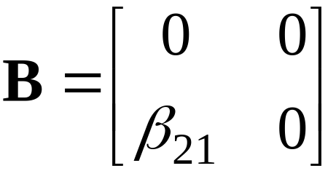
Structural model matrices

