Slide 1
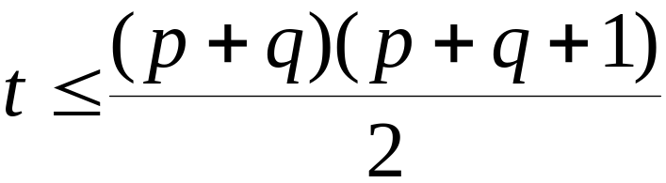
Identification issues in SEM
The identification issues in path models for latent variables are sometimes more complex than in ordinary path analysis. Some results to carry over from path analysis or factor analysis.
The t-rule is still a necessary condition for identification. If the number of independent estimated parameters is t, and if p=the number of Y variables and q=the number of X variables, we must have
This inequality must hold if the model is identified.

Slide 2
Two-step rule
This rule is sufficient for identification: if the rule holds, the model is identified.
Step One: Considering just the measurement model, is the measurement model identified according to our usual rules for identification? If the answer is NO, then stop. If the answer is YES, go to the next question.
Step Two: Considering just the structural model, is the structural model identified according to our usual rules for identification? If the answer is NO, then stop. If the answer is YES, the entire model is identified.

Slide 3
Assessing fit in the SEM
In general, there are no new fit evaluation problems presented by expanding our model to include both path structure and latent variables. But there is a new possibility for sequencing the evaluation of fit that comes with the division into structural and measurement models.
Some researchers have advocated a “two-step” model evaluation strategy for SEM’s in which model evaluation proceeds in two stages. The first stage evaluates just the measurement model, with no restrictions on the covariance structure for the latent variables. The second stage then adds in the restrictions on the latent covariance structure that are implied by the structural model.

Slide 4







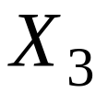



Example of two-step strategy

Slide 5
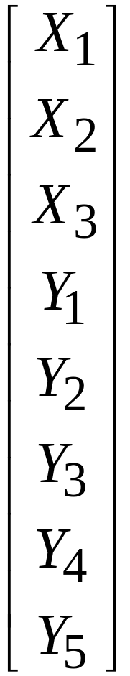
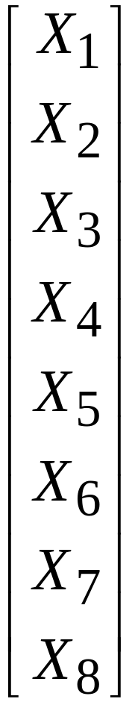


The original model has 3 exogenous and 5 exogenous variables. We will alter this conceptualization and consider all of the 8 variables to be exogenous. Then we impose the hypothesized measurement structure on these 8 variables.

Slide 6
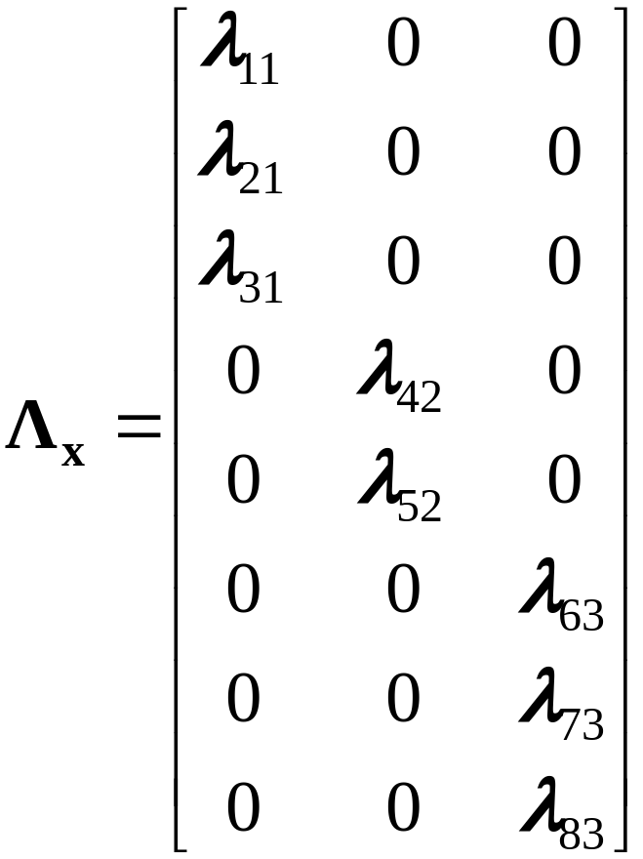
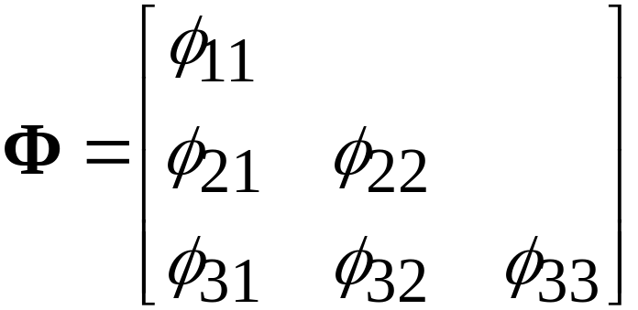

Then the measurement model for X would have the following matrices:

Slide 7
The measurement model is fit to the data as specified. If the model does NOT fit, we conclude that the measurement hypotheses are incorrect at some level. We would normally stop there and consider alternatives.
If the measurement model shows good fit, we then proceed to the second step, and fit the entire SEM. Note that the entire SEM is nested within the measurement model from the first step. For this reason, if the addition of the structural model results in considerable loss of fit, we can have some confidence that while the measurement model is ok, the structural model is at fault.
The purpose of this two-step process is to be able to attribute lack of fit in the entire SEM to either the measurement model, or to the structural model (or both).

Slide 8
SEM Example
This example is taken from
Houghton, J.D. & Jinkerson, D.L. (2007). Constructive thought strategies and job satisfaction: A preliminary examination. Journal of Business and Psychology, 22, 45-53.
This study represents a departure from traditional studies of job satisfaction that have focused on situational determinants (pay, relationships, task-related issues). Instead, the study focuses on dispositional determinants and the possibility that “constructive thoughts” (self-talk, imagery) might influence satisfaction, operating through several mediators.

Slide 9
The study uses four constructs, each measured with parcels of items:
Constructive thought strategies: 3 indicators are subscales from a scale designed to measure this construct. Subscales are “evaluating beliefs and assumptions”, “self-talk”, and “visualizing successful performance”.
Dysfunctional thought processes: 3 indicators, with two as parcels and one as a subscale of a 25-item scale.
Subjective well-being: 3 indicators, with two formed as parcels and one being a single item.
Job Satisfaction: 3 parcels formed from items in the Job Descriptive Index.

Slide 10
CTS
DTP
SWB
JSAT
Structural Model with disturbance terms

Slide 11
Measurement model syntax
TITLE: Houghton & Jinkerson (2007)
4-factor CFA. Figure 10.2, Table 10.1
DATA:
FILE IS "houghton-mplus.dat";
TYPE IS STDEVIATIONS CORRELATION;
NOBSERVATIONS = 263;
VARIABLE:
NAMES ARE work1 work2 work3 happy mood1 mood2
perform1 perform2 approval beliefs selftalk imagery;
ANALYSIS:
TYPE IS GENERAL;
MODEL:
Construc BY beliefs selftalk imagery;
Dysfunc BY perform1 perform2 approval;
WellBe BY happy mood1 mood2;
JobSat BY work1 work2 work3;
OUTPUT: SAMPSTAT MODINDICES(1.0) RESIDUAL STDYX;

Slide 12
Structural model syntax
TITLE: Houghton & Jinkerson (2007)
SR model, Figure 10.3, Table 10.1
DATA:
FILE IS "houghton-mplus.dat";
TYPE IS STDEVIATIONS CORRELATION;
NOBSERVATIONS = 263;
VARIABLE:
NAMES ARE work1 work2 work3 happy mood1 mood2
perform1 perform2 approval beliefs selftalk imagery;
ANALYSIS:
TYPE IS GENERAL;
MODEL:
Construc BY beliefs selftalk imagery;
Dysfunc BY perform1 perform2 approval;
WellBe BY happy mood1 mood2;
JobSat BY work1 work2 work3;
Dysfunc ON Construc;
WellBe ON Dysfunc;
JobSat ON Wellbe Dysfunc;
OUTPUT: SAMPSTAT RESIDUAL MOD(1.0) STDYX;

Slide 13
Fit Summary
Model Chi-sq df RMSEA CFI SRMR
____________________________________________________
Meas 62.468 48 .034 .986 .040
Struct 66.313 50 .035 .984 .045
The measurement model cannot be rejected even via the chi-square. The drop in fit with the structural model restrictions is not significant.

