Slide 1
SEM in longitudinal data
Data in which the same set of participants are measured repeatedly through time are donoted longitudinal data. There are many special cases.
Panel data: Data measured on a relatively small number of occasions. Data are usually not modeled as a function of time here (although this could be done). Instead, the goal is usually to study changes across waves of data. These studies are usually purely observational.
Multiple pre and posttest study: Multiple pretests, followed by a treatment or intervention, which is in turn followed by multiple posttests. A control condition may be included with its own pre and posttests. Purpose is to study intervention effects.

Slide 2
Time series data: Many occasions of measurement, usually purely observational. Goal is to study trends over time.
Growth data: Modest number of occasions, with an attempt to model change as a function of time.
Event history data: Continuous record of when events happened over the course of observations. Interest lies in time elapsed until first event, or in times between events.
Any of these data structures can be modeled in multiple ways, depending on the questions to be answered.
We may or may not have a measurement model for the repeated measures that would separate latent from observed variables. If we do have one, we will evaluate stationarity in measurement.

Slide 3
Latent growth models
These models have two important features. First, the score on the measured variable is a function of time, plus measurement error. Second, each growth curve is modeled at the individual level.
Data for latent growth curve modeling are typically measured on 3-10 occasions, although more occasions are possible. A general form for the growth curve is assumed, with individuals varying within this general form (e.g., linear with varying slopes across individuals).
Multiple group latent growth models (LGM) are possible, as in treatment/control groups within experimental designs.

Slide 4
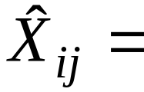
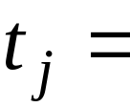
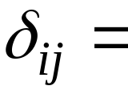
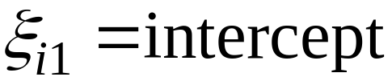
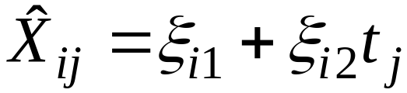
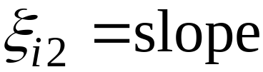
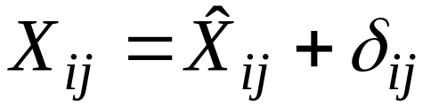
Example: linear growth model
Define:
“true” portion of measure at jth time point for ith person
value of time at jth time point
measurement error for ith person at jth time point

Slide 5
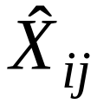


Slide 6
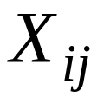
We will have individual differences in the slopes and intercepts for the growth curves, but all curves represent straight-line growth. Slopes and intercepts are regarded as random variables in this model. We are interested in their means, variances, and correlations.
For example, the mean slope value tells us whether the growth curves are increasing or decreasing on average across participants. The variance in the slopes tells us whether the individual differences in slopes are large or small.
The observed data will not necessarily follow a straight-line growth pattern for any individual. This happens because of the measurement errors that affect the observed measures.

Slide 7
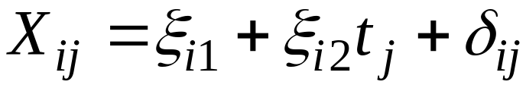

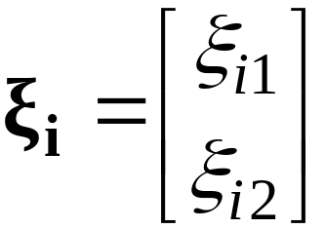
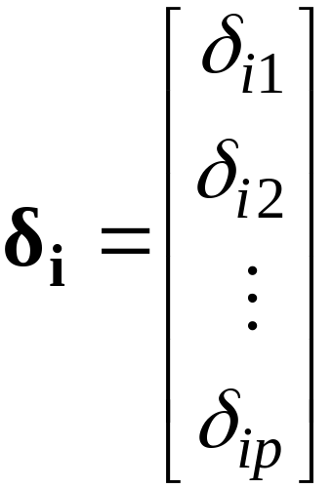
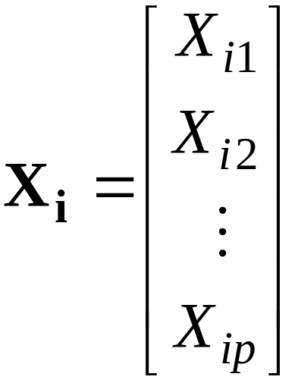
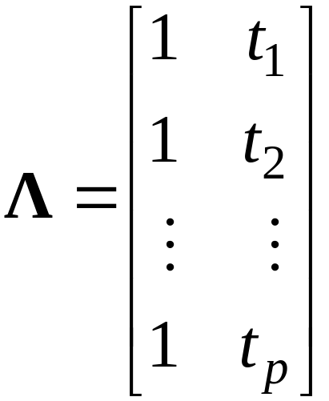


Matrix formulation
Here the loading matrix is known, or nearly so.

Slide 8






The covariance matrix for the measured variables is expressed
pxp covariance matrix for
2x2 covariance matrix for
pxp diagonal covariance matrix for
The LGM includes mean structures as part of the model. Hence either the raw data or a vector of means must be given to the program for the analysis.

Slide 9

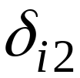

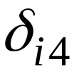
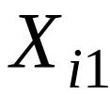
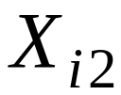
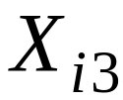
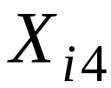







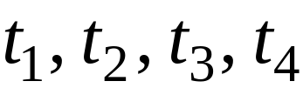
Example: 4 measurement waves
Times are replaced with fixed numbers reflecting actual spacing of waves.

Slide 10





We will estimate the following parameters, in addition to the unique factor variances:
variance in intercepts
variance in slopes
covariance of intercept and slope
mean of intercepts
mean of slopes

Slide 11
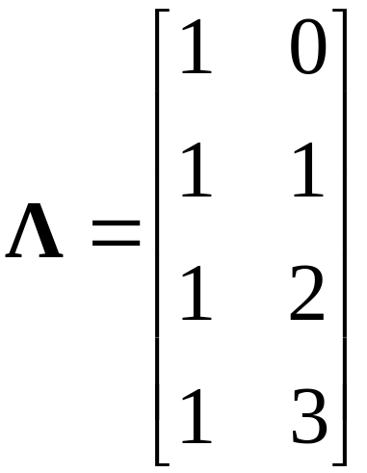
Scaling of time in the loadings matrix
A typical scaling chosen for equally spaced waves is to have consecutive integers, starting with zero at time 1:
The zero at time 1 means that the intercept term serves as “initial status”, or the state of the individual at time 1.

Slide 12


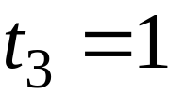



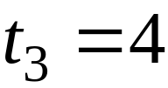

An alternative scaling would place the zero at time 2, making the intercept denote status at time 2:
In some cases, the waves of measurement are not equally spaced. We can then use a scaling that reflects the unequal spacings between measures:
There are many potential choices here. Ordinarily, the best approach is to fix all time values to reflect the spacing of the waves. But it is possible to let p-2 of the time values be free.

Slide 13

The mean and variance of the intercepts depends on the scaling of time, and also the variance in the slopes.
When slopes vary, the choice of placement for zero in will affect the mean and variance of the intercepts:

Slide 14
The correlation between initial status (intercept) and slope also depends on scaling, as illustrated in:
positive corr negative corr
corr depends on location of zero

Slide 15
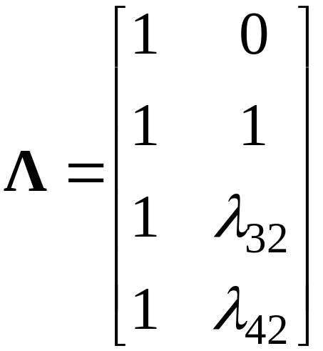
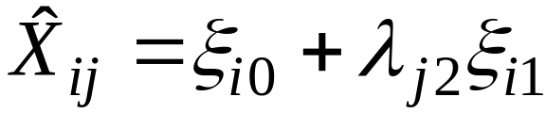
Unspecified elements in
We can leave some elements of unspecified, letting them be estimated from the data. Example:
The free elements are estimated. The linear model says that

Slide 16

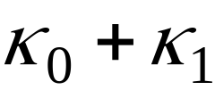
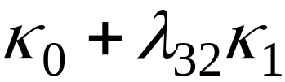
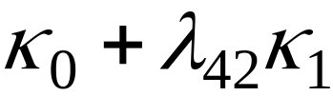
The mean predicted score at wave j for Y is then found as
J=1
J=2
J=3
J=4
In the completely fixed case, the free loadings are replaced with fixed numbers, making the model fit less easily in general.

Slide 17






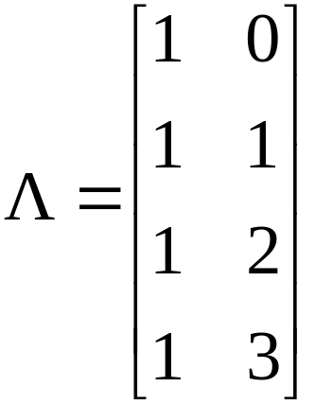



Example taken from Duncan & Duncan (1996)
Four waves of measurement over 4 year period. The variable is alcohol use in the past 6 months (self-report). N=321

Slide 18
TITLE: Principles and Practice of SEM (3rd ed.), Rex Kline
S. Duncan & T. Duncan (1996), Final change model
Figure 11.2 without measurement errors, Table 11.3
DATA:
FILE IS "duncan-mplus.dat";
TYPE IS MEANS STDEVIATIONS CORRELATION;
NGROUPS = 1;
NOBSERVATIONS = 321;
VARIABLE:
NAMES ARE year1 year2 year3 year4 gender famstat;
USEVARIABLES ARE year1 year2 year3 year4;
ANALYSIS:
TYPE IS GENERAL;
MODEL:
Initial Linear | year1@0 year2@1 year3@2 year4@3;
OUTPUT: SAMPSTAT RESIDUAL STDY TECH4;

Slide 19
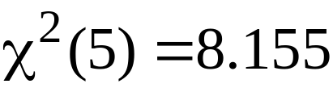
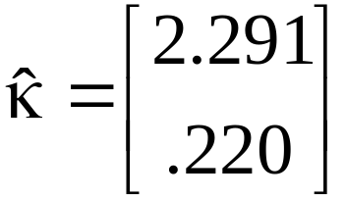





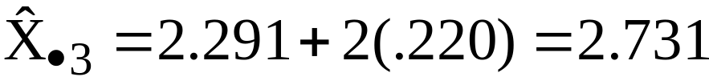



The global fit of the model is quite good:
RMSEA=.044 CFI=.994 SRMR=.033

