Slide 1
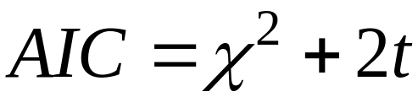
Another global fit statistic: Akaike’s Information Criterion
The AIC index can be used to select the “best” model from among a set of models that are fit to the data. The models being considered are NOT required to be nested in relation to each other.
Here t=number of estimated parameters in the model.
The goal is to select the model with the smallest AIC value.
The scale of the AIC is unique to each set of data. No absolute cutpoint for AIC can be established.

Slide 2
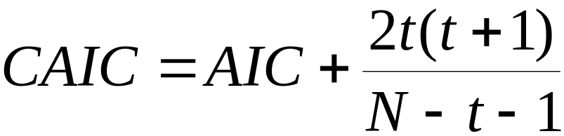
AIC penalizes models with many estimated parameters, unless the parameters contribute to shrinking chi-square substantially.
When the ratio of the sample size to the number of parameters being estimated gets small, we can adjust AIC so that it works better.
Here N = sample size. A general rule is to use CAIC when the ratio of N to t is less than 40.
Burnham, K.P. & Anderson, D.R. (1998). Model selection and inference: A practical information-theoretic approach. New York: Springer.

Slide 3
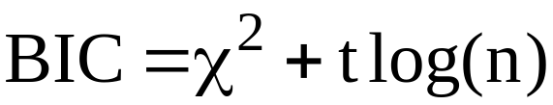
One additional variation on AIC that is provided by Mplus is the Bayesian Information Criterion (BIC):
Here n is the sample size. This index, along with AIC and CAIC, intends to provide a penalty for including many estimated parameters in the model, as reflected in the second term.
In large sample sizes, AIC and its variants may tend to pick highly parameterized models in preference to constrained models, in spite of the penalty….

Slide 4
Two problems with the RMSEA:
1) The appropriate “cut-point” for deciding whether a model offers an acceptable approximation appears to vary across model types and data conditions.
Studies have examined the performance of the conventional (.05, .08) cut-point set across simulated or theoretical conditions and have found that results vary greatly:
Beuducel & Williams (2005), Fan & Sivo (2005), Marsh, Hau, & Wen (2004), Yuan (2005), Saris, Satorra, & van der Veld (2009)

Slide 5
2) The correspondence between a given value of the RMSEA and the model misspecifications that are consistent with that value is unclear.
Example: A single-factor model produces an RMSEA value of .04. What types of model misspecifications could exist under this value for the RMSEA?
Correlations among unique factors? How many and how large?
Additional factors beyond the first factor? How many? How large could the loadings be?

Slide 6
Simulation-Based Fit Procedure
-- Eliminates the use of cut-points on the fit index.
-- Forces investigator to specify one or more alternative models for which the investigator’s target model could be considered a “good approximation”.
-- Simulates data to match the model type and sample size used in the investigator’s empirical study of the target model.
-- Easily implemented using widely available software.

Slide 7
Target Model M0 : The original model that the investigator wants to evaluate for fit.
Alternative Model M1: A model that differs from the target model but is close enough so that the target model is regarded as a “good approximation” to the alternative.
In other words, if the “true” model was M1, the investigator would be willing to declare that the target model M0 is adequate as an approximation to the truth.
The investigator must specify the alternative model fully, even to the extent of providing values for the parameters of the model.

Slide 8
Step 1: Evaluate the target model M0 in real data with sample size N, and record the fit indices.
Step 2: Specify alternative model M1 to reflect “small” differences from M0.
Step 3: Generate q datasets each of size N using the M1
model. Fit the target model M0 to each set of generated data, and record fit index value in each case.
Step 4: Construct frequency distribution of fit index values across the q datasets. Evaluate the fit index value from Step 1 in relation to the distribution of fit index values.

Slide 9
Let F0 = Fit index value for M0 in real data.
P0 = Proportion of fit index values for M0 in generated data that are less than F0.
Our decision for fit of M0 depends on the size of P0.
If P0 is large (e.g. above .90), our target model’s fit in the real data is unlikely to have been produced by data generated under M1.
In this case, we conclude that the lack of fit for M0 in the real data is not explained by the “approximate fit” of M0 to M1. We reject M0.

Slide 10
If P0 is not large (e.g. less than .90), the results suggest that the fit of M0 in the real data is consistent with the fit of M0 in data generated from M1.
In other words, it is plausible that the lack of fit for M0 in the real data is due to the “approximation” of M1 by M0. We retain M0 in this case.
For either decision, the absolute size of F0 plays no direct role in the decision. What matters is the size of F0 within the distribution of F0 values in the generated data.
No a priori cutpoints for F0.

Slide 11
Example: WAIS-R CFA under invariance constraints across gender. N(males) = N(females) = 940
Four measured variables:
Information
Vocabulary
Comprehension
Arithmetic
Single-factor model with invariance constraints on the factor loadings (metric invariance).
Measurement intercepts and unique variances are freely varying across groups.

Slide 12
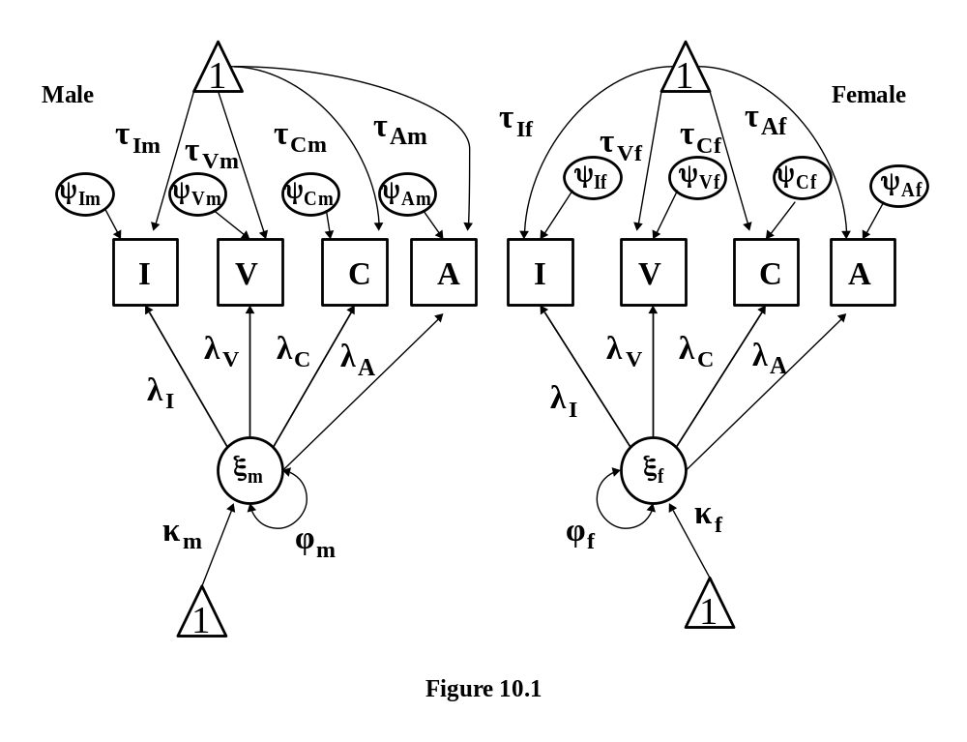
Chi-square (7)=18.959 RMSEA=.043

Slide 13
First M1: Permit group differences in factor loadings for Information, Comprehension, Arithmetic subtests.
The factor loading for Vocabulary was fixed to 1.0 in each group for identification.
The other three loadings were permitted to differ by .10 across groups.
A difference of .10 was deemed “trivial” in magnitude. The lack of fit in M0 could be attributed to such trivial differences in loadings.

Slide 14
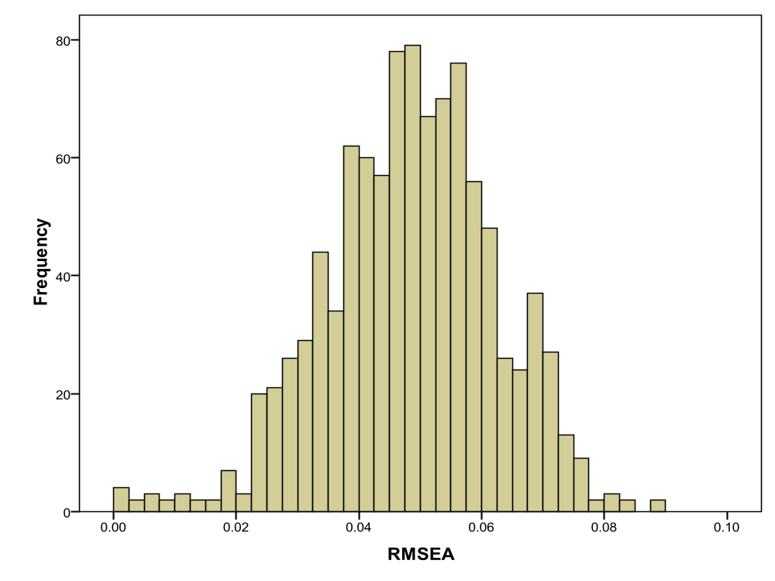

Slide 15
Second M1: Correlated unique factors for Information and Vocabulary
A correlation of r=.20 is permitted between the unique factors for Information and Vocabulary. This level of correlation is deemed trivial, but could explain the lack of fit for M0.
Correlation is introduced for both groups. Actual variances and the covariance for the unique factors are not invariant.
Invariance constraints on loadings are maintained in this M1.

Slide 16
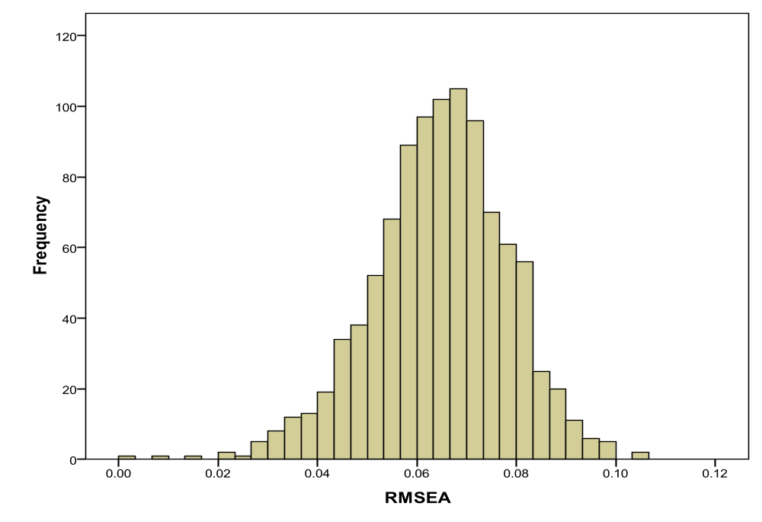

Slide 17
Example: Linear latent growth model for measure of Mother’s closeness to child over 5 waves of data. N=851
Source: Preacher, K.J., Wichman, A.L., MacCallum, R.C., & Briggs, N.E. (2008). Latent Growth Curve Modeling. Los Angeles: Sage.
M0 is a linear latent growth model for 5 waves of data with random intercepts and slopes, and invariant error variances across waves.
Intercepts and slopes are permitted to covary.
Origin defined at wave one.

Slide 18












M0: Linear Latent Growth Model with invariant error vars
Chisq (14) = 75.996
RMSEA=.072

Slide 19
First M1: Heterogeneity of error variances over time.
The model M1 was created by introducing error variances that varied across waves by plus or minus 10%. This difference in variance was regarded as “trivial”.
All other features of the model were maintained as in M0.

Slide 20
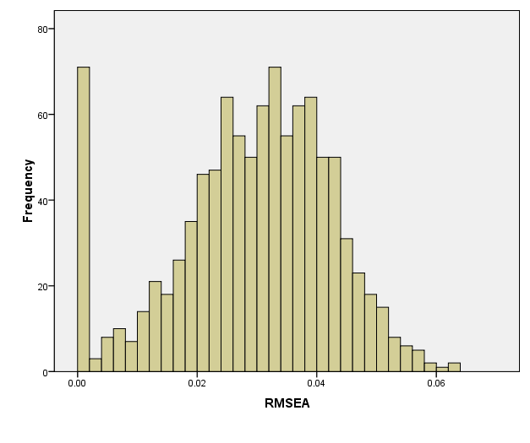
1000 samples Average RMSEA = .029

Slide 21
Second M1: Small quadratic effect included in the model.
In M1, the means and variances of the intercept, linear, and quadratic terms were:
Mean Variance
Intercept 38.00 2.977
Linear -.358 .136
Quad -.010 .010
Error variances were homogeneous as in M0.

Slide 22
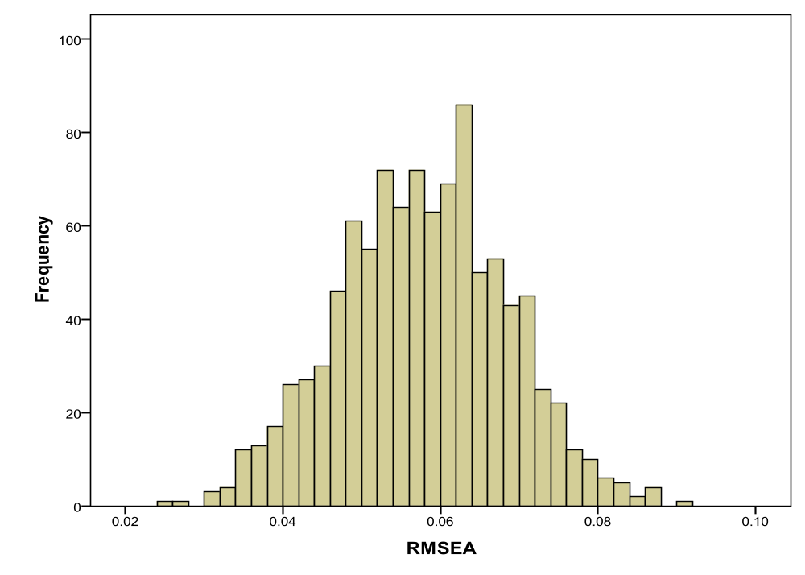

Slide 23
Reporting simulation fit results:
Report M0 and complete fit results in real data.
Report all M1 models, along with histograms and other statistics to describe how M0’s results compare.
Describe why your M1 choices are reasonable, and why you have decided to reject or retain M0.
Anyone who disagrees with your conclusions can construct their own M1 models and evaluate M0.

Slide 24
Question: Can you cheat by using an M1 choice that makes your M0 “look good”?
You must report M1 and argue why M0 should be considered a “good approximation” to M1. You must convince reviewers on this point.
You should look at multiple M1 models if possible.
There is probably less chance of “cheating” with this method than with the standard method of simply relying on cut-points with no specific alternative models.

Slide 25
Generalizations:
1) Use distributions other than normal. Bollen-Stine bootstrap procedure could be used to match real data distribution.
2) Use other fit indices. Potentially any other fit index could be used. The standardized RMSR would be another interesting choice.
The great advantage of the procedure lies in forcing the researcher to be more explicit about the definition of “approximate fit”.

